Slide 1
IS 651: Distributed Systems
Byzantine Fault Tolerance
Sisi Duan
Assistant Professor
Information Systems
sduan@umbc.edu

Slide 2

Recall: Paxos
Tolerates crash failures
Completely-safe and largely-live agreement protocol
Proposer, acceptor, learners
One proposer at a time (viewstamped replication)
Handle crash failures, network partitions, etc. (majority voting)

Slide 3
Recall: Paxos

Slide 4
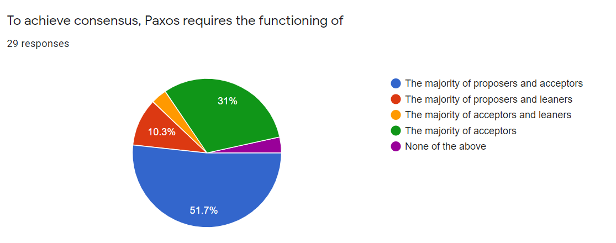
Q1

Slide 5
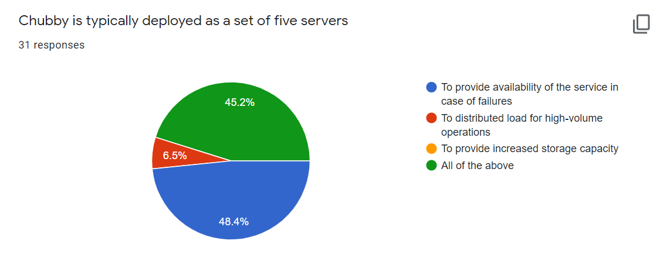
Q2

Slide 6
Announcement
HW5
  Due May 8 (two weeks)
  Answers will be posted after the deadline
Project
  Presentation May 8 (webex)
  Submit both final report and slides May 17 (weekend of the final exam)
  Please sign up for your presentation time (link is available on the class website)
  More information could be found in the slides titled ‘project-final’ on class website
Exam
  May 15 online (requires lockdown browser)
  More information later
  Review slides are posted online (no audio, similar with the review slides in the beginning of each class)

Slide 7
Today
Byzantine Generals Problem
Practical Byzantine Fault Tolerance
ByzGame (Lead by Jim Clavin)

Slide 8
Failure Models
Crash
  Benign failures
  Failing to receive a request, or failing to send a response
Byzantine
  Arbitrary failures
  Processing a request incorrectly
  Corrupting local state
  Sending incorrect or inconsistent messages

Slide 9
The History of the name
Byzantine Generals Problem. Lamport 1982.
With Marshall Pease and Robert Shostak
Byzantine
  Ancient city of Byzantium

Slide 10
The History of the name
Lamport’s reason
  I have long felt that, because it was posed as a cute problem about philosophers seated around a table, Dijkstra's dining philosopher's problem received much more attention than it deserves.
  There is a problem in distributed computing that is sometimes called the Chinese Generals Problem, in which two generals have to come to a common agreement on whether to attack or retreat, but can communicate only by sending messengers who might never arrive. I stole the idea of the generals and posed the problem in terms of a group of generals, some of whom may be traitors, who have to reach a common decision. I wanted to assign the generals a nationality that would not offend any readers. At the time, Albania was a completely closed society, and I felt it unlikely that there would be any Albanians around to object, so the original title of this paper was The Albanian Generals Problem. Jack Goldberg was smart enough to realize that there were Albanians in the world outside Albania, and Albania might not always be a black hole, so he suggested that I find another name. The obviously more appropriate Byzantine generals then occurred to me.
  http://lamport.azurewebsites.net/pubs/pubs.html#byz

Slide 11
Byzantine Generals Problem
Byzantine army
  Generals with traitors
  Decide on a common plan of actions
Agreement
  All loyal generals decide upon the same plan of action
  A small number of traitors cannot cause the loyal generals to adopt a bad plan

Slide 12
Byzantine Generals Problem
Concerned with (binary) atomic broadcast
  All correct nodes receive the same value
  If broadcaster is correct, correct nodes receive broadcasted value
Can be used to build consensus/agreement protocol
  BFT Paxos

Slide 13
Practical Byzantine Fault Tolerance
Asynchronous BFT?
  FLP impossibility: Asynchronous consensus may not terminate
  Holds even when servers can only crash!
  Protocol cannot always be live (but there exist randomized BFT variants that are live)
We consider partially synchronous model in this class

Slide 14
OK, what we’ve learned so far
Traditional state machine replicated protocols tolerate benign failures
  Paxos
  Node crashes
  Network partitions
2f+1 replicas can tolerate f failures

Slide 15

Byzantine faults
Arbitrary failures?
  Faulty node performs incorrect computation
  Faulty nodes can collude

Slide 16
Why 2f+1 cannot tolerate Byzantine failures?
indistinguishable

Slide 17
PBFT
Practical Byzantine Fault Tolerance. M. Castro and B. Liskov. OSDI 1999.
Replicate services across many nodes
  Assumption: only a small fraction of nodes are Byzantine
  Rely on a super-majority of votes to decide on correct computation
Use at least 3f+1 replicas to tolerate f failures
Byzantine Paxos!

Slide 18
Challenges
Cannot rely on the primary to assign sequence number
  Malicious primary can assign the same sequence number to different requests
If the primary failures and we need view changes
  Complicated
  Think about the case where the replicas can lie about their logs..
  Bad nodes tell different things to different nodes…

Slide 19
PBFT Overview
Static configuration (3f+1 replicas)
To deal with malicious primary
  3-phase agreement
To deal with loss of agreement
  Use a bigger quorum (2f+1 out of 3f+1)
Need to authenticate communications

Slide 20
Authentication
If A sends a message msg to B, how do you know the message received by B is indeed the message sent by A?
Symmetric crypto
  Secret key shared by A and B
  Message Authentication Code (MAC)
Asymmetric crypto
  RSA based key, each node has a public/private key pair.
  Public key is available to everyone. Private key is only known to he node.
  Digital signature
(m, auth)
Integrity

Slide 21
BFT Quorums
Quorum size: 2f+1 out of 3f+1
Formally, f= floor((n-1)/3), quorum size = ceil((n+f+1)/2)
Why?
  Any two quorums intersect at least f+1 nodes.
  One quorum = 2f+1, two quorums = 4f+2, there are 3f+1 nodes in the system
  There are at most f faulty replicas
  So in the intersection, there is at least one correct replica!
  Discussion and reminder: why the correct replica is important?

Slide 22
Byzantine Quorum
Formally, f= floor((n-1)/3), quorum size = ceil((n+f+1)/2)
10 nodes, tolerating 3 failures
Quorum size?

Slide 23
Byzantine Quorum
Formally, f= floor((n-1)/3), quorum size = ceil((n+f+1)/2)
11 nodes, tolerating 3 failures
Quorum size?

Slide 24
Byzantine Quorum
Formally, f= floor((n-1)/3), quorum size = ceil((n+f+1)/2)
12 nodes, tolerating 3 failures
Quorum size?

Slide 25
PBFT Overview
Primary runs the protocol in the normal case
Replicas can vote to elect a new primary through a view change protocol (if they have enough evidence that the primary fails)
Replicas agree on the order of client requests (use sequence number)
All the messages are authenticated using MACs or digital signatures
Note: We are going to ignore some details... So it’s a simplified version of the protocol

Slide 26
Replica’s state
Replica id i (0 through n-1 assuming there are n=3f+1 replicas)
  0,1,2,…
A view number v, initially 0
Primary has id i=v%n
Last accepted request sequence number s’
Status of each sequence number (PRE-PREPARE, PREPARED, COMMITTED)

Slide 27
The PBFT Protocol
Client sends a request m to the primary

Slide 28
The PBFT Protocol
Phase 1: PRE-PREPARE
Primary selects a client request m, assigns a sequence number s, and send < PRE-PREPARE,v,s,m> to all the replicas

Slide 29
The PBFT Protocol
Phase 2: PREPARE
On receiving a <PRE-PREPARE, v,s,m> message
  If the current view = v, s>s’, accept the order, update its s’ to s, and sends a <PREPARE,v,s,m> message to all other replicas

Slide 30
The PBFT Protocol
Phase 3: COMMIT
On receiving 2f matching <PREPARE,v,s,m> messages (including its own message), a replica
  Sets its status as prepared
  Sends a COMMIT message to other replicas
Note: the figure is not accurate.
In the third step, the primary
also sends COMMIT messages
to other nodes as well.

Slide 31
The PBFT Protocol
On receiving 2f+1 matching <COMMIT,v,s,m> messages (including its own message), a replica
  Sets its status as committed
  Sends a reply message to the client

Slide 32
The PBFT Protocol
Discussion1:
Why do we need all the replicas to send reply message to the client?
What should be the requirement for a client to know the reply is correct?

Slide 33
The PBFT Protocol
Client needs to wait for f+1 matching replies to know the request is completed and agreed by the replicas.
Because there are Byzantine replicas!

Slide 34
The PBFT Protocol
Discussion 2:
It is sufficient if the client only sends the request to the primary?

Slide 35
The PBFT Protocol
No, because the primary could be Byzantine to the client but correct to the replicas.
It can simply ignore the client request…
Two options: client directly sends a request to the replicas, or client sends a request to the primary and sets a timer…

Slide 36
The PBFT Protocol
Discussion 3:
If the primary is correct, what could be wrong?
Assuming there are fewer than f failures

Slide 37
The PBFT Protocol
Nope. But the primary can be partially faulty…
What’s good about the protocol in this case?
We call it a reliable broadcast (considering only the replicas)
This is also why we need a prepare and a commit phase

Slide 38
What if the primary is Byzantine?
Replicas cannot reach an agreement!
Why?

Slide 39
Byzantine primary cannot violate safety
If one correct replica commits a request
  It receives 2f+1 COMMIT messages
  And 2f PREPARE messages
  There are no two 2f+1 quorums
  One of the correct replicas must agree on both m and m’ with the same sequence number!

Slide 40
How to handle faulty primary?
How does Viewstamped replication or Paxos detect faulty primary?
Will it work in Byzantine model?
How should we handle this in BFT?

Slide 41
What will happen if the primary is Byzantine
Every replica will set up a timer upon receiving a client request
If the client request hasn’t been processed before the timer expires
Send a <VIEW-CHANGE,v+1> message to all other replicas
When receiving f+1 VIEW-CHANGE messages (if the replica hasn’t voted for view change yet), sends a VIEW-CHANGE message to all replicas
When receiving 2f+1 VIEW-CHANGE messages, we know all the correct replicas must know we are going to have view change! (Why?)
Start view change!

Slide 42
VIEW-CHANGE
The new primary re-orders all the client requests that have not been agreed and start normal operations again
Way much trickier than the benign failure model (Think about Viewstamped Replication)

Slide 43
Other components
State transfer
Checkpointing
Timing of view changes

Slide 44
Optimization
In the PRE-PREARE message, original message m is included.
In other messages, only hash of m should be included (why?)
Read optimization
  Remember in the crash model (like Chubby), only the master node replies to the client’s read request.
  What should we do in the Byzantine model?

Slide 45
What does BFT provide?
CIA triad – model for security
Availability
  Reliable access to the service/information/data
Integrity
  The information/data/service is trustworthy
Confidentiality
  Roughly equals to privacy
  Access of the information

Slide 46
Summary of BFT
BFT in general
  3f+1 vs. f
  Mask Byzantine failures
PBFT
  3 phases
  First practical Byzantine fault tolerance
  All-to-all communication
  Widely used in practice

Slide 47
BFT in the real world
Aircraft system
  Boeing aircraft information system, flight control system
Spacecraft
  SpaceX Dragon flight system
Blockchains (next week)

Slide 48
ByzGame
Link to ByzGame: https://www.byzgame.com/
Click the link to have a quick demo: https://umbc.webex.com/recordingservice/sites/umbc/recording/playback/e21531f4c3b54d8ba30b489839a09395
Click ‘Presentation’ to get more information
Instructions:
  Click Quiz #1 to take a quick quiz
  Play with ByzGame for as much time as you like
  Click Quiz #1 again to take the same quiz
  Click Quiz #2

Slide 49
Reading List
(Optional)
  Leslie Lamport, Robert E. Shostak, Marshall C. Pease. The Byzantine Generals Problem. ACM Trans. Program. Lang. Syst. 4(3), 1982.
  Miguel Castro and Barbara Liskov. Practical Byzantine Fault Tolerance. OSDI 1999.
  Sisi Duan, Hein Meling, Sean Peisert, and Haibin Zhang. BChain: Byzantine Replication with High Throughput and Embedded Reconfiguration. OPODIS 2014.

