Slide 1

IS 651: Distributed Systems
Web Technologies
Sisi Duan
Assistant Professor
Information Systems
sduan@umbc.edu

Slide 2
Last Time
Web Architecture
Inside the architecture
  Web-based systems
  Web services
  Web server
  Communication

Slide 3
External cache
  Content delivery networks (CDNs)
Web servers
  Dispatches requests to the App Server Tier
Application servers
  Core services
Databases
Internal cache
  For the use of web servers and application servers
Misc. Services
  Other services

Slide 4
The Glue
Load balancers
Routers
Switches
Firewalls

Slide 5
Takeaway
A lot of tradeoffs
Understanding the workload is key in choosing the right product to use at each layer
De-coupling
  Pros and cons
Load balancing
  Pros and cons

Slide 6
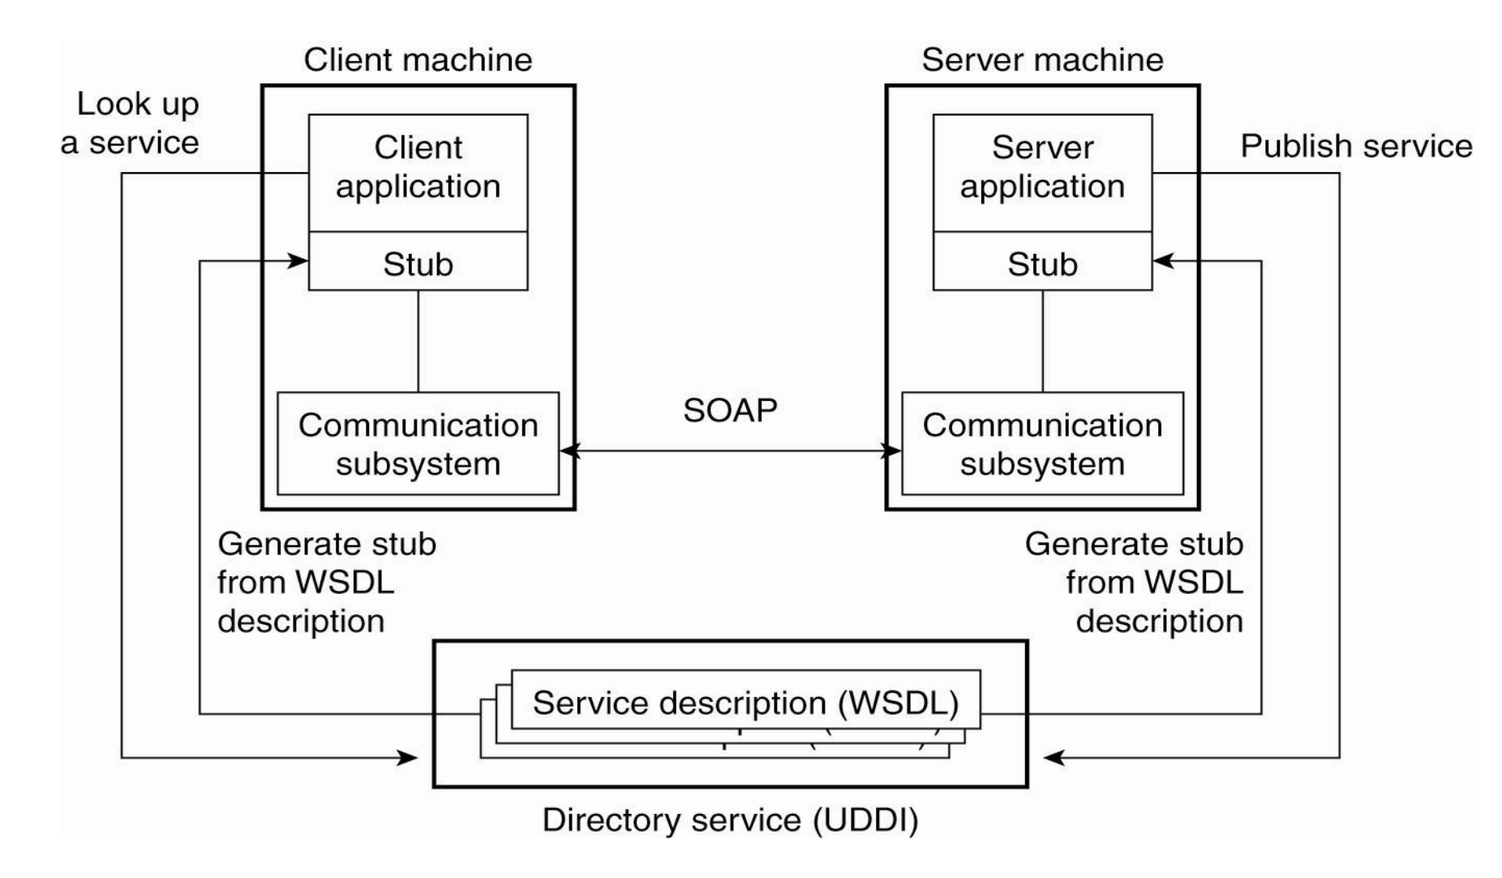
Web services
Service made available over the Internet

Slide 7
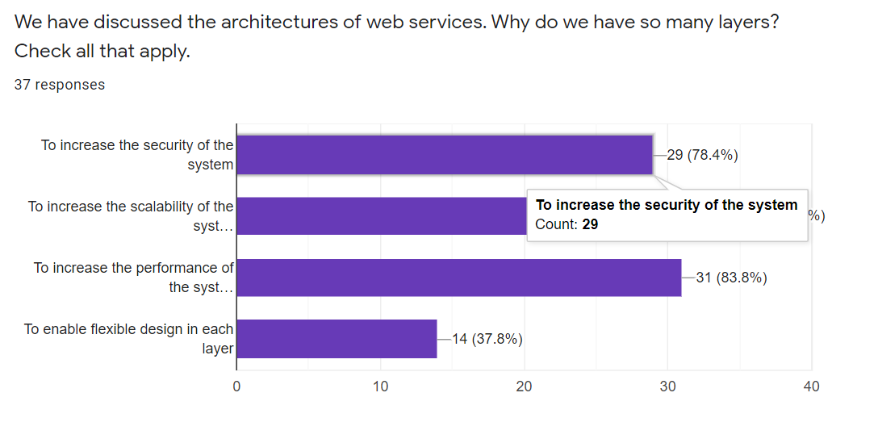
Exercise #1: Q1

Slide 8
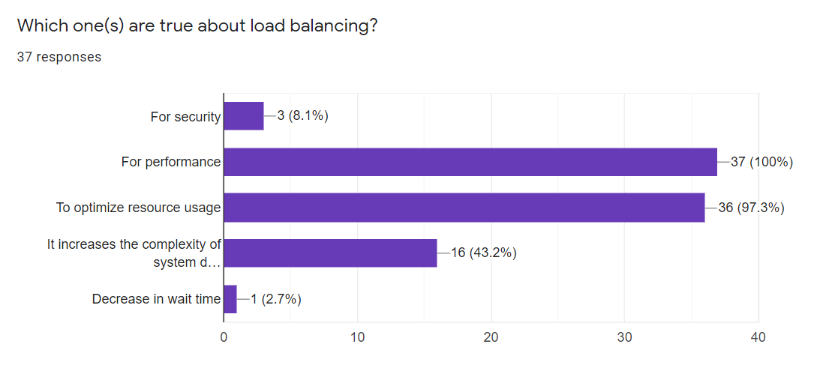
Exercise #1: Q2

Slide 9
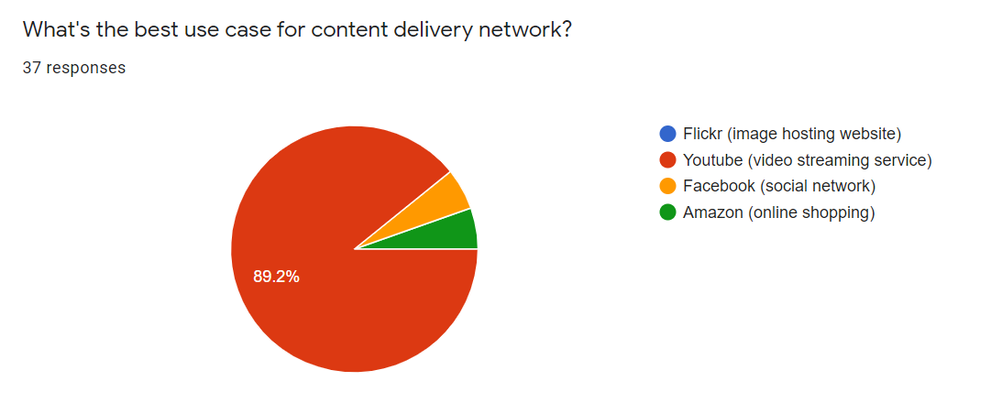
Content Delivery Network (Exercise #1: Q3)

Slide 10
Content Delivery Network
Akamai
Google Cloud CDN (Youtube: Akamai->Cloud CDN)
Facebook Content Distribution Network (FBCDN)
Amazon CloudFront
  Integrated with AWS
Flickr
  Does not distribute images like a true CDN (Squid Cache)

Slide 11
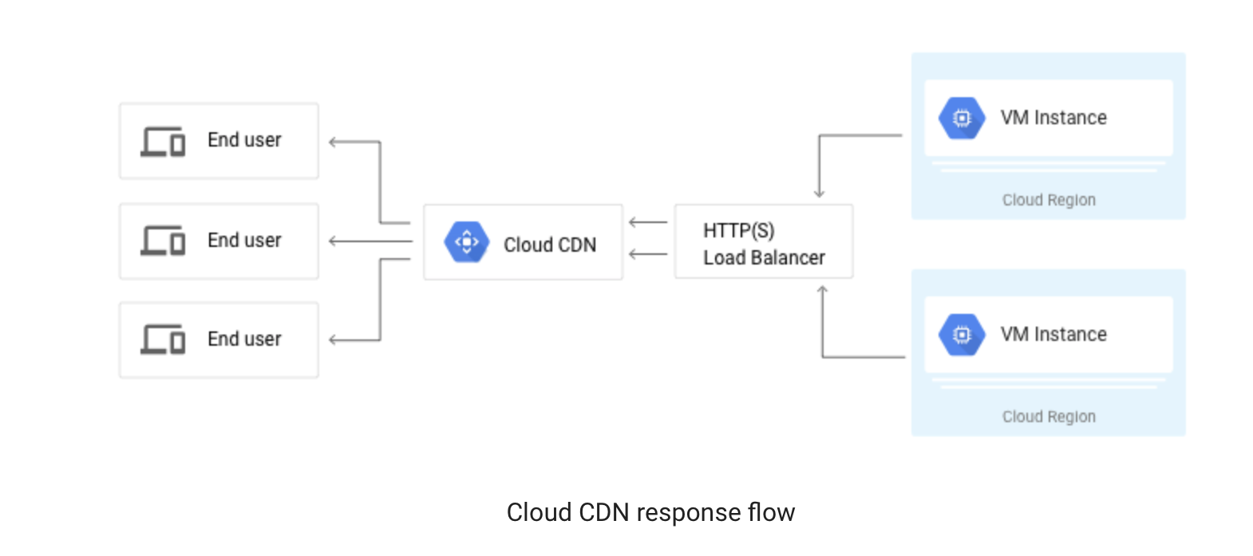
Google Cloud CDN

Slide 12
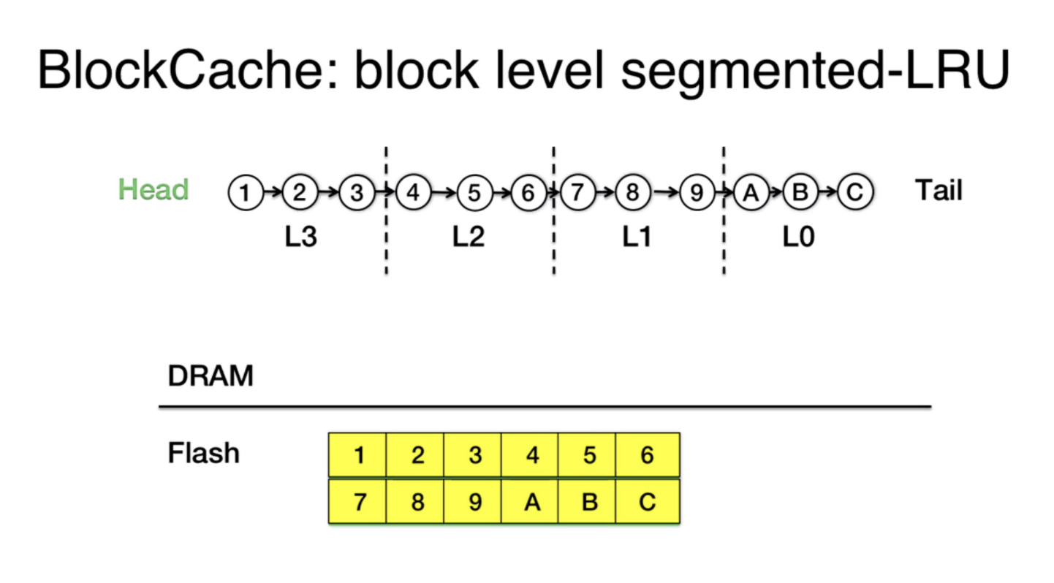
FBCDN
  Photos and videos
  Combination of NAND-flash SSD and RAM

Slide 13
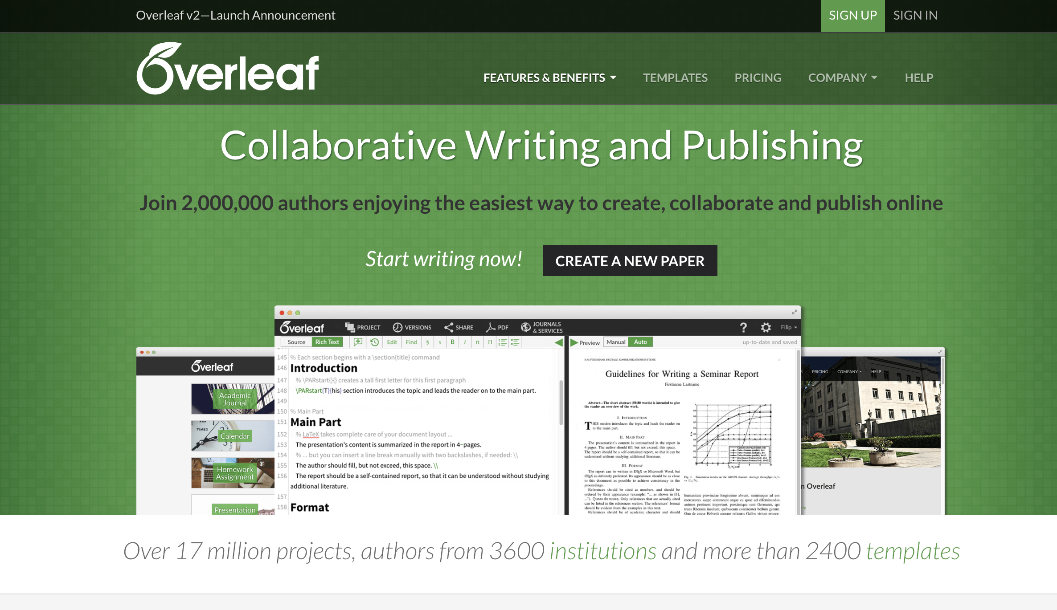
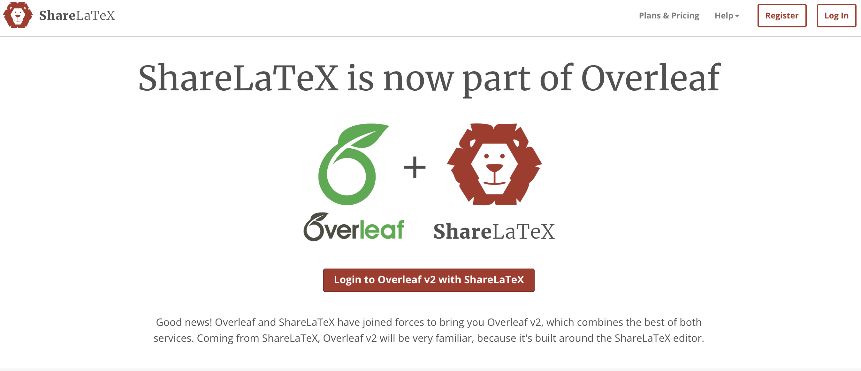
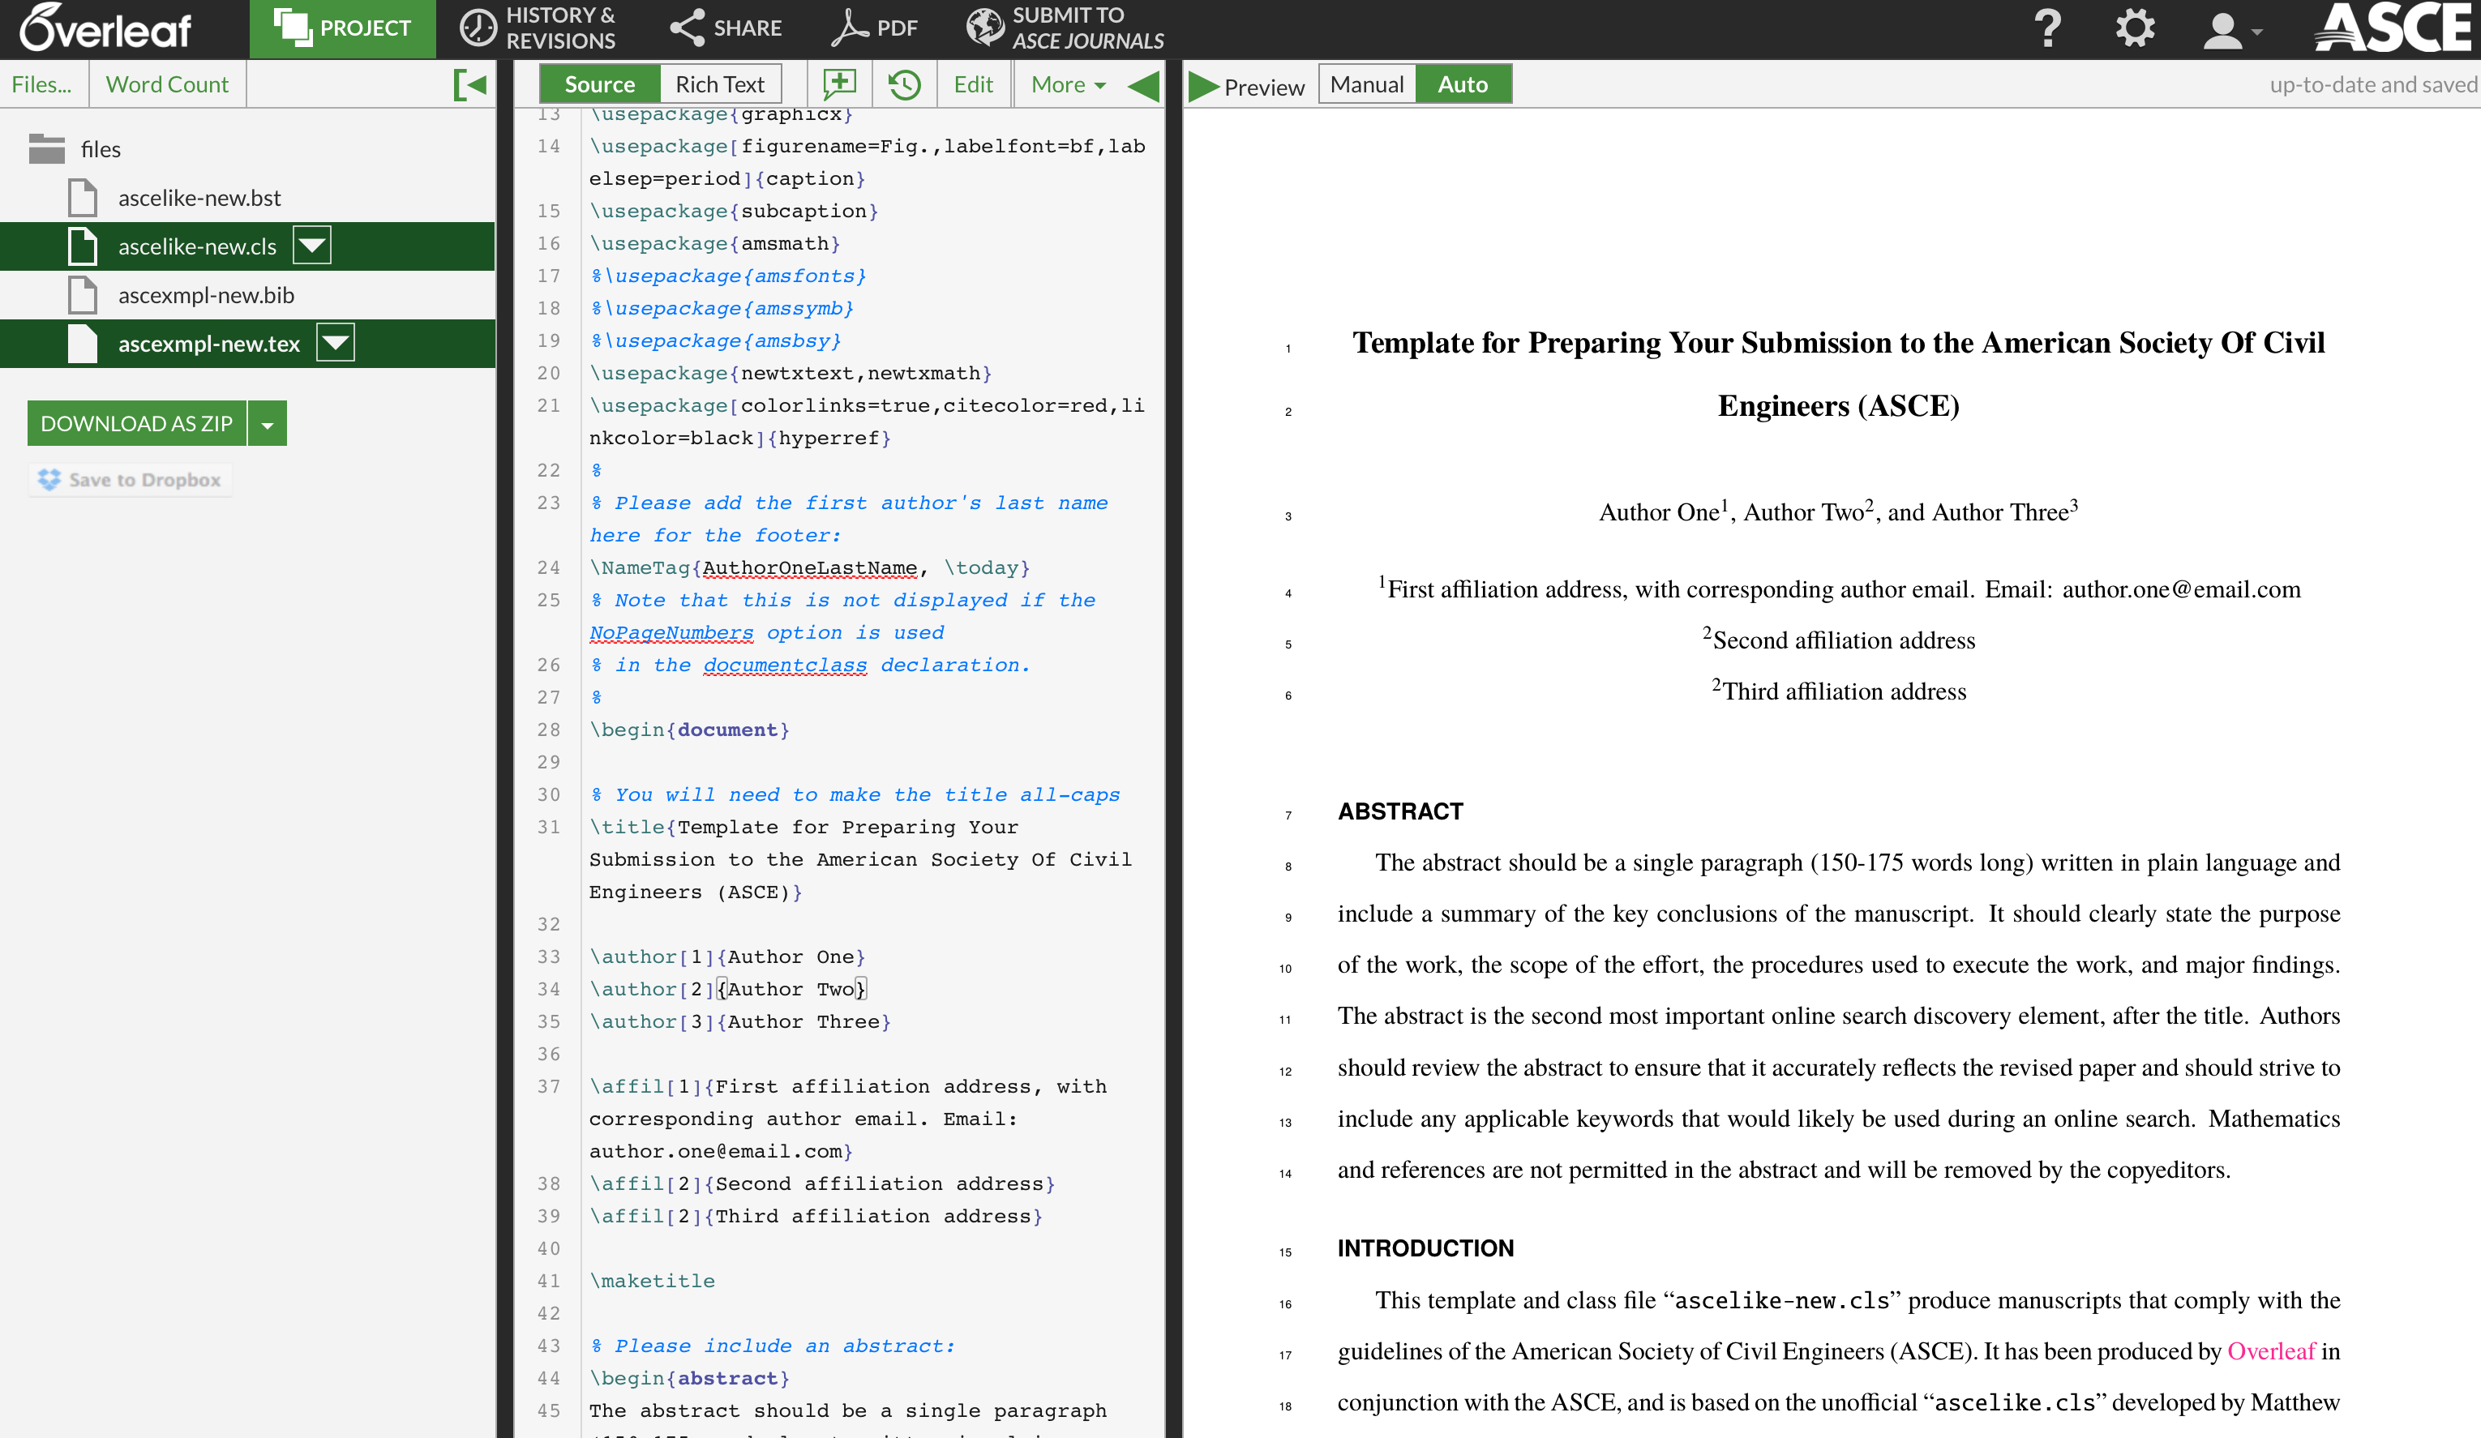
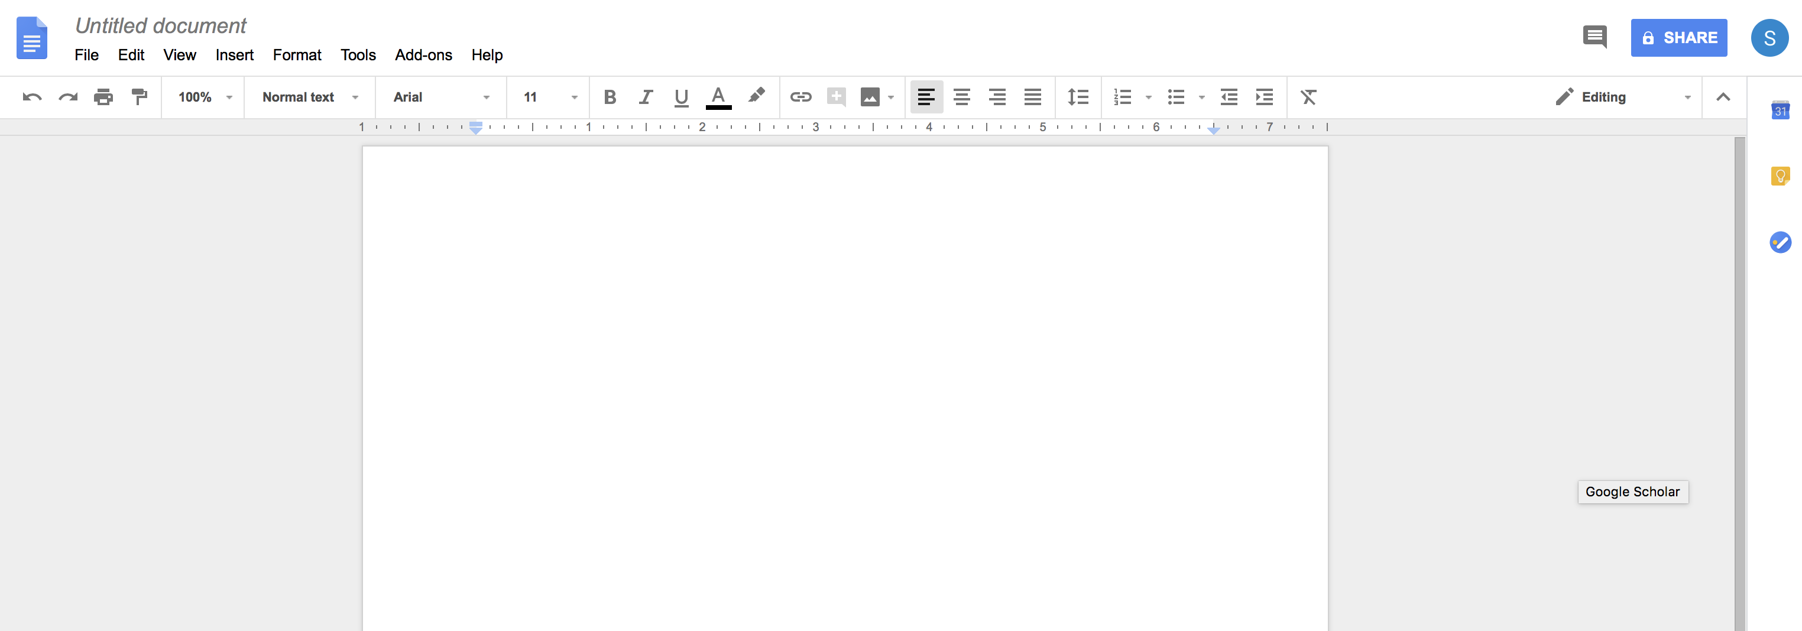
Discussion: Collaborative Writing

Slide 14
Discussion: Collaborative Writing
What type of architecture do we need?
What else? What should be the goal of the system design?
  Synchronization
  Consistency
  Security

Slide 15
Discussion: Collaborative Writing
Examples
  Only authorized users are allowed to edit the document
  All the content should be provided by authorized users
  All the users should eventually see the same document
    Consistency!
    Any issues?
    Think about github…

Slide 16
Reading List
Optional:
  Tanenbaum book, ch2, ch12
  Canfield book, ch3 https://userpages.umbc.edu/~jianwu/is651/651book/is651-strapdown.php?f=is651-Chapter03.md
  https://www.w3schools.com

Slide 17
CDN info
Optional:
  Amazon CloudFront https://aws.amazon.com/cloudfront/
  FBCDN https://research.fb.com/the-evolution-of-advanced-caching-in-the-facebook-cdn/
  Google Cloud CDN https://cloud.google.com/cdn/

