Slide 1
IS 651: Distributed Systems
Web Technologies
Sisi Duan
Assistant Professor
Information Systems
sduan@umbc.edu

Slide 2
Recall
Define Distributed Systems
  A distributed system consists of multiple autonomous computers that communicate through a computer network. The computers interact with each other in order to achieve a common goal.
  A distributed system is a system in which I can’t do my work because some computer that I’ve never even heard of has failed

Slide 3
Recall
Why distribution?
  Sharing of information and services
Availability
Reliability
Fault tolerance
Performance
Scalability
…

Slide 4
Recall

Slide 5
Recall
Distributed systems goals
  Raise the level of abstraction, provide location transparency, scalability, availability, modularity
Distributed systems challenges
  Interfaces, scalability, consistency, fault tolerance, security

Slide 6
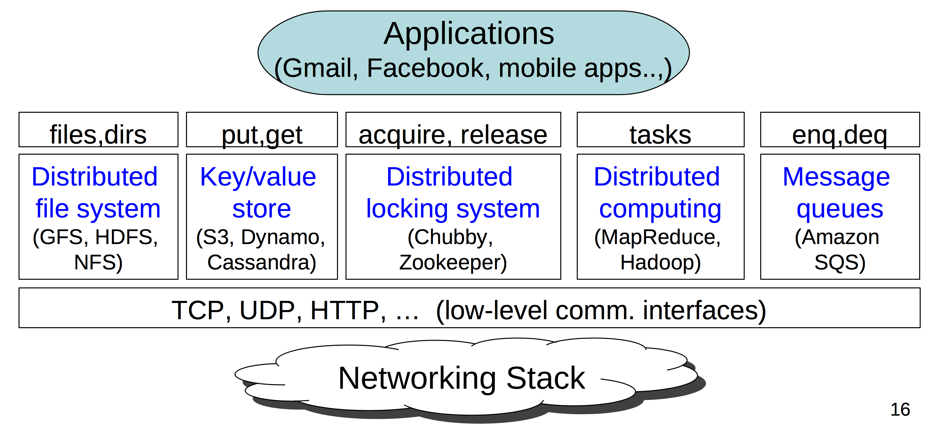
Recall

Slide 7
Today
Web Architecture
Inside the architecture
  Web-based systems
  Web services
  Web server
  Communication

Slide 8
Client-Server Model
Popular protocols between clients/servers
  Http, https
  Ajax: asynchronous requests
  XMLRPC, SOAP: web service API requests

Slide 9
Server-Side Processing
Initially, web servers returned static HTML pages
  No processing on server, no state, no user-provided data
1994: Common Gateway Interface (CGI)
  Server invokes a program upon each request
  Program gets client data from stdin, outputs HTML to stdout
Server-side frameworks:
  More flexible and extensible than CGI
  ASP, JSP, PHP…
  Can access DB

Slide 10
3-tier architecture
What is good/bad about this architecture?
  + Modularity, better reliability/scalability
  - poor latency

Slide 11
Client-Side Computation
In reality, the line is much fuzzier…
Discussion: Why?

Slide 12
Real Architectures
Each Layer
  What constitutes it?
  What does it do?
  Hardware requirements
  Deployment choices

Slide 13
External Caching Tier
What is it?
  Content-delivery networks (CDNs)
What does it do?
  Caches outbound data
  Images, CSS, XML, HTML, pictures, videos, etc.
  Denial of service defense
  Cache may be close to user

Slide 14
External Caching Tier
Hardware requirements
  Lots of memory
  Moderate to little CPU
  Fast network
  Potentially distributed across the world

Slide 15
Front-end Tier
What is it?
  Apache
  Thttpd
What does it do?
  http, https
  Serves static content from disk
  Generates dynamic content
    CGI/PHP/python/Django/..
  Dispatches requests to the App Server Tier
    Tomcat, Weblogic, Websphere, JRun, ...

Slide 16
Front-end Tier
Hardware requirements
  Lots and lots of memory
    Memory is main bottleneck in web serving
  CPU depends on usage
    Dynamic pages need CPU
    Static pages need little CPU
  Cheap slow disk is enough

Slide 17
Application Server Tier
What does it do?
  Dynamic page processing
    ASP,JSP
  Internal services
    Search, processing payments
    Varies depending on the websites

Slide 18
Application Server Tier
How does it work?
1. Web Tier generates the request using
  Home-brewed RPC
  REST
  Corba
  Java RMI
  SOAP
  XMLRPC
2. App Server processes request and responds

Slide 19
Application Server Tier
Decoupling of services is GOOD!
  Manage Complexity using well-defined APIs
BUT: remote calling overhead can be expensive!
  Marshaling of data, sockets, net latency, ...
  SOAP, XMLRPC ... don’t scale that well...

Slide 20
Application Server Tier
Hardware requirements
  Lots and lots and lots of memory
App Servers are very memory hungry
  Fast CPU required, and lots of them
  Disk typically isn’t needed
(This will be an expensive machine.)

Slide 21
Database Tier
What is this?
  Relational databases (distributed or not)
    PostgreSQL, SQLite, Oracle, MySQL, Berkeley DB
  Non-relational databases or distributed file systems
    Bigtable, Megastore, MongoDB, Hadoop Hbase, HDFS, ...
Tradeoffs:
  Relational databases don’t scale that well, but provide convenient interface, sound properties (e.g., strong consistency)
  Non-relational DBs scale better

Slide 22
Database Tier
Hardware Requirements
  Entirely dependent upon application
  Likely to be your most expensive machine(s)
  Tons of memory
  Large disks
  RAID is useful for redundancy

Slide 23
Internal Caching Tier
What does it do?
  Caches objects closer to the Application or Web Tiers
  Tuned for the application
    The external cache is generic
  Very fast access (<1ms)

Slide 24
Internal Caching Tier
Hardware requirements
  Lots of memory
  Little or no disk
  Moderate to low CPU
  Fast network

Slide 25
Misc. Services
Lots of extra services commonly used in Web services
  DNS
  Time synchronization (next week)
  System health monitoring
  Intrusion detection systems
  …

Slide 26
The Glue
Load balancers
Routers
Switches
Firewalls

Slide 27
So far
Web architectures are complex
There are well-known solutions
A lot of tradeoffs
Understanding the workload is key in choosing the right product to use at each layer
Each layer has distinct hardware requirements and likely distinct bottlenecks
  Except for RAM, which is very popular

Slide 28
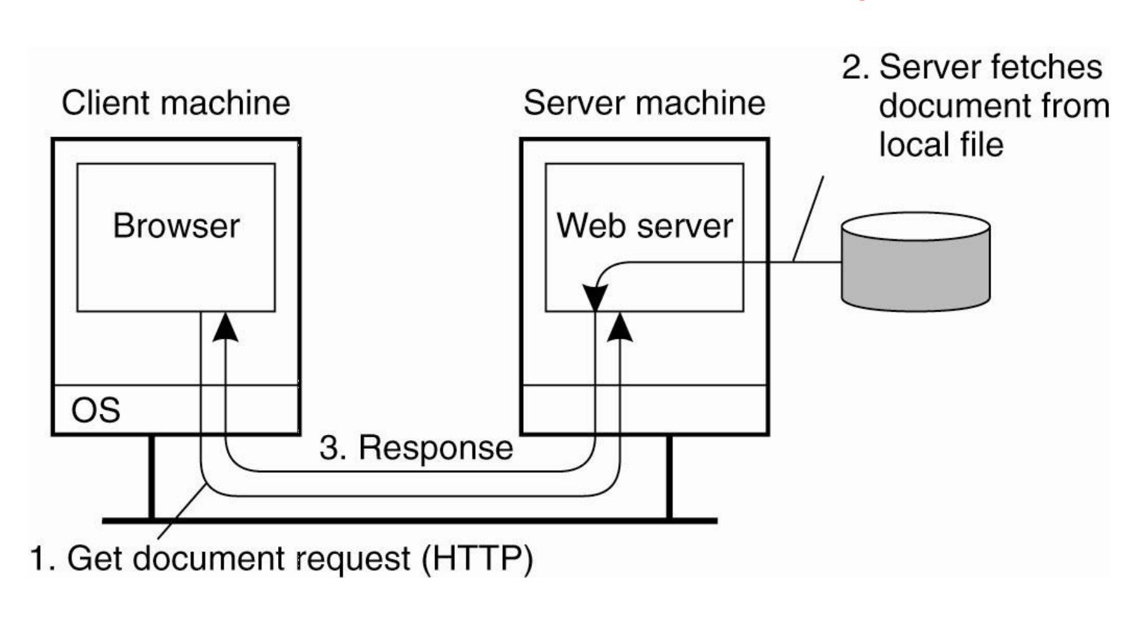
What’s inside?

Slide 29
Traditional Web-Based Systems
Browsers, URLs (Uniform Resource Locator)
  http://sduan.informationsystems.umbc.edu:80/index.html
  Protocol
  Host
  Port
  path from web root
  Anchor

Slide 30
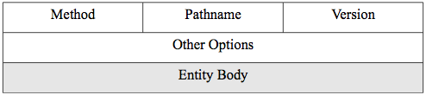
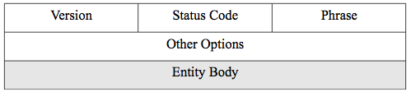
Traditional Web-Based Systems
HTTP (HyperText Transfer Protocol)
  Request
    Method: GET, POST, etc
    Path: requested file under the web root directory
    Entity body: data sent to the server
  Response
    Status code: standard code for the response
    Phrase: an English version of the status code
    Entity body: Data for web browser to display

Slide 31
Traditional Web-Based Systems
Web documents
  Main part: acts as a template for the second part
  Second part: contains many pieces that jointly constitute the document
Markup language: text document with annotation (usually tags)
  HyperText Markup Language (HTML)
  EXtensible Markup Language (XML)
  EXtensible HyperText Markup Language (XHTML) etc.
Multipurpose Internet Mail Exchange (MIME)
  Embedded documents
  Text, image, audio, video, application, multipart

Slide 32
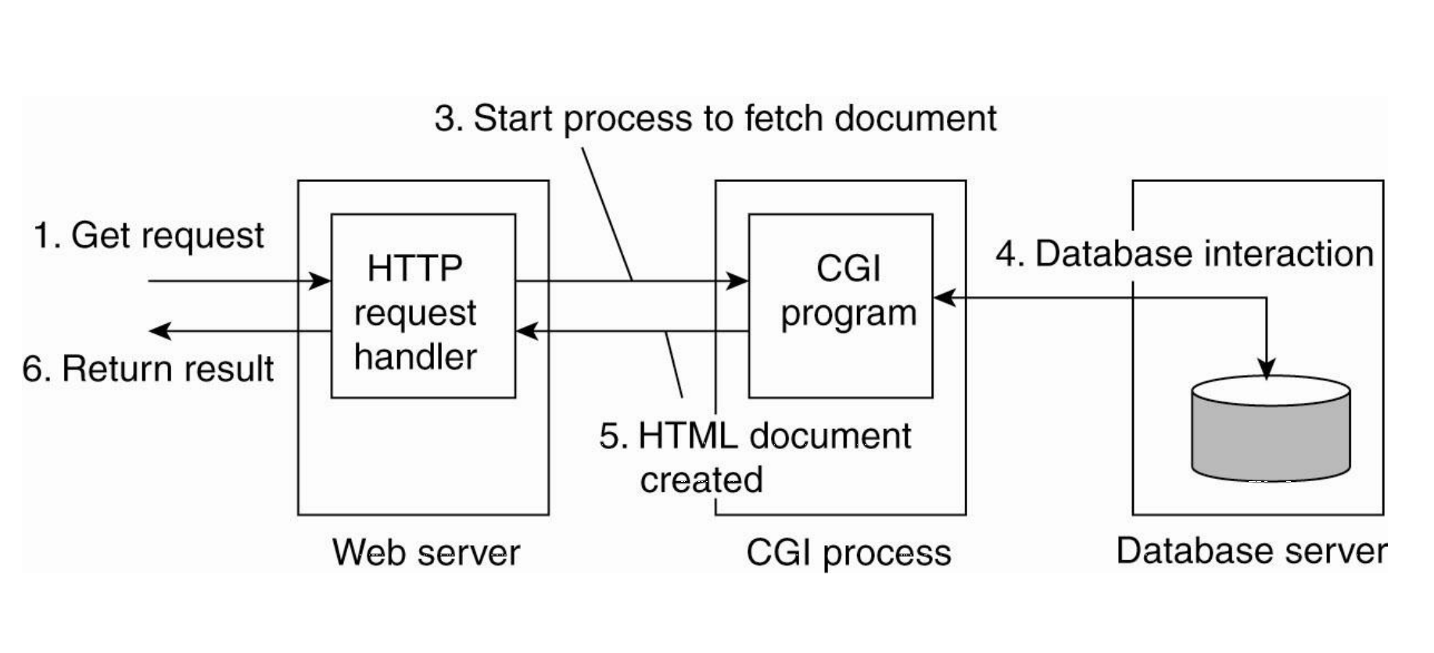
Multitiered architecture

Slide 33
Multitiered architecture
Common Gateway Interface (CGI)
  Defines a standard way by which a web server can execute a program taking user data as input
  One disadvantage is its poor performance. It forks a new process for each request, which is not scalable

Slide 34
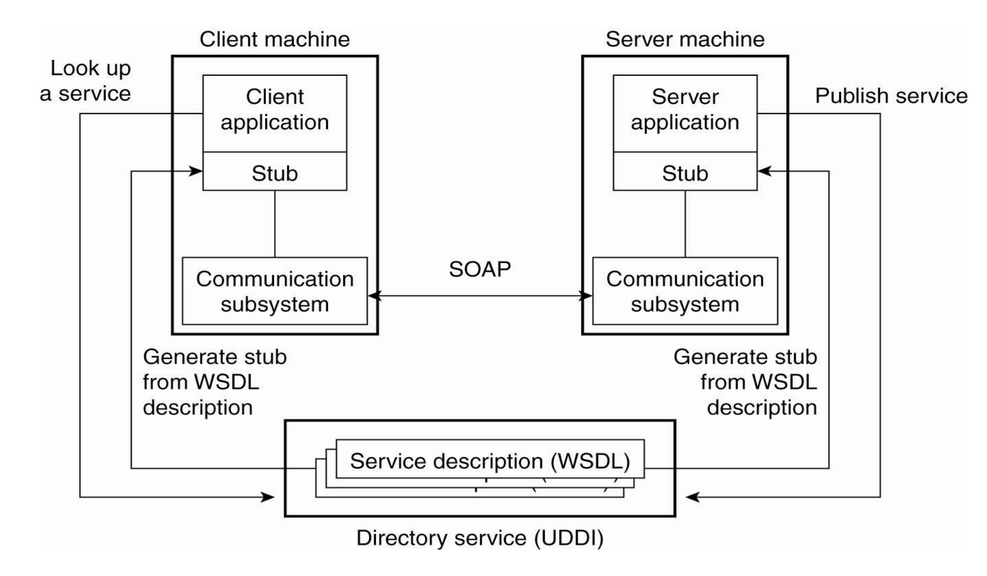
Web services
Service made available over the Internet

Slide 35
Web services
Client application calls upon the services
Universal Description, Discovery, and Integration (UDDI)
  Directory service storing service descriptions
  Prescribes the layout of a database containing service descriptions that will allow web service clients to browse for relevant services

Slide 36
Web services
Web Services Definition Language (WSDL)
  Formal language to support RPC-based communication
Simple Object Access Protocol (SOAP)
  A framework where communication of two processes can be standardized

Slide 37
Web service composition and coordination
Web services are usually more complicated
  Example: web-based shop
  Ordering, paying, delivery
  Services from multiple providers
Coordination
  Coordination protocols
  Various steps that need to take place for a service to succeed
  Single coordinator v.s. multiple coordinators (Pros and Cons?)

Slide 38
Web Server
Apache Web serer is the most popular one
Used by 67% of all web sites
Runtime environment: Apache Portable Runtime (APR)
  Platform-independent interface for file handling, networking, locking, threads, etc.

Slide 39
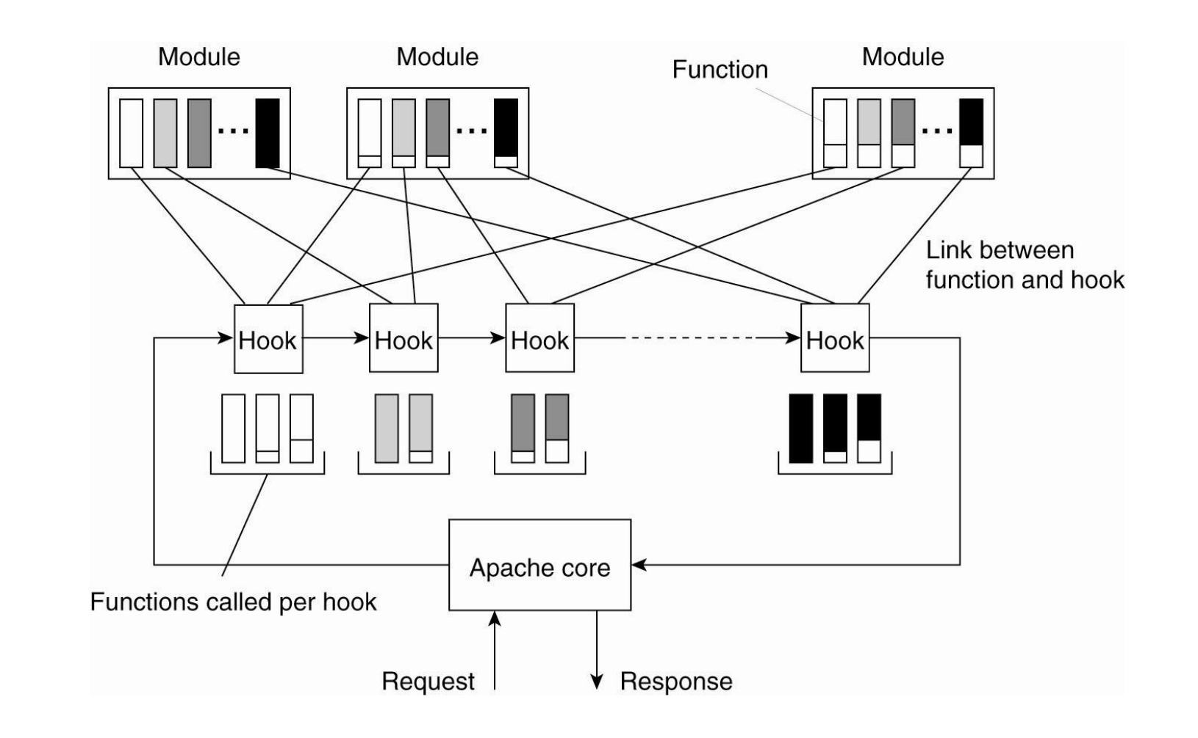
Apache Web Server
Hook
  Translate a url to a local file name
  Checking a client’s identification
  Checking access right
  Checking MIME type
  …

Slide 40
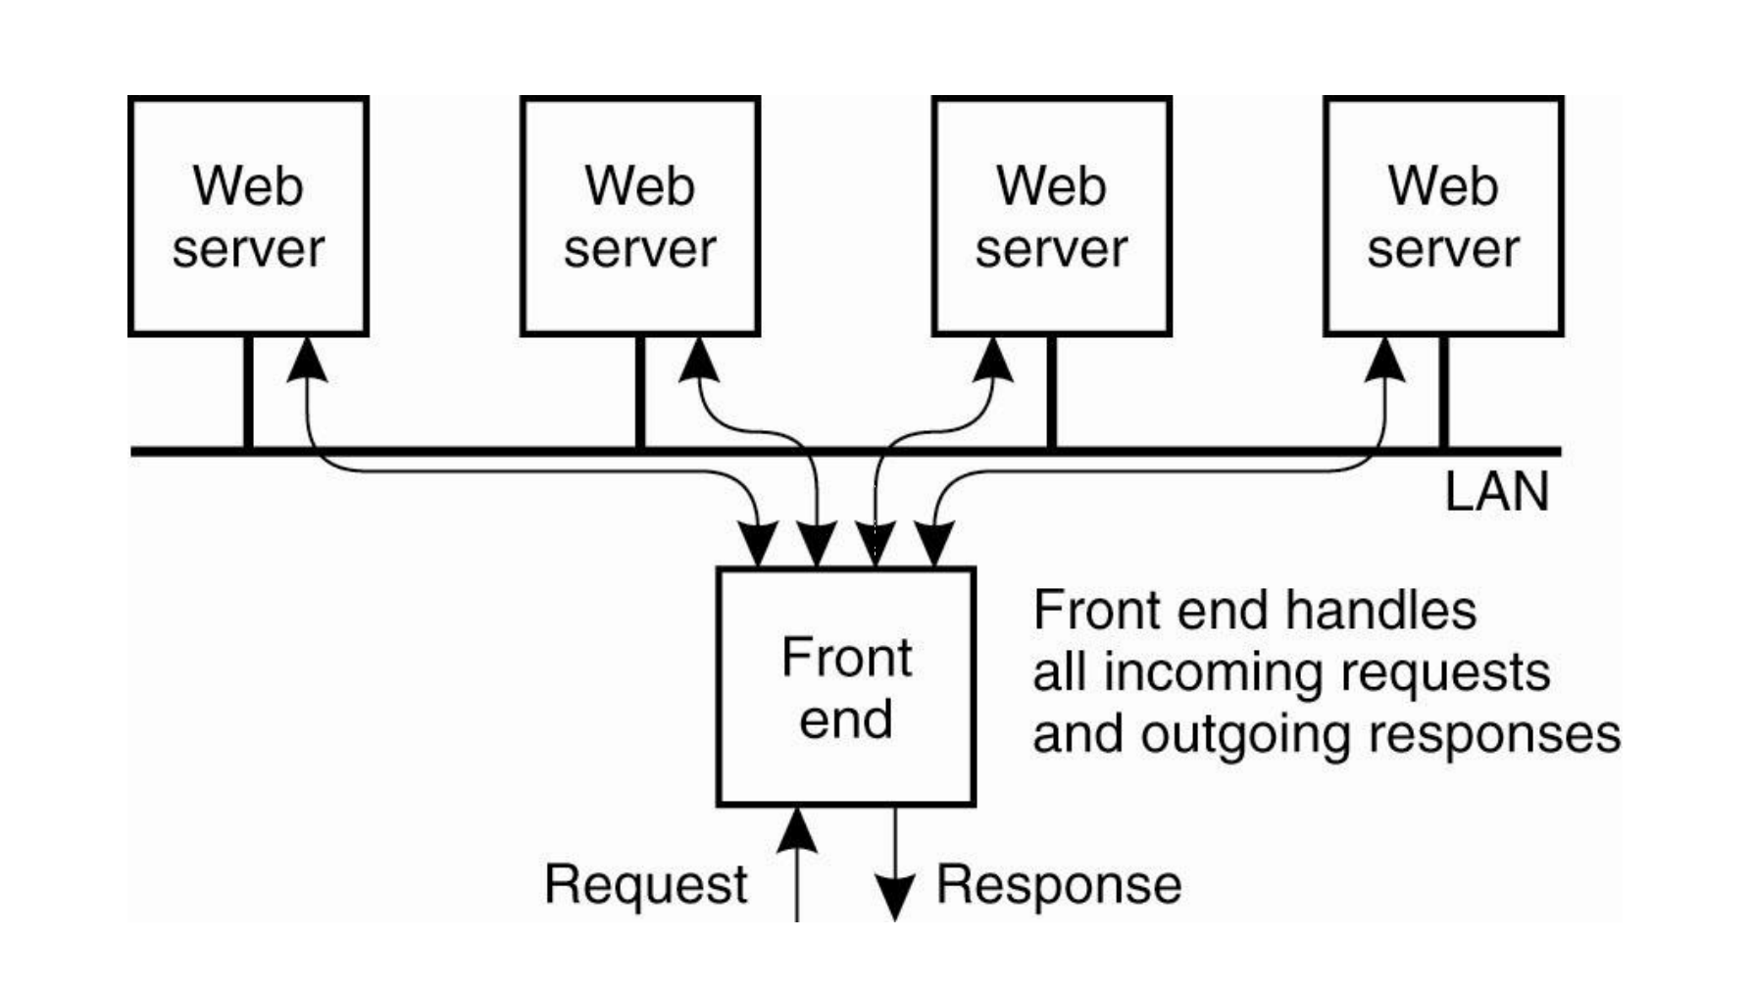
Web Server Clusters
Load balancing
  Content-aware distribution
    Always distribute the same request for the same document to the same server
    Discussion: What’s the pros and cons?

Slide 41
Web Server Clusters
Load balancing
  Content-aware distribution
    Always distribute the same request for the same document to the same server
    What’s the pros and cons?
    +: efficiency
    -: load for the front-end

Slide 42
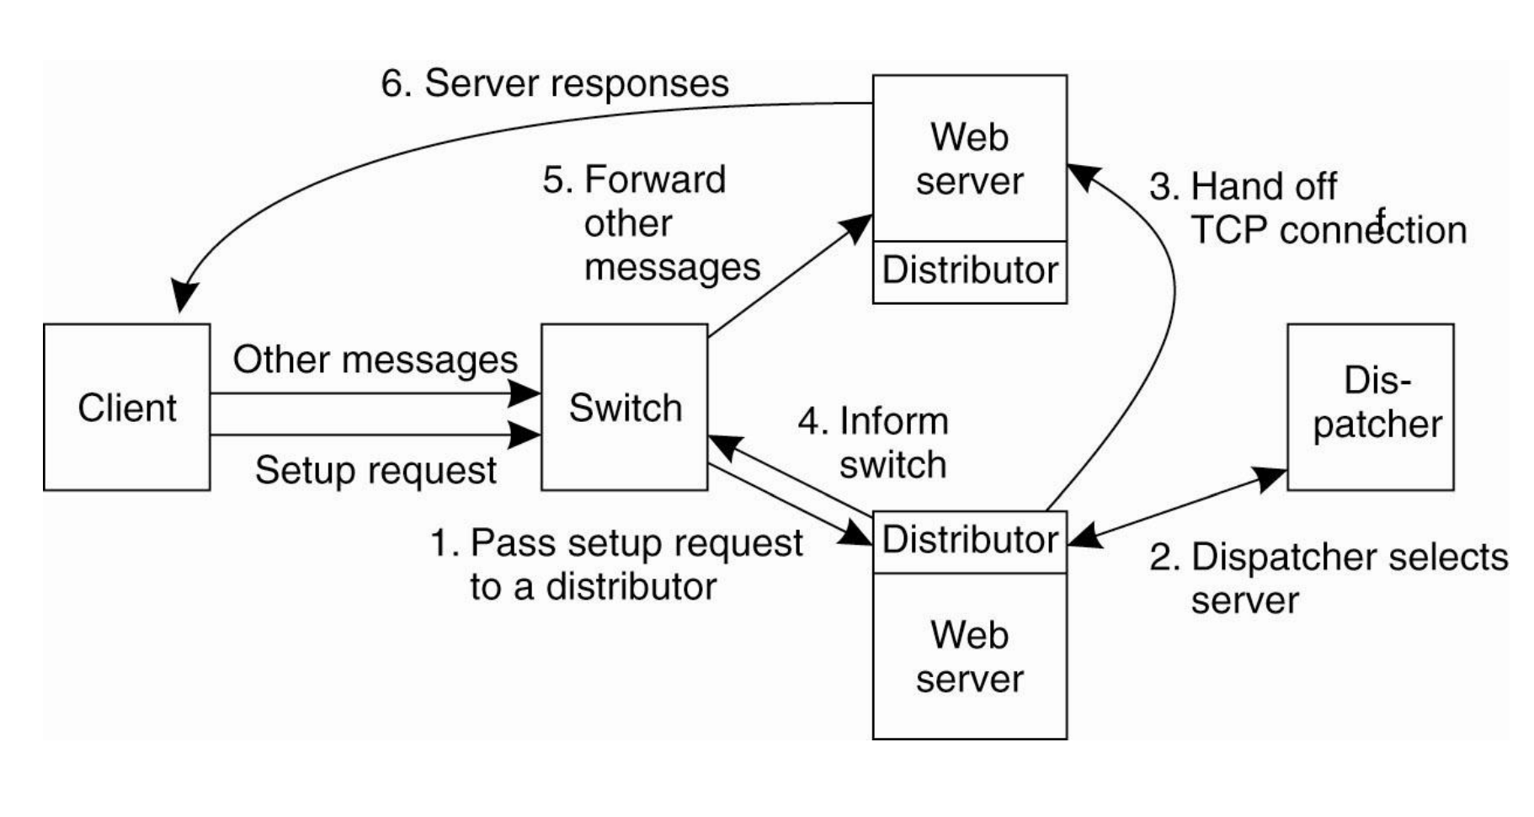
Web Server Clusters
A more scalable version
Distribute the work of the front end

Slide 43
Web Server Clusters
Dispatcher
  Decides which server a TCP connection should be handled off
Distributor
  Monitors incoming traffic for a handed-off connection
Switch
  Forward TCP messages to a distributor

Slide 44
Communication
Traditional web systems
  HTTP
Web services
  SOAP

Slide 45
Client-Side Techniques
HTML
  Fundamental markup language for web pages • Define the content of web pages
Cascading style sheets (CSS)
  Used to set the presentational properties (or layout) of an HTML page: colors, fonts, layout, alignments, borders, etc.
  It has its own syntax
JavaScript
  Program the behavior of web pages
  It is an object-oriented, dynamically typed scripting language that can be run by an interpreter inside the web browser and therefore included inside web page code
  https://java.com/en/download/faq/java_javascript.xml

Slide 46
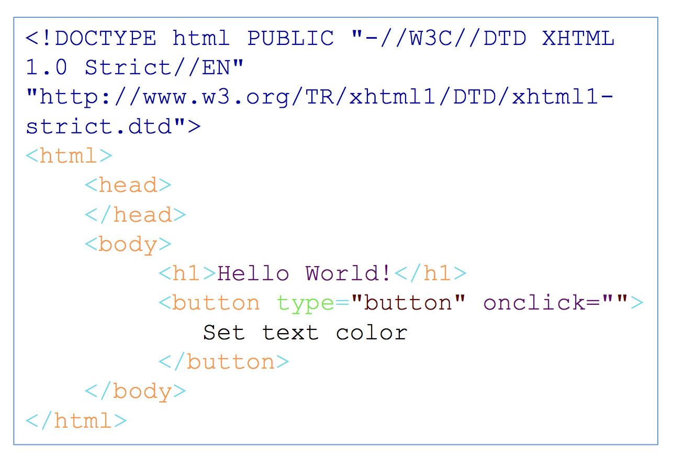
HTML
DOCTYPE: defines the document type to be HTML
  DOCTYPE is also used in XML
  XHTML (Extensible HTML): define an HTML as an XML document, stricter than HTML, well- formed XML
<html> : an HTML document
<head>: information about the document.
  Javascripts and CSS are often defined here.
<body>: the visible page content
<h1>: the most important heading

Slide 47
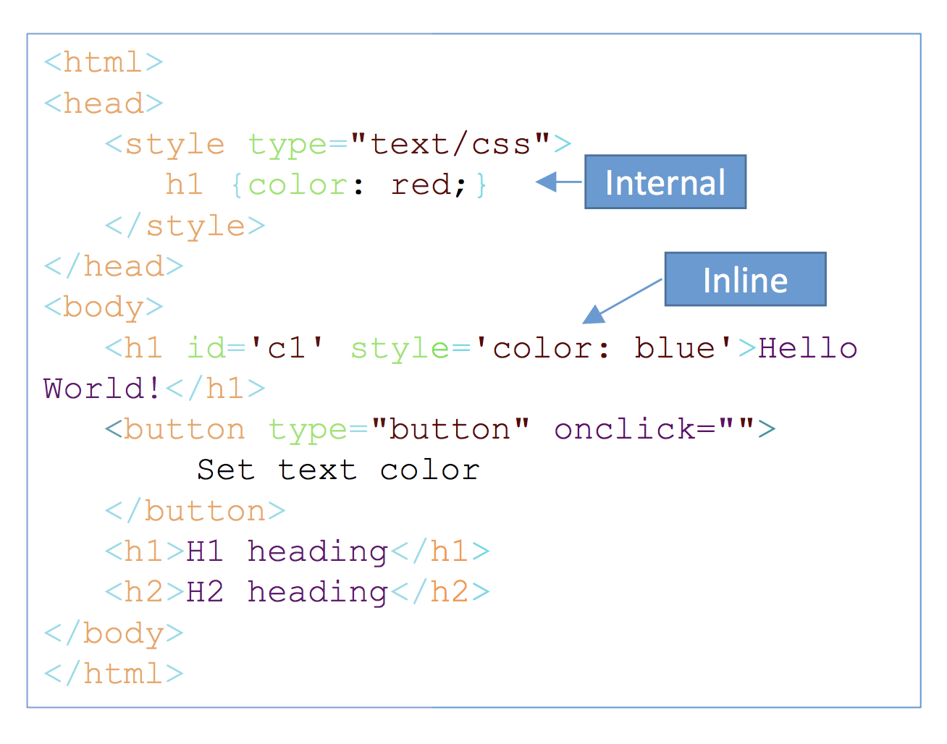
Cascading Style Sheets (CSS)
Syntax: selector {prop1:value1; prop2: value2; ...}
Selector: select HTML elements based on element name, id, class, attribute, etc.
Styling can be added to HTML elements in 3 ways: inline, internal, external
Cascading: a cascading order where the different types of stylesheets take priority and override a previous one
  The four stylesheet types with increasing priority: browser default, external, internal, and inline

Slide 48
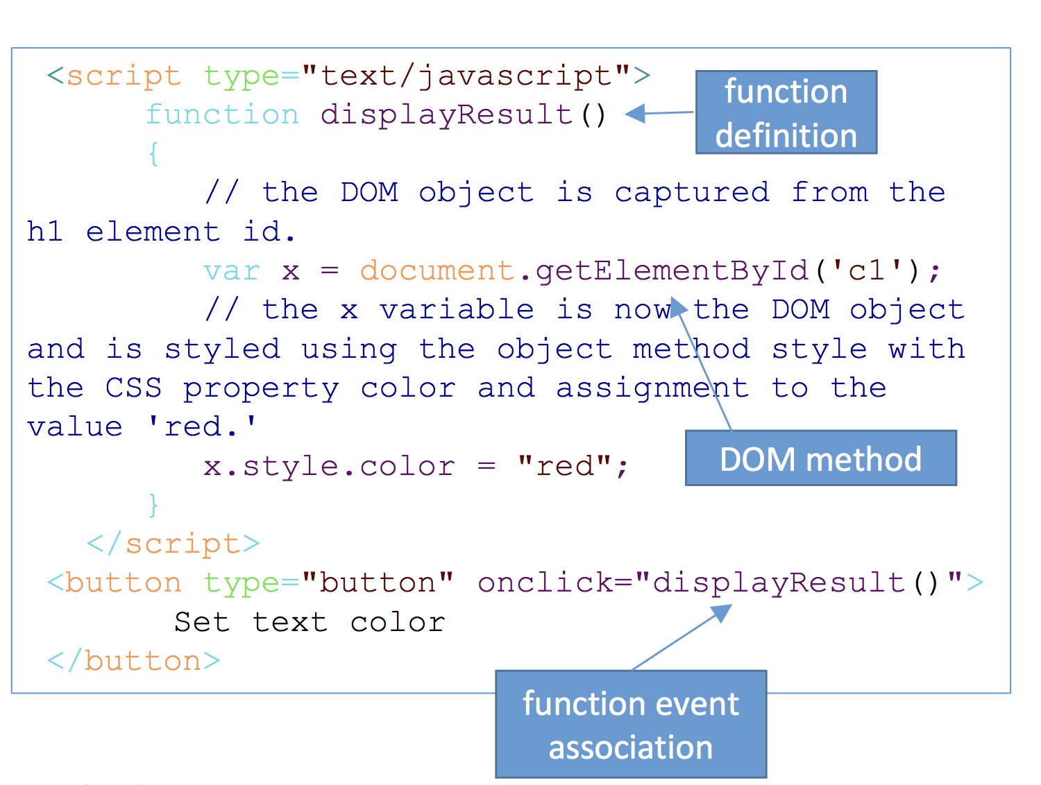
JavaScript
A program language to dynamically change a web page based on its DOM
  Add, change, and remove HTML elements and attributes
  Change CSS styles
  React to existing events
  Create new events
Basic logic
  Define event handler function
  Associate an event with a function
HTML DOM Events
  Mouse event: onclick, oncontextmenu, ...
  Keyboard Events: onkeydown, onkeyup, ...

Slide 49
Server-Side Techniques
CGI
Web server application programming interfaces (APIs)
  Plug-ins for web servers that allow the web server process to spin off new threads for each request rather than a process, which much more light-weight
  The scripts can be embedded in html using special template tags such as <%...%>
  Script languages include PHP, JSP, ASP, etc.
Java Servlet API: a special type of server API
  Allows a Java virtual machine to work as a plug-in to a web server
  A servlet is a java class that receives a request, then prepares and sends a response
  Normally work with Java Server Pages (JSP) together for dynamic web pages

Slide 50
PHP
Originally stands for Personal Home Page, but it is now a recursive backronym: PHP: Hypertext Preprocessor.
PHP scripts are embedded using <? ?>. They can be part of a html or not.
PHP scripts (optionally) read some inputs from client request, generate output as html content
  Read input: $_GET, $_POST
  Generate output: echo/print
You won’t see php source code using “View Page Source” option
  Local web browser only get html content generated by PHP script

Slide 51
So far
Web-based systems
  Traditional vs. multitiered
Web services
Web server
  Web server clusters
Communication
  Client-side and server-side techniques

Slide 52
What else?
Discussion: Collaborative writing
Synchronization
Consistency
  Caching and replication
Security

Slide 53
Reading List
Optional:
  Tanenbaum book, ch2, ch12
  Canfield book, ch3 https://userpages.umbc.edu/~jianwu/is651/651book/is651-strapdown.php?f=is651-Chapter03.md
  https://www.w3schools.com

