Slide 1
IS 651: Distributed Systems
Distributed Communication
Sisi Duan
Assistant Professor
Information Systems
sduan@umbc.edu

Slide 2

Today
Socket
RPC
REST
Abstracting Distributed Communication

Slide 3
Common Communication Pattern

Slide 4
Communication Mechanisms
Many protocols are available
  Sockets
  Remote Procedure Call (RPC)
  Distributed shared memory (later in the class)
  MPI
  …

Slide 5
Socket Communication
Your own protocol on top of a transmission protocol
Remember the network layers from the first class?
  What’s TCP?
  What’s UDP?
  When is it best to use TCP v.s. UDP?

Slide 6
Socket Communication
TCP (Transmission Control Protocol)
  Protocol built upon the IP networking protocol, which supports sequenced, reliable, two-way transmission over a connection (or session, stream) between two sockets
  More reliable
  More expensive
UDP (User Datagram Protocol)
  Also protocol built on top of IP. Supports best-effort, transmission of single datagrams
  It’s ok to lose, re-order, or duplicate messages
  Low latency

Slide 7
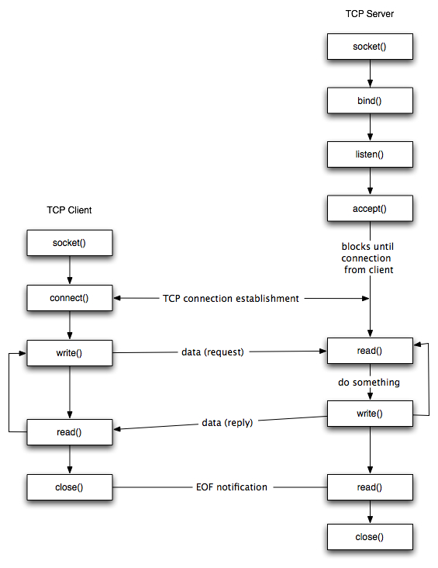
TCP Socket API

Slide 8
TCP Socket Demo
Python 3 (code for python 2 is also available )
Java will be similar (links are provided in the reading list)
Simple-client.py
Simple-server.py
(Available at class website under Reading)

Slide 9
sock = socket.socket(socket.AF_INET, socket.SOCK_STREAM)
sock.bind((hostname, port))
sock.listen(1)
conn,addr = sock.accept()
server_addr=(hostname,portnum)
sock.connect(server_addr)
sock.sendall(msg)
buf = conn.recv(8092)
sock.close()

Slide 10
Socket API
You need to manually implement a lot of things
Very handy if you are a distributed systems developer

Slide 11
RPC
Remote Procedure Call
A type of client/server communication
Ease of programming
Hide complexity
Standardize some low-level data packaging protocols

Slide 12
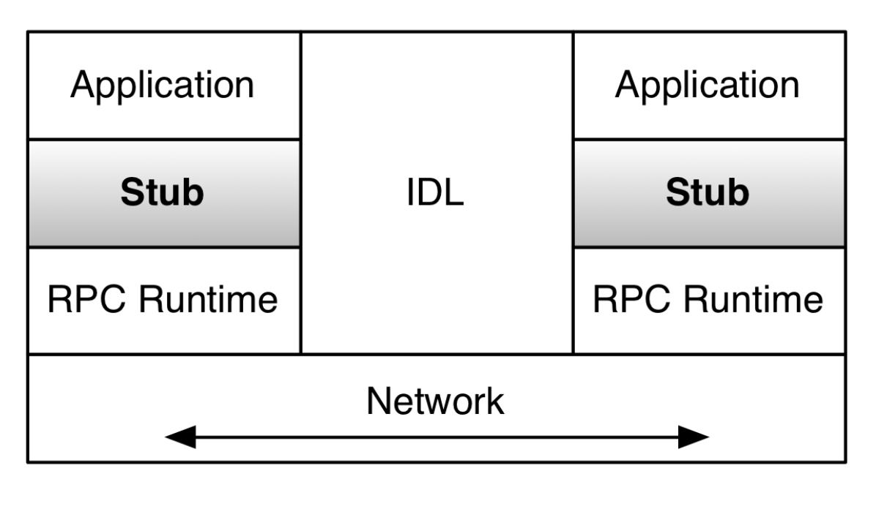
RPC
The application calls the remote procedure locally at the stub
The stub intercepts calls that are for remote servers
  Marshalling: pack the parameters into a message
  Make a system call to send the message
  Stubs are generated automatically by RPC frameworks (libraries), which also provide the RPC Runtime
  Programmers only write definitions for their data structures and protocols in an IDL

Slide 13
RPC
The RPC Runtime handles message sending
The interface definition language (IDL) handles message translation
RPC hides heterogeneity among the computers and handles the communication across network

Slide 14
RPC technologies
XML/RPC
  Over HTTP, huge XML parsing overheads
SOAP
  Designed for web services via HTTP, huge XML overhead
CORBA
  Relatively comprehensive, but quite complex and heavy
Protocol buffers
  Lightweight, developed by Google
Thrift
  Lightweight, supports services, developed by Facebook

Slide 15
Extensible Markup Language (XML)
XML documents form a tree structure
Well-formed XML v.s. Valid XML
XML validation
  Document type definition (DTD)
  XML Schema

Slide 16
Well-formed XML
It contains only properly encoded, legal Unicode characters
None of the special syntax characters (<, &) appear except when
performing their markup-delineation roles
The begin, end, and empty-element tags that delimit the elements are correctly nested, with none missing and none overlapping
The element tags are case-sensitive - the beginning and end tags must match exactly
There is a single "root" element that contains all the other elements

Slide 17
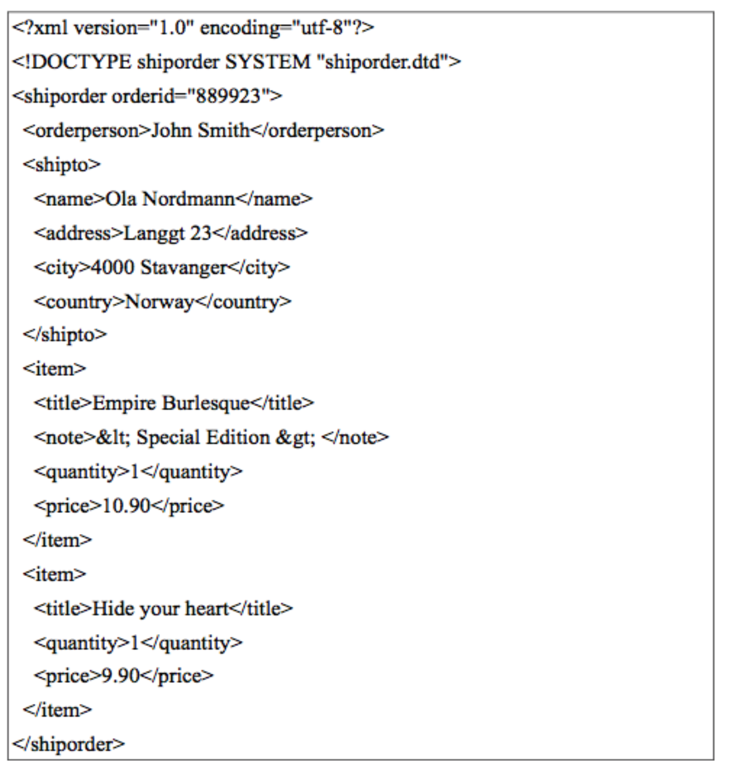
Valid XML
The declaration in line 1 is contains question mark characters and is called a processing instruction. It references the version and encoding for the XML document.
Line 2 has a reference to an external DTD file that contains the DTD.
  It can replaced by embedding DTD content
Line 3 is the root tag for the document. Note that it contains an attribute. Any XML tag may have an attribute and it must be quoted.
Note that even though item is repeated, it uses the same tag. Never create tags like item1, item2, etc.

Slide 18
Document Type Definition (DTD)
The declaration of the DTD in the XML document has the syntax where SYSTEM refers to that fact that the DTD is a private implementation for this document rather than a standard. It would change to PUBLIC if it was a standard.
  < DOCTYPE root-element SYSTEM "URI" >
DTDs do not have XML syntax. They have their own syntax.
The !ELEMENT declares an element (also called a tag).
The child elements of a tag are declared as an ordered list in parentheses. If an element can be repeated 1 or more times, it must have a plus sign (+) after it. The character star (*) means 0 or more and so makes elements optional.
A leaf node of the hierarchy is declared #PCDATA which means parsed character data and it is the text of the content.
The &lt; and &gt; are XML entities for the less than and greater than (< >) characters. XML markup characters cannot be used
because they would confuse a parser, so these pre-defined entities must replace them.
There are no data types in DTDs. Everything is text.
The !ATTLIST declares an attribute for an element and typically declares it as CDATA which means character data. This means that the XML parser does not parse it.
One can require a document to have an attribute in order to be valid by using #REQUIRED.

Slide 19
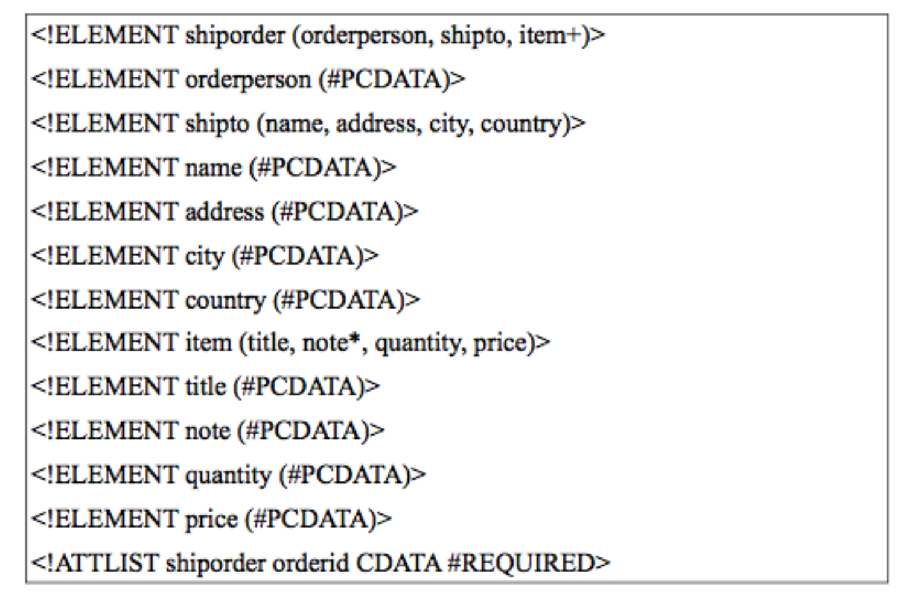
DTD Example
Validation command: $>xmllint --noout --valid shiporder.xml

Slide 20
XML
Well-form check command
  xmllint --noout shiporder.xml
  xmllint --noout shiporder-not-well-formed.xml
  xmllint --noout shiporder-well-formed-not-valid.xml
Validation check command
  xmllint --noout --valid shiporder.xml
  xmllint --noout --valid shiporder-well-formed-not-valid.xml

Slide 21
XML/RPC – a HTTP POST request
Data serialization: XML
  RPC call to add(17,13) results in this request
<?xml version="1.0" encoding="ISO-8859-1"?>
<methodCall>
<methodName>sample.add</methodName>
<params>
<param>
<value><int>17</int></value>
</param>
<param>
<value><int>13</int></value>
</param>
</params>
</methodCall>

Slide 22
XML/RPC
Server side has to implement a function to process the request
Sample Response
<?xml version="1.0"?>
<methodResponse>
<params>
<param>
<value><int>30</int></value>
</param>
</params>
</methodResponse>

Slide 23
Problems with XML/RPC
XML is very verbose, which affects performance
The library doesn’t support protocol versioning
  What happens if I want another param?
  What happens if I reverse order of x and y?
    Nothing, but what if function weren’t cumulative?
  What if I forgot to add a param?
  In general, lack of types makes it difficult to build and maintain code
There are other more complex and flexible XML/RPC libraries.

Slide 24
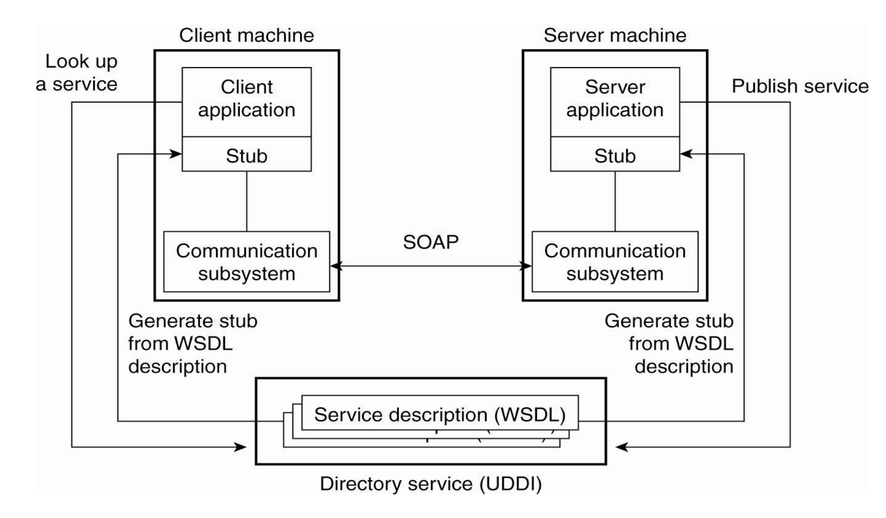
SOAP
Simple Object Access Protocol (SOAP)
It is the messaging protocol for XML web services
SOAP is described in XML following SOAP schema
SOAP is usually used with HTTP
SOAP structure
RPC-style SOAP VS. Document-style SOAP

Slide 25
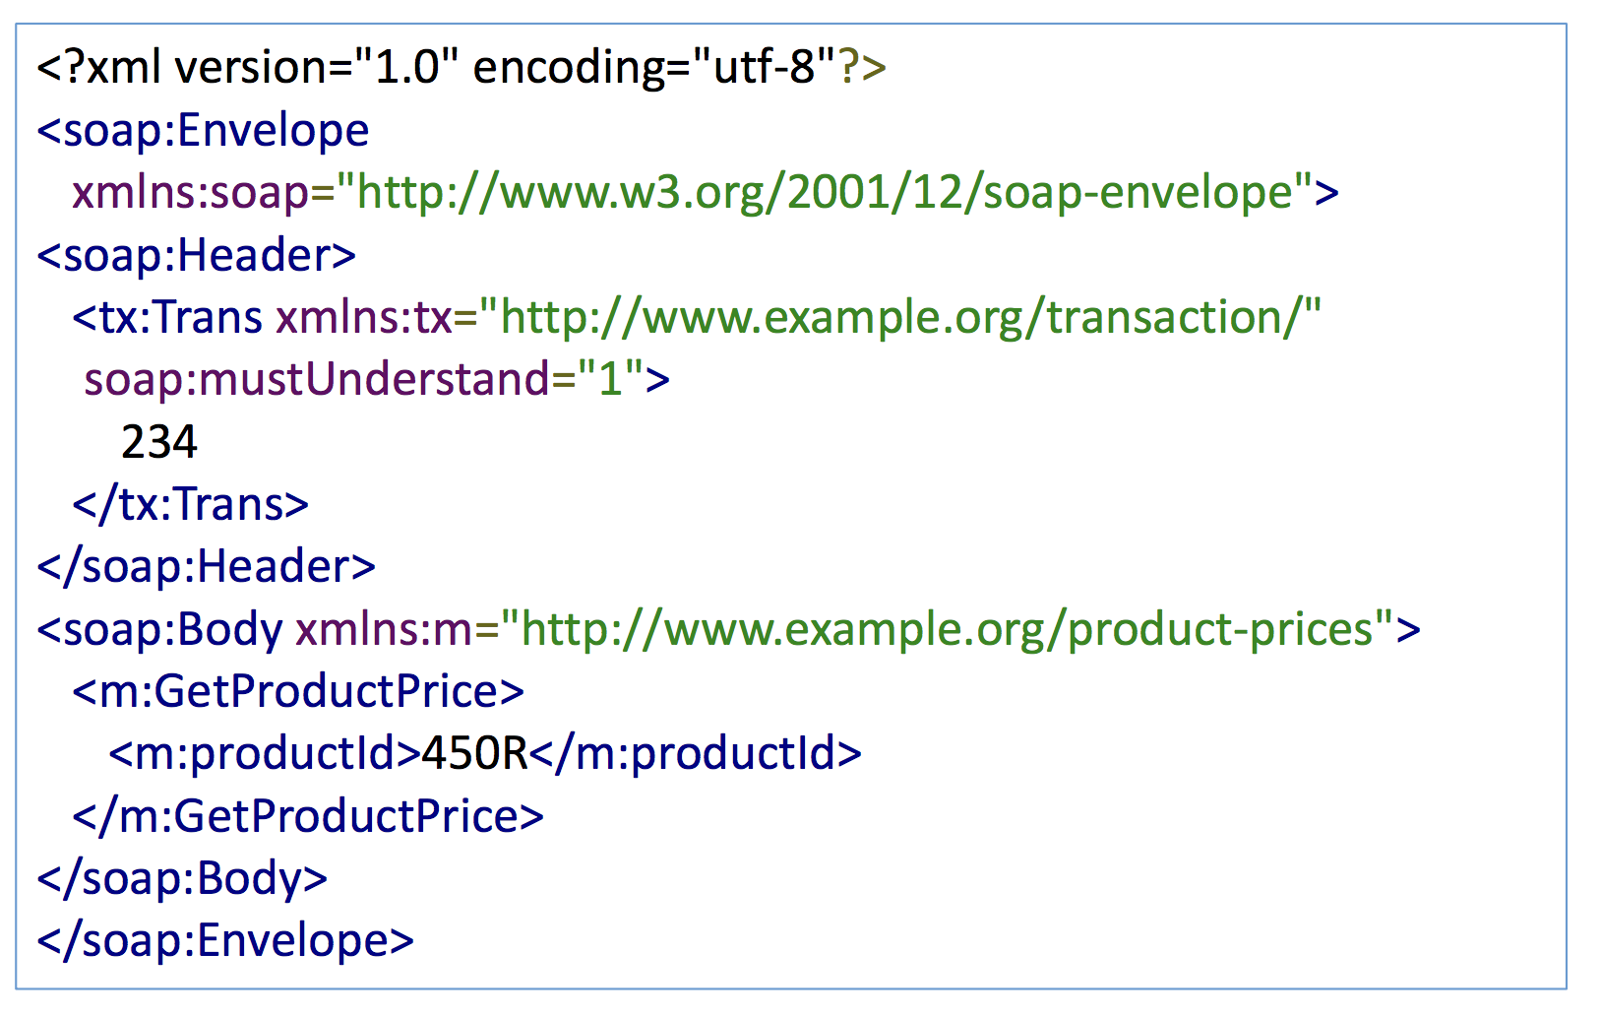
RPC-style SOAP
The message corresponds to a procedure call

Slide 26
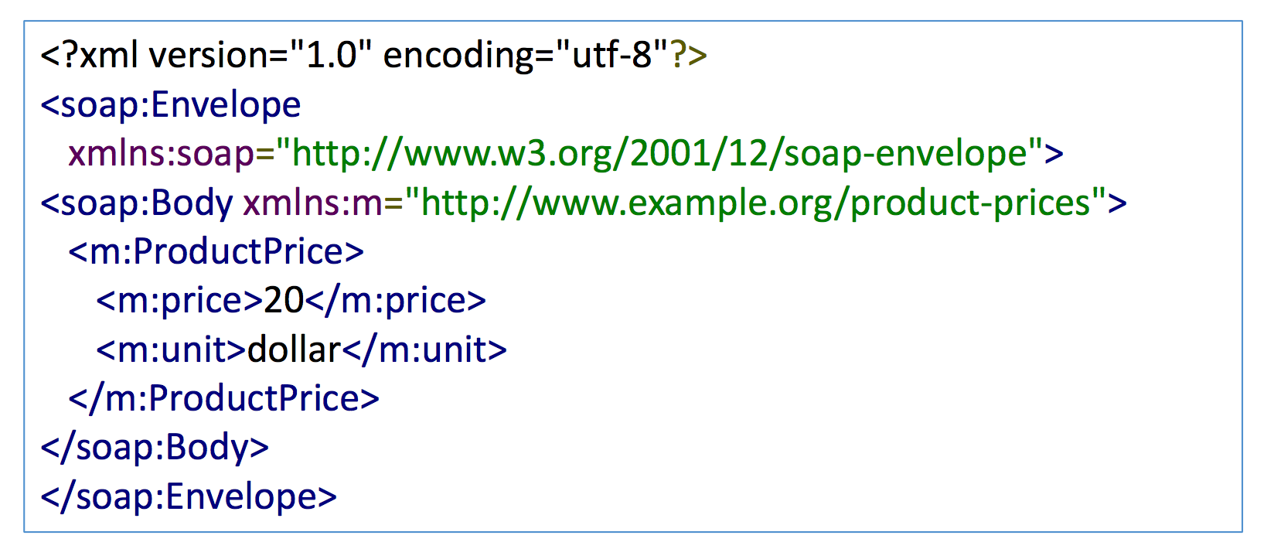
RPC-style SOAP
Sample response

Slide 27
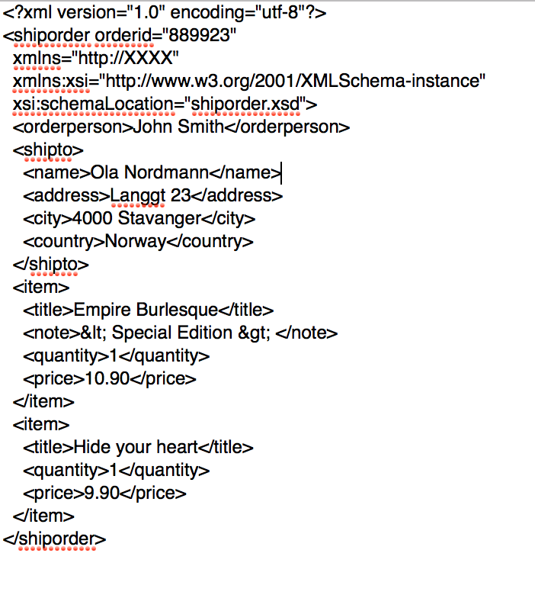
Document-style SOAP
Client just sends XML documents
Service knows what to do…

Slide 28
XML/RPC
Demo

Slide 29
Socket-based Approach Demo
Client.py
Server.py

Slide 30
Other types of RPC
Protocol Buffers
  Efficient, binary serialization
  Support protocol evolution
  Support types (more compile-time errors)
  Usage: serializing data to non-relational databases
Thrift
  Very similar to protocol buffers
  Supports both ordered lists and unordered sets

Slide 31
RPC Benefits
Hides marshaling details (Do not need to implement the low-level details such as network-level communication, byte orders)
Supports evolution of the communication components independently (e.g., protocol version numbers, rules of when to remove/rename arguments to procedure calls, etc.)
Allows for efficient packaging

Slide 32
RPC Problems
Latency (can be expensive)
Pointer transfers
  local address space isn’t shared with remote process. The programmer/RPC library has to make a decision of whether to follow pointers and serialize in depth, or to exclude that information. Typically, IDLs avoid this problem by requiring one to specify one’s messages/data structures to avoid pointer confusion.

Slide 33
RPC Key Challenges
RPC semantics in the face of
  Communication failures
    Delayed and lost messages
    Connection resets
    Expected packets never arrive
  Machine failures
    Server or client failures
    Did server fail before or after processing the request?
  Might be impossible to tell communication failures from machine failures

Slide 34
ATM Example
A distributed system with an ATM machine and the bank back-end system (networked system)
Client request: withdrawal of cash from the ATM machine
Expected response: success or fail
How?

Slide 35
ATM Example
Server
  Check person’s identity (password)
  Check whether the person has sufficient funds (talk to the back-end bank system to get a response of yes or no)
  Withdraw the amount from back account (write to the database)
  Wait wait wait…
  Until the back-end bank says ok (RPC…)
  Sends reply to the client
What if the ATM does not get any response?
What could be wrong?

Slide 36
ATM Example
ATM cannot wait forever… (since client won’t wait)
What is our goal?
  If the customer leaves, his/her balance should not change
  Can we guarantee that easily?
Need timeout (what should be the timeout value?)

Slide 37
ATM Example
A possible solution
  ATM keep trying to talk to the bank until it gets a response
  What if the ATM itself fails at some point?
Alternatively
  ATM gives the money upon a time anyway and resolves the consistency issue with the back-end later…
  Any issues?

Slide 38
RPC Summary
RPC focuses on programming use and aims to
  Make distributed communication similar to local calls
  Support protocol evolution
  Make it hard to get it wrong
Semantics are challenging
  Can’t really hide the network and make it all look local
Performance is often the concern

Slide 39
RPC Semantics
Semantic of an RPC invocation?
  Network failures imply timeouts and retransmissions
  Server will see (a lot of) duplicates
  How should the server behave when it sees duplications?

Slide 40
RPC Semantics
At least once
  The RPC call, once issued by the client, is executed eventually at least once, but possibly multiple times
  Easy to implement but raises issues
  How to implement?

Slide 41
RPC Semantics
At least once implementation
  Client keeps issuing the RPC multiple times until it gets a response from the server
  As long as the failures are temporary, the RPC will be executed at least once
  Good for some cases (Any example?)
    Email in a user’s inbox has been read (basically read requests)
  Might be problematic for other types of request
    ATM..

Slide 42
RPC Semantics
At most once
  The RPC call, once issued by a client, gets executed zero or one time.
  How to implement?

Slide 43
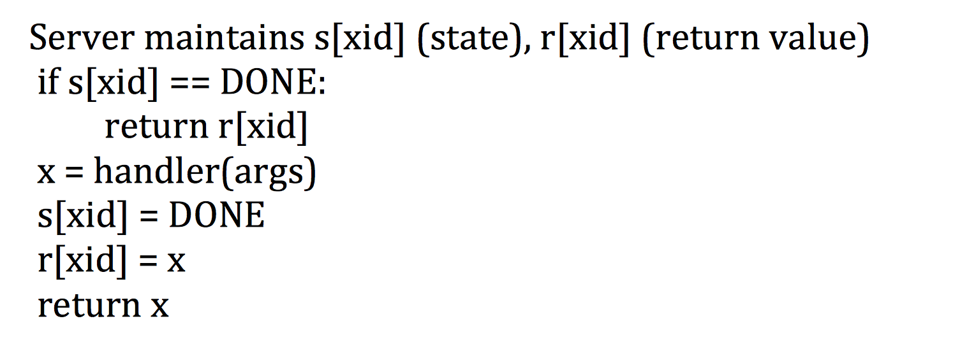
RPC Semantics
At most once implementation
  Server remembers the requests that it has already seen and processed
  Ignore duplicated messages
  Key: unique id for the messages
  What if server crashes/restarts?

Slide 44
RPC Semantics
Exactly once
  Ideal case
  This is when the RPC, once issued by the client, is invoked exactly once by the server.
  How to implement?
At most once implementation
Will it work?

Slide 45
REST
Representational State Transfer
For web services only
REST defines a set of architectural principles by which you can design Web services that focus on a system's resources, including how resource states are addressed and transferred over HTTP by a wide range of clients written in different languages.
There are no standards/specifications for REST Web service

Slide 46
REST
An HTTP REST Web service follows three basic design principles
  Use HTTP methods explicitly (HTTP is stateless)
  Expose directory structure-like URIs
  Transfer XML, JavaScript Object Notation (JSON), or both

Slide 47
HTTP
Methods
  POST: create, sending data
  GET: read, list, retrieve
  PUT: replace, update
  DELETE: delete
Payload
  The web service makes available a URL to submit a purchase order (PO)
  The payload (HTTP entity body) should be in XML or JSON

Slide 48
Other communication models
So far…
  Point-to-point communication
  What else?

Slide 49
Other communication models
Broadcast
Multicast

Slide 50
Reading List and Resources
Recommended
  Socket
    Python https://docs.python.org/2/howto/sockets.html
    Java https://www.geeksforgeeks.org/socket-programming-in-java/
  XML https://www.w3schools.com/xml/default.asp
  XML-RPC
    Java https://www.tutorialspoint.com/xml-rpc/index.htm
    Python2 https://docs.python.org/2/library/xmlrpclib.html
    Python3 https://docs.python.org/3/library/xmlrpc.client.html
  SOAP https://www.w3schools.com/xml/xml_soap.asp
    Python library https://python-zeep.readthedocs.io/en/master/
Optional
  Cachin book Ch2
  Protocol Buffer https://developers.google.com/protocol-buffers/docs/overview
  Thrift https://www.scribd.com/presentation/95866167/Thrift-Protobuf

