Slide 1
IS 651: Distributed Systems
Time and Synchronization
Sisi Duan
Assistant Professor
Information Systems
sduan@umbc.edu

Slide 2
Announcement
HW1 due next week
HW2 is available, due in two weeks

Slide 3

Today
Distributed time
Synchronizing real clocks
  Cristian’s algorithm
  The Berkeley Algorithm
  Network Time Protocol (NTP)
Logical clocks
  Lamport logical clocks
  Vector clocks

Slide 4
Global Timing
Why?
  Airplane check-in, who got the last seat?
  Who submitted final auction bid before deadline?
  If two file servers get different update requests to the same file, what should be the order of those requests?
  Think about the collaborative writing example from last class
A globally consistent time standard would be ideal
But it’s impossible

Slide 5
Time and Mutual Exclusion Overview
Multiple machines write to a file, print on a network printer, etc.
Each machine wants to make sure it’s the only one doing that
  What will be the consequences otherwise?
  Mutual exclusion
They need to agree on a time to start executing something.
  Local time or global time?

Slide 6
Time and Mutual Exclusion Overview
Distributed debugging
Different machines have their local logs
Admin combines all logs together and create a complete log
Order of the events is important to see what happened before the crash…

Slide 7
Time Standards
UT1 (Universal Time)
  Based on astronomical observations
  “Greenwich Mean Time”
TAI (International Atomic Time)
  Started Jan 1, 1958
  Each second is 9,192,631,770 cycles of radiation emitted by Cesium atom
  Has diverged from UT1 due to slowing of earth’s rotation
UTC (Coordinated Universal Time)
  TAI + leap seconds to be within 800ms of UT1

Slide 8
Distributed Time
The notion of time is well-defined (and measurable) at each single location
But the relationship between time at different locations is unclear
  Can minimize discrepancies, but never eliminate them
Stationary GPS receivers can get global time with negligible error

Slide 9
A Baseball Example
Four locations: pitcher’s mound (P), home plate, first base, third base

Slide 10
A Baseball Example
Ten events (ordered by time)
E1. Pitcher (P) throws ball toward home
E2. Ball arrives at home
E3. Batter (B) hits ball toward pitcher
E4: B runs toward first base
E5. Runner runs toward home
E6. Ball arrives at pitcher
E7. P throws ball toward first base
E8. Runner arrives at home
E9. Ball arrives at first base
E10. B arrives at first base

Slide 11
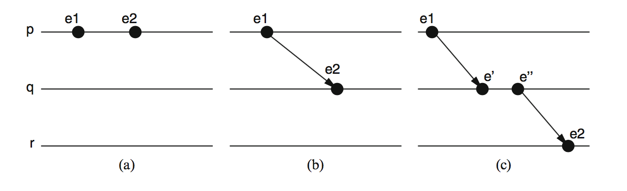
The Happened-Before Relation
e1 -> e2

Slide 12
A Baseball Example
Ten events (ordered by time)
E1. Pitcher (P) throws ball toward home
E2. Ball arrives at home
E3. Batter (B) hits ball toward pitcher
E4: B runs toward first base
E5. Runner runs toward home
E6. Ball arrives at pitcher
E7. P throws ball toward first base
E8. Runner arrives at home
E9. Ball arrives at first base
E10. B arrives at first base

Slide 13
A Baseball Example
What we know
Pitcher knows E1 happens before E6, which happens before E7
Home plate knows E2 is before E3, which is before E4, which is before E8
Relationship between E8 and E9 is unclear

Slide 14
Ways to synchronize
Send message from first base to home?
  Or to a central timekeeper
  How long does it take for the message to arrive?
Synchronize clocks before the game?
  Clocks drift
    Million to one => 1 second in 11 days
Synchronize continuously during the game?
  GPS, pulsars, etc

Slide 15
Real-Clock Synchronization
Suppose I want to synchronize two machines M1 and M2
Straightforward solution
  M1 (sender) sends its own time T in message to M2
  M2 (receiver) sets its time according to the message
  But what time should M2 set?

Slide 16
Perfect Networks
Message always arrive, with propagation delay exactly d
Sender sends time T in a message
Receiver sets clock to T+d
  Synchronization is exact

Slide 17
Synchronous Networks
Messages always arrive, with propagation delay at most d
Sender sends time T in a message
Receiver sets clock to T+d/2
  Synchronization error is at most d/2

Slide 18
Timing Assumptions in Distributed Systems
Synchronous Systems
  Synchronous Computation
    There is a known upper bound on processing delays
    The time taken by any process to execute a step is always less than this bound
  Synchronous Communication
    There is a known upper bound on message transmission delays
    The time period between the instant at which a message is sent and the instant at which the message is delivered by the destination process is smaller than this bound

Slide 19
Timing Assumptions in Distributed Systems
Asynchronous systems
  Do not make any timing assumption about processes and links
Partial synchrony
  There is a bound on the processing delays and transmission delays, but the bound is unknown
Real networks are asynchronous
  Propagation delays are arbitrary
Real networks are unreliable
  Messages don’t always arrive
Discussion: How to “guess” the upper bound in the partial synchrony model?

Slide 20
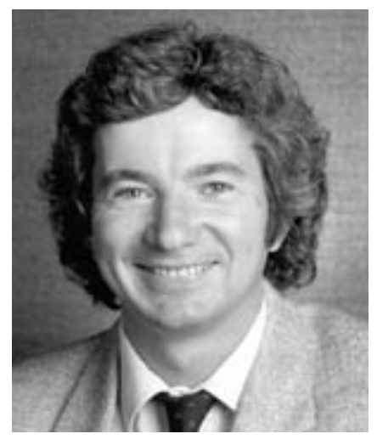
Cristian’s Algorithm, 1989
Request time, get reply
  Measure actual round-trip time d
Sender’s time was T between t1 and t2
Receiver sets time to T+d/2
  Synchronization error is at most d/2
Can retry until we get a relatively small d
Flaviu Cristian, 1951-1999

Slide 21
The Berkeley Algorithm, 1989
Gusella and Zatti, UC Berkeley
A master node uses Cristian’s algorithm to get time from many clients
  Compute average time
  Can discard outliers
Send time adjustments back to all clients

Slide 22

The Network Time Protocol (NTP)
First version 1985, latest version 2010.
Use a hierarchy of time servers
  Class 1 servers have highly-accurate clocks
    Connected directly to atomic clocks, etc.
  Class 2 servers get time from only class 1 and class 2 servers
  Class 3 servers get time from any server
Synchronization similar to Cristian’s algorithm
  Modified to use multiple one-way messages instead of immediate round-trip
Accuracy: local ~ 1ms, global ~ 10ms
David Mills

Slide 23
The Network Time Protocol (NTP)
Used by (probably) all of our devices for clock synchronization
How close are our clocks?
  Tens of miliseconds
  Good enough in real life
  Not sufficient for machines
  A regular computer can execute billions of instructions…

Slide 24
Real synchronization is imperfect
Clocks never exactly synchronized
Often inadequate for distributed systems
  Might need totally-ordered events
  Might need millionth-of-a-second precision
But…
  More often than not, distributed systems do not need real time, but sometimes that every machine in a protocol agrees upon!
    Suppose file servers S1 and S2 receive two update requests, W1 and W2, for file F
    They need to apply W1 and W2 in the same order, but they may not really care precisely which order…

Slide 25
Logical Time
Captures just the “happened-before” relationship between events
  Discard the infinitesimal granularity of time
  Corresponds roughly to causality
Definition (->): we say e1->e2 if e1 happens before e2

Slide 26
Global Logical Time
Definition (->): We define e->e’ if…
  Logical ordering: e->e’ if e->e’ for any process I
  Messages: send (m) -> receive (m) for any message m
  Transitivity: e->e’‘ if e->e’ and e’->e’’
We say e happens before e’ if e->e’

Slide 27
Concurrency
-> is only a partial order
some events are unrelated
Definition (concurrency): We say e is concurrent with e’ (written e||e’) if neither e->e’ nor e’->e

Slide 28
The baseball example revisited
Ten events (ordered by time)
E1. Pitcher (P) throws ball toward home
E2. Ball arrives at home
E3. Batter (B) hits ball toward pitcher
E4: B runs toward first base
E5. Runner runs toward home
E6. Ball arrives at pitcher
E7. P throws ball toward first base
E8. Runner arrives at home
E9. Ball arrives at first base
E10. B arrives at first base

Slide 29
The baseball example revisited
E1->E2
  by the message rule
E1->E10
  E1->E2
  E2->E4
  E4->E10
  Repeated transitivity of the above relations
E8||E9
  No application of the ->rules yields either E8->E9 or E9->E8

Slide 30
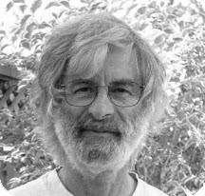
Lamport Logical Clocks
Lamport clock L assigns logical timestamps to events consistent with “happens before” ordering
  If e->e’, then L(e)<L(e’)
But not the converse
  L(e)<L(e’) does not imply e->e’
Similar rules for concurrency
  L(e)=L(e’) implies e||e’ (for distinct e,e’)
  E||e’ does not imply L(e) = L(e’)
Lamport clocks arbitrarily order some concurrent events
Leslie Lamport
2013 Turing Award

Slide 31
Lamport’s Algorithm
Each process i keeps a local clock, Li
Three rules:
  At process i, increment Li before each event
  To send a message m at process i, apply rule 1 and then include the current local time in the message: i.e., send(m,Li)
  To receive a message (m,t) at process j, set Lj = max(Lj,t) and then apply rule 1 before time-stamping the receive event
The global time L(e) of an event e is just its local time
– For an event e at process i, L(e) = Li(e)

Slide 32
Lamport’s Algorithm on the baseball example
Initializing each local clock to 0, we get
Pitcher L0 = 0
1st base L1 = 0
Home plate L2=0
3rd base L3 = 0
E1. Pitcher (P) throws ball toward home
E2. Ball arrives at home

Slide 33
Lamport’s Algorithm on the baseball example
E1. Pitcher (P) throws ball toward home
E2. Ball arrives at home
Pitcher L0(E1) = 0->1
1st base L1=0
Home plate L2(E2) = L(E1)+1 = 2
3rd base L3 = 0
E3. Batter (B) hits ball toward pitcher

Slide 34
Lamport’s Algorithm on the baseball example
E3. Batter (B) hits ball toward pitcher
Pitcher L0(E1) = 1
1st base L1=0
Home plate L2(E3) = L(E2)+1=3
3rd base L3 = 0
E4: B runs toward first base

Slide 35
Lamport’s Algorithm on the baseball example
E4: B runs toward first base
Pitcher L0(E1) = 1
1st base L1=0
Home plate L2(E4) = L(E3)+1=4
3rd base L3 = 0
E5. Runner runs toward home

Slide 36
Lamport’s Algorithm on the baseball example
E5. Runner runs toward home
Pitcher L0(E1) = 1
1st base L1=0
Home plate L2(E4)=4
3rd base L3(E5) = 0+1=1
E6. Ball arrives at pitcher

Slide 37
Lamport’s Algorithm on the baseball example
E6. Ball arrives at pitcher
Pitcher L0(E6)=L(E3)+1 = 4
1st base L1=0
Home plate L2(E4)=4
3rd base L3(E5) =1
E7. P throws ball toward first base

Slide 38
Lamport’s Algorithm on the baseball example
E7. P throws ball toward first base
Pitcher L0(E7)=L(E6)+1=5
1st base L1=0
Home plate L2(E4)=4
3rd base L3(E5) =1
E8. Runner arrives at home

Slide 39
Lamport’s Algorithm on the baseball example
E8. Runner arrives at home
Pitcher L0(E7)=5
1st base L1=0
Home plate
  L2(E4)=4
  L(E5)=1
  L(E8)=max(L)+1 = 5
3rd base L3(E5) =1
E9. Ball arrives at first base

Slide 40
Lamport’s Algorithm on the baseball example
E9. Ball arrives at first base
Pitcher L0(E7)=5
1st base
  L1=0
  L(E7)=5
  L1(E9) = L(E7)+1 = 6
Home plate L(E8)= 5
3rd base L3(E5) =1
E10. B arrives at first base

Slide 41
Lamport’s Algorithm on the baseball example
E10. B arrives at first base
Pitcher L0(E7)=5
1st base L1(E10)=L(E9)+1 = 7
Home plate L(E8)= 5
3rd base L3(E5) =1

Slide 42
Lamport’s Algorithm on the baseball example
Initializing each local clock to 0, we get
L(e1) = 1 (pitcher throws ball to home)
L(e2) = 2 (ball arrives at home)
L(e3) = 3 (batter hits ball to pitcher)
L(e4) = 4 (batter runs to first base)
L(e5) = 1 (runner runs to home)
L(e6) = 4 (ball arrives at pitcher)
L(e7) = 5 (pitcher throws ball to first base)
L(e8) = 5 (runner arrives at home)
L(e9) = 6 (ball arrives at first base)
L(e10) = 7 (batter arrives at first base)

Slide 43
Ok, what do we get?
E1->E2
E1->E10 (E1->E2,E2->E4,E4->E10)
E8||E9
  No application of the ->rules yields either E8->E9 or E9->E8
L(e1) = 1 (pitcher throws ball to home)
L(e2) = 2 (ball arrives at home)
L(e3) = 3 (batter hits ball to pitcher)
L(e4) = 4 (batter runs to first base)
L(e5) = 1 (runner runs to home)
L(e6) = 4 (ball arrives at pitcher)
L(e7) = 5 (pitcher throws ball to first base)
L(e8) = 5 (runner arrives at home)
L(e9) = 6 (ball arrives at first base)
L(e10) = 7 (batter arrives at first base)

Slide 44
Summary of Lamport clocks
Each process maintains its own version of the logical clock
Each process updates its clock as the protocol advances (events happen)
Whenever two processes communicate, the process whose clock is behind catches up and advances the clock
Partial order of events

Slide 45
Total order Lamport clocks
Many systems require a total-ordering of events, not a partial-ordering
Use Lamport’s algorithm, but break ties using the process ID
  L(e) = M * Li(e) + I
  M = maximum number of processes

Slide 46
Vector Clocks
Goal
  Want ordering that matches causality
  V(e) < V(e’) if and only if e → e’
Method
  Label each event by vector V(e) [c1, c2 ..., cn]
  ci = # events in process i that causally precede e

Slide 47
Vector Clock Algorithm
Initially, all vectors [0,0,...,0]
For event on process i, increment its own ci
Label message sent with local vector
When process j receives message with vector [d1, d2, ..., dn]:
  Set local each local entry k to max(ck, dk)
  Increment value of cj

Slide 48
Vector clocks on the baseball example
Vector [0,0,0,0] (pitcher,1st base, home,3rd base)
Pitcher [0,0,0,0]
1st base [0,0,0,0]
Home [0,0,0,0]
3rd base [0,0,0,0]
E1. Pitcher (P) throws ball toward home

Slide 49
Vector clocks on the baseball example
E1. Pitcher (P) throws ball toward home
Pitcher [1,0,0,0]
1st base [0,0,0,0]
Home [0,0,0,0]
3rd base [0,0,0,0]
E2. Ball arrives at home

Slide 50
Vector clocks on the baseball example
E2. Ball arrives at home
Pitcher [1,0,0,0]
1st base [0,0,0,0]
Home [1,0,1,0]
3rd base [0,0,0,0]
E3. Batter (B) hits ball toward pitcher

Slide 51
Vector clocks on the baseball example
E3. Batter (B) hits ball toward pitcher
Pitcher [1,0,0,0]
1st base [0,0,0,0]
Home [1,0,2,0]
3rd base [0,0,0,0]
E4: B runs toward first base

Slide 52
Vector clocks on the baseball example
E4: B runs toward first base
Pitcher [1,0,0,0]
1st base [0,0,0,0]
Home [1,0,3,0]
3rd base [0,0,0,0]
E5. Runner runs toward home

Slide 53
Vector clocks on the baseball example
E5. Runner runs toward home
Pitcher [1,0,0,0]
1st base [0,0,0,0]
Home [1,0,3,0]
3rd base [0,0,0,1]
E6. Ball arrives at pitcher

Slide 54
Vector clocks on the baseball example
E6. Ball arrives at pitcher
Pitcher [2,0,2,0]
1st base [0,0,0,0]
Home [1,0,3,0]
3rd base [0,0,0,1]
E7. P throws ball toward first base

Slide 55
Vector clocks on the baseball example
E7. P throws ball toward first base
Pitcher [3,0,2,0]
1st base [0,0,0,0]
Home [1,0,3,0]
3rd base [0,0,0,1]
E8. Runner arrives at home

Slide 56
Vector clocks on the baseball example
E8. Runner arrives at home
Pitcher [3,0,2,0]
1st base [0,0,0,0]
Home [1,0,4,1]
3rd base [0,0,0,1]
E9. Ball arrives at first base

Slide 57
Vector clocks on the baseball example
E9. Ball arrives at first base
Pitcher [3,0,2,0]
1st base [3,1,2,0]
Home [1,0,4,1]
3rd base [0,0,0,1]
E10. B arrives at first base

Slide 58
Vector clocks on the baseball example
E10. B arrives at first base
Pitcher [3,0,2,0]
1st base [3,2,3,0]
Home [1,0,4,1]
3rd base [0,0,0,1]

Slide 59
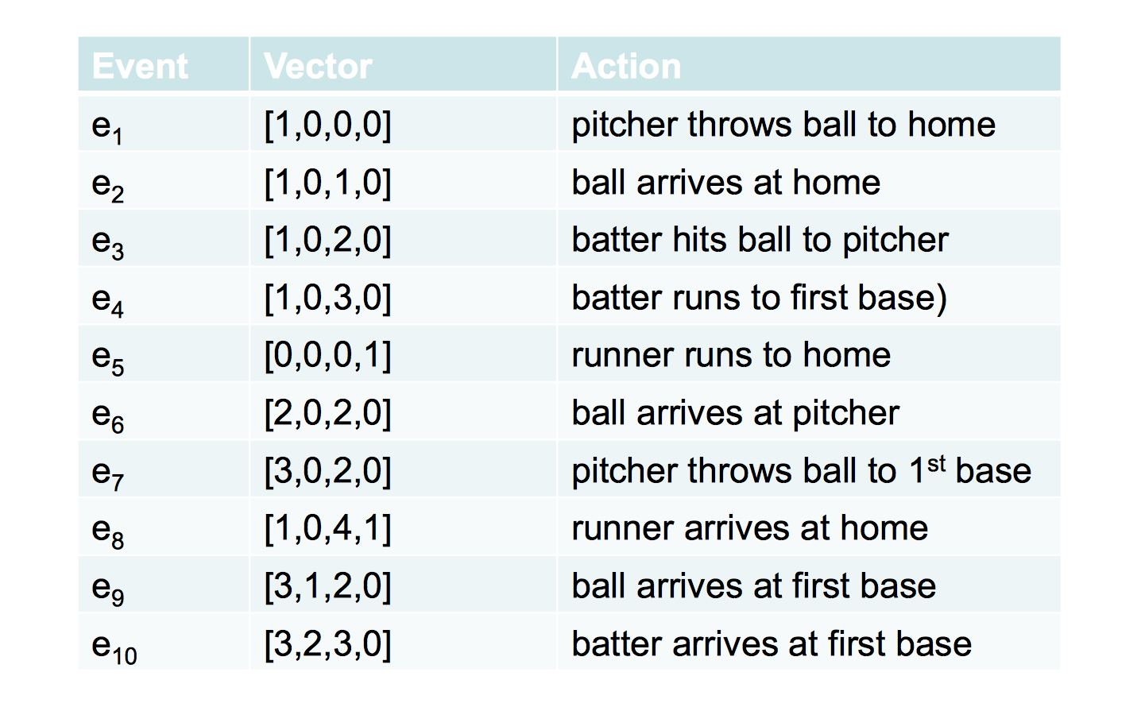
Vector clocks on the baseball example
Vector: [pitcher,1st base, home,3rd base]

Slide 60
Ok, what do we get?
E1->E2
E1->E10 (E1->E2,E2->E4,E4->E10)
E8||E9
  No application of the ->rules yields either E8->E9 or E9->E8
How do we break ties?
  Use process IDs as tie breaker

Slide 61
So far
Physical Clocks
  Can keep closely synchronized, but never perfect
Logical Clocks
  Encode causality relationship
  Lamport clocks provide only one-way encoding
  Vector clocks provide exact causality information

Slide 62
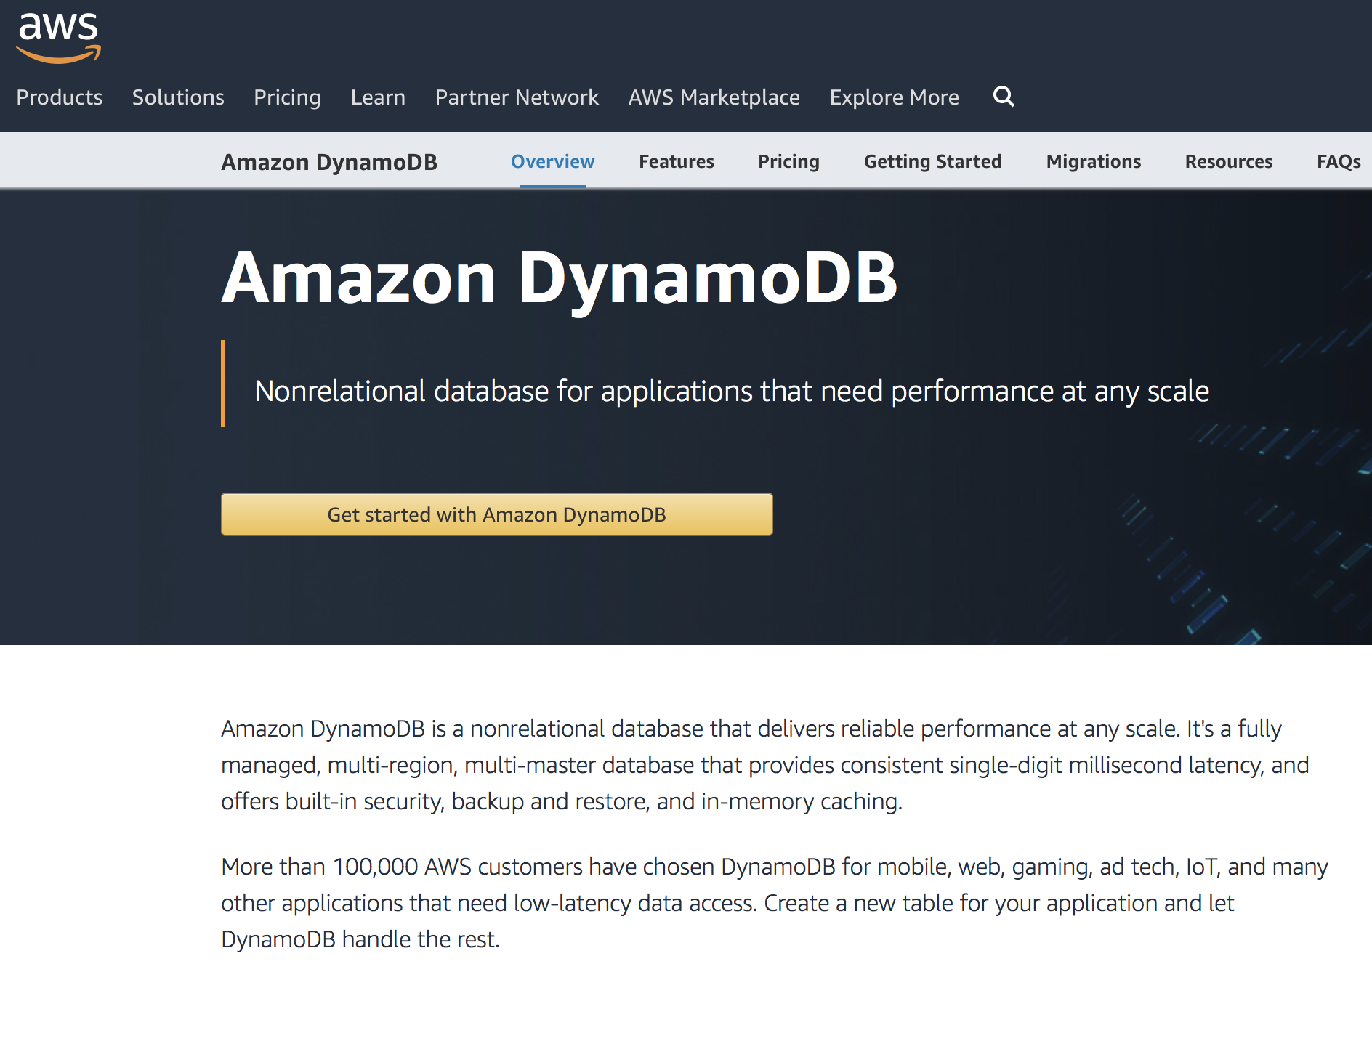
Logical Clocks in Real Systems
Amazon Dynamo
  Highly available key-value store
  Serverless web app
  Mobile, IoT…
  Uses vector clocks to capture the causality between different versions of the same object

Slide 63
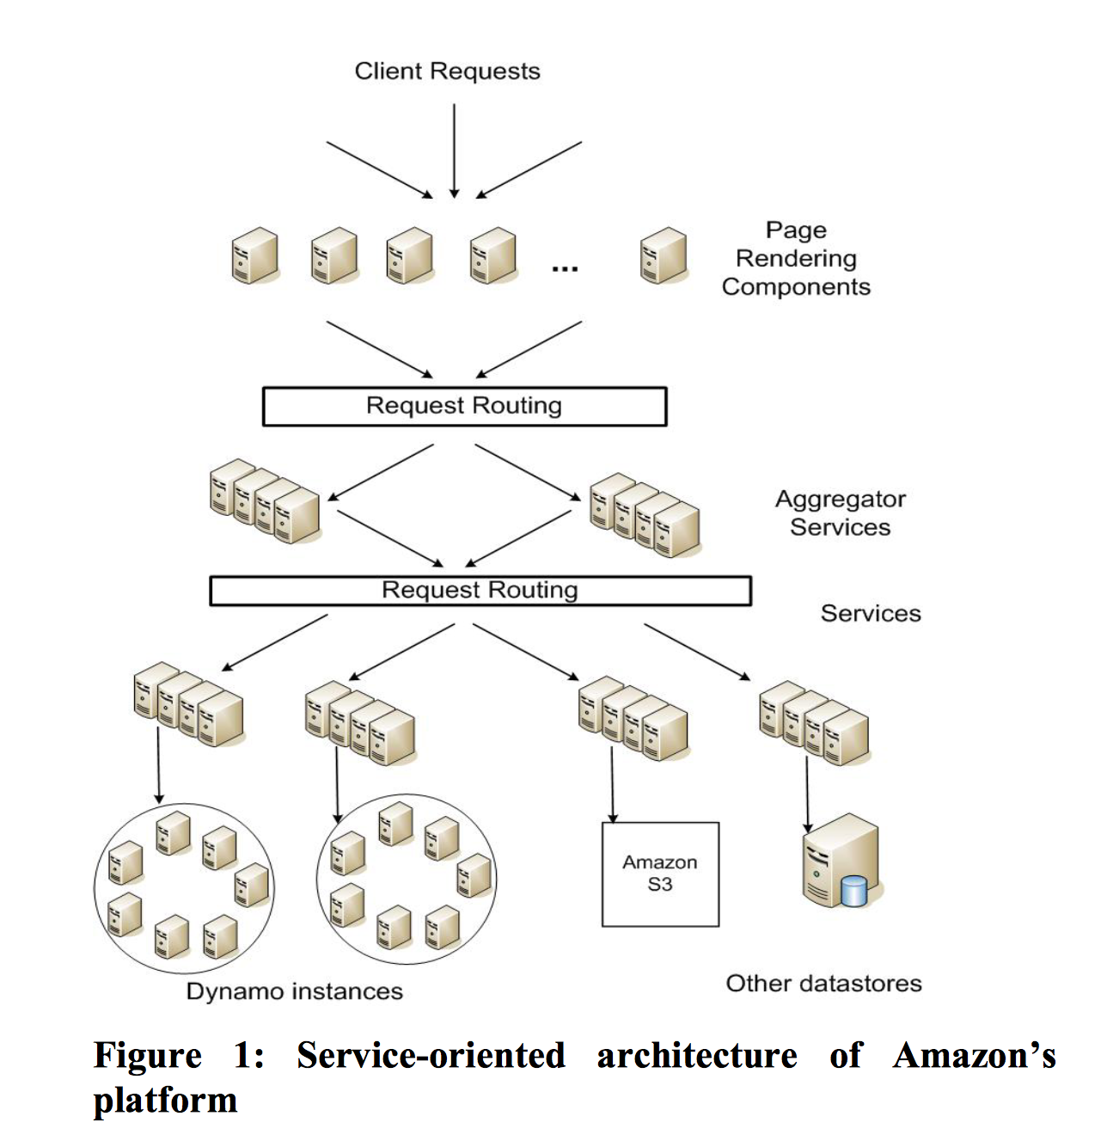
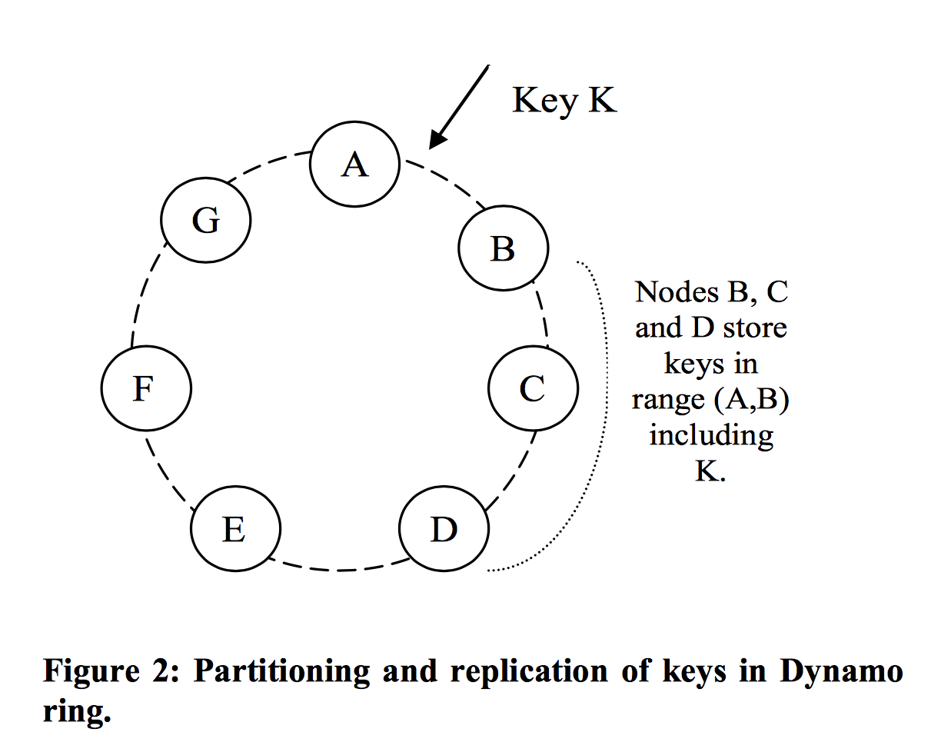
Amazon Dynamo

Slide 64
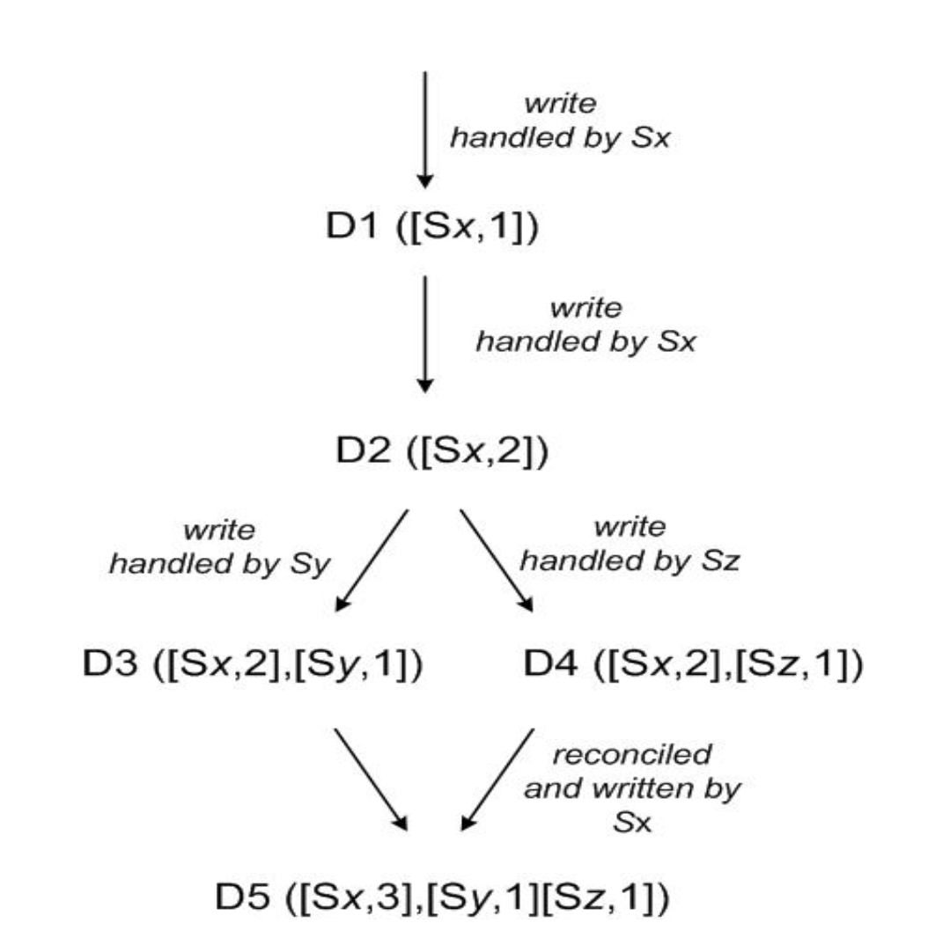
Amazon Dynamo
Nodes/servers: Sx, Sy, Sz
Objects/Client requests: D1 D2…
Use vector clock to detect concurrency (D3 and D4)
Not exactly vectors, but only the timestamps of the nodes that have every written to the data are included.

Slide 65

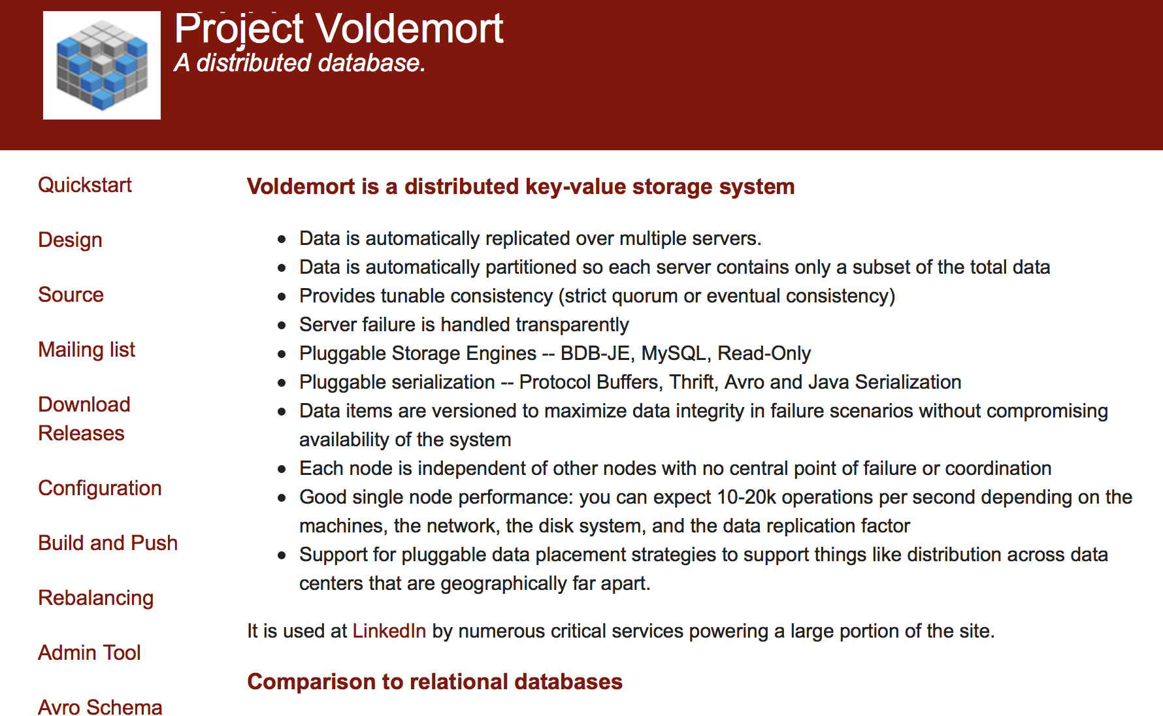
Other examples of using vector clock
Variants of Dynamo
  Riak
  Voldemort
Bayou
  Weakly consistent, replicated storage system

