Slide 1
IS 651: Distributed Systems
Time and Synchronization
Mutual Exclusion
Sisi Duan
Assistant Professor
Information Systems
sduan@umbc.edu

Slide 2
Recall
Distributed Communication
  Socket
  RPC
  Abstracting Distributed Communication

Slide 3
Recall
Socket
  Interface
  You need to program/define the low-level data packaging

Slide 4
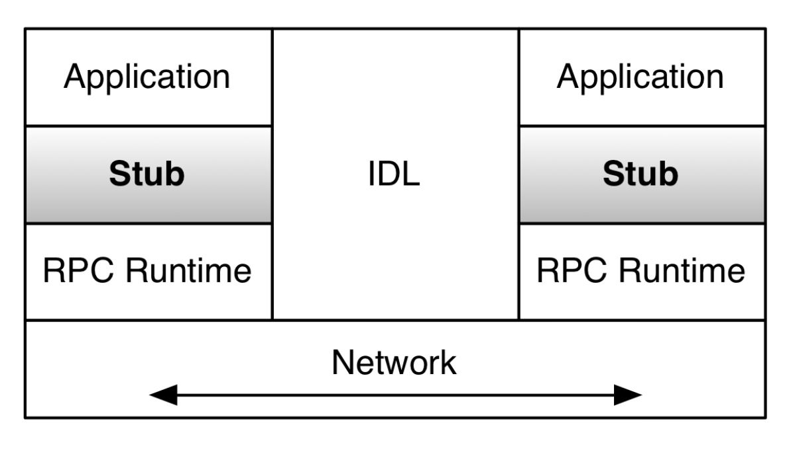
Recall
RPC (Remote Procedure Call)
  Ease of programming
  Standardize low-level data packaging protocol
XML/RPC
SOAP
  RPC-style SOAP
  Document-style SOAP
…

Slide 5
Recall
RPC Issues and semantics
  Failures are not easy to handle
  Performance is often the concern
At least once
  The RPC call, once issued by the client, is executed eventually at least once, but possibly multiple times
At most once
  The RPC call, once issued by a client, gets executed zero or one time.
Exactly once
  When the RPC, once issued by the client, is invoked exactly once by the server.

Slide 6
Recall
Broadcast
Point-to-point communication
Multicast

Slide 7
Announcement
HW2 due next week
If you have trouble programming or haven’t formed a team for the project, please let me know by the end of the week.
Late submissions (for both homework and project)
  Within one day – once for each student
  After that – will not be graded

Slide 8
HW1
Q1.
The key difference is how many jobs we move to the client side.
Main benefit: performance at server side (low latency, high throughput)

Slide 9
HW1
Q2.
Caching vs. Replication
Similarity: data duplication
Purposes:
  Cache – faster data retrieval
  Replication – availability and reliability (consistency)
CDN
  Can use replication to enhance reliability
  But we usually cache data that do not need to be changed.

Slide 10
Homework and projects
Please cite your references if you use any.

Slide 11
Today
Distributed time
Synchronizing real clocks
  Cristian’s algorithm
  The Berkeley Algorithm
  Network Time Protocol (NTP)
Logical clocks
  Lamport logical clocks
  Vector clocks
Mutual Exclusion

Slide 12
Global Timing
Why?
  Airplane check-in, who got the last seat?
  Who submitted final auction bid before deadline?
  If two file servers get different update requests to the same file, what should be the order of those requests?
  Think about the collaborative writing example from last class
A globally consistent time standard would be ideal
But it’s impossible

Slide 13
Time and Mutual Exclusion Overview
Multiple machines write to a file, print on a network printer, etc.
Each machine wants to make sure it’s the only one doing that
  What will be the consequences otherwise?
  Mutual exclusion
They need to agree on a time to start executing something.
  Local time or global time?

Slide 14
Time and Mutual Exclusion Overview
Distributed debugging
Different machines have their local logs
Admin combines all logs together and create a complete log
Order of the events is important to see what happened before the crash…

Slide 15
Time Standards
UT1 (Universal Time)
  Based on astronomical observations
  “Greenwich Mean Time”
TAI (International Atomic Time)
  Started Jan 1, 1958
  Each second is 9,192,631,770 cycles of radiation emitted by Cesium atom
  Has diverged from UT1 due to slowing of earth’s rotation
UTC (Coordinated Universal Time)
  TAI + leap seconds to be within 800ms of UT1

Slide 16
Distributed Time
The notion of time is well-defined (and measurable) at each single location
But the relationship between time at different locations is unclear
  Can minimize discrepancies, but never eliminate them
Stationary GPS receivers can get global time with negligible error

Slide 17
A Baseball Example
Four locations: pitcher’s mound (P), home plate, first base, third base

Slide 18
A Baseball Example
Ten events (ordered by time)
E1. Pitcher (P) throws ball toward home
E2. Ball arrives at home
E3. Batter (B) hits ball toward pitcher
E4: B runs toward first base
E5. Runner runs toward home
E6. Ball arrives at pitcher
E7. P throws ball toward first base
E8. Runner arrives at home
E9. Ball arrives at first base
E10. B arrives at first base

Slide 19
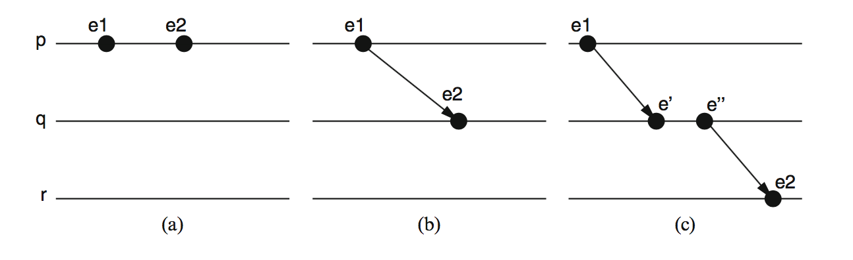
The Happened-Before Relation
e1 -> e2

Slide 20
A Baseball Example
Ten events (ordered by time)
E1. Pitcher (P) throws ball toward home
E2. Ball arrives at home
E3. Batter (B) hits ball toward pitcher
E4: B runs toward first base
E5. Runner runs toward home
E6. Ball arrives at pitcher
E7. P throws ball toward first base
E8. Runner arrives at home
E9. Ball arrives at first base
E10. B arrives at first base

Slide 21
A Baseball Example
What we know
Pitcher knows E1 happens before E6, which happens before E7
Home plate knows E2 is before E3, which is before E4, which is before E8
Relationship between E8 and E9 is unclear

Slide 22
Ways to synchronize
Send message from first base to home?
  Or to a central timekeeper
  How long does it take for the message to arrive?
Synchronize clocks before the game?
  Clocks drift
    Million to one => 1 second in 11 days
Synchronize continuously during the game?
  GPS, pulsars, etc

Slide 23
Real-Clock Synchronization
Suppose I want to synchronize two machines M1 and M2
Straightforward solution
  M1 (sender) sends its own time T in message to M2
  M2 (receiver) sets its time according to the message
  But what time should M2 set?

Slide 24
Perfect Networks
Message always arrive, with propagation delay exactly d
Sender sends time T in a message
Receiver sets clock to T+d
  Synchronization is exact

Slide 25
Synchronous Networks
Messages always arrive, with propagation delay at most d
Sender sends time T in a message
Receiver sets clock to T+d/2
  Synchronization error is at most d/2

Slide 26
Timing Assumptions in Distributed Systems
Synchronous Systems
  Synchronous Computation
    There is a known upper bound on processing delays
    The time taken by any process to execute a step is always less than this bound
  Synchronous Communication
    There is a known upper bound on message transmission delays
    The time period between the instant at which a message is sent and the instant at which the message is delivered by the destination process is smaller than this bound

Slide 27
Timing Assumptions in Distributed Systems
Asynchronous systems
  Do not make any timing assumption about processes and links
Partial synchrony
  There is a bound on the processing delays and transmission delays, but the bound is unknown
Real networks are asynchronous
  Propagation delays are arbitrary
Real networks are unreliable
  Messages don’t always arrive
Discussion: How to “guess” the upper bound in the partial synchrony model?

Slide 28
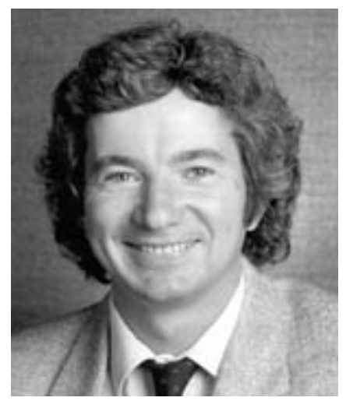
Cristian’s Algorithm, 1989
Request time, get reply
  Measure actual round-trip time d
Sender’s time was T between t1 and t2
Receiver sets time to T+d/2
  Synchronization error is at most d/2
Can retry until we get a relatively small d
Flaviu Cristian, 1951-1999

Slide 29
The Berkeley Algorithm, 1989
Gusella and Zatti, UC Berkeley
A master node uses Cristian’s algorithm to get time from many clients
  Compute average time
  Can discard outliers
Send time adjustments back to all clients

Slide 30

The Network Time Protocol (NTP)
First version 1985, latest version 2010.
Use a hierarchy of time servers
  Class 1 servers have highly-accurate clocks
    Connected directly to atomic clocks, etc.
  Class 2 servers get time from only class 1 and class 2 servers
  Class 3 servers get time from any server
Synchronization similar to Cristian’s algorithm
  Modified to use multiple one-way messages instead of immediate round-trip
Accuracy: local ~ 1ms, global ~ 10ms
David Mills

Slide 31
The Network Time Protocol (NTP)
Used by (probably) all of our devices for clock synchronization
How close are our clocks?
  Tens of miliseconds
  Good enough in real life
  Not sufficient for machines
  A regular computer can execute billions of instructions…

Slide 32
Real synchronization is imperfect
Clocks never exactly synchronized
Often inadequate for distributed systems
  Might need totally-ordered events
  Might need millionth-of-a-second precision
But…
  More often than not, distributed systems do not need real time, but sometimes that every machine in a protocol agrees upon!
    Suppose file servers S1 and S2 receive two update requests, W1 and W2, for file F
    They need to apply W1 and W2 in the same order, but they may not really care precisely which order…

Slide 33
Logical Time
Captures just the “happened-before” relationship between events
  Discard the infinitesimal granularity of time
  Corresponds roughly to causality
Definition (->): we say e1->e2 if e1 happens before e2

Slide 34
Global Logical Time
Definition (->): We define e->e’ if…
  Logical ordering: e->e’ if e->e’ for any process I
  Messages: send (m) -> receive (m) for any message m
  Transitivity: e->e’‘ if e->e’ and e’->e’’
We say e happens before e’ if e->e’

Slide 35
Concurrency
-> is only a partial order
some events are unrelated
Definition (concurrency): We say e is concurrent with e’ (written e||e’) if neither e->e’ nor e’->e

Slide 36
The baseball example revisited
Ten events (ordered by time)
E1. Pitcher (P) throws ball toward home
E2. Ball arrives at home
E3. Batter (B) hits ball toward pitcher
E4: B runs toward first base
E5. Runner runs toward home
E6. Ball arrives at pitcher
E7. P throws ball toward first base
E8. Runner arrives at home
E9. Ball arrives at first base
E10. B arrives at first base

Slide 37
The baseball example revisited
E1->E2
  by the message rule
E1->E10
  E1->E2
  E2->E4
  E4->E10
  Repeated transitivity of the above relations
E8||E9
  No application of the ->rules yields either E8->E9 or E9->E8

Slide 38
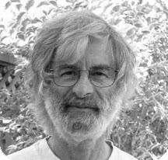
Lamport Logical Clocks
Lamport clock L assigns logical timestamps to events consistent with “happens before” ordering
  If e->e’, then L(e)<L(e’)
But not the converse
  L(e)<L(e’) does not imply e->e’
Similar rules for concurrency
  L(e)=L(e’) implies e||e’ (for distinct e,e’)
  E||e’ does not imply L(e) = L(e’)
Lamport clocks arbitrarily order some concurrent events
Leslie Lamport
2013 Turing Award

Slide 39
Lamport’s Algorithm
Each process i keeps a local clock, Li
Three rules:
  At process i, increment Li before each event
  To send a message m at process i, apply rule 1 and then include the current local time in the message: i.e., send(m,Li)
  To receive a message (m,t) at process j, set Lj = max(Lj,t) and then apply rule 1 before time-stamping the receive event
The global time L(e) of an event e is just its local time
– For an event e at process i, L(e) = Li(e)

Slide 40
Lamport’s Algorithm on the baseball example
Initializing each local clock to 0, we get
Pitcher L0 = 0
1st base L1 = 0
Home plate L2=0
3rd base L3 = 0
E1. Pitcher (P) throws ball toward home
E2. Ball arrives at home

Slide 41
Lamport’s Algorithm on the baseball example
E1. Pitcher (P) throws ball toward home
E2. Ball arrives at home
Pitcher L0(E1) = 0->1
1st base L1=0
Home plate L2(E2) = L(E1)+1 = 2
3rd base L3 = 0
E3. Batter (B) hits ball toward pitcher

Slide 42
Lamport’s Algorithm on the baseball example
E3. Batter (B) hits ball toward pitcher
Pitcher L0(E1) = 1
1st base L1=0
Home plate L2(E3) = L(E2)+1=3
3rd base L3 = 0
E4: B runs toward first base

Slide 43
Lamport’s Algorithm on the baseball example
E4: B runs toward first base
Pitcher L0(E1) = 1
1st base L1=0
Home plate L2(E4) = L(E3)+1=4
3rd base L3 = 0
E5. Runner runs toward home

Slide 44
Lamport’s Algorithm on the baseball example
E5. Runner runs toward home
Pitcher L0(E1) = 1
1st base L1=0
Home plate L2(E4)=4
3rd base L3(E5) = 0+1=1
E6. Ball arrives at pitcher

Slide 45
Lamport’s Algorithm on the baseball example
E6. Ball arrives at pitcher
Pitcher L0(E6)=L(E3)+1 = 4
1st base L1=0
Home plate L2(E4)=4
3rd base L3(E5) =1
E7. P throws ball toward first base

Slide 46
Lamport’s Algorithm on the baseball example
E7. P throws ball toward first base
Pitcher L0(E7)=L(E6)+1=5
1st base L1=0
Home plate L2(E4)=4
3rd base L3(E5) =1
E8. Runner arrives at home

Slide 47
Lamport’s Algorithm on the baseball example
E8. Runner arrives at home
Pitcher L0(E7)=5
1st base L1=0
Home plate
  L2(E4)=4
  L(E5)=1
  L(E8)=max(L)+1 = 5
3rd base L3(E5) =1
E9. Ball arrives at first base

Slide 48
Lamport’s Algorithm on the baseball example
E9. Ball arrives at first base
Pitcher L0(E7)=5
1st base
  L1=0
  L(E7)=5
  L1(E9) = L(E7)+1 = 6
Home plate L(E8)= 5
3rd base L3(E5) =1
E10. B arrives at first base

Slide 49
Lamport’s Algorithm on the baseball example
E10. B arrives at first base
Pitcher L0(E7)=5
1st base L1(E10)=L(E9)+1 = 7
Home plate L(E8)= 5
3rd base L3(E5) =1

Slide 50
Lamport’s Algorithm on the baseball example
Initializing each local clock to 0, we get
L(e1) = 1 (pitcher throws ball to home)
L(e2) = 2 (ball arrives at home)
L(e3) = 3 (batter hits ball to pitcher)
L(e4) = 4 (batter runs to first base)
L(e5) = 1 (runner runs to home)
L(e6) = 4 (ball arrives at pitcher)
L(e7) = 5 (pitcher throws ball to first base)
L(e8) = 5 (runner arrives at home)
L(e9) = 6 (ball arrives at first base)
L(e10) = 7 (batter arrives at first base)

Slide 51
Ok, what do we get?
E1->E2
E1->E10 (E1->E2,E2->E4,E4->E10)
E8||E9
  No application of the ->rules yields either E8->E9 or E9->E8
L(e1) = 1 (pitcher throws ball to home)
L(e2) = 2 (ball arrives at home)
L(e3) = 3 (batter hits ball to pitcher)
L(e4) = 4 (batter runs to first base)
L(e5) = 1 (runner runs to home)
L(e6) = 4 (ball arrives at pitcher)
L(e7) = 5 (pitcher throws ball to first base)
L(e8) = 5 (runner arrives at home)
L(e9) = 6 (ball arrives at first base)
L(e10) = 7 (batter arrives at first base)

Slide 52
Summary of Lamport clocks
Each process maintains its own version of the logical clock
Each process updates its clock as the protocol advances (events happen)
Whenever two processes communicate, the process whose clock is behind catches up and advances the clock
Partial order of events

Slide 53
Total order Lamport clocks
Many systems require a total-ordering of events, not a partial-ordering
Use Lamport’s algorithm, but break ties using the process ID
  L(e) = M * Li(e) + I
  M = maximum number of processes

Slide 54
Vector Clocks
Goal
  Want ordering that matches causality
  V(e) < V(e’) if and only if e → e’
Method
  Label each event by vector V(e) [c1, c2 ..., cn]
  ci = # events in process i that causally precede e

Slide 55
Vector Clock Algorithm
Initially, all vectors [0,0,...,0]
For event on process i, increment its own ci
Label message sent with local vector
When process j receives message with vector [d1, d2, ..., dn]:
  Set local each local entry k to max(ck, dk)
  Increment value of cj

Slide 56
Vector clocks on the baseball example
Vector [0,0,0,0] (pitcher,1st base, home,3rd base)
Pitcher [0,0,0,0]
1st base [0,0,0,0]
Home [0,0,0,0]
3rd base [0,0,0,0]
E1. Pitcher (P) throws ball toward home

Slide 57
Vector clocks on the baseball example
E1. Pitcher (P) throws ball toward home
Pitcher [1,0,0,0]
1st base [0,0,0,0]
Home [0,0,0,0]
3rd base [0,0,0,0]
E2. Ball arrives at home

Slide 58
Vector clocks on the baseball example
E2. Ball arrives at home
Pitcher [1,0,0,0]
1st base [0,0,0,0]
Home [1,0,1,0]
3rd base [0,0,0,0]
E3. Batter (B) hits ball toward pitcher

Slide 59
Vector clocks on the baseball example
E3. Batter (B) hits ball toward pitcher
Pitcher [1,0,0,0]
1st base [0,0,0,0]
Home [1,0,2,0]
3rd base [0,0,0,0]
E4: B runs toward first base

Slide 60
Vector clocks on the baseball example
E4: B runs toward first base
Pitcher [1,0,0,0]
1st base [0,0,0,0]
Home [1,0,3,0]
3rd base [0,0,0,0]
E5. Runner runs toward home

Slide 61
Vector clocks on the baseball example
E5. Runner runs toward home
Pitcher [1,0,0,0]
1st base [0,0,0,0]
Home [1,0,3,0]
3rd base [0,0,0,1]
E6. Ball arrives at pitcher

Slide 62
Vector clocks on the baseball example
E6. Ball arrives at pitcher
Pitcher [2,0,2,0]
1st base [0,0,0,0]
Home [1,0,3,0]
3rd base [0,0,0,1]
E7. P throws ball toward first base

Slide 63
Vector clocks on the baseball example
E7. P throws ball toward first base
Pitcher [3,0,2,0]
1st base [0,0,0,0]
Home [1,0,3,0]
3rd base [0,0,0,1]
E8. Runner arrives at home

Slide 64
Vector clocks on the baseball example
E8. Runner arrives at home
Pitcher [3,0,2,0]
1st base [0,0,0,0]
Home [1,0,4,1]
3rd base [0,0,0,1]
E9. Ball arrives at first base

Slide 65
Vector clocks on the baseball example
E9. Ball arrives at first base
Pitcher [3,0,2,0]
1st base [3,1,2,0]
Home [1,0,4,1]
3rd base [0,0,0,1]
E10. B arrives at first base

Slide 66
Vector clocks on the baseball example
E10. B arrives at first base
Pitcher [3,0,2,0]
1st base [3,2,3,0]
Home [1,0,4,1]
3rd base [0,0,0,1]

Slide 67
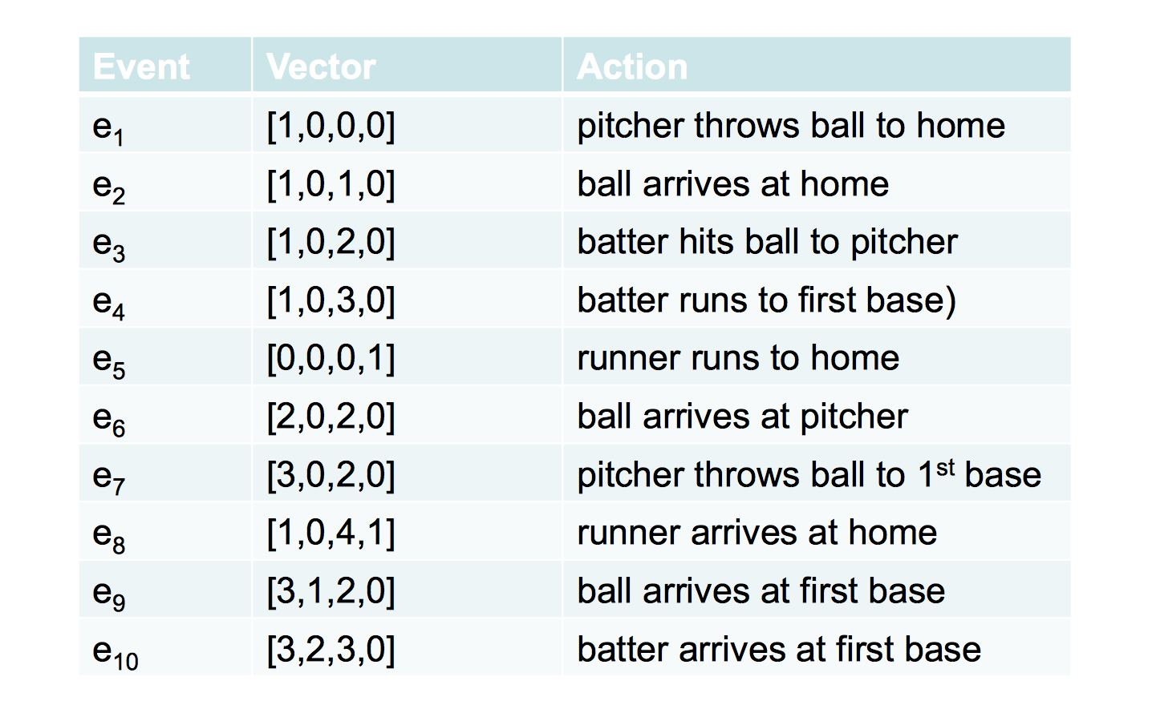
Vector clocks on the baseball example
Vector: [pitcher,1st base, home,3rd base]

Slide 68
Ok, what do we get?
E1->E2
E1->E10 (E1->E2,E2->E4,E4->E10)
E8||E9
  No application of the ->rules yields either E8->E9 or E9->E8
How do we break ties?
  Use process IDs as tie breaker

Slide 69
So far
Physical Clocks
  Can keep closely synchronized, but never perfect
Logical Clocks
  Encode causality relationship
  Lamport clocks provide only one-way encoding
  Vector clocks provide exact causality information

Slide 70
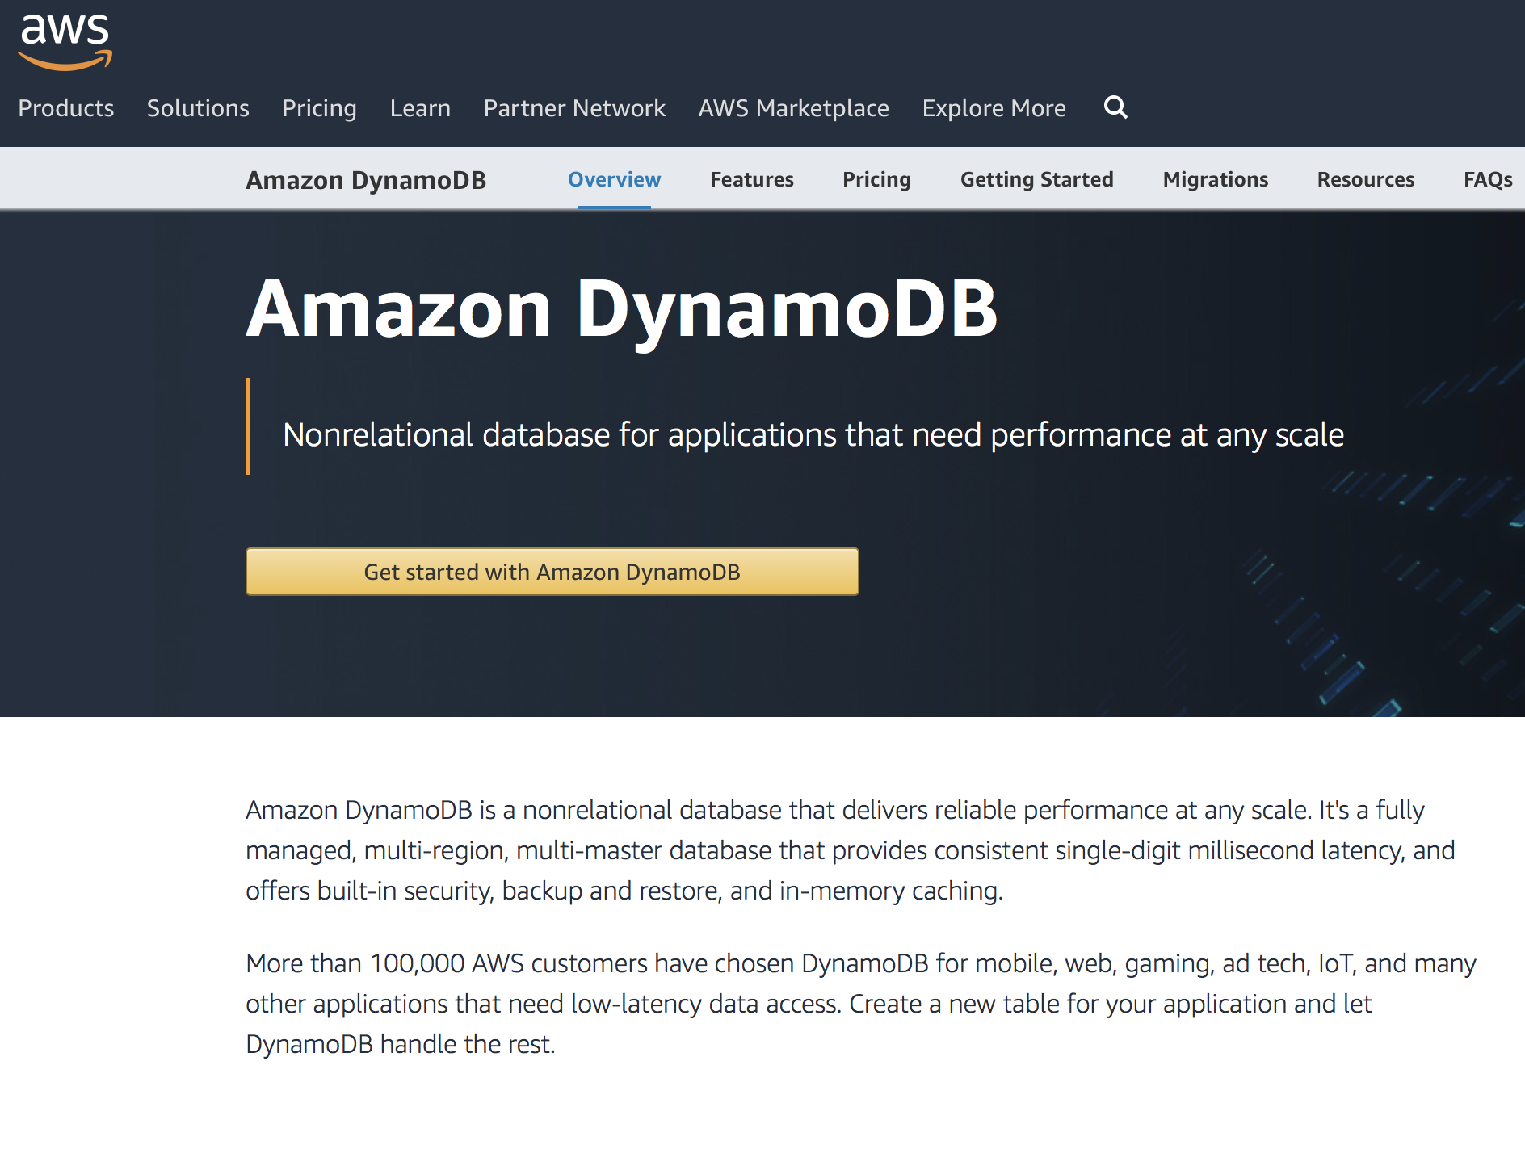
Logical Clocks in Real Systems
Amazon Dynamo
  Highly available key-value store
  Serverless web app
  Mobile, IoT…
  Uses vector clocks to capture the causality between different versions of the same object

Slide 71
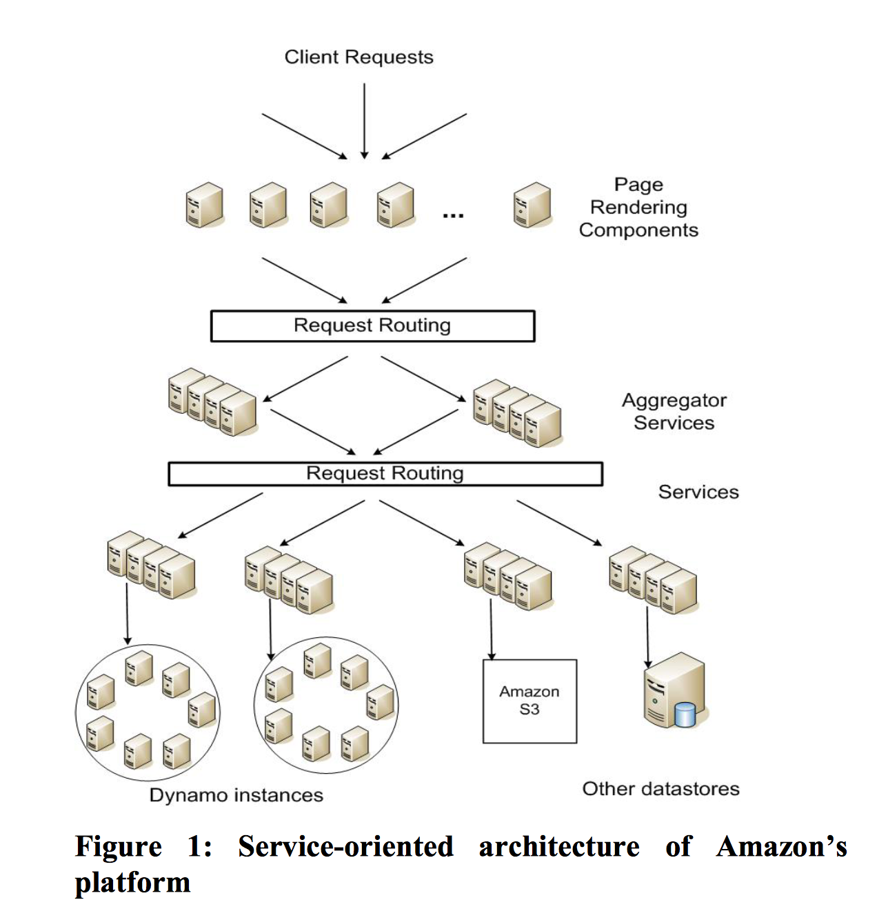
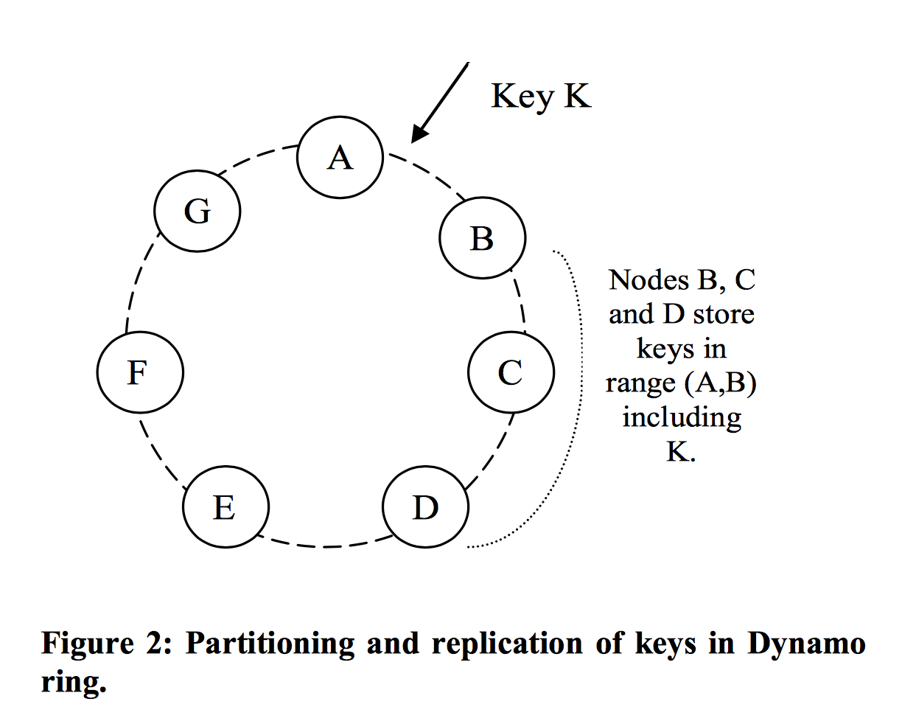
Amazon Dynamo

Slide 72
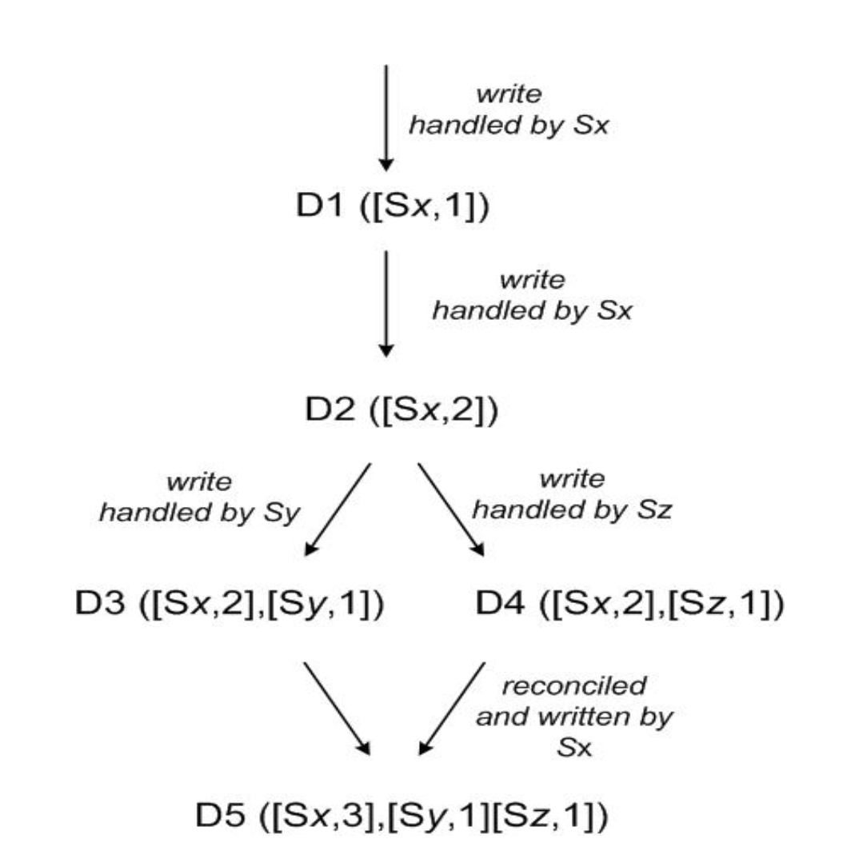
Amazon Dynamo
Nodes/servers: Sx, Sy, Sz
Objects/Client requests: D1 D2…
Use vector clock to detect concurrency (D3 and D4)
Not exactly vectors, but only the timestamps of the nodes that have every written to the data are included.

Slide 73

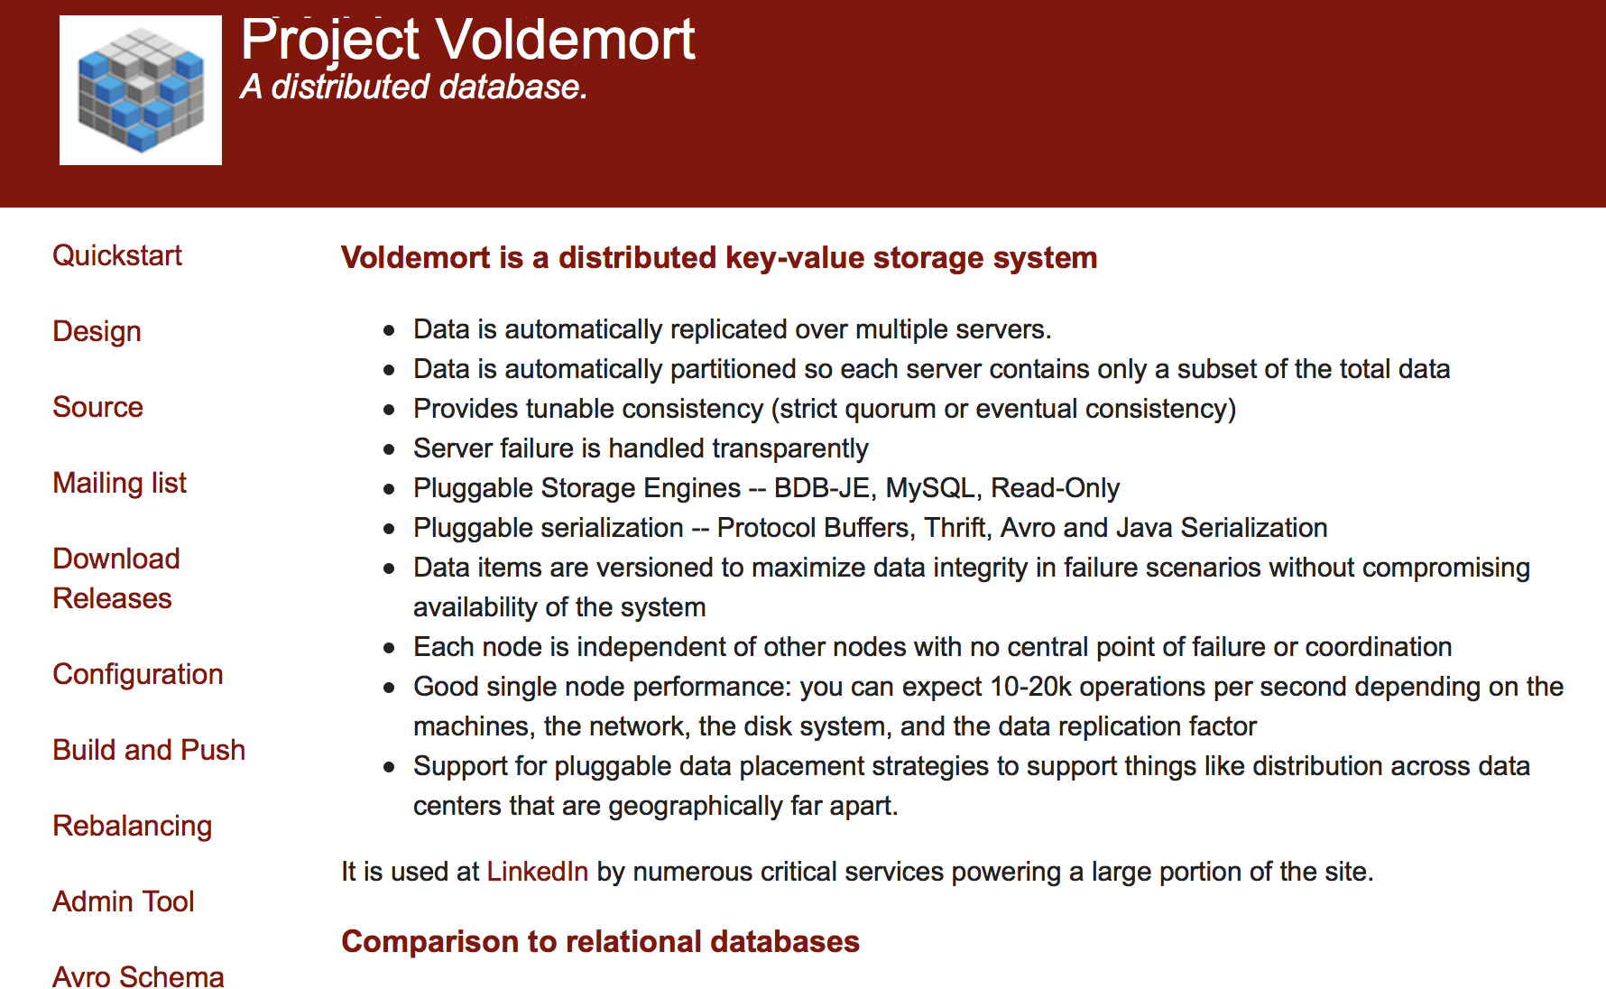
Other examples of using vector clock
Variants of Dynamo
  Riak
  Voldemort
Bayou
  Weakly consistent, replicated storage system

Slide 74
Mutual Exclusion
A word of warning:
  None of the algorithms is perfect, all have tradeoffs
  So, don’t expect a natural progression to some “great” algorithm
  The goal is to understand several algorithms, so you get used to the idea of distributed algorithms, logical clocks, voting, etc.
We will look at a few today
  Centralized algorithm
  Token algorithm
  Distributed algorithm

Slide 75
Distributed Mutual Exclusion
Maintain mutual exclusion among n distributed processes
  Terminology: use process/processor/machine/server/node to denote the processing unit in a distributed system
Model: Each process executes loop of form:
While true:
Perform local operations
Acquire()
Execute critical section
Release()

Slide 76
Distributed Mutual Exclusion
During critical section, process interacts with remote processes or directly with shared resource
Example: send a message to a shared file server asking it to write something to a file
While true:
Perform local operations
Acquire()
Execute critical section
Release()

Slide 77
Goals of Distributed Mutual Exclusion
Much like regular mutual exclusion
  Safety: at most one process holds the lock at any time
  Liveness: progress (if no one holds the lock, a processor requesting it will get it)
  Fairness: bounded wait and in-order (logical time)
Other goals:
  Minimize message traffic
  Minimize synchronization delay
  Switch quickly between processes waiting for lock
  i.e., if no one has the lock and you ask for it, you should quickly get it

Slide 78
Distributed Mutual Exclusion Is Different
Regular mutual exclusion solved using shared state
E.g., atomic test-and-set of shared variable
We solve distributed mutual exclusion with message passing
Assumptions
  The network is reliable (all messages sent get to their destinations at some point in time)
  Network is asynchronous (messages may take long time)
  Processes may fail at any time

Slide 79
Distributed Mutual Exclusion Protocols
Key ideas:
  Before entering critical section, processor must get permission from other processors
  When exiting critical section, processor must let the others know that he’s finished
  For fairness, processors allow other processors who have asked for permission earlier than them to proceed
We’ll give examples of four such protocols
  We’ll compare them from a liveness, message overhead, synchronization delay perspective

Slide 80
#1: Centralized Lock Server
To enter critical section
  send REQUEST to central server
  wait for permission from server
To leave critical section:
  send RELEASE to central server
Server
  Has an internal queue of all REQUESTs it’s received but to which it hasn’t yet sent OK
  Delays sending OK back to process until process is at head of queue
  Removes process from the queue after it gets RELEASE

Slide 81
#1: Centralized Lock Server
Pros
  Simple!
  Only 3 messages required per sync session (enter & exit)
Cons
  Single point of failure
  Single performance bottleneck
  With an asynchronous network, doesn’t achieve in-order fairness (even for logical time order)
  Must select (or elect) a central server

Slide 82
#2: A Ring-based Algorithm
Pass a toke around a ring
  Can enter critical section only if you hold the token
Problems
  Not in-order
  Long synchronization delay
    Need to wait for up to N-1 messages, for N processors
  Very unreliable
    Any process failure breaks the ring

Slide 83
#2’: A better ring-based solution
Token contains the time t of the earliest known outstanding request
To enter critical section:
  Stamp your request with the current time Tr, wait for token
When you get token with time t while waiting with request from time Tr, compare Tr to t:
  If Tr = t: hold token, run critical section
  If Tr > t: pass token
  If t not set or Tr < t: set token-time to Tr, pass token, wait for token
To leave critical section:
  Set token-time to null (i.e., unset it), pass token

Slide 84
#3: A Shared Priority Queue
By Lamport, using Lamport clocks
Each process i locally maintains Qi, part of a shared priority queue
To run critical section, must have replies from all other processes AND be at the front of Qi
  When you have all replies:
  #1: All other processes are aware of your request
  #2: You are aware of any earlier requests for the mutex

Slide 85
#3: A Shared Priority Queue
To enter critical section at process i :
  Stamp your request with the current time T
  Add request to Qi
  Broadcast REQUEST(T) to all processes
  Wait for all replies and for T to reach front of Qi
To leave:
  Pop head of Qi, Broadcast RELEASE to all processes
On receipt of REQUEST(T’) from process j:
  Add T’ to Qi
  If waiting for REPLY from j for an earlier request T, wait until j replies to you
  Otherwise REPLY
On receipt of RELEASE
  Pop head of Qi
This delay enforces property #2

Slide 86
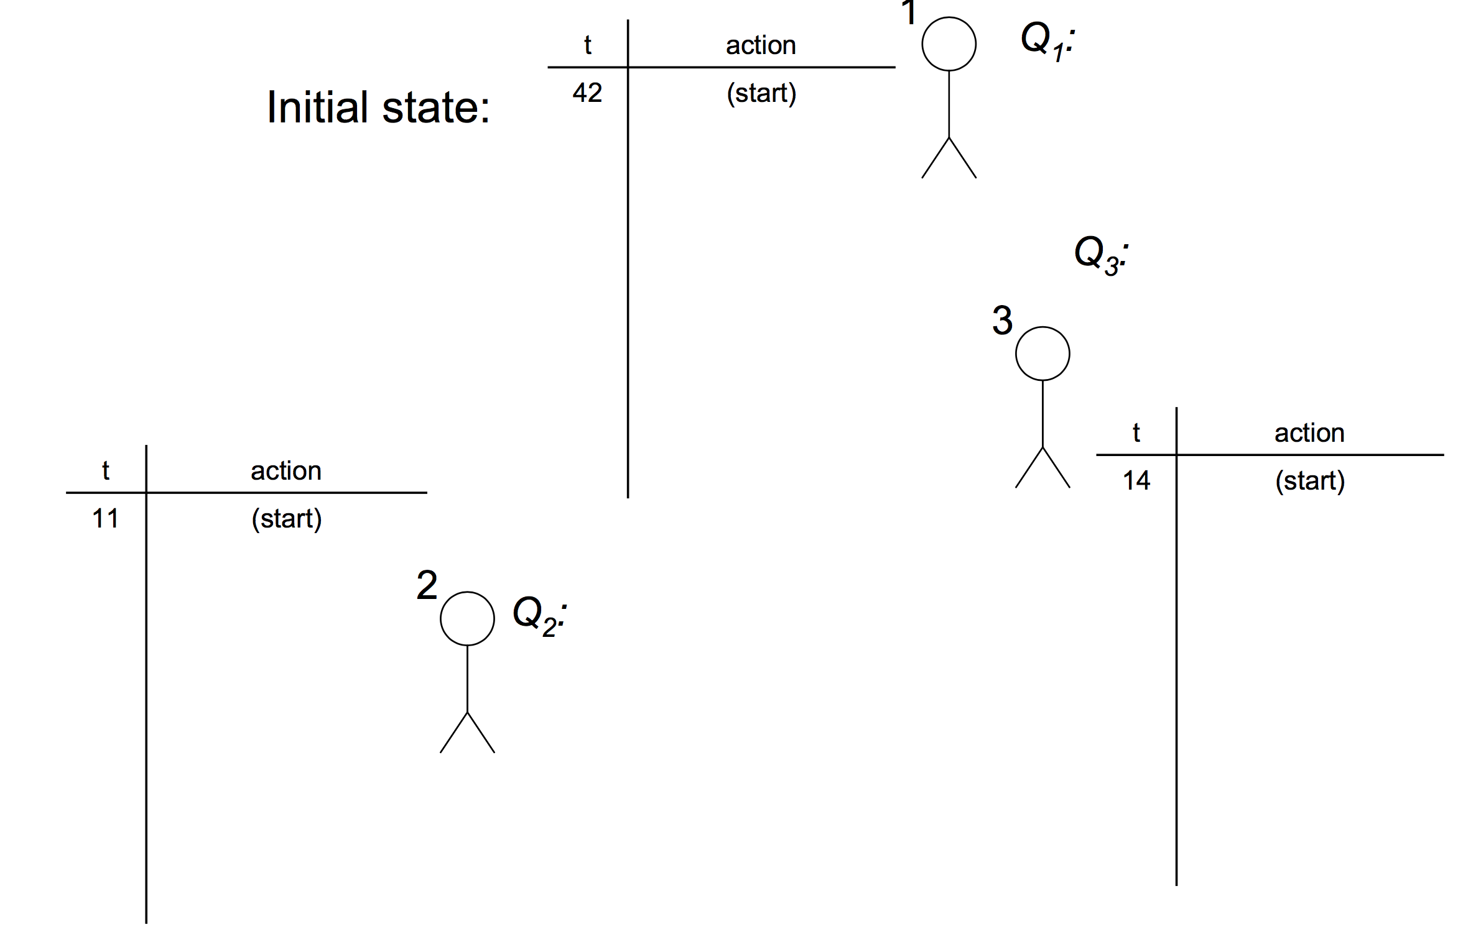
#3: A Shared Priority Queue

Slide 87
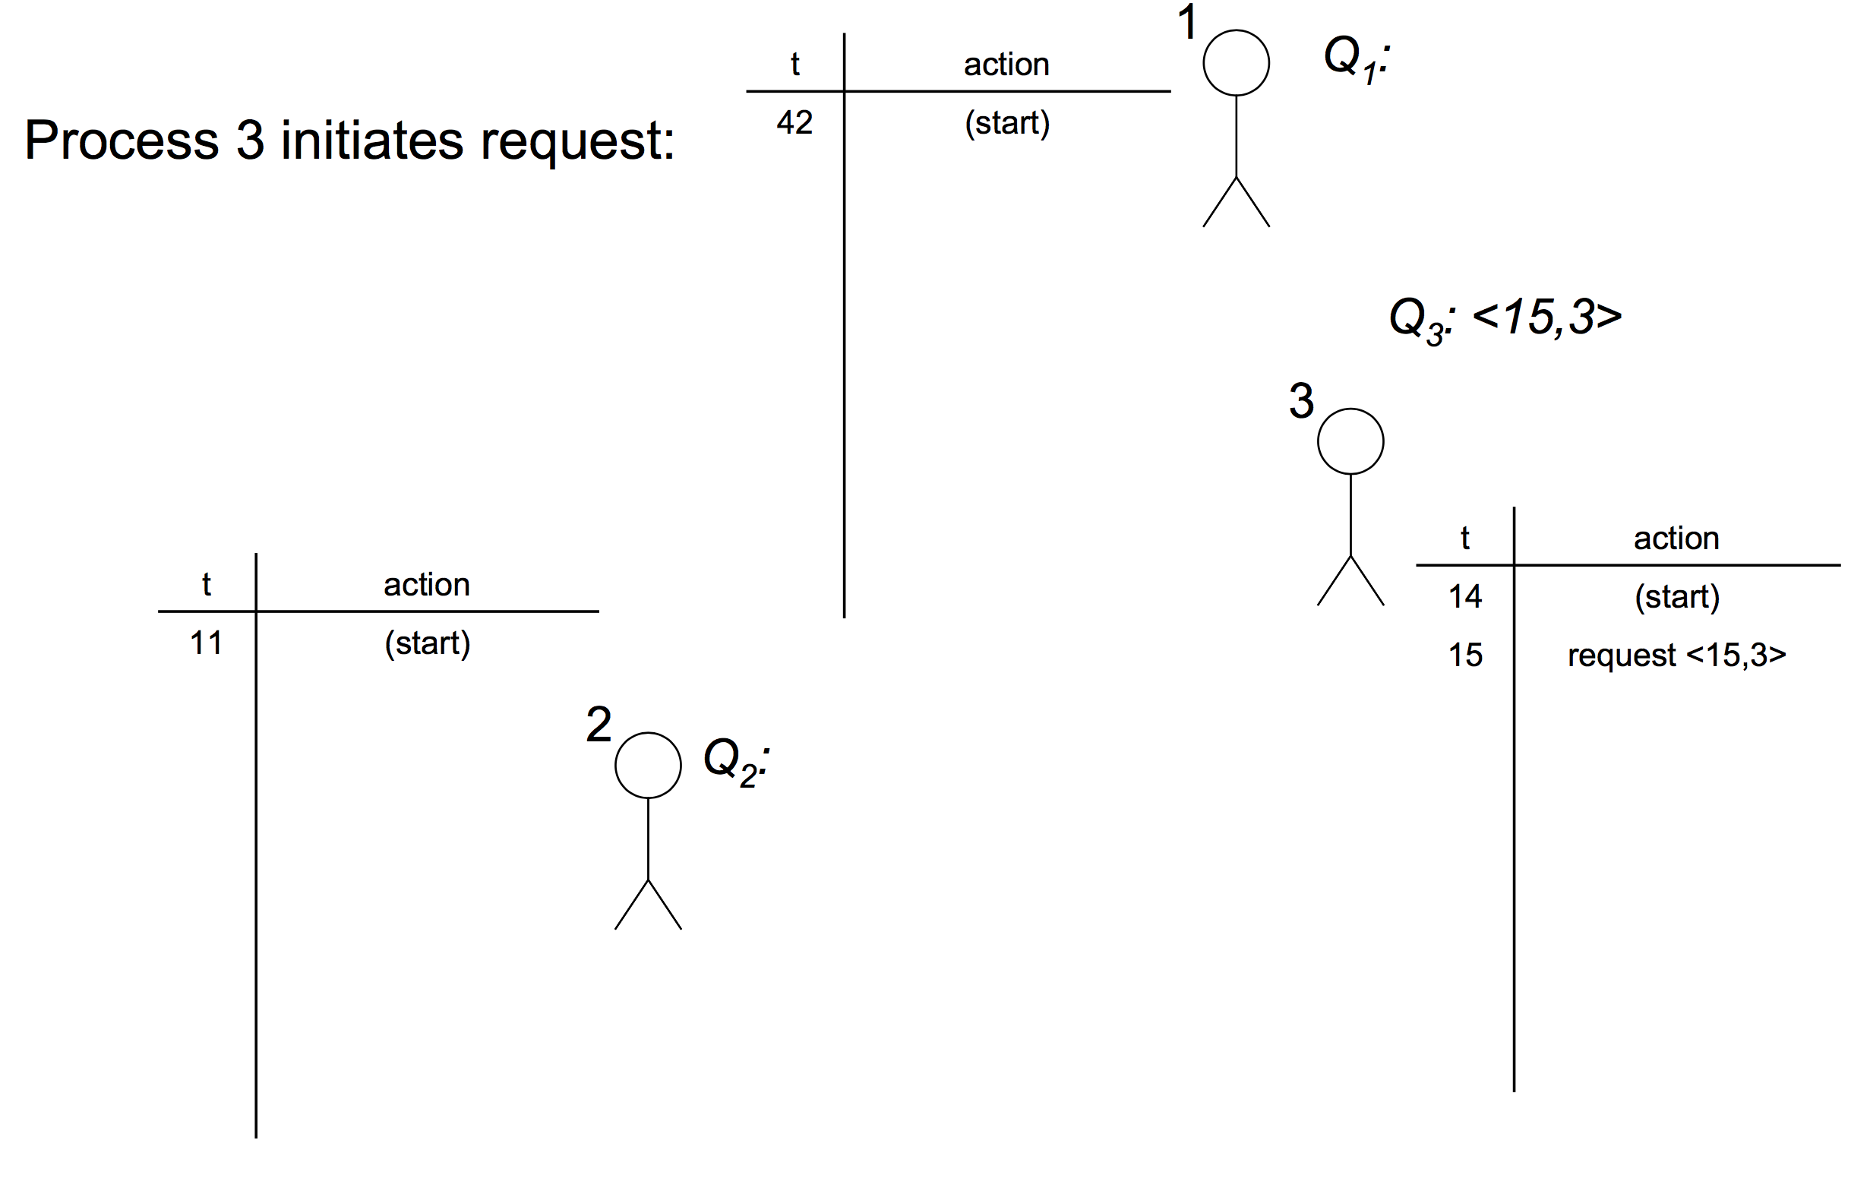
#3: A Shared Priority Queue

Slide 88
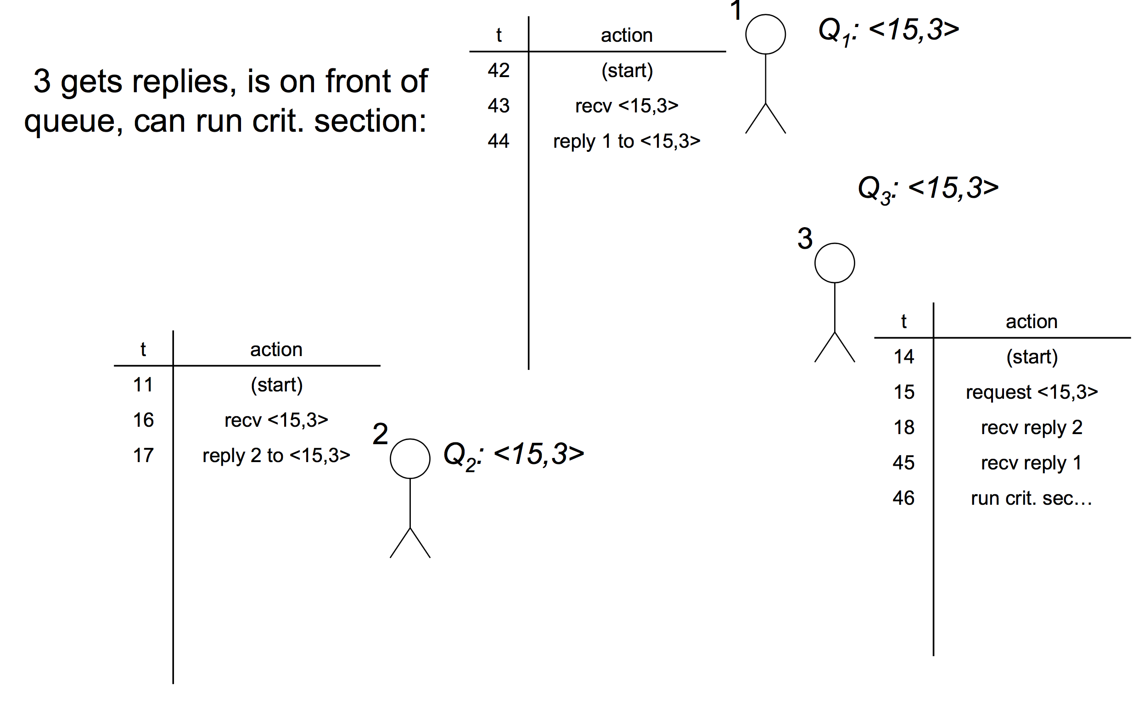
#3: A Shared Priority Queue

Slide 89
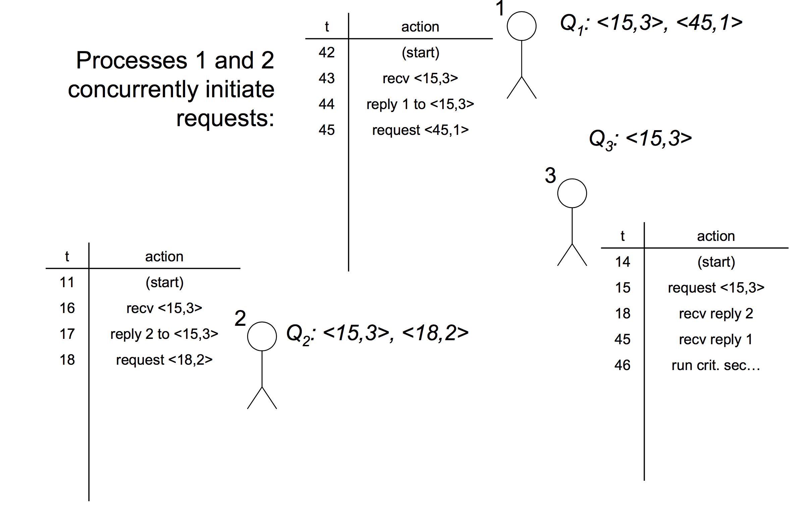
#3: A Shared Priority Queue

Slide 90
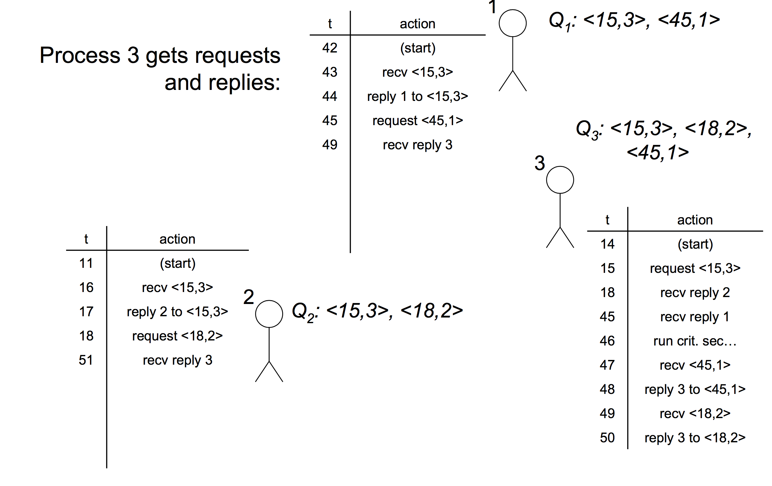
#3: A Shared Priority Queue

Slide 91
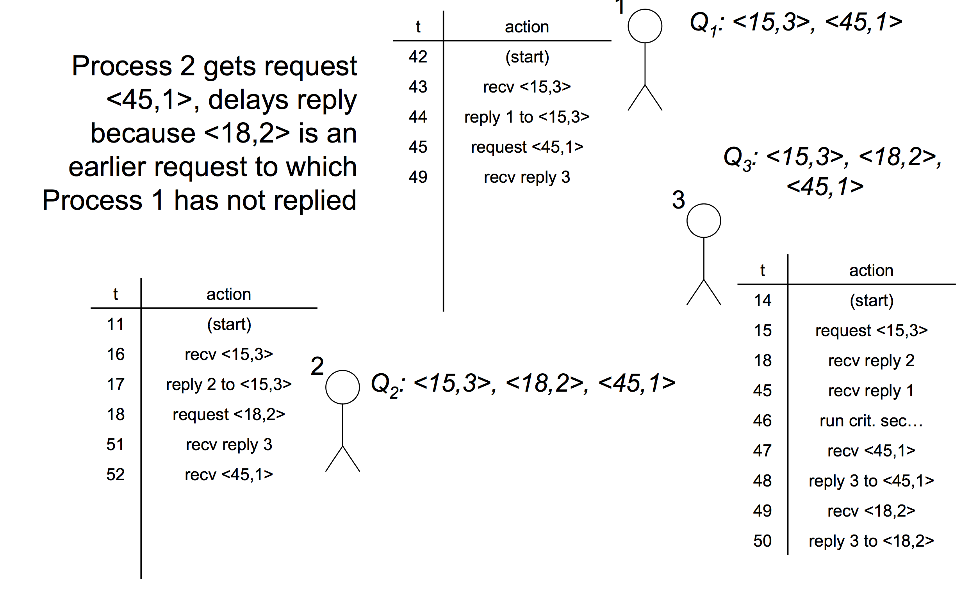
#3: A Shared Priority Queue

Slide 92
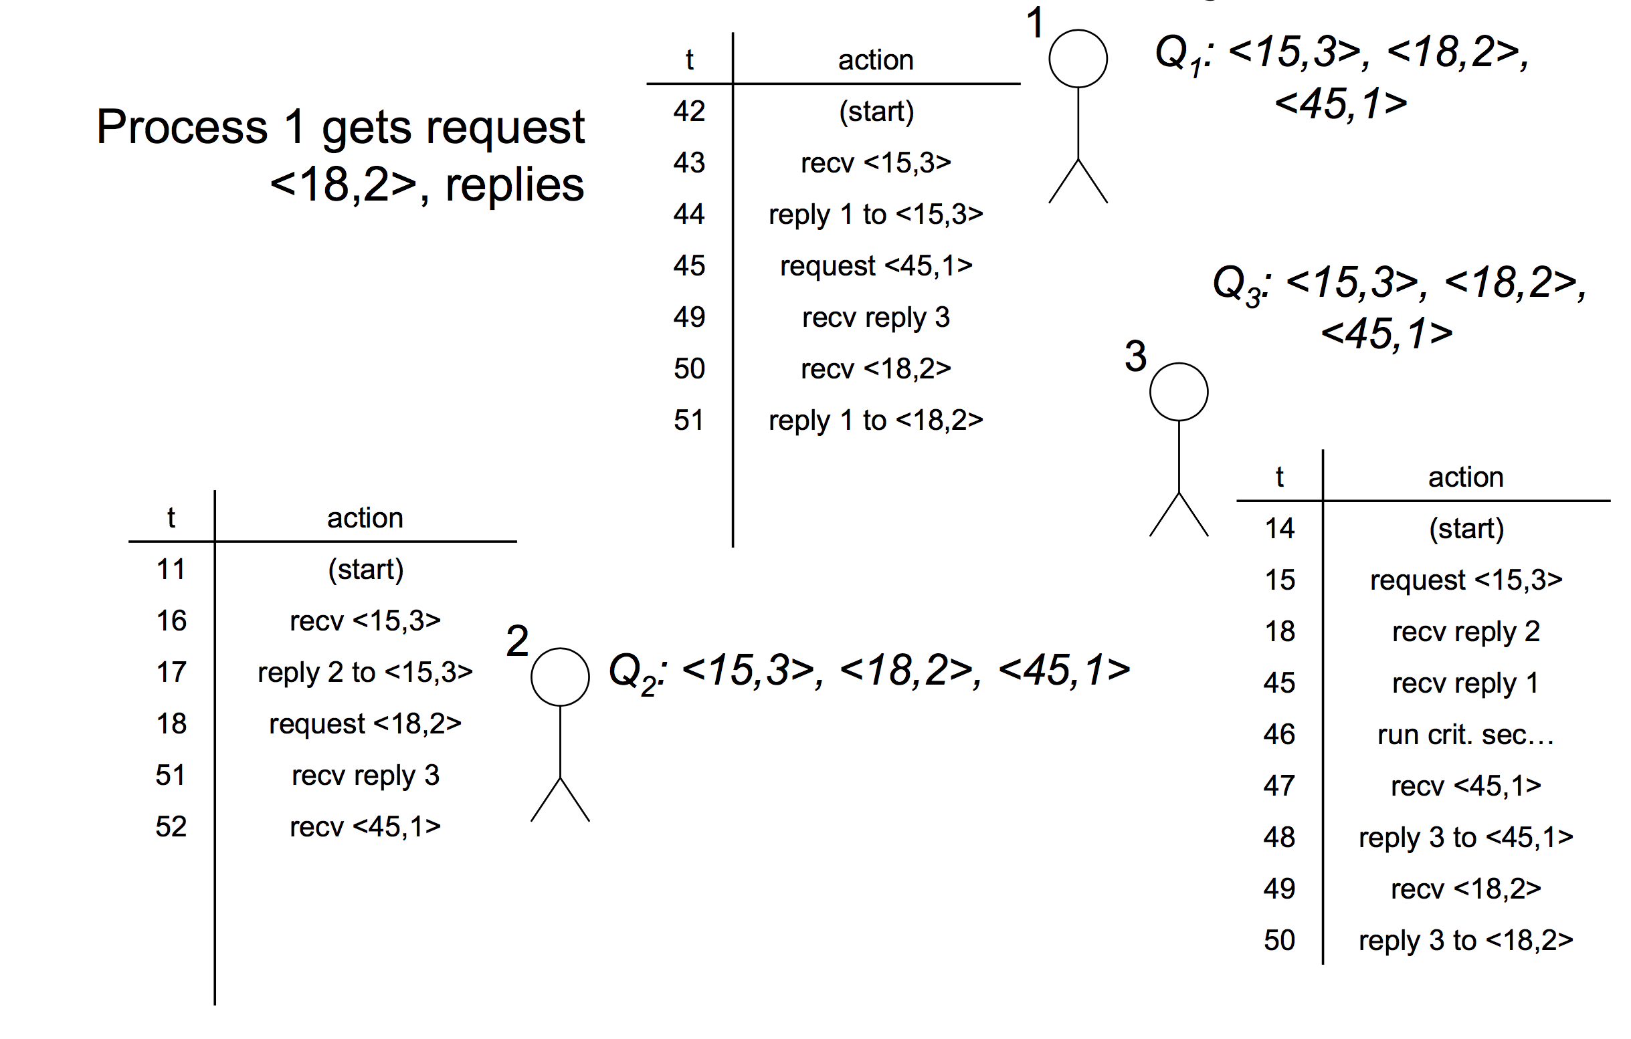
#3: A Shared Priority Queue

Slide 93
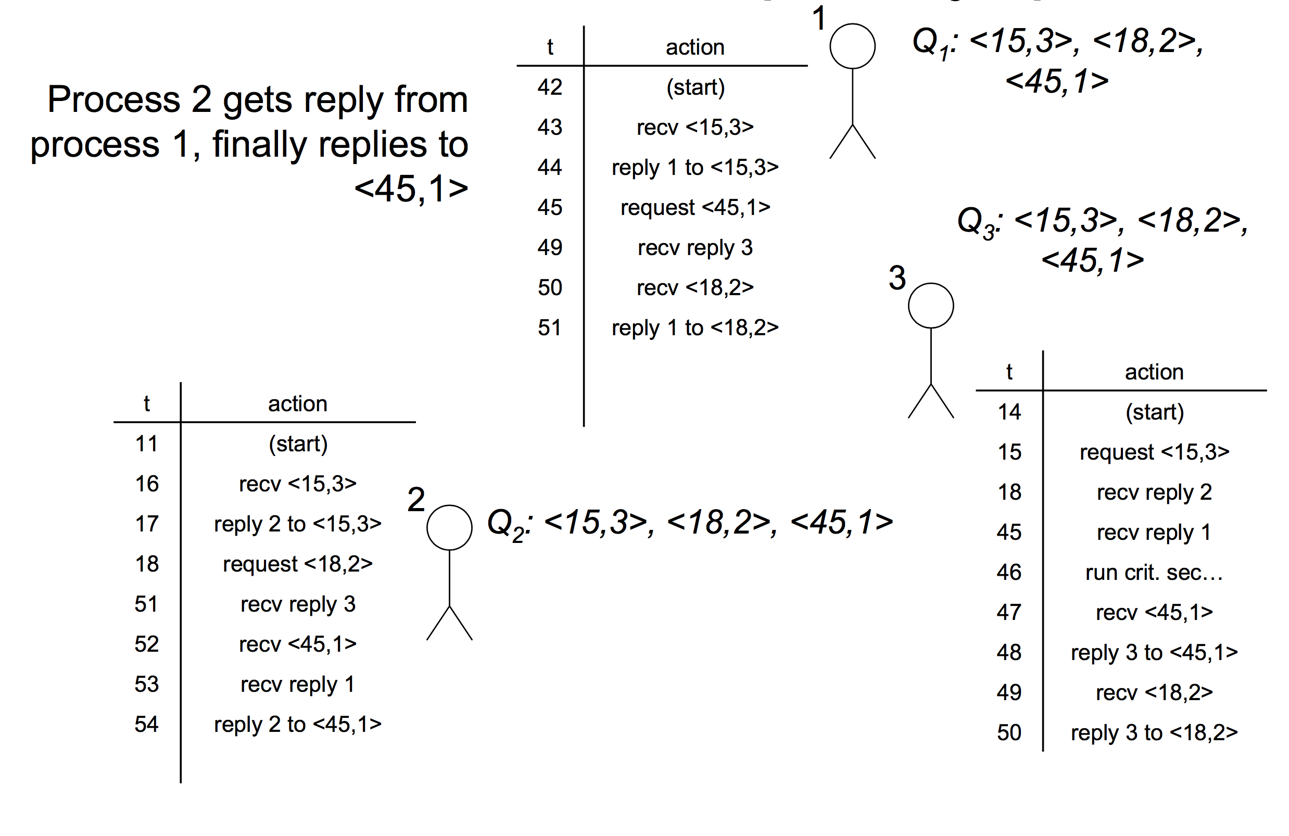
#3: A Shared Priority Queue

Slide 94
#3: A Shared Priority Queue
Advantages:
  Fair
  Short synchronization delay
Disadvantages:
  Very unreliable
    Any process failure halts progress
  3(N-1) messages per entry/exit

Slide 95
#4: Majority Votes
Instead of collecting REPLYs, collect VOTEs
  Each process VOTEs for which process can hold the mutex
  Each process can only VOTE once at any given time
  You hold the mutex if you have a majority of the VOTEs
  Only possible for one process to have a majority at any given time!

Slide 96
#4: Majority Votes
To enter critical section at process i:
  Broadcast REQUEST(T), collect VOTEs
  Can enter crit. sec. if collect a majority of VOTEs
To leave:
  Broadcast RELEASE-VOTE to all processes who VOTEd for you
On receipt of REQUEST(T’) from process j:
  If you have not VOTEd, VOTE for T’
  Otherwise, add T’ to Qi
On receipt of RELEASE-VOTE:
  If Qi not empty, VOTE for pop(Qi)

Slide 97
#4: Majority Votes
Advantages:
  Can progress with as many as N/2 – 1 failed processes
Disadvantages:
  Not fair
  Deadlock!
  No guarantee that anyone receives a majority of votes

Slide 98
Conclusion
Mutual Exclusion
  Centralized Solution
  Ring based Solution
  Distributed Solution
Trade-offs everywhere!
The closest one to industrial standards is...
  The centralized model (e.g., Google’s Chubby, Yahoo’s ZooKeeper)
  But replicate it for fault-tolerance across a few machines
  Replicas coordinate closely via mechanisms similar to the ones we’ve shown for the distributed algorithms (e.g., voting) – we’ll talk later about generalized voting alg.
  For manageable load, app writers must avoid using the centralized lock service as much as humanly possible!

Slide 99
Reading List
Optional
  Cachin book Ch2
  Tanenbaum book Ch6
  Leslie Lamport. Time, Clocks, and the Ordering of Events in a Distributed System. Commun. ACM 21(7): 558-565 (1978)

