Slide 1
IS 651: Distributed Systems Distributed File Systems
Sisi Duan
Assistant Professor
Information Systems
sduan@umbc.edu

Slide 2
Today
Distributed File Systems
Google File System (GFS)
A few words about other distributed file systems

Slide 3
Networked File System
File system spread over multiple, autonomous machines
Goals
Have a consistent namespace for files across computers
Let authorized users access their files from any computer
Commonly used in cloud environment and high performance computing
Amazon S3
Google Cloud Storage
Microsoft Azure
Ceph
Lustre, HDFS…

Slide 4
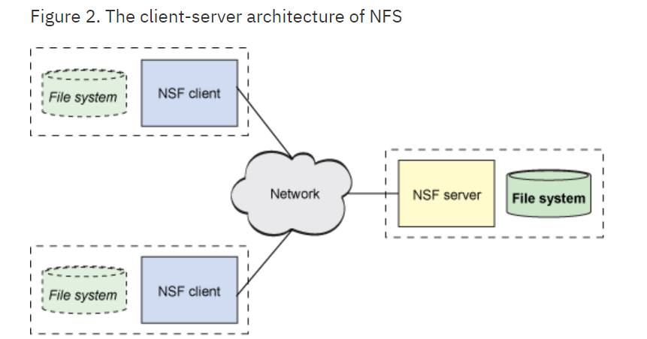
History of distributed file systems
File Access Listener, 1976
By Digital Equipment Corporation (DEC)
Based on Data Access Protocol
Still used today
NFS, 1984 (latest version 2010)
By Sun Microsystems
The first modern DFS
Use RPC to route requests between clients and servers

Slide 5
Distributed File System
In general, it should provide
Network transparency
Hide the details of where files are located
File name does not reveal any kind of the file’s physical storage location
High availability: Ease of accessibility irrespective of the physical location of the file
Difficult to achieve since it’s a networked system
Replication is often used to alleviate the problem
However, it introduces additional issues

Slide 6
Distributed File Systems Challenges
Basically the same with the challenges of distributed systems…
Interface
Scalability
Fault Tolerance
Concurrency
Security
How can we even start?

Slide 7
Where to start?
We usually first prioritize list of goals
Performance, scale, consistency – what’s the most important?
Workload-oriented design
Measure characteristics of target workloads to inform the design
GFS is designed for big-data workloads, 2003
Huge files, mostly appends, concurrency, huge bandwidth
Designed to tolerate failures
There are “thousands” of computers in GFS system according to Google

Slide 8
GFS Architecture
One master, many chunk (data) servers
Master stores metadata, and monitors chunk servers
Chunk servers store and serve chunks
Semantics
Nothing for traditional write op
At least once, atomic record appends

Slide 9
GFS Design Constraints
Failures are the norm
1000s of components
Bugs, human errors, failures of memory, disk, connectors, networking, and power supplies
Monitoring, error detection, fault tolerance, automatic recovery must be integral parts of a design
Design for big-data workloads
Search, ads, web analytics, MapReduce…

Slide 10
Workload Characteristics
Files are huge by traditional standards
Multi-GB files are common
Most file updates are appends
Random writes are practically nonexistent
Many files are written once and read sequentially

Slide 11
GFS Architecture
A GFS cluster
A single master (replicated)
Many chunkservers
Accessed by many clients
Divided into fixed-sized chunks (similar to file system blocks)
Each has a unique global ID (called a handle)
Stored at chunkservers
3-way replicated across chunkservers
Master keeps track of metadata (e.g., which chunks belong to which files)

Slide 12
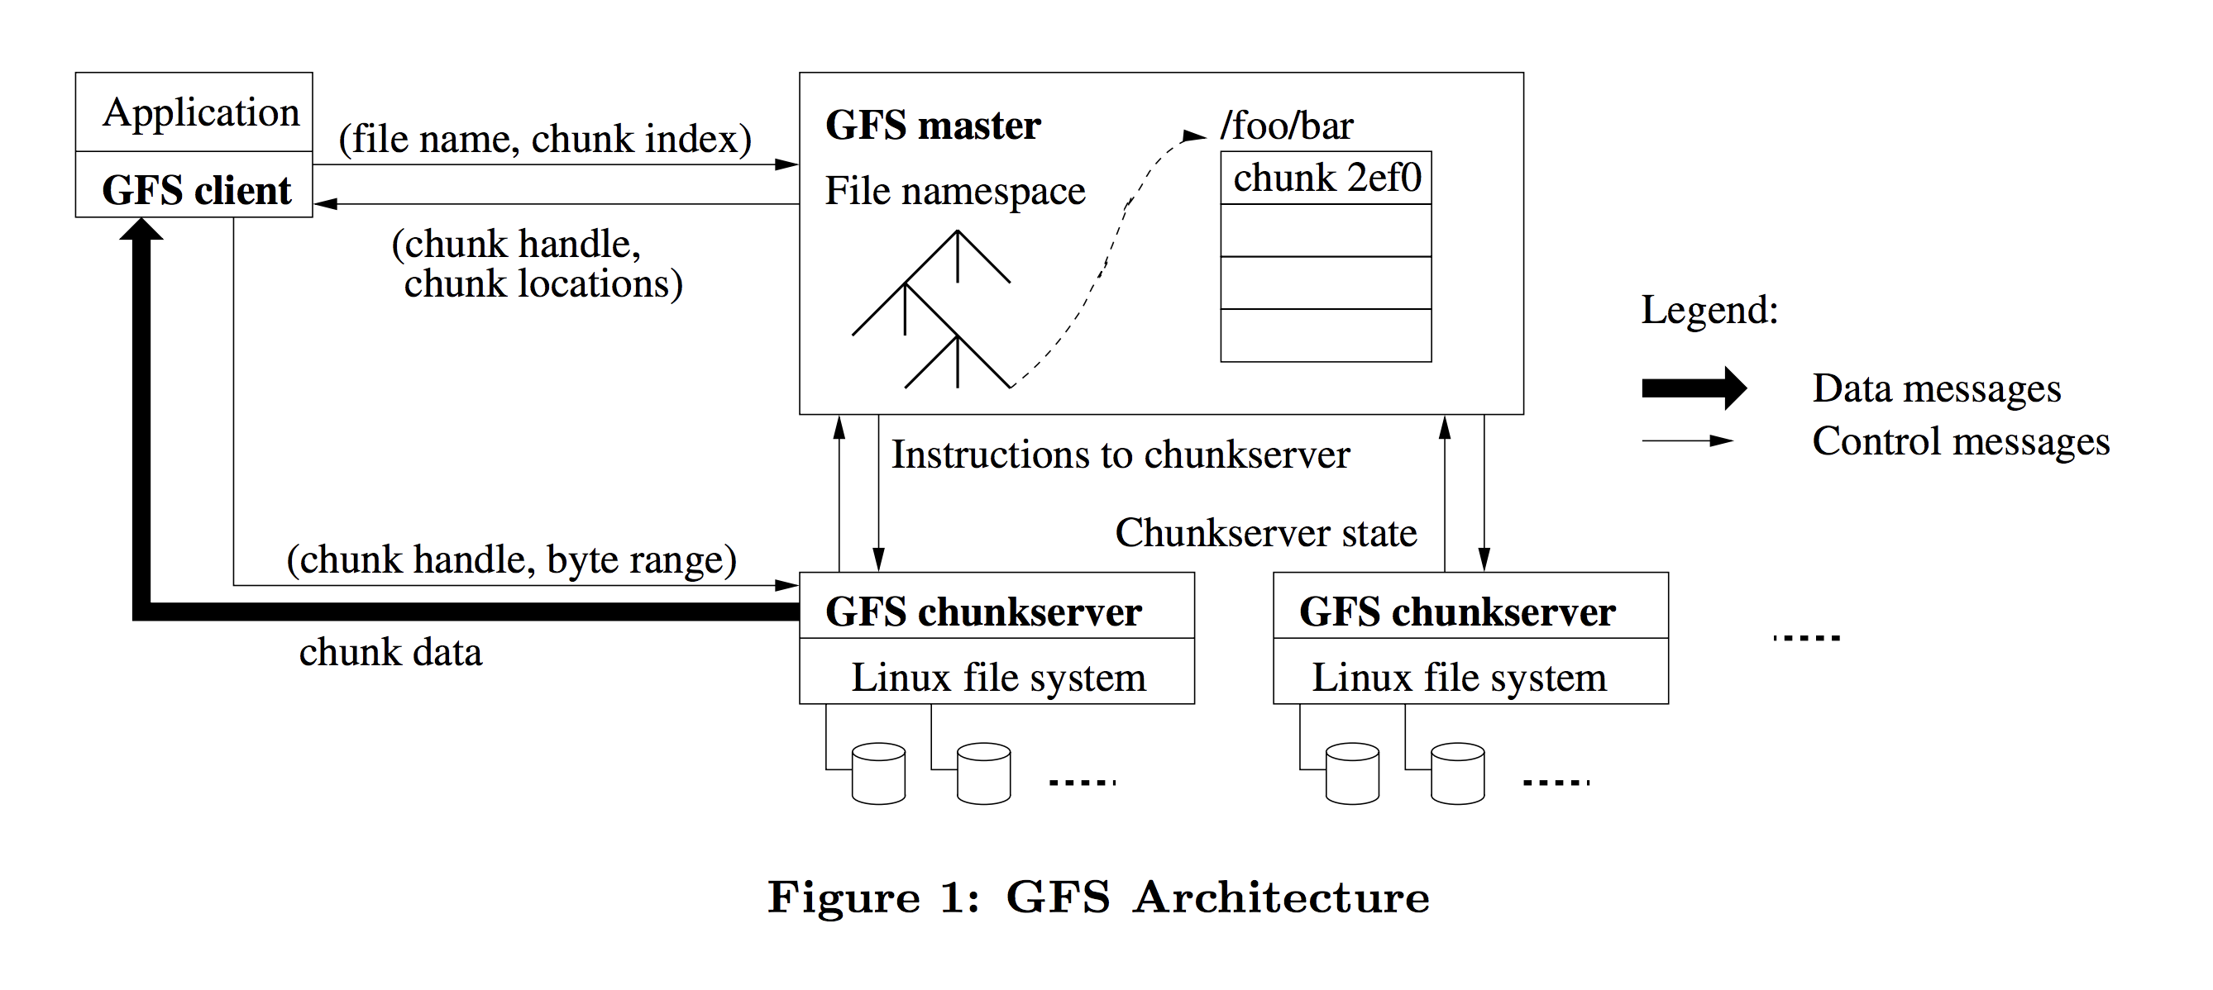
GFS Architecture
Client retrieves metadata from master
Read/Write data flows between client and chunkserver
Minimizing the master’s involvement in read/write operations alleviates the single-master bottleneck
Notes:
Google tries to index everything on the internet. Every filename is mapped to an index on GFS servers.

Slide 13
Chunks
Size: 64MB
Normal file system block sizes are 512B - 8KB
Pros and cons?

Slide 14
Chunks
Size: 64MB
Normal file system block sizes are 512B - 8KB
Pros of big chunk sizes:
Less load on server (less metadata, hence can be kept in master’s memory)
Suitable for big-data applications (e.g., search)
Sustains large bandwidth, reduces network overhead
Cons of big chunk sizes:
Fragmentation if small files are more frequent than initially believed

Slide 15
The GFS Master
A process running on a separate machine
Initially, GFS supported just a single master, but then they added master replication for fault-tolerance in other versions/distributed storage systems
The replicas use Paxos, an algorithm that we’ll talk about later to keep coordinate, i.e., to act as one (think of the voting algorithm we looked at for distributed mutual exclusion)
Stores all metadata
File and chunk namespaces
Hierarchical namespace for files, flat namespace for chunks
File-to-chunk mappings
Locations of a chunk’s replicas

Slide 16
Master Controls/Coordinates Chunkservers
Master and chunkserver communicate regularly (heartbeat):
Is chunkserver down?
Are there disk failures on chunkserver?
Are any replicas corrupted?
Which chunks does chunkserver store?
Master sends instructions to chunkserver
Delete a chunk
Create a new chunk
Replicate and start serving this chunk (chunk migration)
Why do we need migration?

Slide 17
File System Operations
Reads
Writes
Appends

Slide 18
Read

Slide 19
Read

Slide 20
Updates
Writes
Causes data to be written at application-specified file offset
Record appends
Operations that append data to a file
Cause data to be appended atomically at least once
Offset chosen by GFS, not by the client (Think about it: why?)
Goals
Clients can read, write, append records in parallel
Some consistency that we can understand
Hence, favor concurrency/performance over semantics

Slide 21
Update Order
For consistency, updates to each chunk must be ordered in the same way at the different chunk replicas
Consistency means that replicas will end up with the same version of the data and not diverge
For this reason, for each chunk, one replica is designated as the primary
The other replicas are designated as secondaries
Primary defines the update order
All secondaries follows this order

Slide 22
Primary Leases
For correctness, at any time, there needs to be one single primary for each chunk
Or else, they could order different writes in different ways

Slide 23
Primary Leases
To ensure that, GFS uses leases
Master selects a chunkserver and grants it lease for a chunk
The chunkserver holds the lease for a period T after it gets it, and behaves as primary during this period
The chunkserver can refresh the lease endlessly
But if the chunkserver can't successfully refresh lease from master, he stops being a primary
If master doesn't hear from primary chunkserver for a period, he gives the lease to someone else
So, at any time, at most one server is primary for each chunk
But different servers can be primaries for different chunks

Slide 24
Write

Slide 25
Write Consistency
Primary enforces one update order across all replicas for concurrent writes
It also waits until a write finishes at the other replicas before it replies
Therefore
We will have identical replicas
But, file region may end up containing mingled fragments from different clients
E.g., writes to different chunks may be ordered differently by their different primary chunkservers
Thus, writes are consistent but undefined in GFS

Slide 26
Read

Slide 27
Read

Slide 28
Write

Slide 29
Appends
The client specifies only the data, not the file offset
File offset is chosen by the primary
Why do they have this?
Meaningful semantic: at least once atomically
Because file system is not constrained: where to place data, it can get atomicity without sacrificing concurrency
Rough mechanism
If record fits in chunk, primary chooses the offset and communicates it to all replicas -> offset is arbitrary
If record doesn’t fit in chunk, the chunk is padded and client gets failure -> file may have blank spaces
If a record append fails at any replica, the client retries the operation -> file may contain record duplicates

Slide 30
Appends
1. Application originates record append request.
2. GFS client translates request and sends it to master.
3. Master responds with chunk handle and (primary + secondary) replica locations.
4. Client pushes write data to all locations.
5. Primary checks if record fits in specified chunk.
6. If record does not fit, then:
The primary pads the chunk, tells secondaries to do the same, and informs the client.
Client then retries the append with the next chunk.
7. If record fits, then the primary:
appends the record at some offset in chunk,
tells secondaries to do the same (specifies offset),
receives responses from secondaries,
and sends final response to the client.

Slide 31
GFS Summary
Optimized for large files and sequential appends
large chunk size
File system API tailored to stylized workload
Single-master design to simplify coordination
But minimize workload on master by not involving master in large data transfers
Implemented on top of commodity hardware

Slide 32
Other distributed file systems
Lustre, 2003
Ceph, 2006
HDFS, 2010

Slide 33
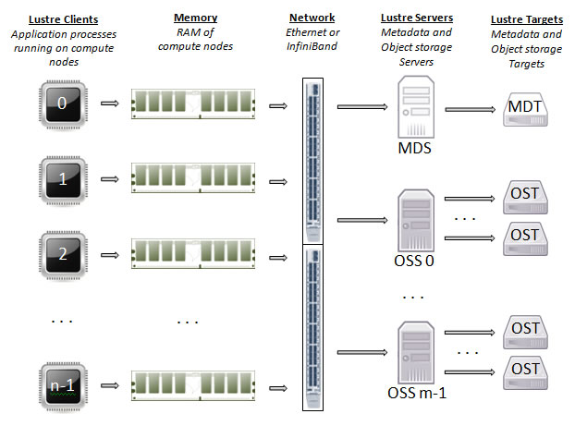
Lustre, 2003
Parallel distributed file system, under GPL license
Object storage
Commonly used in high performance computing environment
Does not replicate any data
Notes:
GPL: GNU general public license
OSS: Object storage service
OST: Object storage targe

Slide 34
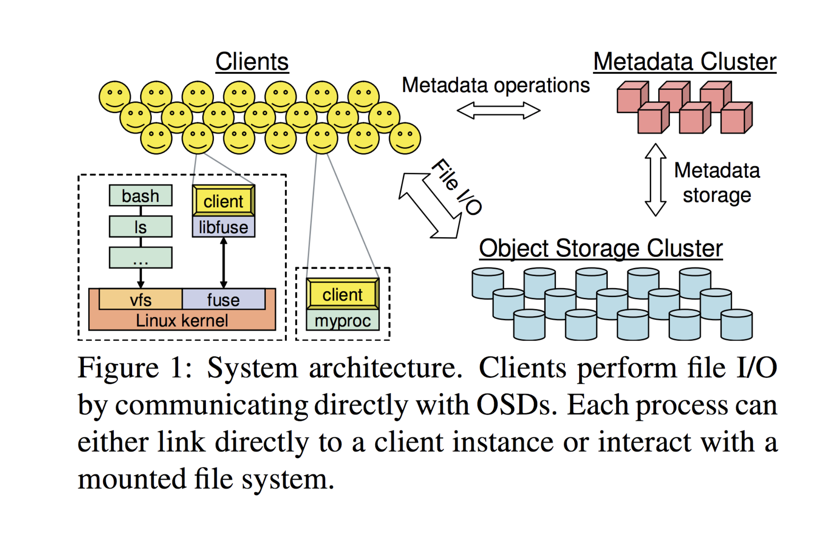
Ceph, 2006
Open source distributed file system, developed by Sage Weil
Object storage, totally distributed system
Also used in some high performance computing (HPC) environment

Slide 35
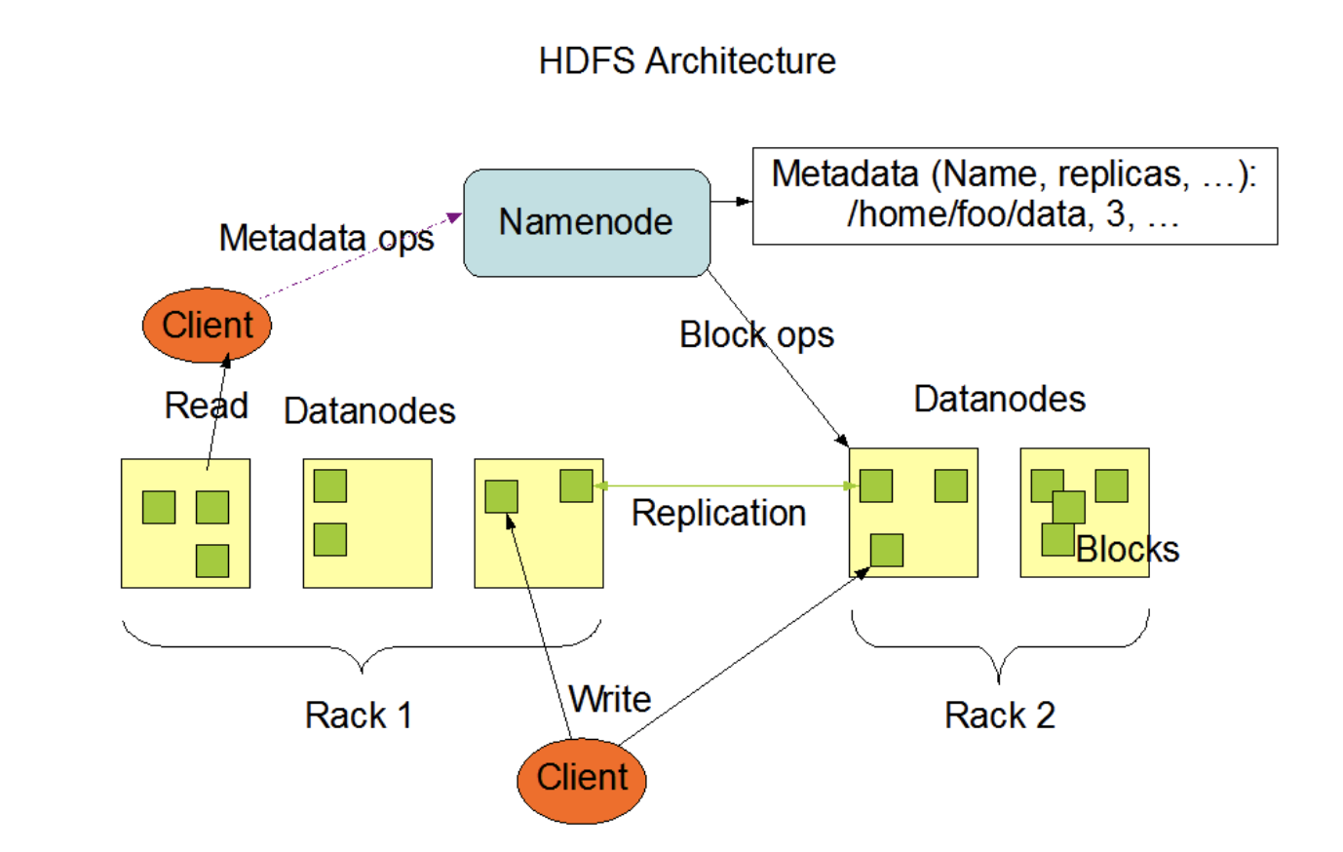
HDFS, 2010
Hadoop Distributed File System
Developed by Apache Software Foundation
Centralized distributed system (only one namenode)
Namenode keeps the locations of all the replicas

Slide 36
Reading List
Sanjay Ghemawat, Howard Gobioff, and Shun-Tak Leung. The Google File System. SOSP 2003.
(Optional)
Konstantin Shvachko, Hairong Kuang, Sanjay Radia, and Robert Chansler. The Hadoop distributed file system. MSST 2010.
Sage A. Weil, Scott A. Brandt, Ethan L. Miller, Darrel D.E. Long, and Carlos Maltzahn. Ceph: A scalable, high-performance distributed file system. OSDI 2006.
Philip Schwan. Lustre: Building a file system for 1,000-node clusters. Linux symposium 2003.
Benjamin Depardon, Gaël Le Mahec, Cyril Séguin. Analysis of Six Distributed File Systems. 2013.

