Slide 1
IS 651: Distributed Systems
Mutual Exclusion
Sisi Duan
Assistant Professor
Information Systems
sduan@umbc.edu

Slide 2
Recall
Time Synchronization
Perfect synchronizing of real clocks is impossible
  Cristian’s algorithm, Berkerley algorithm, Network time protocol (NTP)
Logical clocks
  Lamport logical clocks
  Vector clocks

Slide 3
Recall
Logical clocks
Lamport logical clock
  Causality of events
Vector clock
  Causality of events
  It can detect the violation of causality and resolve it so as to provide total order of events (more about this next week)
  Any advantages/disadvantages compared with Lamport clock?

Slide 4
Announcement
HW 1 due today (Feb 28)
Project Description Report due next week
  Send me an email by the end of this week if you still don’t have a team
HW2 due next weeks
Late policy (every one has one chance of late submission for 24 hours)

Slide 5
Today
Mutual Exclusion
Multiple machines write to a file, print on a network printer, etc.
Each machine wants to make sure it’s the only one doing that
  What will be the consequences otherwise?
  Mutual exclusion

Slide 6
Mutual Exclusion
A word of warning:
  None of the algorithms is perfect, all have tradeoffs
  So, don’t expect a natural progression to some “great” algorithm
  The goal is to understand several algorithms, so you get used to the idea of distributed algorithms, logical clocks, voting, etc.
We will look at a few today
  Centralized algorithm
  Token algorithm
  Distributed algorithm

Slide 7
Distributed Mutual Exclusion
Maintain mutual exclusion among n distributed processes
  Terminology: use process/processor/machine/server/node to denote the processing unit in a distributed system
Model: Each process executes loop of form:
While true:
Perform local operations
Acquire()
Execute critical section
Release()

Slide 8
Distributed Mutual Exclusion
During critical section, process interacts with remote processes or directly with shared resource
Example: send a message to a shared file server asking it to write something to a file
While true:
Perform local operations
Acquire()
Execute critical section
Release()

Slide 9
Goals of Distributed Mutual Exclusion
Much like regular mutual exclusion
  Safety: at most one process holds the lock at any time
  Liveness: progress (if no one holds the lock, a processor requesting it will get it)
  Fairness: bounded wait and in-order (logical time)
Other goals:
  Minimize message traffic
  Minimize synchronization delay
  Switch quickly between processes waiting for lock
  i.e., if no one has the lock and you ask for it, you should quickly get it

Slide 10
Distributed Mutual Exclusion Is Different
Regular mutual exclusion solved using shared state
E.g., atomic test-and-set of shared variable
We solve distributed mutual exclusion with message passing
Assumptions
  The network is reliable (all messages sent get to their destinations at some point in time)
  Network is asynchronous (messages may take long time)
  Processes may fail at any time

Slide 11
Distributed Mutual Exclusion Protocols
Key ideas:
  Before entering critical section, processor must get permission from other processors
  When exiting critical section, processor must let the others know that he’s finished
  For fairness, processors allow other processors who have asked for permission earlier than them to proceed
We’ll give examples of four such protocols
  We’ll compare them from a liveness, message overhead, synchronization delay perspective

Slide 12
#1: Centralized Lock Server
To enter critical section
  send REQUEST to central server
  wait for permission from server
To leave critical section:
  send RELEASE to central server
Server
  Has an internal queue of all REQUESTs it’s received but to which it hasn’t yet sent OK
  Delays sending OK back to process until process is at head of queue
  Removes process from the queue after it gets RELEASE

Slide 13
#1: Centralized Lock Server
Pros
  Simple!
  Only 3 messages required per sync session (enter & exit)
Cons
  Single point of failure
  Single performance bottleneck
  With an asynchronous network, doesn’t achieve in-order fairness (even for logical time order)
  Must select (or elect) a central server

Slide 14
#2: A Ring-based Algorithm
Pass a toke around a ring
  Can enter critical section only if you hold the token
Problems
  Not in-order
  Long synchronization delay
    Need to wait for up to N-1 messages, for N processors
  Very unreliable
    Any process failure breaks the ring

Slide 15
#2’: A better ring-based solution
Token contains the time t of the earliest known outstanding request
To enter critical section:
  Stamp your request with the current time Tr, wait for token
When you get token with time t while waiting with request from time Tr, compare Tr to t:
  If Tr = t: hold token, run critical section
  If Tr > t: pass token
  If t not set or Tr < t: set token-time to Tr, pass token, wait for token
To leave critical section:
  Set token-time to null (i.e., unset it), pass token

Slide 16
#3: A Shared Priority Queue
By Lamport, using Lamport clocks
Each process i locally maintains Qi, part of a shared priority queue
To run critical section, must have replies from all other processes AND be at the front of Qi
  When you have all replies:
  #1: All other processes are aware of your request
  #2: You are aware of any earlier requests for the mutex

Slide 17
#3: A Shared Priority Queue
To enter critical section at process i :
  Stamp your request with the current time T
  Add request to Qi
  Broadcast REQUEST(T) to all processes
  Wait for all replies and for T to reach front of Qi
To leave:
  Pop head of Qi, Broadcast RELEASE to all processes
On receipt of REQUEST(T’) from process j:
  Add T’ to Qi
  If waiting for REPLY from j for an earlier request T, wait until j replies to you
  Otherwise REPLY
On receipt of RELEASE
  Pop head of Qi
This delay enforces property #2

Slide 18
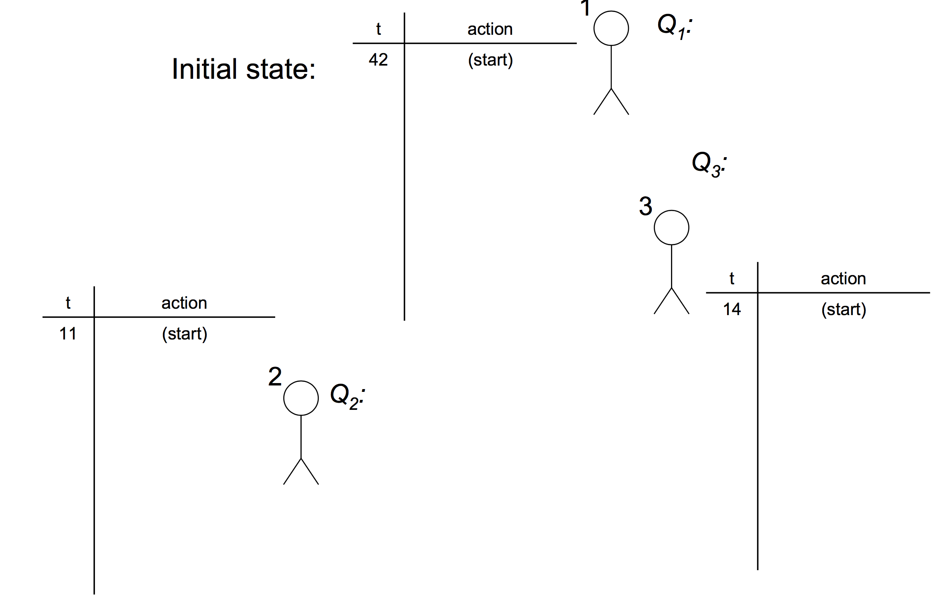
#3: A Shared Priority Queue

Slide 19
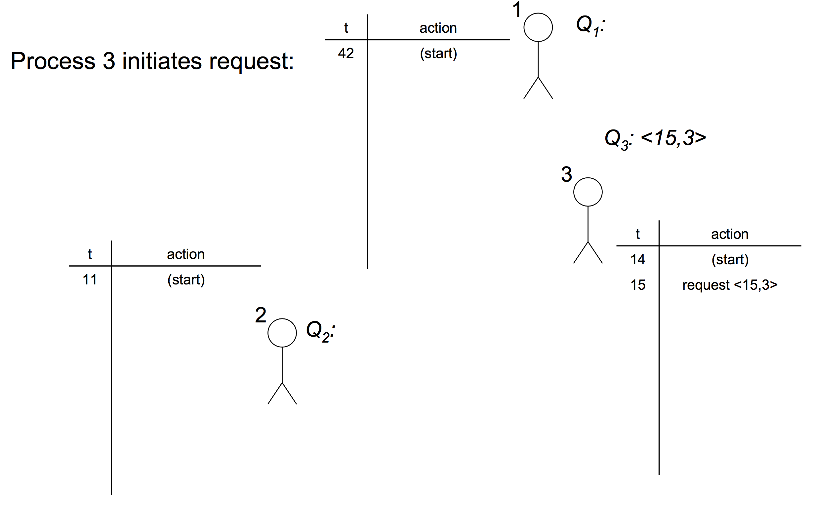
#3: A Shared Priority Queue

Slide 20
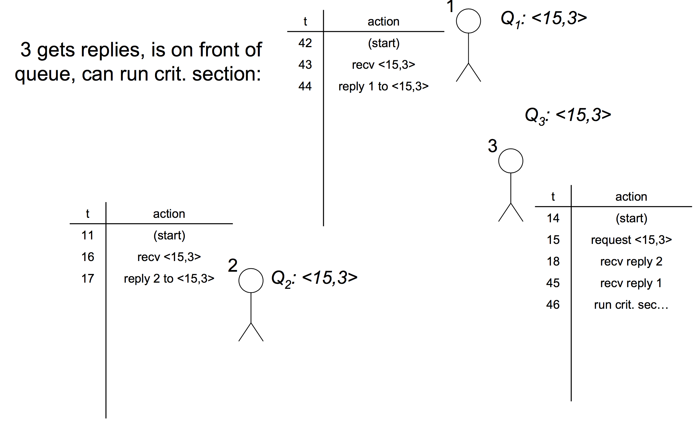
#3: A Shared Priority Queue

Slide 21
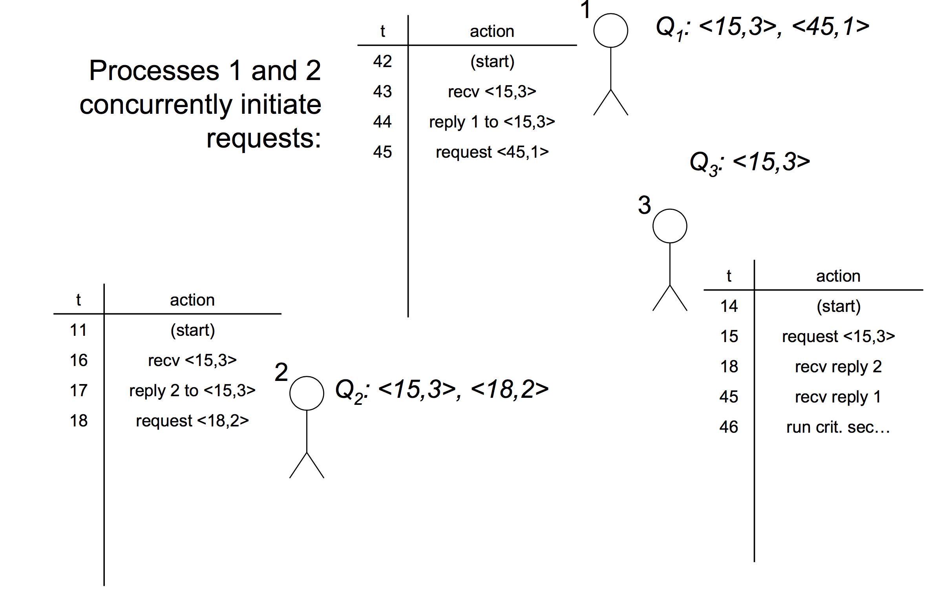
#3: A Shared Priority Queue

Slide 22
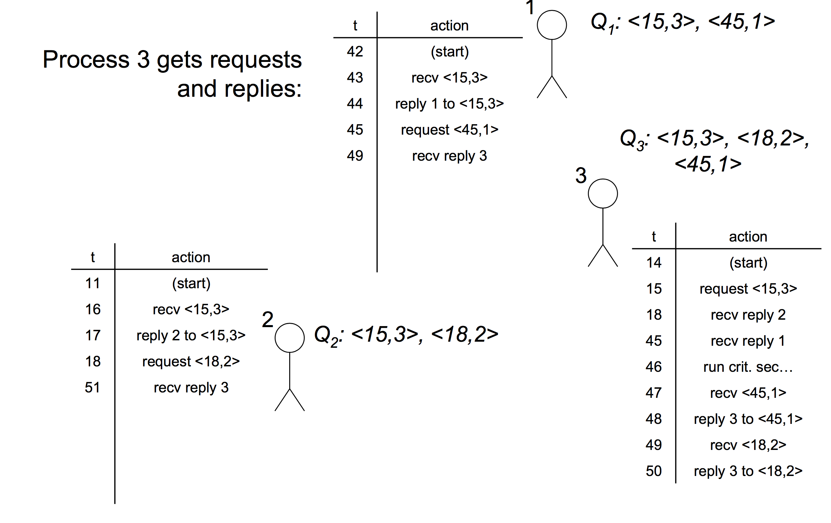
#3: A Shared Priority Queue

Slide 23
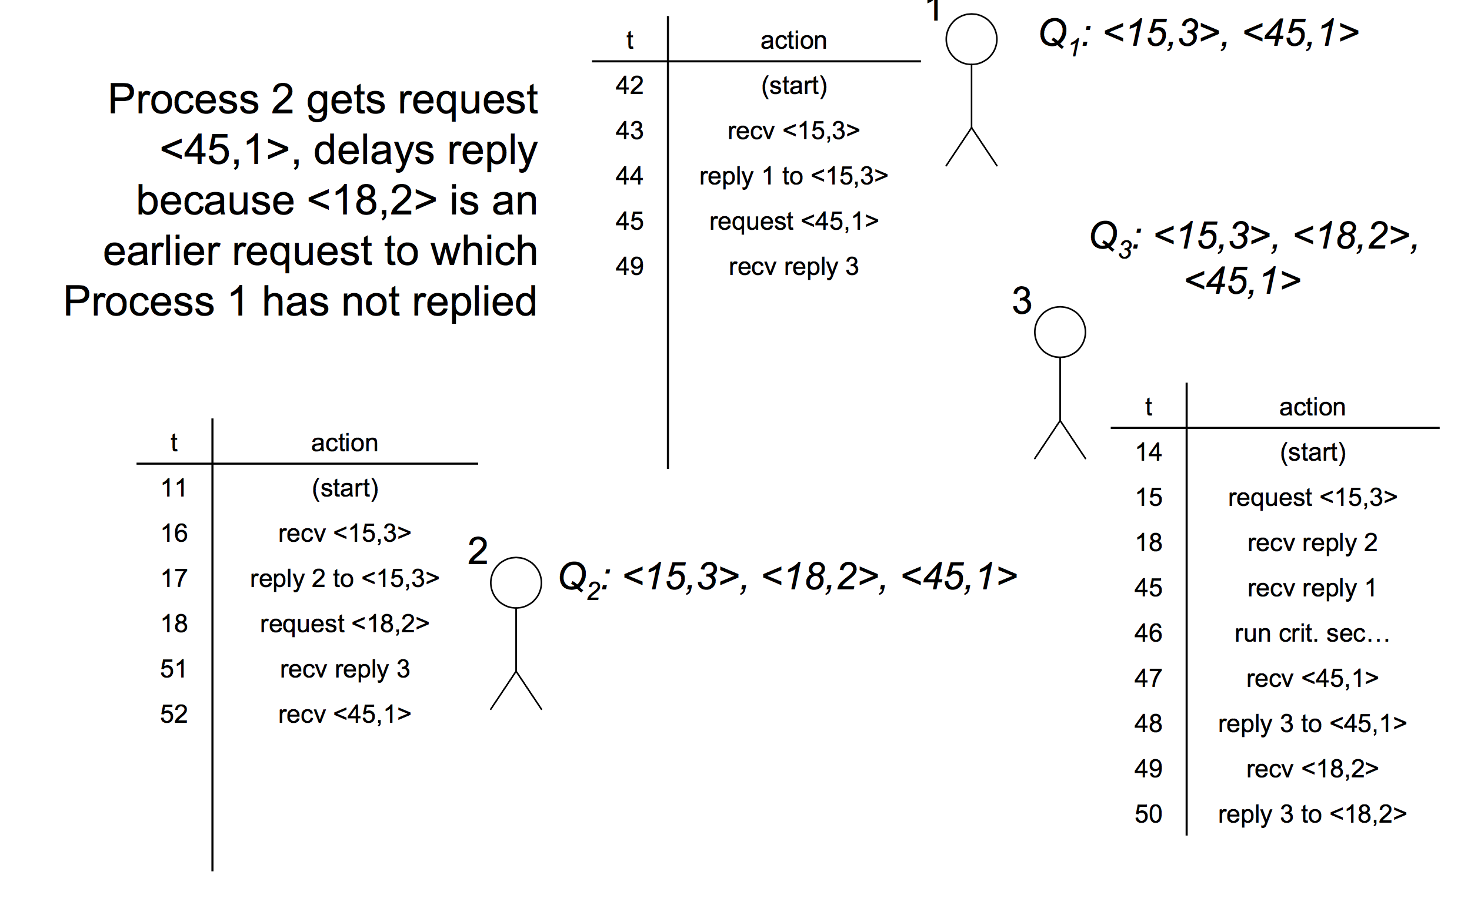
#3: A Shared Priority Queue

Slide 24
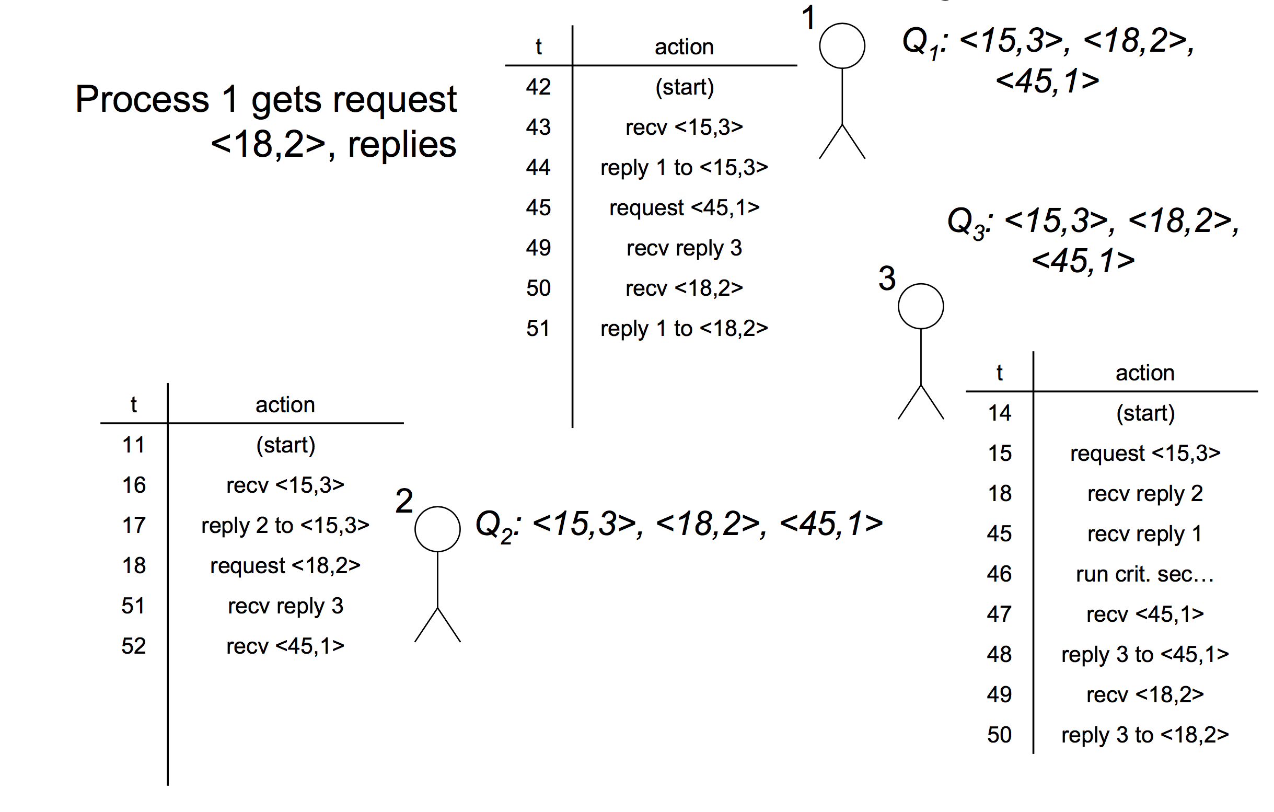
#3: A Shared Priority Queue

Slide 25
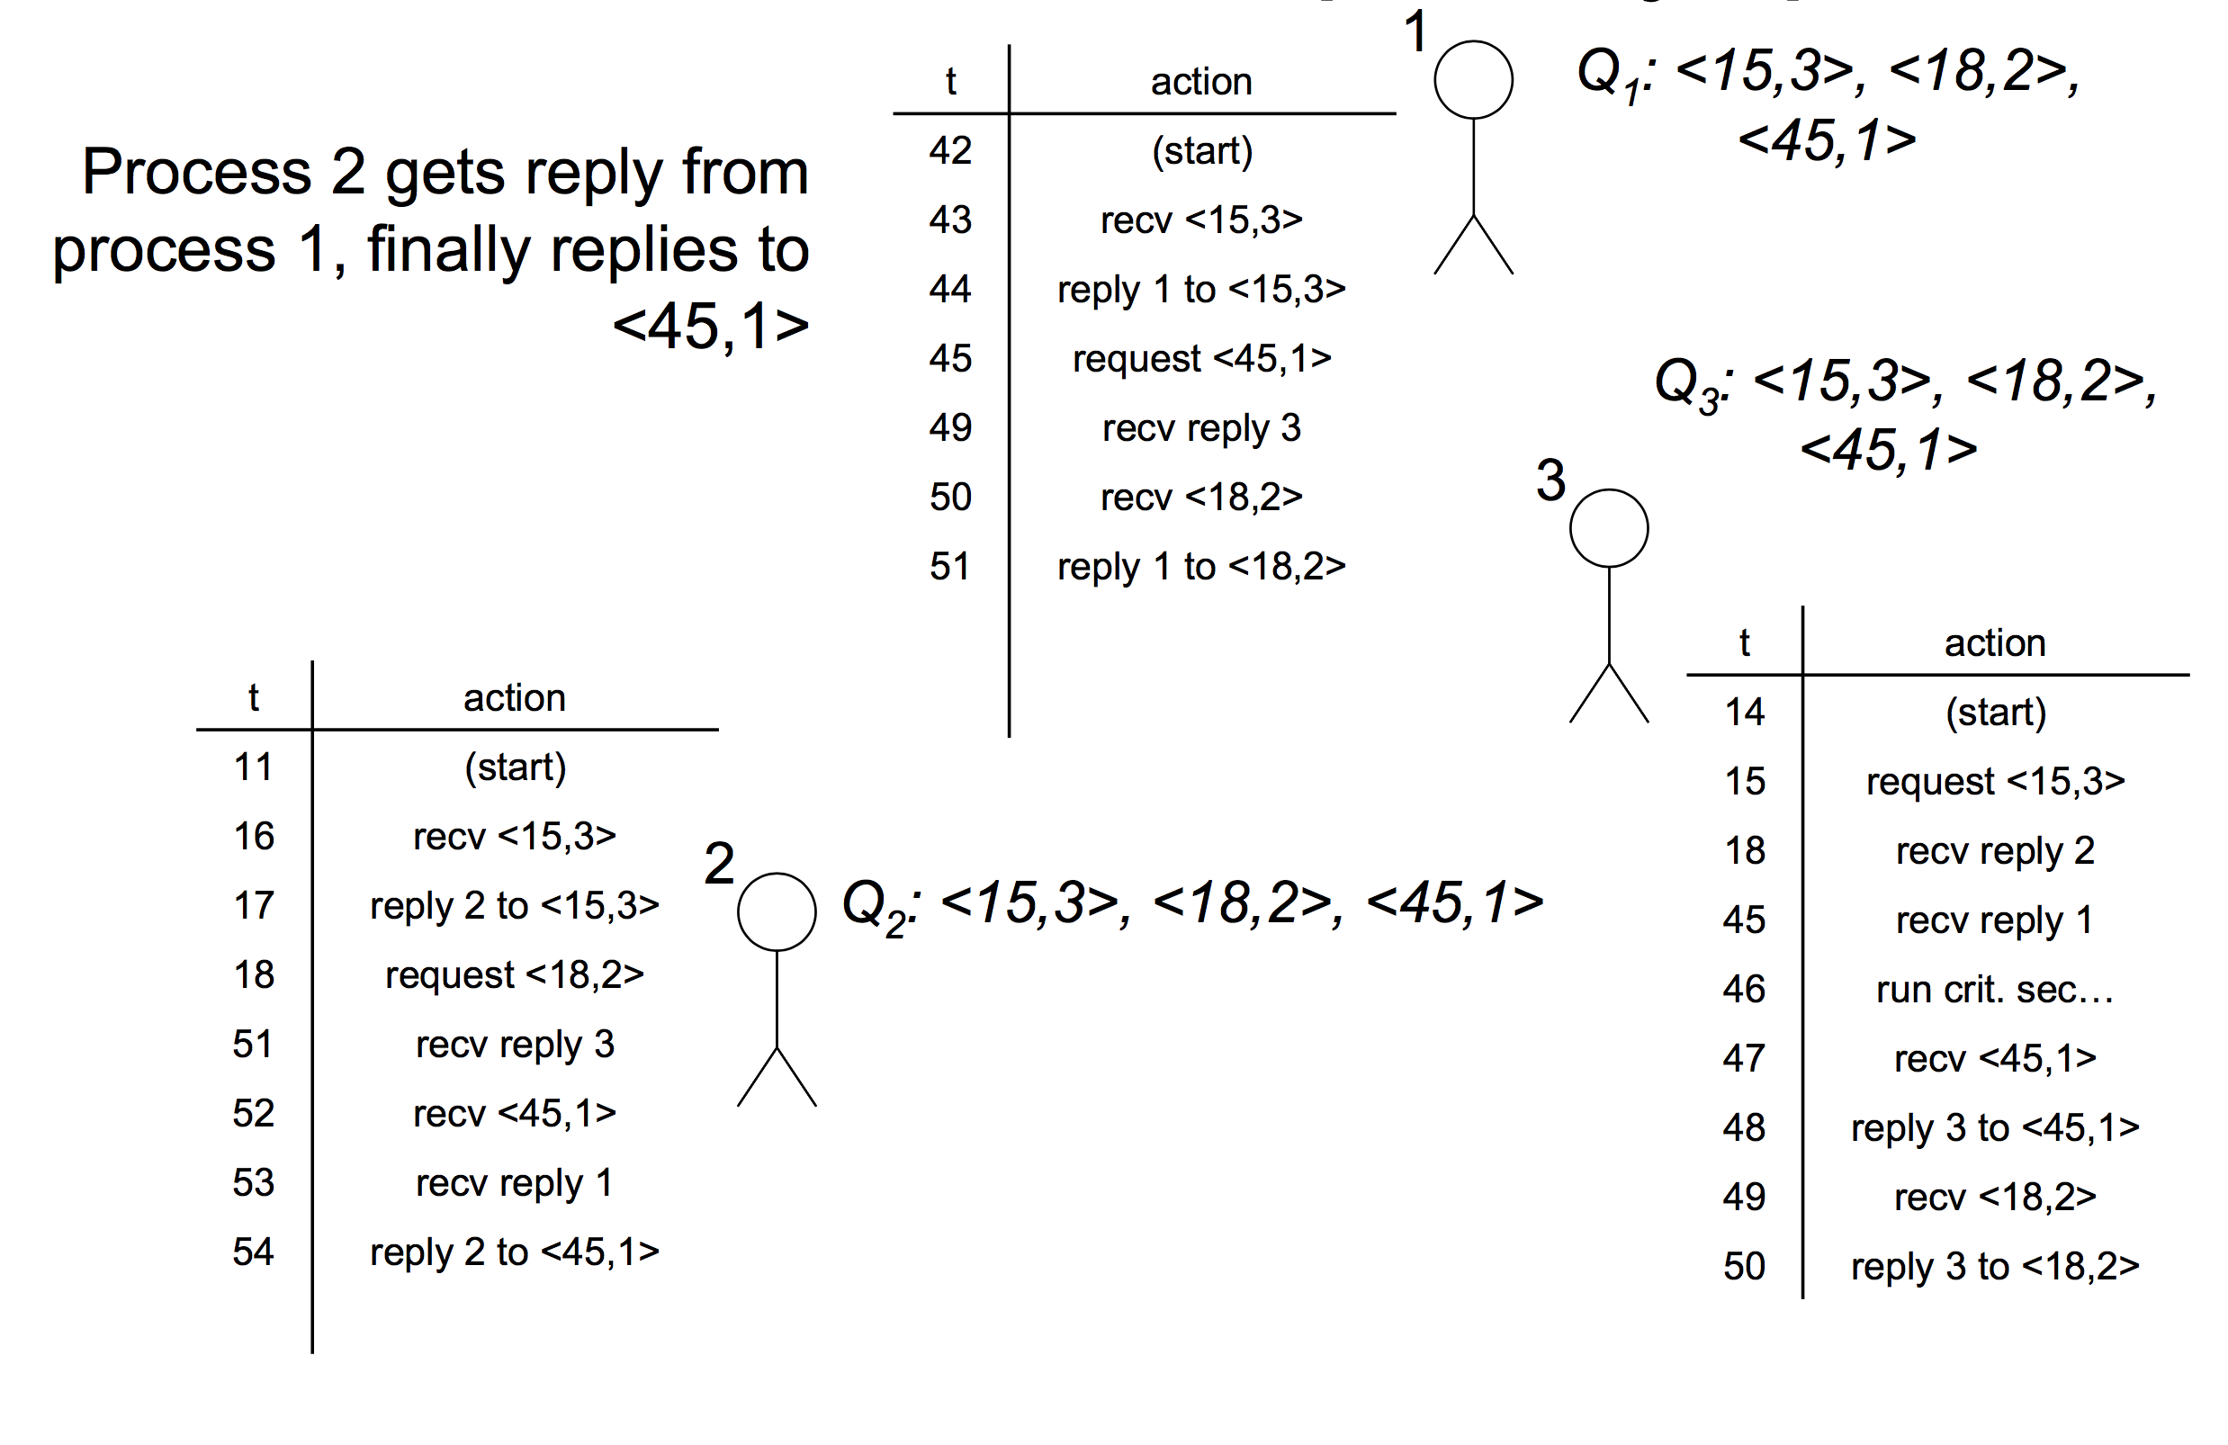
#3: A Shared Priority Queue

Slide 26
#3: A Shared Priority Queue
Advantages:
  Fair
  Short synchronization delay
Disadvantages:
  Very unreliable
    Any process failure halts progress
  3(N-1) messages per entry/exit

Slide 27
#4: Majority Votes
Instead of collecting REPLYs, collect VOTEs
  Each process VOTEs for which process can hold the mutex
  Each process can only VOTE once at any given time
  You hold the mutex if you have a majority of the VOTEs
  Only possible for one process to have a majority at any given time!

Slide 28
#4: Majority Votes
To enter critical section at process i:
  Broadcast REQUEST(T), collect VOTEs
  Can enter crit. sec. if collect a majority of VOTEs
To leave:
  Broadcast RELEASE-VOTE to all processes who VOTEd for you
On receipt of REQUEST(T’) from process j:
  If you have not VOTEd, VOTE for T’
  Otherwise, add T’ to Qi
On receipt of RELEASE-VOTE:
  If Qi not empty, VOTE for pop(Qi)

Slide 29
#4: Majority Votes
Advantages:
  Can progress with as many as N/2 – 1 failed processes
Disadvantages:
  Not fair
  Deadlock!
  No guarantee that anyone receives a majority of votes

Slide 30
Conclusion
Mutual Exclusion
  Centralized Solution
  Ring based Solution
  Distributed Solution
Trade-offs everywhere!
The closest one to industrial standards is...
  The centralized model (e.g., Google’s Chubby, Yahoo’s ZooKeeper)
  But replicate it for fault-tolerance across a few machines
  Replicas coordinate closely via mechanisms similar to the ones we’ve shown for the distributed algorithms (e.g., voting) – we’ll talk later about generalized voting alg.
  For manageable load, app writers must avoid using the centralized lock service as much as humanly possible!

Slide 31
Reading List
Optional
  Cachin book Ch2
  Tanenbaum book Ch6
  Leslie Lamport. Time, Clocks, and the Ordering of Events in a Distributed System. Commun. ACM 21(7): 558-565 (1978)

