Slide 1
IS 651: Distributed Systems Consistency
Sisi Duan
Assistant Professor
Information Systems
sduan@umbc.edu

Slide 2
Announcement
HW3 is available, due in two weeks
Answers will be posted online after the deadline
Midterm: Mar 27 in-class

Slide 3
HW1-Q1
De-coupling
Separate the functions of the systems into different nodes so different groups of nodes are in charge of independent tasks
Benefits
Flexibility of design (each group can have its own needs and design accordingly)
Better system performance
Better scalability (different groups can be extended in different ways)

Slide 4
HW1
What’s the main difference between distributed computing and single-server computing?
Client inputs: any format, any length
Send through the network (What format?)
Server needs to understand the network packet and extract the client inputs

Slide 5
HW1 - RPC
RPC is straightforward
Client inputs: function_name, input1, input2
Convert the inputs into XML (the xml_rpc library/stub does this)
Send through the network (01010100011)
Convert the packet into XML (the xml_rpc library/stub does this)
Parse

Slide 6
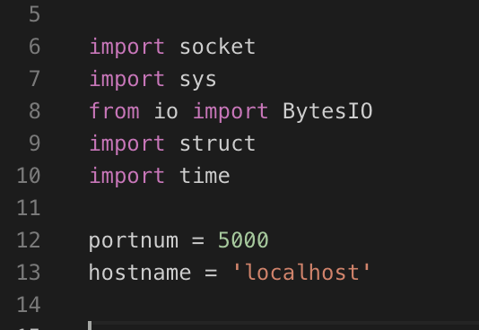
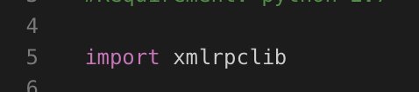
The Blocks: Clients
RPC
Socket
Import the libraries

Slide 7
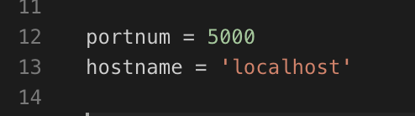
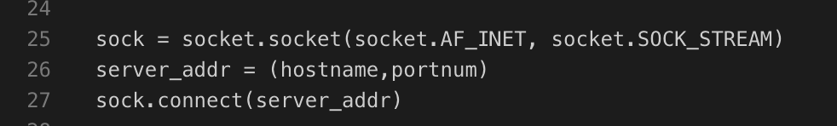
The Blocks: Clients
RPC
Socket
Define the server socket address

Slide 8
The Blocks: Clients
RPC
XML/RPC does the same thing through defining an URL
Socket
Define the server address

Slide 9
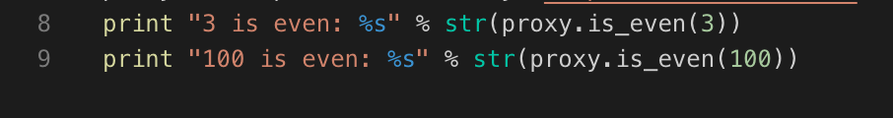
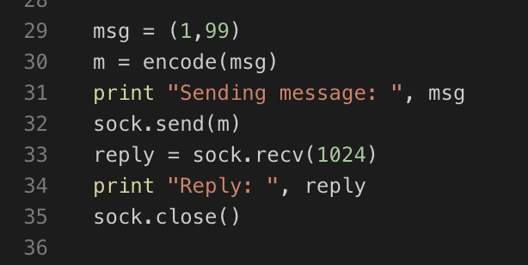
The Blocks: Clients
RPC
XML/RPC the same thing through directly calling the function name
(Socket sends a message and expect that the server knows how to parse it)
Socket
Sending the requests

Slide 10
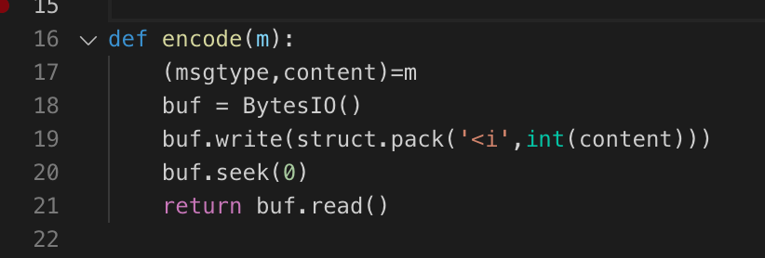
The Blocks: Clients
RPC
XML/RPC the same thing through converting the data into an XML
(handled by the library)
Socket
Serializing the data

Slide 11
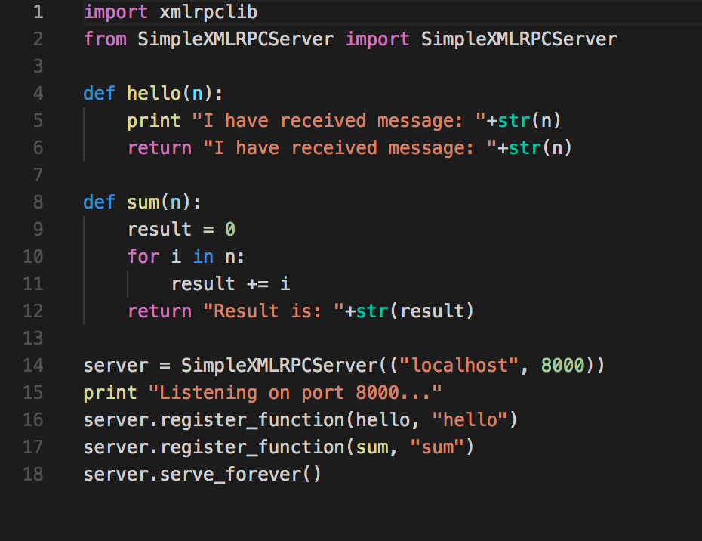
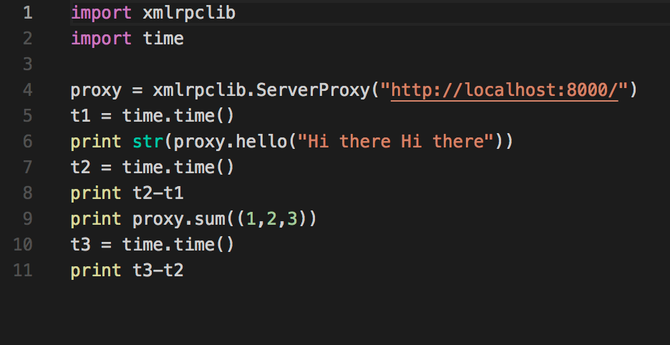
HW1 - RPC
client
server

Slide 12
HW1
Q2: Time/Latency: socket is much more efficient
Q3:
Socket: short latency, consume less bandwidth, more difficult to develop
RPC: long latency, XML can be cumbersome, easier to develop
Multiple servers: RPC is easier to develop (still up to which RPC you use). Socket definitely performs better

Slide 13
HW1:Optional - Socket
Available solutions
Client inputs: msg_type, input
If msg_type==0, input is a list, calculate the multiplication
If msg_type==1, input is a list, calculate the sum
The program you implement convert that into some format and send in the network
Common answers: convert list into json, pickle, string, etc.
Encode the json, pickle, or string into bytes
Send through the network
….

Slide 14
HW1 - Socket
How should we evaluate the approach?
Performance/Latency. How?
Cost for conversion (pack and unpack)
Message length – network bandwidth
Generic
So it can be extended easily for other similar tasks/functions
Works for multiple programming languages
Probably many more criteria…

Slide 15
HW1 - Socket
Json (less verbose than xml)
Pickle (python serialization and marshalling file format, less verbose than json and xml, only available to python)
String

Slide 16
HW1 - Socket
Client input [1,2,3,4,5,6]
Send a string “1,2,3,4,5,6”
Server splits the string and get the list/vector of numbers
It’s ok for a class exercise since it’s natural (close to most exercises on one single machine…)
But it’s not efficient and not generic in DISTRIBUTED systems. Why?

Slide 17
HW1 - Socket
What if client’s inputs are strings?
What if client’s inputs are bytes?
What if the client’s inputs combine strings, int, bytes?
Client message <PREPARE,m,timestamp,MAC>…
What if the client’s inputs contain 10,000 numbers?

Slide 18
HW1 - Socket
A single char delimiter has length of 1 byte
But it may not work (think about inputs are several strings?)
Assuming the client inputs contain n numbers, each has length of 4 bytes
Length of one delimiter: m
Total length (besides msgtype): 4n+m(n-1)

Slide 19
HW1 - Socket
Cost for conversion
Pickle > json > (?) string
For json and string, we are converting inputs -> string -> bytes
Message length (The shorter, the better)
Json > string > pickle
Generality
Json > pickle > string
Pickle is limited to only python
Notes:
https://konstantin.blog/2010/pickle-vs-json-which-is-faster/

Slide 20
HW1 - Socket
0000000….…01
0000000…….10
0000000…….11
0000000…..100
0000000…..101
….
….
A more efficient method
Total message length: 4n+4 (int has 4 bytes)
Have you tried sizeof(int)? What does it mean?
In most today’s machines, sizeof(int)=4 bytes=32 bits

Slide 21
Today
Strong consistency models
Strict consistency
Sequential consistency
Linearizability
Weaker consistency models
Causal consistency
Eventual consistency

Slide 22
What is Consistency
Consistency
Meaning of concurrent reads and writes on shared, possibly replicated, state
Important in many designs
Trade-offs between performance/scalability vs elegance of the design
We will look at shared memory today
Similar concepts in other systems (e.g., storage, filesys)

Slide 23
Distributed Shared Memory (DSM)
Two models for communication in distributed systems
Message passing
Shared memory
Shared memory is often thought more intuitive to write parallel programs than message passing
Each machine can access a common address space

Slide 24
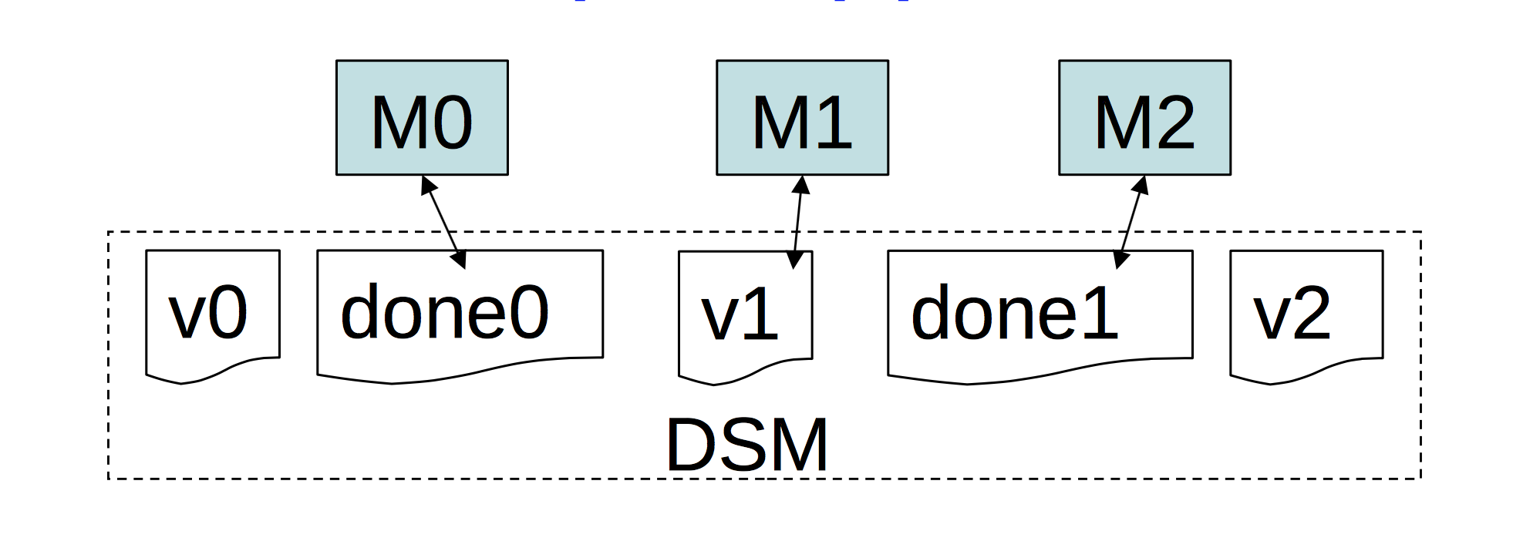
Distributed Shared Memory (DSM)
M0 writes a value v0 and sets a variable done0 = 1
After M0 finishes, M1 writes a value v1=f1(v0) and sets a variable done1 = 1
After M1 finishes, M2 writes a value v2=f2(v0,v1)

Slide 25
Distributed Shared Memory (DSM)
What’s the intuitive intent?
M2 should execute f2 based on v0 and v1, which are generated by M0 and M1
M2 needs to wait for M1 to finish
M1 needs to wait for M0 to finish

Slide 26
A Naïve Solution
Each machine maintains a local copy of all of memory
Operations
Read: from local memory
Write: send updates to all other machines
Fast: never waits for communication
Discussion
What’s the issue?

Slide 27
Problem with the naïve solution
M2 only needs to wait for done1 signal to start writing v2
But he doesn’t have the latest value of v0 yet!
M1 and M2 have inconsistent order of M0’s write and M1’s write

Slide 28
Naïve DSM
Fast but has unexpected behavior
A lot of consistency issues
And we need consistency models to build a distributed system!
Depending on what we want

Slide 29
Consistency Models
Memory system promises to behave according to certain rules, which constitute the system’s “consistency model”
We write programs assuming those rules
The rules are a “contract” between memory system and programmer

Slide 30
Consistency Models
Discussion
What’s the consistency model for a webpage, e.g., shopping, shared doc?
Consistency is hard in (distributed) systems:
Data replication (caching)
Concurrency
Failures

Slide 31
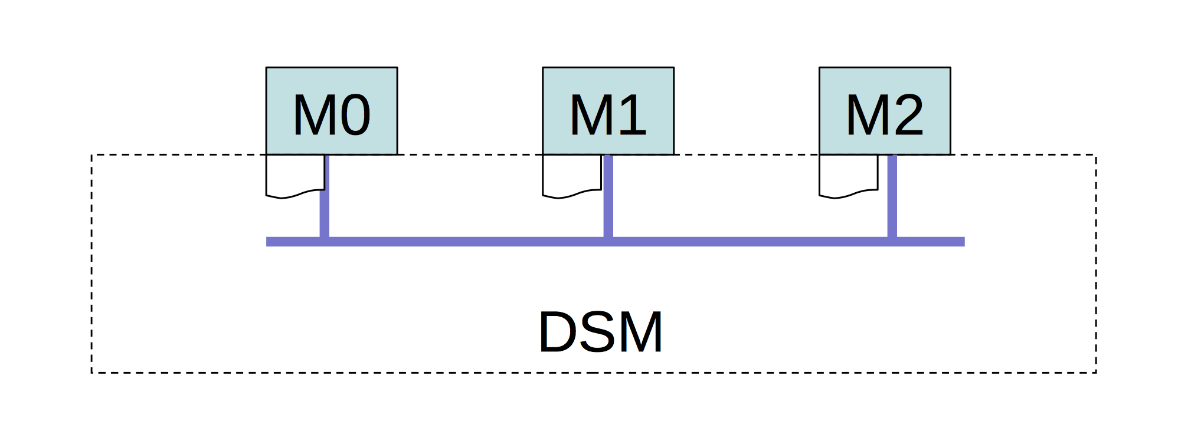
Model 1: Strict Consistency
Each operation is stamped with a global wall-clock time
Rules:
Rule 1: Each read gets the latest written value
Rule 2: All operations at one CPU are executed in order of their timestamps

Slide 32
Model 1: Strict Consistency
Suppose we already implement the rules
Rule 1: Each read gets the latest written value
Rule 2: All operations at one CPU are executed in order of their timestamps
Problem 1: Can M1 ever see v0 unset but done0=1?
Problem 2: Can M1 and M2 disagree on order of M0 and M1 writes?
So it essentially has the same semantics as a uniprocessor

Slide 33
Model 1: Strict Consistency
We are just like reading and writing on a single processor
Any execution is the same as if all read/write ops were executed in order of wall-clock time at which they were issued

Slide 34
Model 1: Strict Consistency
We are just like reading and writing on a single processor
Any execution is the same as if all read/write ops were executed in order of wall-clock time at which they were issued

Slide 35
How to implement Strict Consistency?
We need to ensure…
Each read must be aware of, and wait for, each write
RD@2 aware of WR@1; WR@4 must know how long to wait
Real-time clocks are strictly synchronized
Unfortunately
Time between instructions << speed-of-light
Real-clock synchronization can be tough (even now)
So, strict consistency is tough to implement efficiently

Slide 36
Model 2: Sequential Consistency
Slightly weaker model than strict consistency and linearizability
Doesn’t assume real time
Total order
All the machines maintain the same order of operations

Slide 37
Model 2: Sequential Consistency
Rules: There exists a total ordering of ops
Rule 1: Each machine’s own ops appear in order
Rule 2: All machines see results according to total order (i.e., reads see most recent writes)
We say that any runtime ordering of operations (also called a history) can be “explained” by a sequential ordering of operations that follows the rules

Slide 38
Does sequential order avoid problems?
There exists a total ordering of ops
Rule 1: Each machine’s own ops appear in order
Rule 2: All machines see results according to total order (i.e., reads see most recent writes)
Problem 1: Can M1 ever see v0 unset but done0=1?
M0's execution order was v0=... done0=...
M1 saw done0=... v0=...
Each machine's operations must appear in execution order so cannot happen w/ sequential consistency
Problem 2: Can M1 and M2 disagree on ops’ order?
M1 saw v0=... done0=... done1=...
M2 saw done1=... v0=...
This cannot occur given a single total ordering

Slide 39
Sequential Consistency Requirements
Each processor issues requests in the order specified by the program
Do not issue a new one unless last one has finished
Requests to an individual memory location (storage object) are served from a single FIFO queue.
Writes occur in a single order
Once a read observes the effect of a write, it’s ordered behind that write

Slide 40
Model 2: Sequential Consistency
Any execution is the same as if all read/write ops were executed in some global ordering, and the ops of each client process appear in the order specified by its program
Reads may be stale in terms of real time, but not in logical time
Writes are totally ordered according to logical time across all replicas

Slide 41
Model 2: Sequential Consistency
Any execution is the same as if all read/write ops were executed in some global ordering, and the ops of each client process appear in the order specified by its program
Reads may be stale in terms of real time, but not in logical time
Writes are totally ordered according to logical time across all replicas

Slide 42
Model 2: Sequential Consistency
Any execution is the same as if all read/write ops were executed in some global ordering, and the ops of each client process appear in the order specified by its program
Reads may be stale in terms of real time, but not in logical time
Writes are totally ordered according to logical time across all replicas
Strictly consistent
Sequentially consistent
Not Strictly consistent
Sequentially consistent

Slide 43
Model 2: Sequential Consistency
Any execution is the same as if all read/write ops were executed in some global ordering, and the ops of each client process appear in the order specified by its program
Reads may be stale in terms of real time, but not in logical time
Writes are totally ordered according to logical time across all replicas
Not Strictly consistent
Sequentially consistent
The global sequence
w(x)a, r(x)a, w(x)b, r(x)b, r(x)b

Slide 44
Model 2: Sequential Consistency
No notion of real time
Easier to implement efficiently
Performance is still not great
Once a machine's write completes, other machines' reads must see new data
Thus communication cannot be omitted or much delayed
Thus either reads or writes (or both) will be expensive

Slide 45
Linearizability
A slightly stronger model than sequential consistency
Also called atomic
Both sequential consistency and linearizability provide the behavior of a single copy
Linearizability
A read operation returns the most recent write, regardless of the clients
All subsequent read ops should return the same result until the next write, regardless of the clients
So we care about the completion time of an operation!

Slide 46
Linearizability
Sequential consistency example we just saw
With start and complete time…

Slide 47
Linearizability
With sequential consistency, as long as we have a global sequence, it’s fine
But in linearizability, every operation must be atomic, which means that the result is effective only after the operation has completed
The global sequence
w(x)a, r(x)a, w(x)b, r(x)b, r(x)b
The global sequence
w(x)a, w(x)b, r(x)b, r(x)b, r(x)b

Slide 48
Linearizability
It’s quite close to strict consistency
Strongest possible practical model
A lot of details are ignored in the figure. The actual protocol can be more complicated…
The global sequence
w(x)a, w(x)b, r(x)b, r(x)b, r(x)b

Slide 49
Distributed Shared Memory

Slide 50
Model 3: Causal Consistency
Causal consistency
Any execution is the same as if all causally-related read/write ops were executed in an order that reflects their causality
All concurrent ops may be seen in different orders
Lamport (logical) clock enforces causal consistency

Slide 51
Model 3: Causal Consistency
Reads are fresh only w.r.t. the writes that they are causally dependent on
Only causally-related writes are ordered by all replicas in the same way, but concurrent writes may be committed in different orders by different replicas, and hence read in different orders by different applications

Slide 52
Model 3: Causal Consistency
Any execution is the same as if all causally-related read/write ops were executed in an order that reflects their causality
All concurrent ops may be seen in different orders

Slide 53
Model 3: Causal Consistency
Reads are fresh only w.r.t. the writes that they are causally dependent on
Only causally-related writes are ordered by all replicas in the same way, but concurrent writes may be committed in different orders by different replicas, and hence read in different orders by different applications
w(x)a and w(x)b?
r(x)b (@P3) and w(x)b?
r(x)a (@P3) and w(x)a?
r(x)a (@P4) and w(x)a?
r(x)b (@P4) and w(x)b?

Slide 54
Model 3: Causal Consistency
Reads are fresh only w.r.t. the writes that they are causally dependent on
Only causally-related writes are ordered by all replicas in the same way, but concurrent writes may be committed in different orders by different replicas, and hence read in different orders by different applications
Only per-process ordering restrictions
w(x)a || w(x)b
w(x)b -> r(x)b
r(x)b -> r(x)a
Writes can be seen in different orders
by different processes

Slide 55
Model 3: Causal Consistency
Any execution is the same as if all causally-related read/write ops were executed in an order that reflects their causality
All concurrent ops may be seen in different orders
Not causally consistent
W(x)a -> w(x)c since they happen at the same process
P3 has read r(x)c so it cannot read r(x)a

Slide 56
Why Causal Consistency?
Causal consistency is strictly weaker than sequential consistency and can give weird results, as you’ve seen
If system is sequentially consistent -> it is also causally consistent (in the shared memory scenario)
BUT: it also offers more possibilities for concurrency
Concurrent operations (which are not causally-dependent) can be executed in different orders by different people
In contrast, with sequential consistency, you need to enforce a global ordering of all operations
Hence, one can get better performance than sequential

Slide 57
Model 4: Eventually Consistency
Allow stale reads, but ensure that reads will eventually reflect previously written values
Even after a very long time
Doesn’t order concurrent writes as they are executed, which might create conflicts later: which write was first?
Very widely used in real applications

Slide 58
Why Eventually Consistency?
More concurrency opportunities than strict, sequential, or causal consistency
Sequential consistency requires highly available connections
Lots of chatter between clients/servers
Sequential consistency may be unsuitable for certain scenarios
Disconnected clients (e.g. your laptop goes offline, but you still want to edit your shared document)
Network partitioning across datacenters
Apps might prefer potential inconsistency to loss of availability

Slide 59
Sequential vs. Eventual Consistency
Sequential: pessimistic concurrency handling
Decide on update order as they are executed
Eventual: optimistic concurrency handling
Let updates happen, worry about deciding their order later
May raise conflicts
Think about git – you may need to resolve conflicts
Resolving conflicts is not that difficult with code, but it’s very hard in general (e.g., image, video…)

Slide 60

Example Usage
Goal of file synchronization
All replica contents eventually become identical
No lost updates
Do not replace new version with old ones

Slide 61
Assuming we have a server where everyone is connected to…

Slide 62
Prevent Lost Updates
Detect if updates were sequential
If so, replace old version with new one
If not, detect conflict
How?

Slide 63
Prevent Lost Updates
Each write is attached with the timestamp
Problems?
We need clock synchronization to achieve fairness!
Otherwise, new data might have older timestamp than other replicas
Does not detect conflicts

Slide 64
A Better Idea
Carry the entire modification history
If history X is a prefix of Y, Y is newer
If it’s not, then detect and potentially solve conflicts

Slide 65
How to Deal with Conflicts
Easy: mailboxes with two different sets of messages
Medium: changes to different lines of a C source file
Hard: changes to the same line of a C source code
How?

Slide 66
So far
Strict consistency
Clock order
Sequential consistency
Global order
Linearizability
Strongest practical model
Causal consistency
Read/write sequence
Enforces order on the same process
Eventual consistency

Slide 67
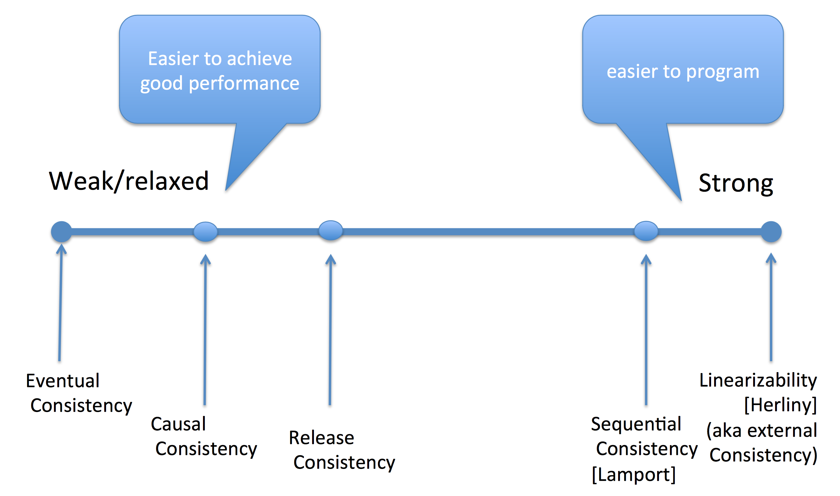

Slide 68
Consistency models in practice
Popular key-value stores
Amazon S3 (Eventual consistency)
Amazon Dynamo (Use Lamport clock to detect concurrency and resolve conflicts)
MySQL with asynchronous replication (Eventual consistency)
Blockchains
Linearizability/Sequential

Slide 69
Amazon S3
Amazon Simple Storage Service
Simple web services interface for reading and writing from anywhere
PUTS and DELETES
Read-after-write consistency for PUTS of new objects
A process writes a new object to Amazon S3 and immediately lists keys within its bucket. Until the change is fully propagated, the object might not appear in the list.
A process replaces an existing object and immediately attempts to read it. Until the change is fully propagated, Amazon S3 might return the prior data.
A process deletes an existing object and immediately attempts to read it. Until the deletion is fully propagated, Amazon S3 might return the deleted data.
A process deletes an existing object and immediately lists keys within its bucket. Until the deletion is fully propagated, Amazon S3 might list the deleted object.

Slide 70
Reading List
Optional:
Charron-Bost book. Chapter 1. (Different notations are used)
Tanenbaun book. Ch 7.1-7.3
Amazon S3 consistency model: https://docs.aws.amazon.com/AmazonS3/latest/dev/Introduction.html#ConsistencyModel

