Slide 1
IS 651: Distributed Systems Final Exam
Sisi Duan
Assistant Professor
Information Systems
sduan@umbc.edu

Slide 2
Final Exam
25% of the score
blackboard, 1 hour
Covers slides 7(primay-backup)-11(blockchain)
Requires LockDown browser
(If you haven’t used it before, there is one in blackboard called ‘mock exam’ where you can try)
Webcam will be enabled to monitor the response

Slide 3
Final
29 Questions total
13 Multiple choices, 4 pts each
16 True/False questions, 3 pts each
Each question has only one correct answer
2 minutes per question. Keep track of your time.
Most questions are similar with in-class exercises (Google form questions) and homework questions.
You can have some printout/materials in front of you to help you answer the questions.
You are not allowed to look up answers online.

Slide 4
What we have discussed so far
Primary backup
Consensus
Paxos
BFT
Blockchains

Slide 5
Replication for fault tolerance
Consistency challenges
Failures
Concurrency of messages

Slide 6
Replication methods
Active replication
Passive replication
What’s the difference?
Pros and cons?

Slide 7
Primary Backup replication
Passive replication
Fewer message exchange (lower network bandwidth)
Backups do not have to actively participate
Backup failures are easy to handle

Slide 8
Primary Backup Replication
Handling primary failure is not easy. Why?
Viewstamped replication
What’s it? Why does it work?

Slide 9
What we have discussed so far
Primary backup
Consensus
Paxos
BFT
Blockchains

Slide 10
Consensus problem
Some nodes propose something
All nodes, despite failures, agree on something
Correctness of consensus
Safety
Liveness

Slide 11
Consensus
X = read(A)
Y = read (B)
Write (A, X-100)
Write (B, y+100)
Distributed databases
ACID
Atomicity (All-or-nothing)
Consistency
Isolation (Concurrent requests do not interfere)
Durability (can tolerate failures)
T1: Transfer $100 from A to B
T2: Transfer $100 from A to C
A T1 fully completes or leaves nothing
D once T1 commits, T1’s writes are not lost
I no races, as if T1 happens either before or after T2
C preserves invariants, e.g., account balance > 0

Slide 12
Consensus
Isolation v.s. performance
Serializability
X = read(A)
Y = Read(B)
Write (A, x+100)
Write (B, y-100)
commit
X = read(A)
Y = Read(B)
Print (x+y)
commit
A (serial) schedule: R(A),R(B),W(A),W(B),C,R(A),R(B),C
Serializable? R(A),R(B), R(A),R(B),C, W(A),W(B),C
Serializable? R(A),R(B),C, R(A),R(B), W(A),W(B),C
Serializable? R(A),R(B), W(A), R(A),R(B),C, W(B),C

Slide 13
2PC
X = read(A)
Y = Read(B)
Write (A, x-100)
Write (B, y+100)
commit
Client sends a request to the coordinator
Coordinator sends a PREPARE message
A, B replies YES or NO
Coordinator sends a COMMIT or ABORT message
COMMIT if both say yes
ABORT if either says no

Slide 14
3PC
3PC solves the problem of 2PC by splitting COMMIT into PRE-COMMIT and COMMIT
But 3PC has network partition problem

Slide 15
What we have discussed so far
Primary backup
Consensus
Paxos
BFT
Blockchains

Slide 16
Paxos
Tolerates crash failures
Completely-safe and largely-live agreement protocol
Proposer, acceptor, learners
One proposer at a time (viewstamp replication)
Handle crash failures, network partitions, etc. (majority voting)

Slide 17
Paxos
Why Paxos is correct?
What’s the key to correctness?

Slide 18
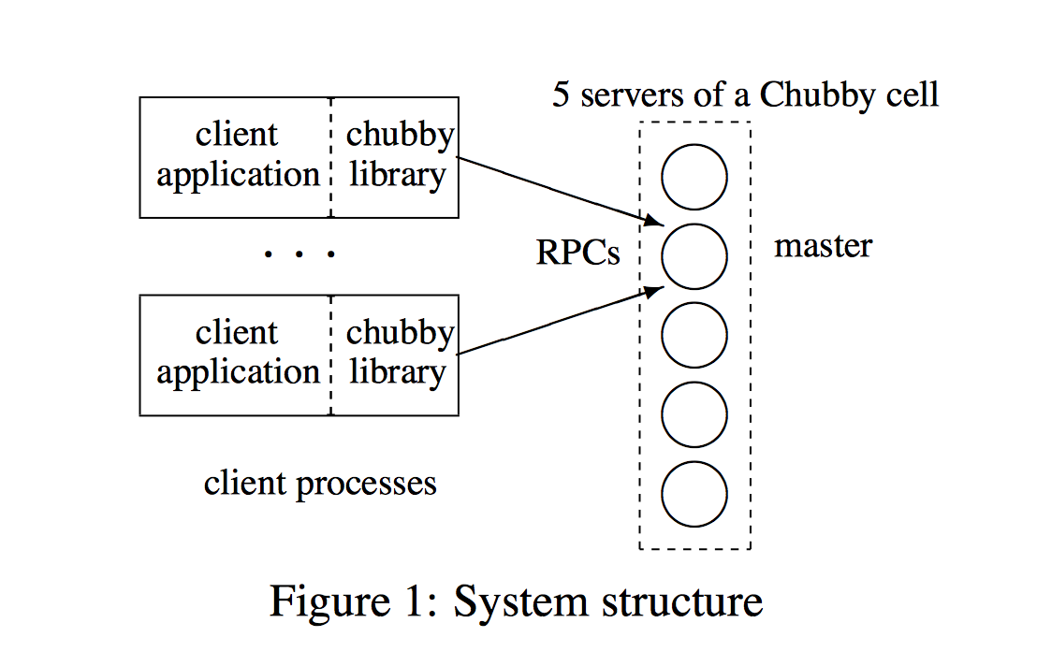
Chubby
Use Paxos to achieve high availability
Uses a slightly different method to elect leader and interactions between clients and servers

Slide 19
What we have discussed so far
Primary backup
Consensus
Paxos
BFT
Blockchains

Slide 20
BFT: What is it? Why?
BFT
Consensus problem
Mask Byzantine failures
3f+1 vs. f
indistinguishable

Slide 21
Key to correctness
BFT/Byzantine Quorum
2f+1 out of 3f+1
Difference between BFT quorum and CFT quorum?
Another way: If there are n nodes in the system…
Tolerates one-third failures f=(n-1)/3
Quorum (n+f+1)/2

Slide 22
PBFT
Key to correctness?

Slide 23
What we have discussed so far
Primary backup
Consensus
Paxos
BFT
Blockchains

Slide 24
Categories of blockchains
What’s it?
Based on underlying primitives
Permissionless
Permissioned
Hybrid
Based on participants
Public blockchains
Consortium blockchains
Private blockchains

Slide 25
Permissionless blockchain
What’s the problem it tries to solve?
Why it solves the same problem with permissioned blockchain?
What’s block?
What’s the chain?
How do we make sure everything is correct?
What are the issues?

Slide 26
Permisisoned blockchains
Consensus using BFT
Challenges?
Advantages compared to permissioned blockchain?

Slide 27
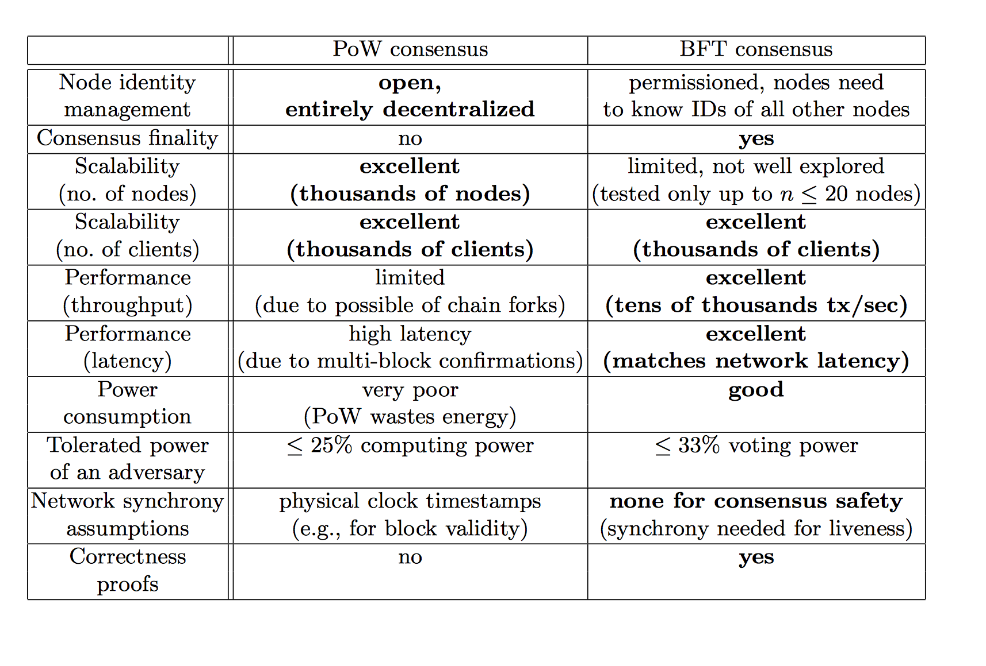
Permissionless v.s. Permissioned Blockchains
M. Vukolic 2015

