Slide 1
IS 651: Distributed Systems
Midterm
Sisi Duan
Assistant Professor
Information Systems
sduan@umbc.edu

Slide 2
Midterm
25% of the score
Oct 16, in-class, 2.5 hours
Covers slides 1(intro)-6(consistency)
Closed-book
One A4 page cheat sheet (front and back) – You prepare it.
Turn in the cheat sheet (with your name) at the end of the exam

Slide 3
Midterm
Multiple choices
  Similar with class exercises
Short answers/diagrams
  Similar with homework
No programming questions. But I may ask concepts.
Advice
  Explanation can help you get partial credit even your answer is not correct.
  Be brief, but not too simple.

Slide 4
What we have discussed so far
Distributed systems overview
Web technologies
Distributed communication
Time and synchronization
Mutual exclusion
Distributed File systems
Consistency

Slide 5
What we have discussed so far
Distributed systems overview
Web technologies
Distributed communication
Time and synchronization
Mutual exclusion
Distributed File systems
Consistency

Slide 6
Distributed Systems Overview
What is a distributed system?
  Who? What? How?
What are the architecture and design philosophy?
  Scalability
  Reliability
  Performance
  Openness

Slide 7
Distributed Systems Overview
Distributed systems goals
  Raise the level of abstraction, provide location transparency, scalability, availability, modularity
Distributed systems challenges
  Interfaces, scalability, consistency, fault tolerance, security

Slide 8
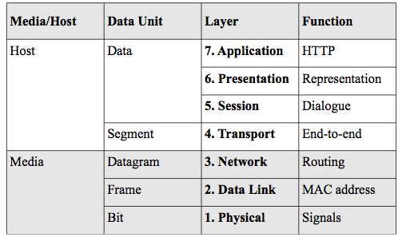
Distributed Systems Overview
Network layers
P2P
Onion Routing

Slide 9
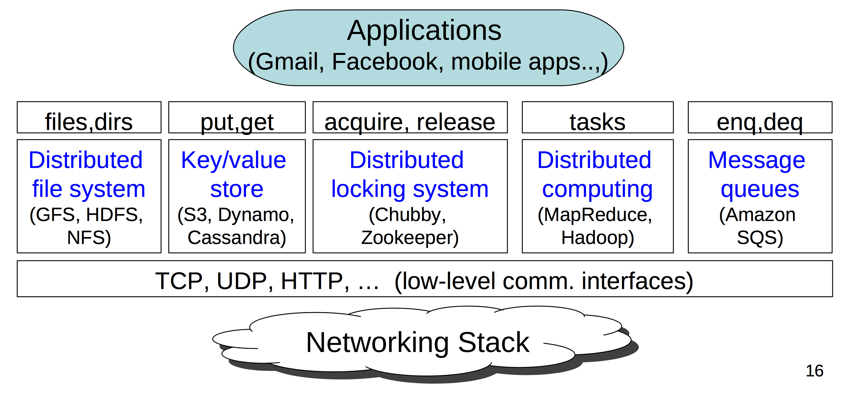
Distributed Systems Overview

Slide 10
What we have discussed so far
Distributed systems overview
Web technologies
Distributed communication
Time and synchronization
Mutual exclusion
Distributed File systems
Consistency

Slide 11
Web Technology
Client-Server Model

Slide 12
Web Technology: 3-tier architecture
What is good/bad about this architecture?
  + Modularity, better reliability/scalability
  - poor latency

Slide 13
Web Technology
Real Architecture
Why so many layers?
De-coupling
Performance
Scalability
Security
…

Slide 14
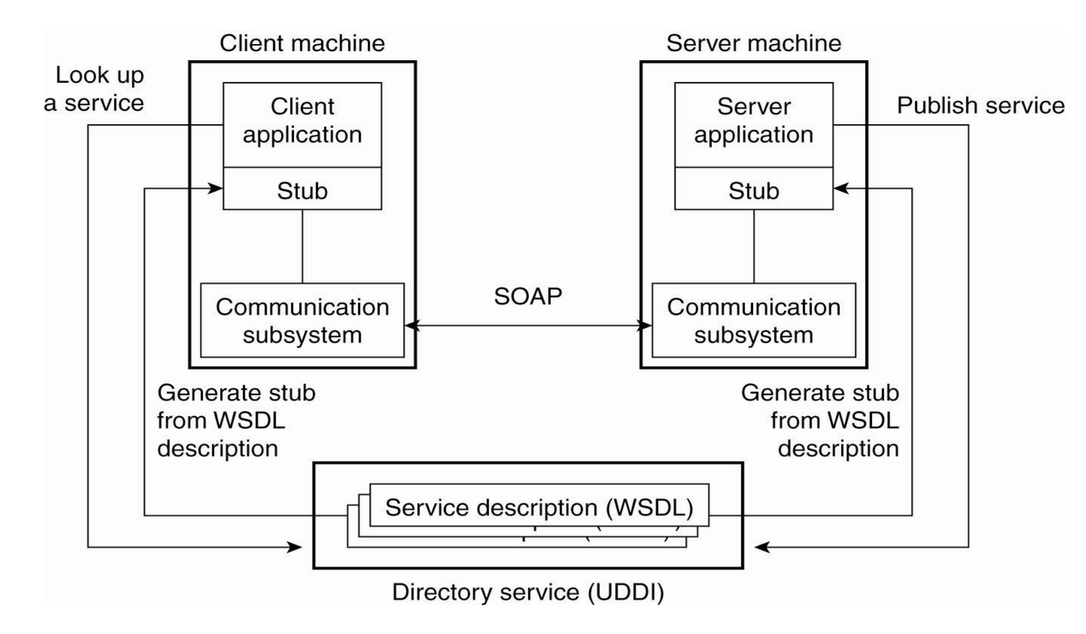
Web Service
Usually more complicated
  Services from multiple providers
Coordination is challenging

Slide 15
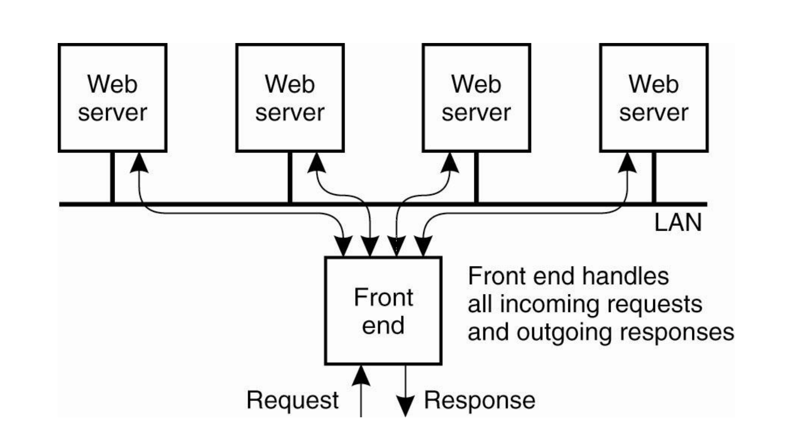
Web Service
Load balancing
  Content-aware distribution
    Always distribute the same request for the same document to the same server

Slide 16
What we have discussed so far
Distributed systems overview
Web technologies
Distributed communication
Time and synchronization
Mutual exclusion
Distributed File systems
Consistency

Slide 17
Distributed Communication
Sockets
Remote Procedure Call
Distributed Shared Memory

Slide 18
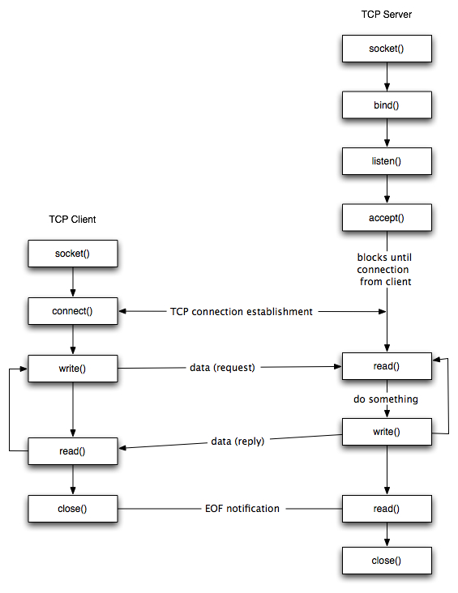
Distributed Communication
TCP vs UDP

Slide 19
sock = socket.socket(socket.AF_INET, socket.SOCK_STREAM)
sock.bind((hostname, port))
sock.listen(1)
conn,addr = sock.accept()
server_addr=(hostname,portnum)
sock.connect(server_addr)
sock.sendall(msg)
buf = conn.recv(8092)
sock.close()

Slide 20
Distributed Communication
Socket
  interface

Slide 21
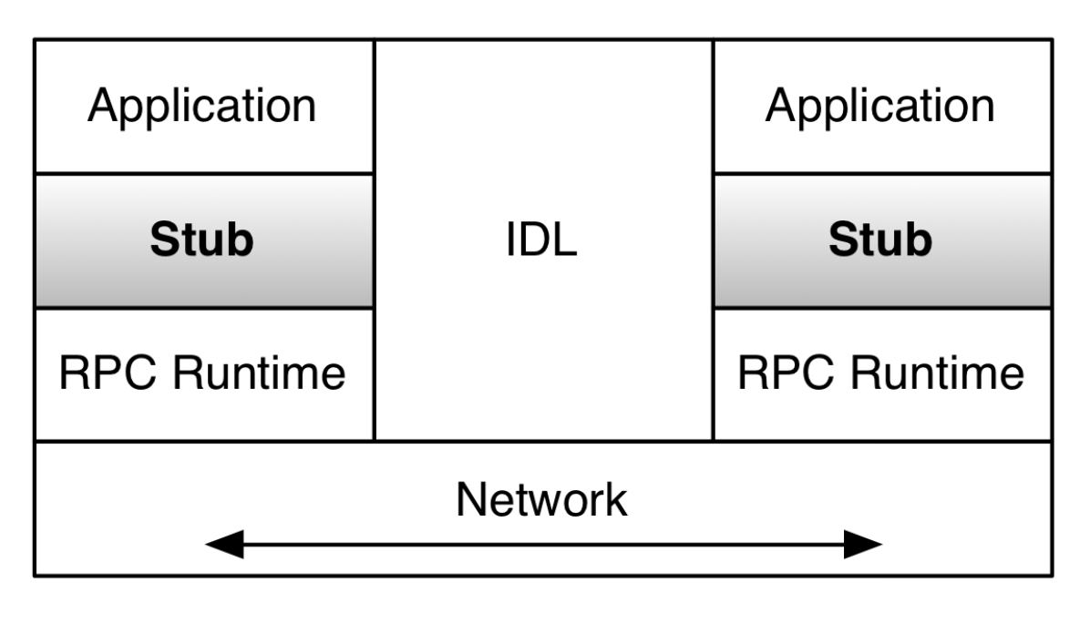
Distributed Communication
Remote Procedure Call (RPC)

Slide 22
Distributed Communication
RPC
  XML/RPC
  SOAP
    RPC-style
    Document-style
  Both use XML
  Advantages?
  Disadvantages?

Slide 23
What we have discussed so far
Distributed systems overview
Web technologies
Distributed communication
Time and synchronization
Mutual exclusion
Distributed File systems
Consistency

Slide 24
Time and Synchronization
Why?
Synchronizing real clocks
  Cristian’s algorithm
  The Berkeley Algorithm
  Network Time Protocol (NTP)
Logical clocks
  Lamport logical clocks
  Vector clocks

Slide 25
Time and Synchronization
Synchronizing real clocks
  Christian’s algorithm
  Berkerley algorithm
  NTP
  Never perfect

Slide 26
Time and Synchronization
Lamport clock
L(e1) = 1 (pitcher throws ball to home)
L(e2) = 2 (ball arrives at home)
L(e3) = 3 (batter hits ball to pitcher)
L(e4) = 4 (batter runs to first base)
L(e5) = 1 (runner runs to home)
L(e6) = 4 (ball arrives at pitcher)
L(e7) = 5 (pitcher throws ball to first base)
L(e8) = 5 (runner arrives at home)
L(e9) = 6 (ball arrives at first base)
L(e10) = 7 (batter arrives at first base)

Slide 27
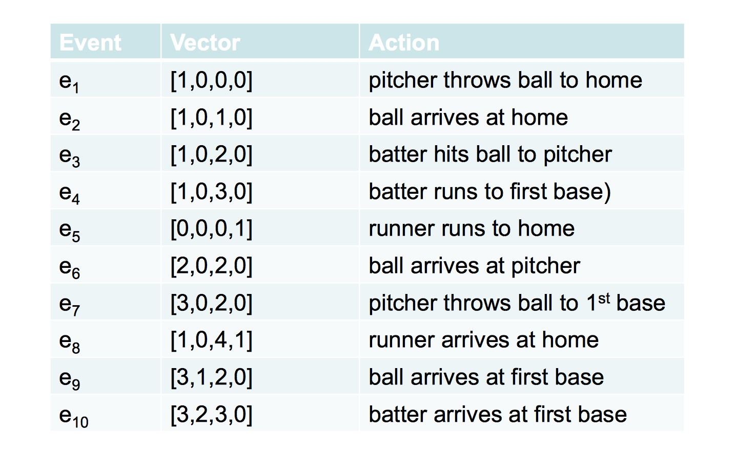
Time and Synchronization
Vector Clock

Slide 28
What we have discussed so far
Distributed systems overview
Web technologies
Distributed communication
Time and synchronization
Mutual exclusion
Distributed File systems
Consistency

Slide 29
Mutual Exclusion
What’s mutual exclusion?
Why?
Goals?
While true:
Perform local operations
Acquire()
Execute critical section
Release()

Slide 30
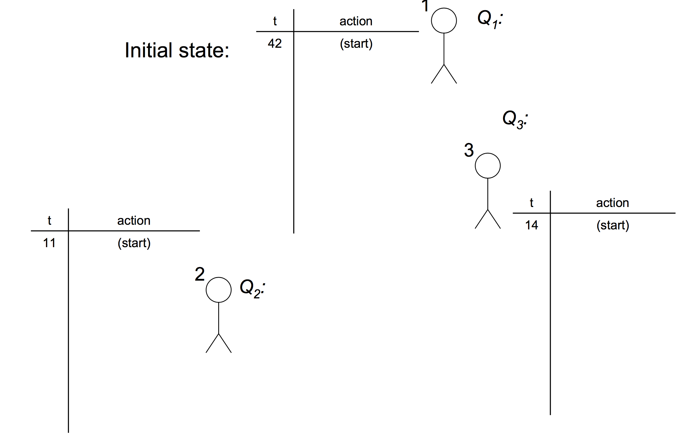
Mutual Exclusion
While true:
Perform local operations
Acquire()
Execute critical section
Release()
Centralized Solution
Ring based Solution
Shared priority queue
Majority voting

Slide 31
What we have discussed so far
Distributed systems overview
Web technologies
Distributed communication
Time and synchronization
Mutual exclusion
Distributed File systems
Consistency

Slide 32
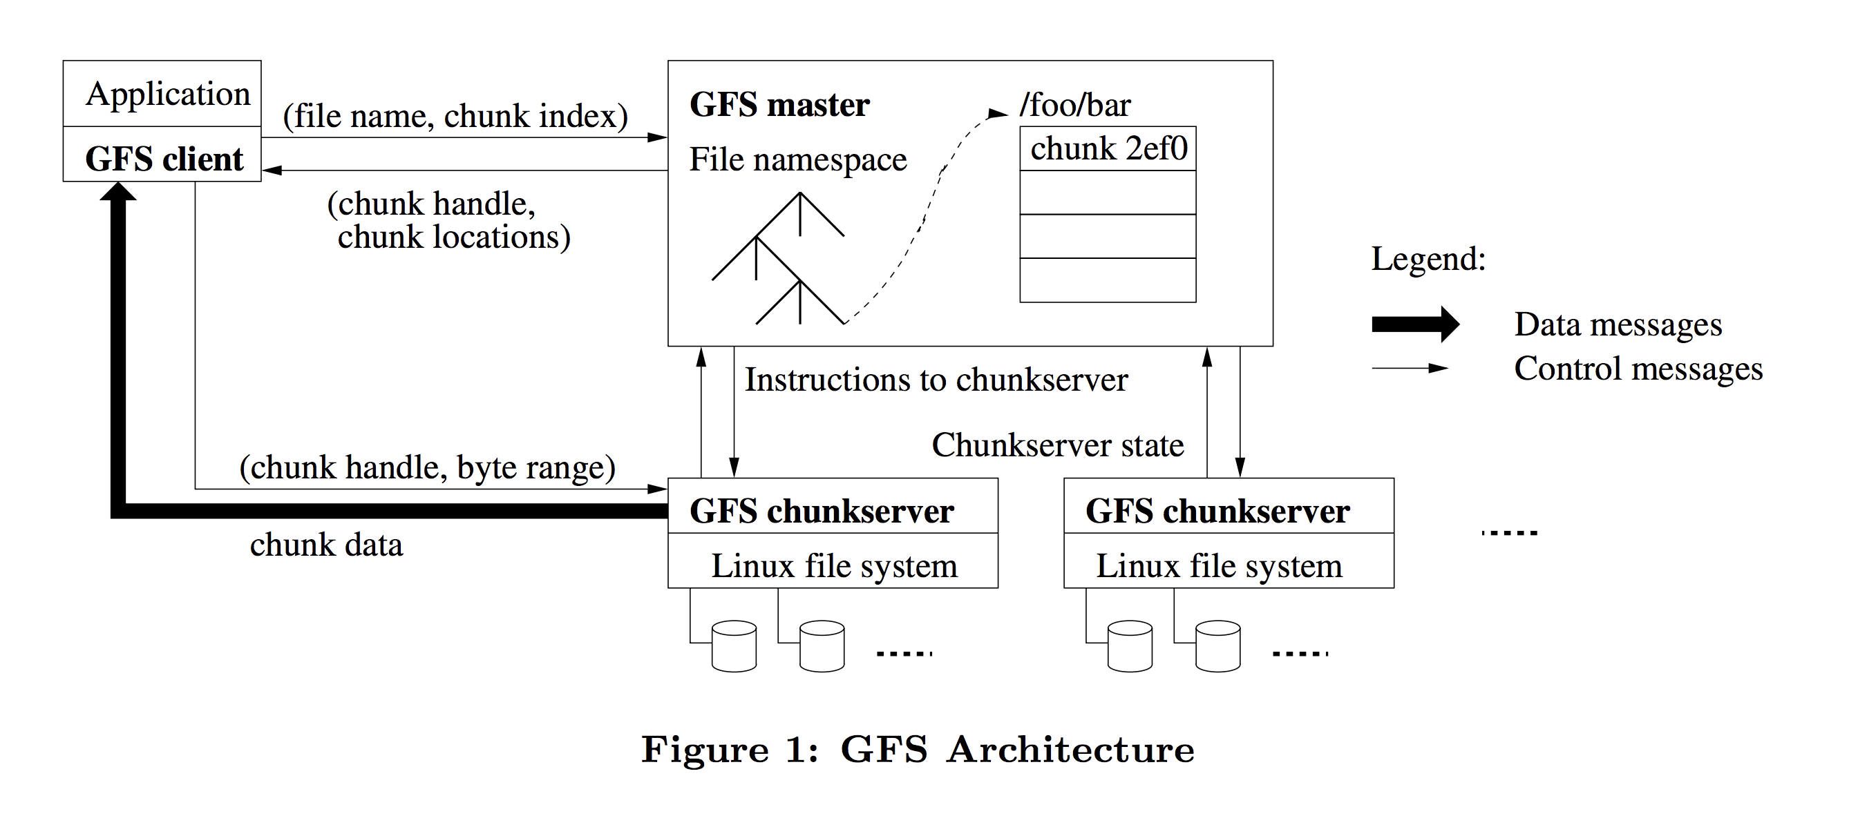
GFS Architecture
Client retrieves metadata from master
Read/Write data flows between client and chunkserver
Minimizing the master’s involvement in read/write operations alleviates the single-master bottleneck

Slide 33
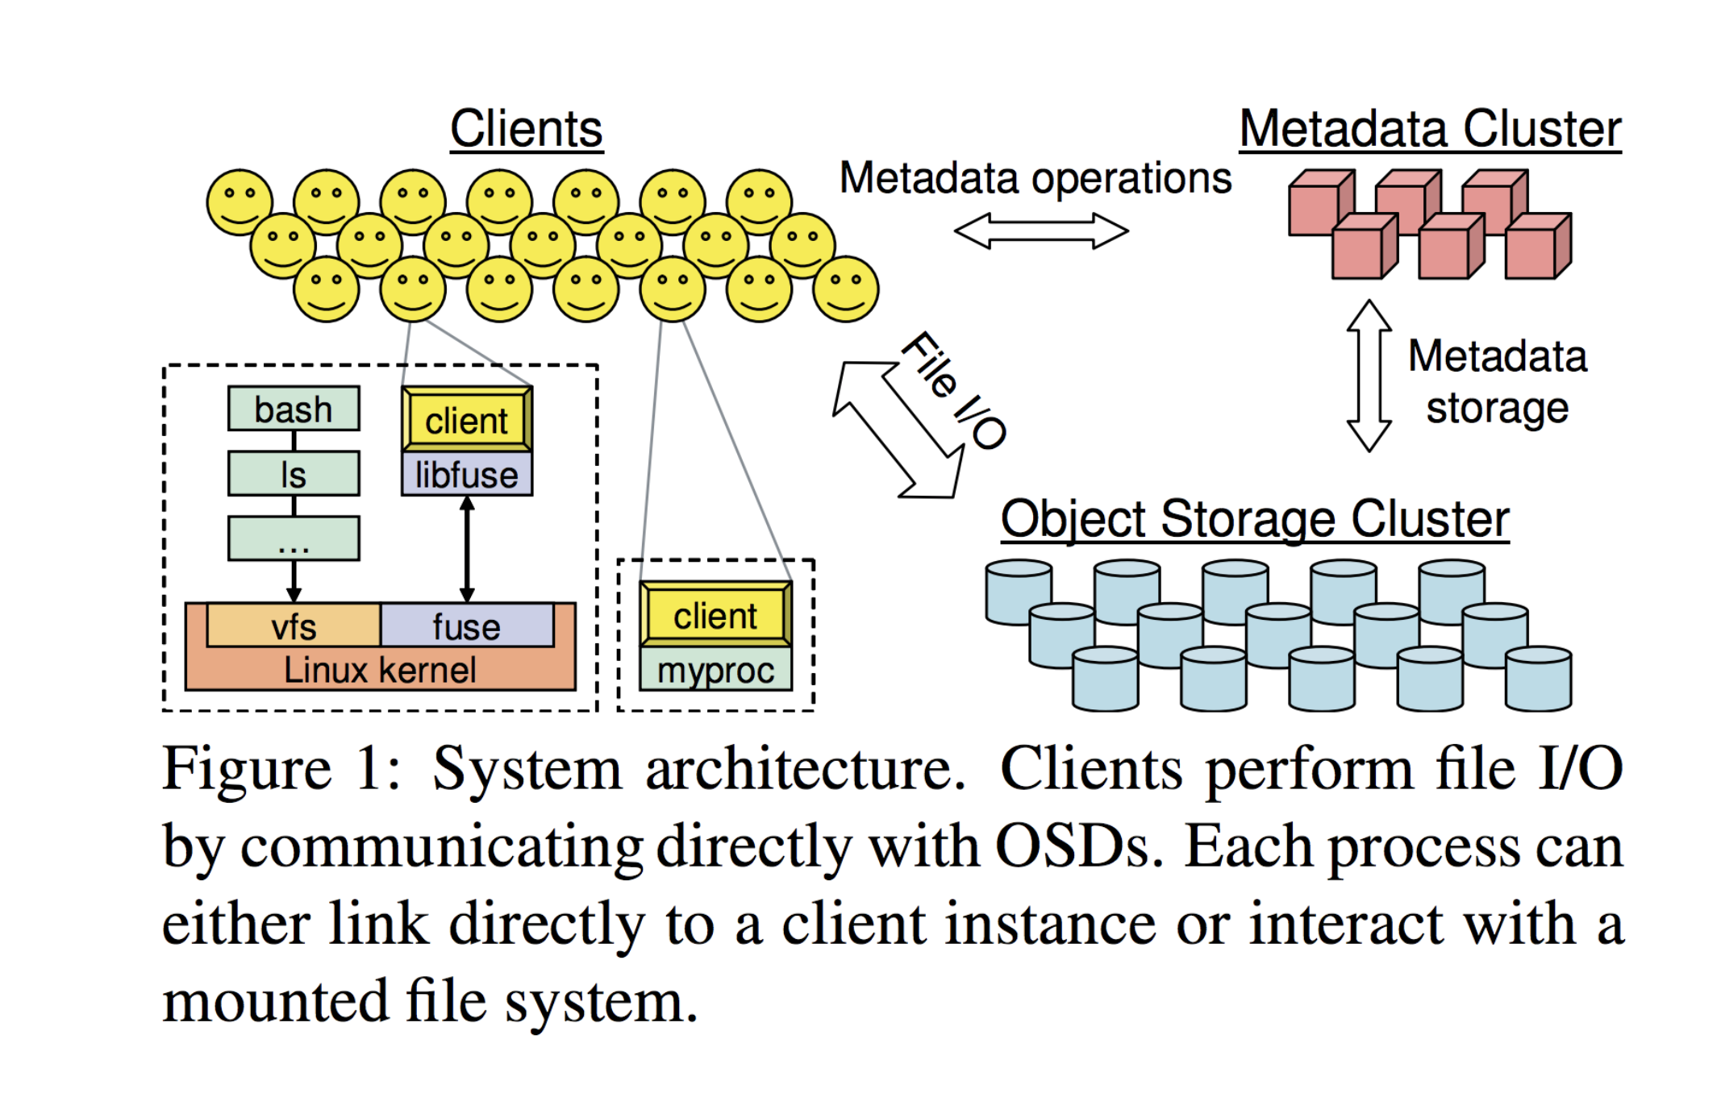
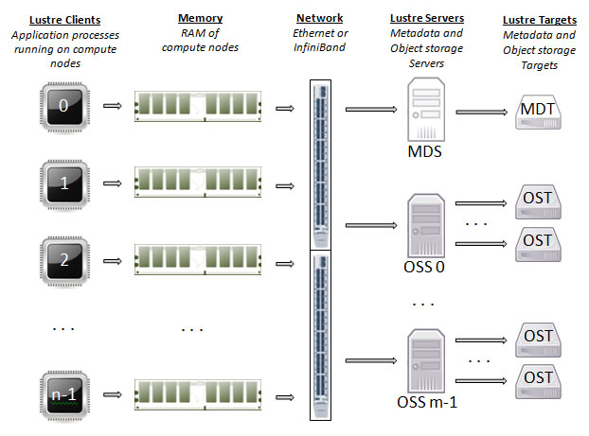
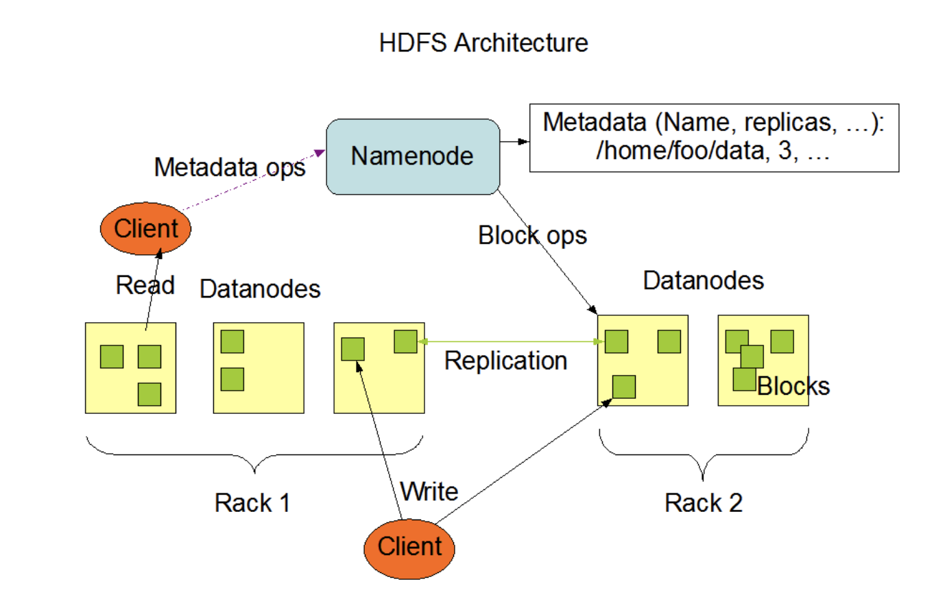
Distributed File Systems

Slide 34
What we have discussed so far
Distributed systems overview
Web technologies
Distributed communication
Time and synchronization
Mutual exclusion
Distributed File systems
Consistency

Slide 35
Consistency
Shared memory
Consistency model
  Rules
  ”contract” between memory system and programmer

Slide 36
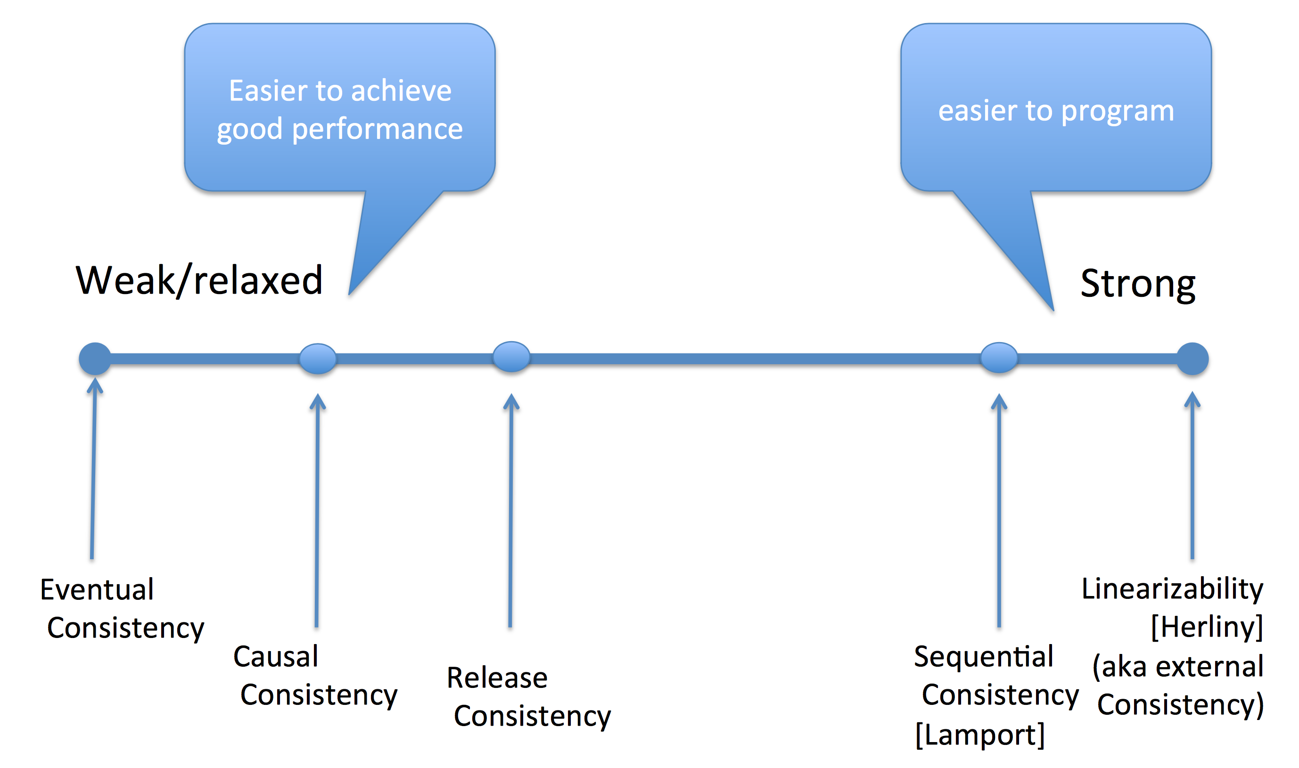

Slide 37
Consistency Models
Strict consistency
Sequential consistency
Causal consistency
Eventual consistency

