Slide 1
IS 698/800-01:
Advanced Distributed Systems
Scalable Byzantine Fault Tolerance
Sisi Duan
Assistant Professor
Information Systems
sduan@umbc.edu

Slide 2
Outline
The cost of scalability
Available methods
Steward
Eyrie

Slide 3
The cost of BFT/Permissioned Blockchains
Unfortunately, Byzantine agreement requires a number of messages quadratic in the number of participants, so it is infeasible for use in synchronizing a large number of replicas (Pond: the OceanStore prototype)
Eventually batch cannot compensate for the quadratic number of messages of Practical Byzantine Fault Tolerance (PBFT) (HQ replication)
The communication overhead of Byzantine Agreement is inherently large (server-initial agreement for general hierarchy wired/wireless networks)

Slide 4
Available Techniques and Limits
Denial of Service attacks
  A good node cannot afford handling too many requests at a time
  Overlay network/hierarchy
  Challenges: who can decide the roles and positions of the nodes?
Amplifying Randomness
  Select a small set of representative nodes which generate an agreed upon logarithmic length string with mostly random bits
Running elections
  Construct a small set of representatives

Slide 5
The key to scalable SMR
Hierarchy
  Steward
  Amir, Yair, et al. "Scaling byzantine fault-tolerant replication towide area networks." DSN. IEEE, 2006.
Partitions/Sharding
  Eyrie/Volery
  Bezerra, Carlos Eduardo, Fernando Pedone, and Robbert Van Renesse. "Scalable state-machine replication." DSN. IEEE, 2014.

Slide 6
Steward Hierarchy
Multiple wide area sites
Each site is like a group
S sites, N nodes
Clients can be located at any sites
Read requests can be performed locally
Write requests need to be totally ordered
(Guess what will it look like? What are the requirements?)

Slide 7
Steward benefits
Reduces the complexity from O(N²) to O(S²)
Tolerates malicious replicas to local site, enabling the use of a benign fault-tolerant algorithm over the WAN
Read requests are performed locally
Public keys of replicas need to be known only within their own site
How does the protocol work?

Slide 8
The Architecture
Every site has a representative
A leading site for all the sites

Slide 9
The Normal Operations
Client->local server->local site representative->leading site

Slide 10
The Normal Operations
Leading site:
  ASSSIGN-SEQUENCE procedure
  Output: proposal, THRESHOLD-SIGN
  Representative sends the output to the representatives of all the sites

Slide 11
The Normal Operations
Upon receiving proposal:
  Forwards to servers in the site
A server
  Generates ACCEPT
  TREHOLD-SIGN it
Representative
  Combines signatures and send to to other sites
How many ACCEPT messages are good enough?

Slide 12
The Normal Operations
Upon receiving ACCEPT from other sites
  Forward the ACCEPT to local servers
A server
  Commit when receiving N/2 ACCEPT messages
Reply to the client

Slide 13
A few concerns and issues
Which protocol should the leading site run?
What’s the THRESHOLD-SIGN configuration
What’s the underlying failure consideration?

Slide 14
A few concerns and issues
What if the client does not get response for a long time?
What if the leading site fail?
What if a site representative fail?

Slide 15
The timeouts
Local representative (T1)
  When no global progress takes place for a period of time
Leading site representative (T2)
  For servers in the leading site only
  When no global progress takes place for a period of time
  T2>(f+2)*maxT1
Leading site (T3)
  No progress…
  T3=(f+3)T2
Client timer (T0)
  When expired, broadcast to all nodes

Slide 16
View changes
Local view change
  Change site representative
Global view change
  Change leading site

Slide 17
View changes
Construct collective state
  Guarantee intra-site reconciliation to safely make progress
  Generating a message reflecting the site’s level of knowledge (global view change)
Procedures
  Site representative -> all servers in the site: seq
  Servers->representative: acknowledge with all the execution history
  Site representative -> all: new view
  Servers : TRESHOLD-SIGN the message

Slide 18
View Changes
Local View Change
  New representative
    Invoke CONSTRUCT-COLLECTIVE-STATE
    View changes…
    Invoke ASSIGN-SEQUENCE to replay all pending updates in the view changes
Global View Change
  After leading site election
  Representative of the new leading site
    Invoke CONSTRUCT-COLLECTIVE-STATE
    The new leading site generates a new view and threshold signatures by the site members
    Send to all the site representatives

Slide 19
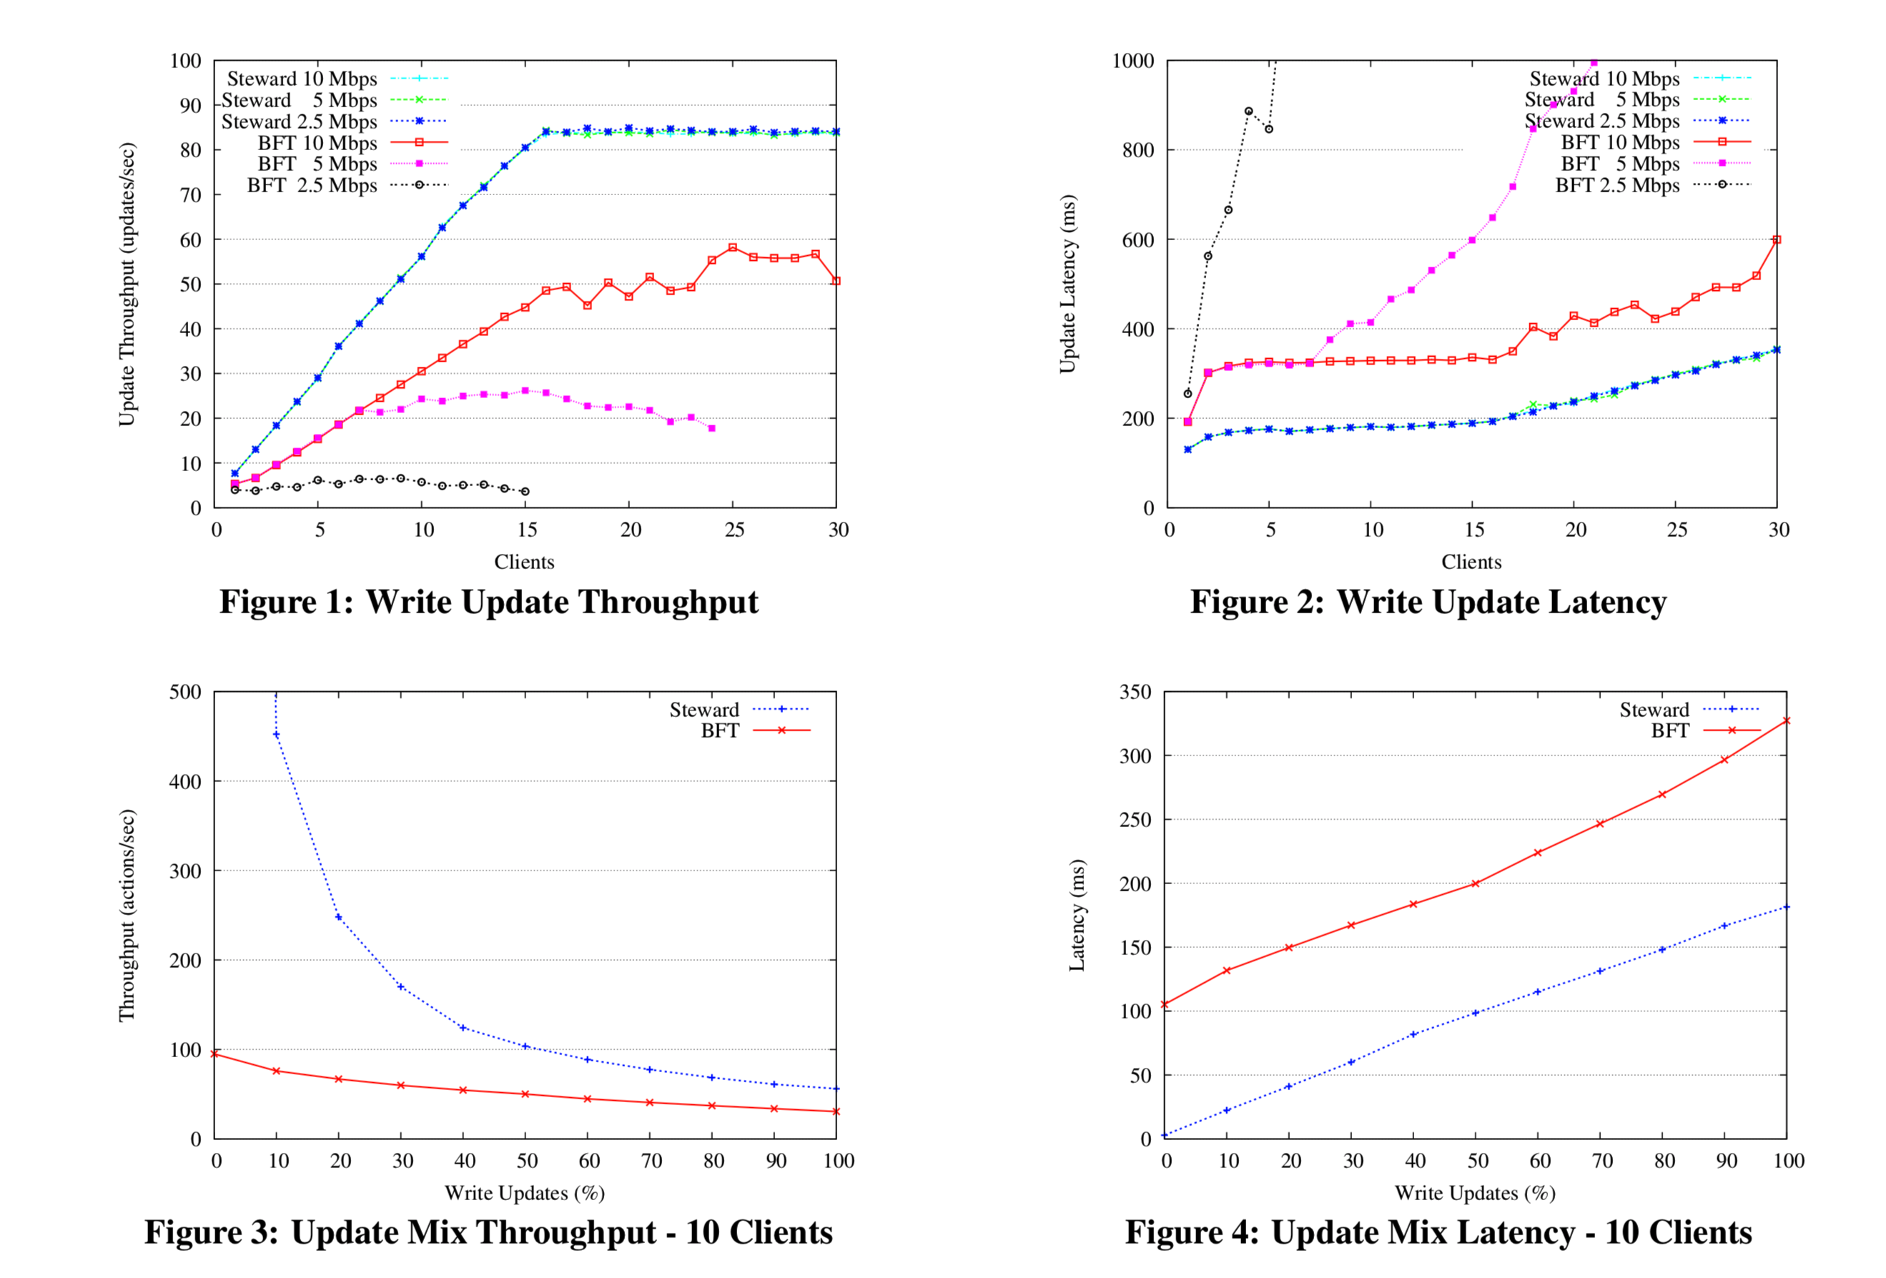
Evaluation
Testbed: planetlab
5 sites, using up to 20 3.2GHz, 64 bit Intel Xeon computers.
16 machines for the leading site. 1 machine for each non-leading site

Slide 20
What are the issues?
Safety
Timers
Failure model

Slide 21
Eyrie
Bezerra, Pedone, van Renesse. DSN 2014
Partition based consensus
S-SMR (scalable state machine replication)
P partitions, P₁, ….P_{P}
Application state V
For each variable v in V, it must be assigned to at least one partition part(v)
Each partition is replicated by servers in group S_{i}

Slide 22
Eyrie
To execute a command C
  Client multicasts C to all partitions that hold the variables by C
  (The assumption: the client knows the partitions these variables belong to)
When receiving command C
  If the server has all the variables in C, execute it
  Otherwise, communicate with the servers in other partitions to execute C
  The operation op (read, write, or computation operation)

Slide 23
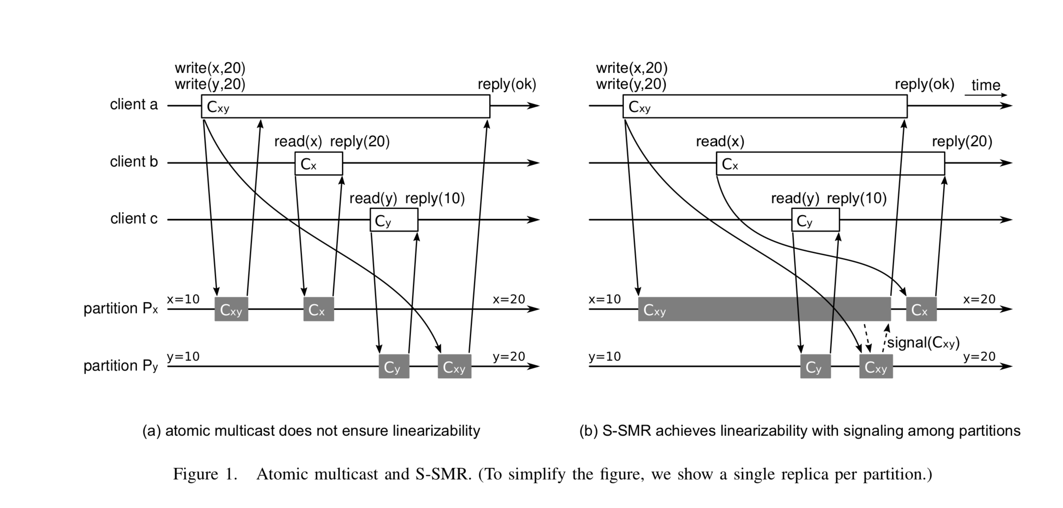
The procedure
Linearizability: the effect of an operation is not reflected until the operation finishes
Total order of ending time…

Slide 24
The signal process
For commands that involve more than one partition
Every partition has replicas
X: P1, P2, P4, Y: P3, P5, P6…
When executing an operation
Send signal to all the replicas involved in the command
Wait until it receive a signal(C) from at least on server in every other partition
To tolerate f failures, how many replicas for each partition should we have?
Notes:
F+1 replicas

Slide 25
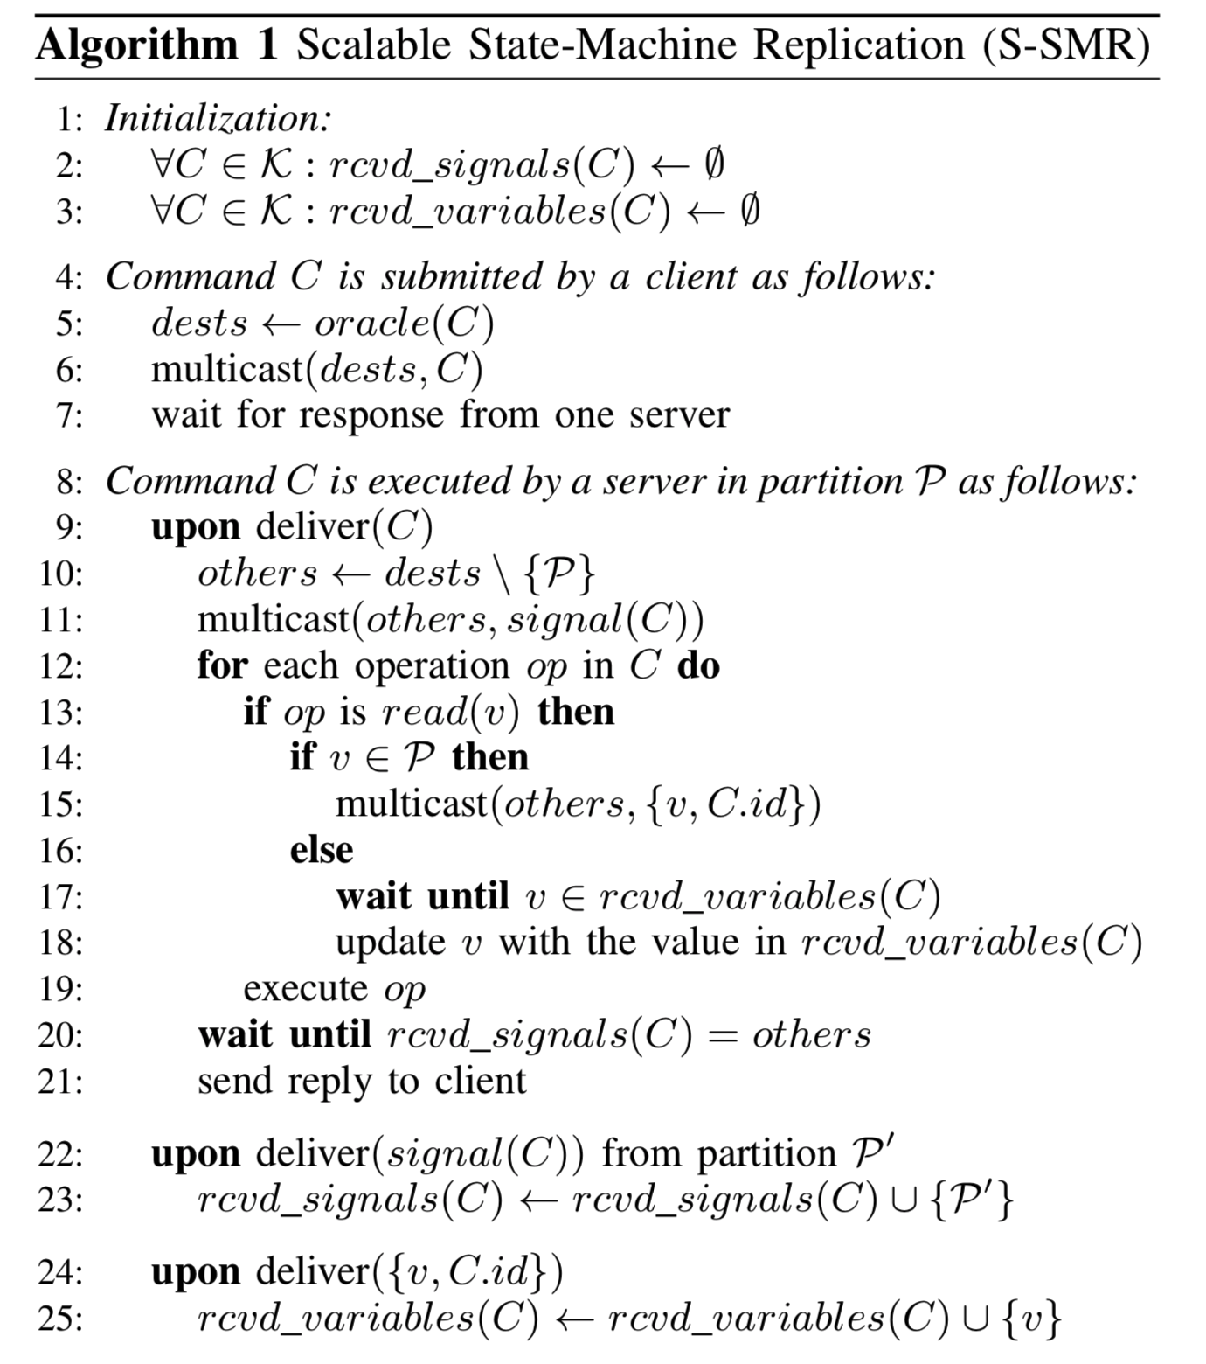
The more concrete procedures
Client sends C to all the involved servers
Upon receiving C
  Server s multicasts signal(C) to others
  Buffers all the incoming messages and wait for enough signal(C)
  Execute the command (the only thing that cannot be done immediately locally: read(v))
    If the value v belongs s’s partition, send to the nodes
    Otherwise, waits until up-to-date value of v has been delivered
Notes:
F+1 replicas

Slide 26
Issues and optimization
One result from one server in each partition is good enough
  We still need to maintain consistency among all the replicas (?)
Optimization
  Conservative caching
    Update after getting messages from other servers
  Speculative caching
    Assuming the cached value is up-to-date

Slide 27
Hierarchy vs partition-based SMR
Number of nodes that are involved
  Hierarchy: all the nodes still need to learn the results
  Partition: only those nodes that are involved in the relevant partitions
Total order of requests
  Hierarchy: yes and straightforward
  Partition: only order those requests that might create conflicts…
Bottleneck
  Hierarchy: group communication
  Partition: operations that involve multiple partitions

