Slide 1
IS 698/800-01: Advanced Distributed Systems Asynchronous Byzantine Fault Tolerance
Sisi Duan
Assistant Professor
Information Systems
sduan@umbc.edu

Slide 2
Overview
Asynchrony vs. partial synchrony
Randomized BFT
HoneyBadgerBFT
BEAT
Asynchronous Binary Agreement

Slide 3
Asynchrony vs. Partial Synchrony
In an asynchronous system, there are no bounds on message transmission delays or process execution rates
Yields protocols that are most robust to timing and denial-of-service attacks
Deterministic total ordering is impossible [Fischer et al., JACM 1985], and so protocols can be only probabilistically live
In a partially synchronous system, there exist such bounds but they are unknown to participants in the system
Where most of the action has been in the last 20 years
These almost always rely on a view-change subprotocol to cope with failures

Slide 4
General BFT SMR vs. (Just) BFT Storage
In both general BFT SMR and BFT Storage, state is represented as a key-value store
“BFT Storage” supports only Read and Write operations
Sometimes called “atomic registers” in the distributed computing literature
“General BFT SMR” supports arbitrary operations (transactions) on the key-value store

Slide 5
Another Look at FLP
Consensus: getting a number of processors to agree a value
In asynchronous system
A faulty node cannot be distinguished from a slow node
Correctness of a distributed system
Safety
No two correct nodes will agree on inconsistent values
Liveness
Correct nodes eventually agree

Slide 6
Put FLP to consensus
Cannot guarantee termination
p₀
p₁
p₂
p₃

Slide 7
Overview of Randomized BFT
Key to termination
Random shared coin
Same for all the replicas
If enough votes are collected
Agree on the value
Otherwise, agree on the random coin

Slide 8
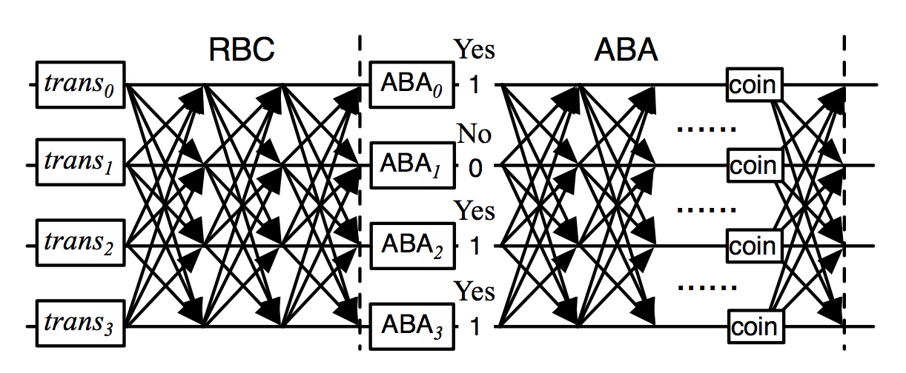
HoneyBadgerBFT [Miller et al., CCS 2016]
Implements total order using Asynchronous Common Subset (ACS) [Ben-Or et al., PODC 1994; Cachin et al., CRYPTO 2001]
Implements ACS, in turn, using Reliable broadcast (RBC) and asynchronous binary Byzantine agreement (ABA)

Slide 9
Asynchronous Common Subset (ACS)
The goal
Every node proposes some transactions
Agree on the superset of all the proposed transactions

Slide 10
Asynchronous Common Subset (ACS)
RBC: Reliable broadcast
Every node proposes some transactions
Randomly from the transaction pool
ABA
Agreement on the proposed transactions by each node
N parallel ABAs

Slide 11
From HoneyBadger to BEAT
A family of protocols for asynchronous networks
Built as a series of adaptations to HoneyBadgerBFT [Miller et al., CCS 2016]
Protocol | Applicability | Features
BEAT0 | General BFT SMR | Efficient threshold encryption & coin flipping Efficient erasure-coding support
BEAT1 | General BFT SMR | Reduced latency via different subprotocol combination
BEAT2 | General BFT SMR | Reduced latency via client-side threshold encryption
BEAT3 | BFT Storage | Storage/bandwidth savings through new protocol combo
BEAT4 | BFT Storage | Read bandwidth savings through new fingerprinted cross checksums

Slide 12
Reliable Broadcast [Bracha, Information and Computation 1987]
A designated replica (the broadcaster) broadcasts a message to all replicas, with the following guarantees:
If any correct replica delivers a broadcast message B, then all correct replicas deliver B.
If the broadcaster is correct, then every correct replica delivers the broadcaster’s message.
Bracha’s protocol tolerates f faulty replicas out of n = 3f+1.

Slide 13
Reliable Broadcast [Bracha, Information and Computation 1987]
B
p₀
p₁
p₂
p₃
“Initiate”

Slide 14
Reliable Broadcast [Bracha, Information and Computation 1987]
B
p₀
p₁
p₂
p₃
“Initiate”
“Echo”

Slide 15
Reliable Broadcast [Bracha, Information and Computation 1987]
B
p₀
p₁
p₂
p₃
“Initiate”
“Echo”

Slide 16
Reliable Broadcast [Bracha, Information and Computation 1987]
B
Communication complexity is O(n²|B|)
p₀
p₁
p₂
p₃
“Initiate”
“Echo”
“Ready”

Slide 17
How to make it cheaper?
Multiple methods
One method:
Reduce the network bandwidth
Erasure coding

Slide 18
AVID [Cachin and Tessaro, SRDS 2005]
Leverages erasure coding and cross checksums to reduce communication complexity to O(n|B|), assuming hashes are free
d₁
B
d₂
Cross checksum
d₃
d₄
Erasure coded fragments
Hashes

Slide 19
AVID [Cachin and Tessaro, SRDS 2005]
Broadcaster sends fragment d_{i} and cross-checksum to replica i, and replica i echoes these to all replicas
For example, at replica 2 …
d₁
From broadcaster:
d₂
B
d₂
Echo from replica 3:
d₃
d₃
Echo from replica 4:
d₄
d₄

Slide 20
AVID-FP [Hendricks et al., PODC 2007]
Additionally leverages homomorphic fingerprints to reduce communication complexity to O(|B|), assuming fingerprints are free
d₁
B
d₂
d₃
d₄
Erasure coded fragments
Fingerprints

Slide 21
AVID-FP [Hendricks et al., PODC 2007]
Broadcaster sends fragment d_{i} and fingerprinted cross-checksum to replica i, and replica i echoes only the fingerprinted cross checksum
For example, at replica 2 …
Replica 2 echoes only the fingerprinted cross-checksum
From broadcaster:
d₂

Slide 22
BEAT
All erasure-coded systems for arbitrary failures use conventional maximum distance separable (MDS) codes (e.g., Reed-Solomon)
Modern erasure-coding schemes can further reduce the read bandwidth, however
BEAT4 incorporates a new adaptation of AVID-FP to pyramid codes [Huang et al., ACM TOS 2013]
Improves read bandwidth by ~50%, in exchange for ~10% additional storage

Slide 23
Asynchronous Binary Agreement
Secret sharing
Based on threshold cryptography
A secret is shared among n parties such that the cooperation of at least t + 1 parties is needed to recover s

Slide 24
Asynchronous Binary Agreement
Binary Byzantine Agreement
Propose(b): start the protocol
decide(b): terminate it, for a bit b
Correctness
Validity: If all honest servers propose v, then some honest server eventually decides v.
Agreement: If some honest server decides v and a distinct honest server decides v′, then v=v′.
Termination: Every honest server eventually decides

Slide 25
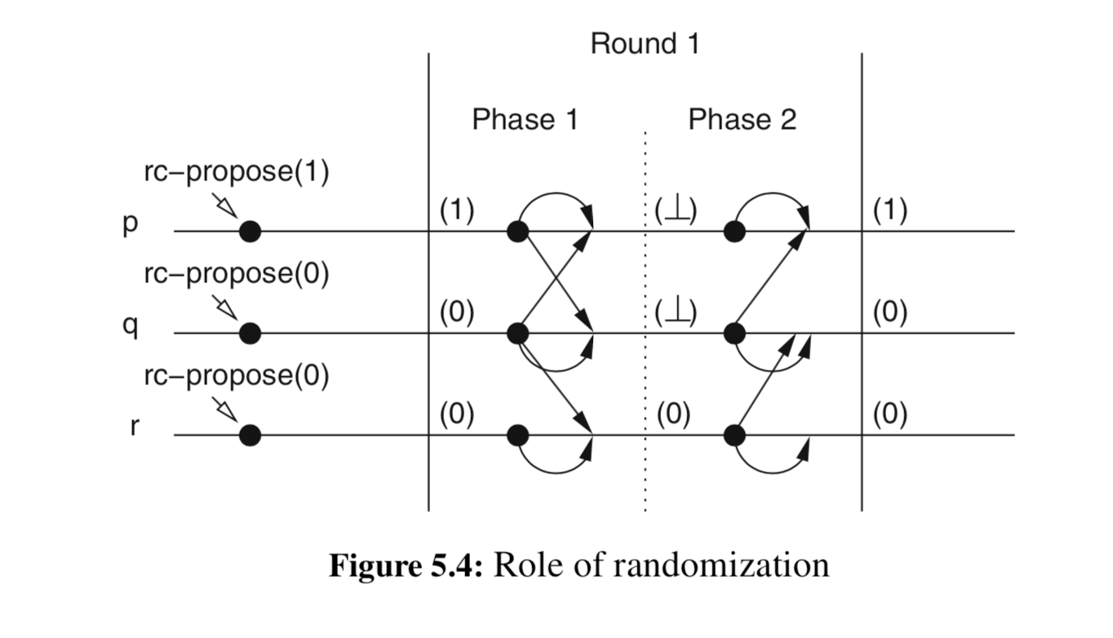
Consider crash failures only for now
Phase 1: propose v
If receiving v from the majority, ok
Otherwise, proposal = NULL
Phase 2, propose proposal
If receiving matching v from the majority, decision = v
Otherwise,
if it has a value w, proposal = w
Otherwise, proposal = c (common coin)
Continue phase 1 if no decision is made
Cachin, Christian, Rachid Guerraoui, and Luís Rodrigues. Introduction to reliable and secure distributed programming. Springer Science & Business Media, 2011.

Slide 26
Consider crash failures only for now
The difficulty of majority voting without common coin
Phase 1: propose v
If receiving v from the majority, ok
Otherwise, proposal = NULL
Phase 2, propose proposal
If receiving matching v from the majority, decision = v
Otherwise,
if it has a value w, proposal = w (??)
Otherwise, proposal = c (common coin)
Continue phase 1 if no decision is made
Notes:
In the first phase, p gets 1 and 0 (from q). Decide NULL. Q receives 1 from p, decide NULL. R receives 0 from q, select 0.
In the second phase, p receives null from itself and q, select 1. q receives NULL from itself and p, select 0.

Slide 27
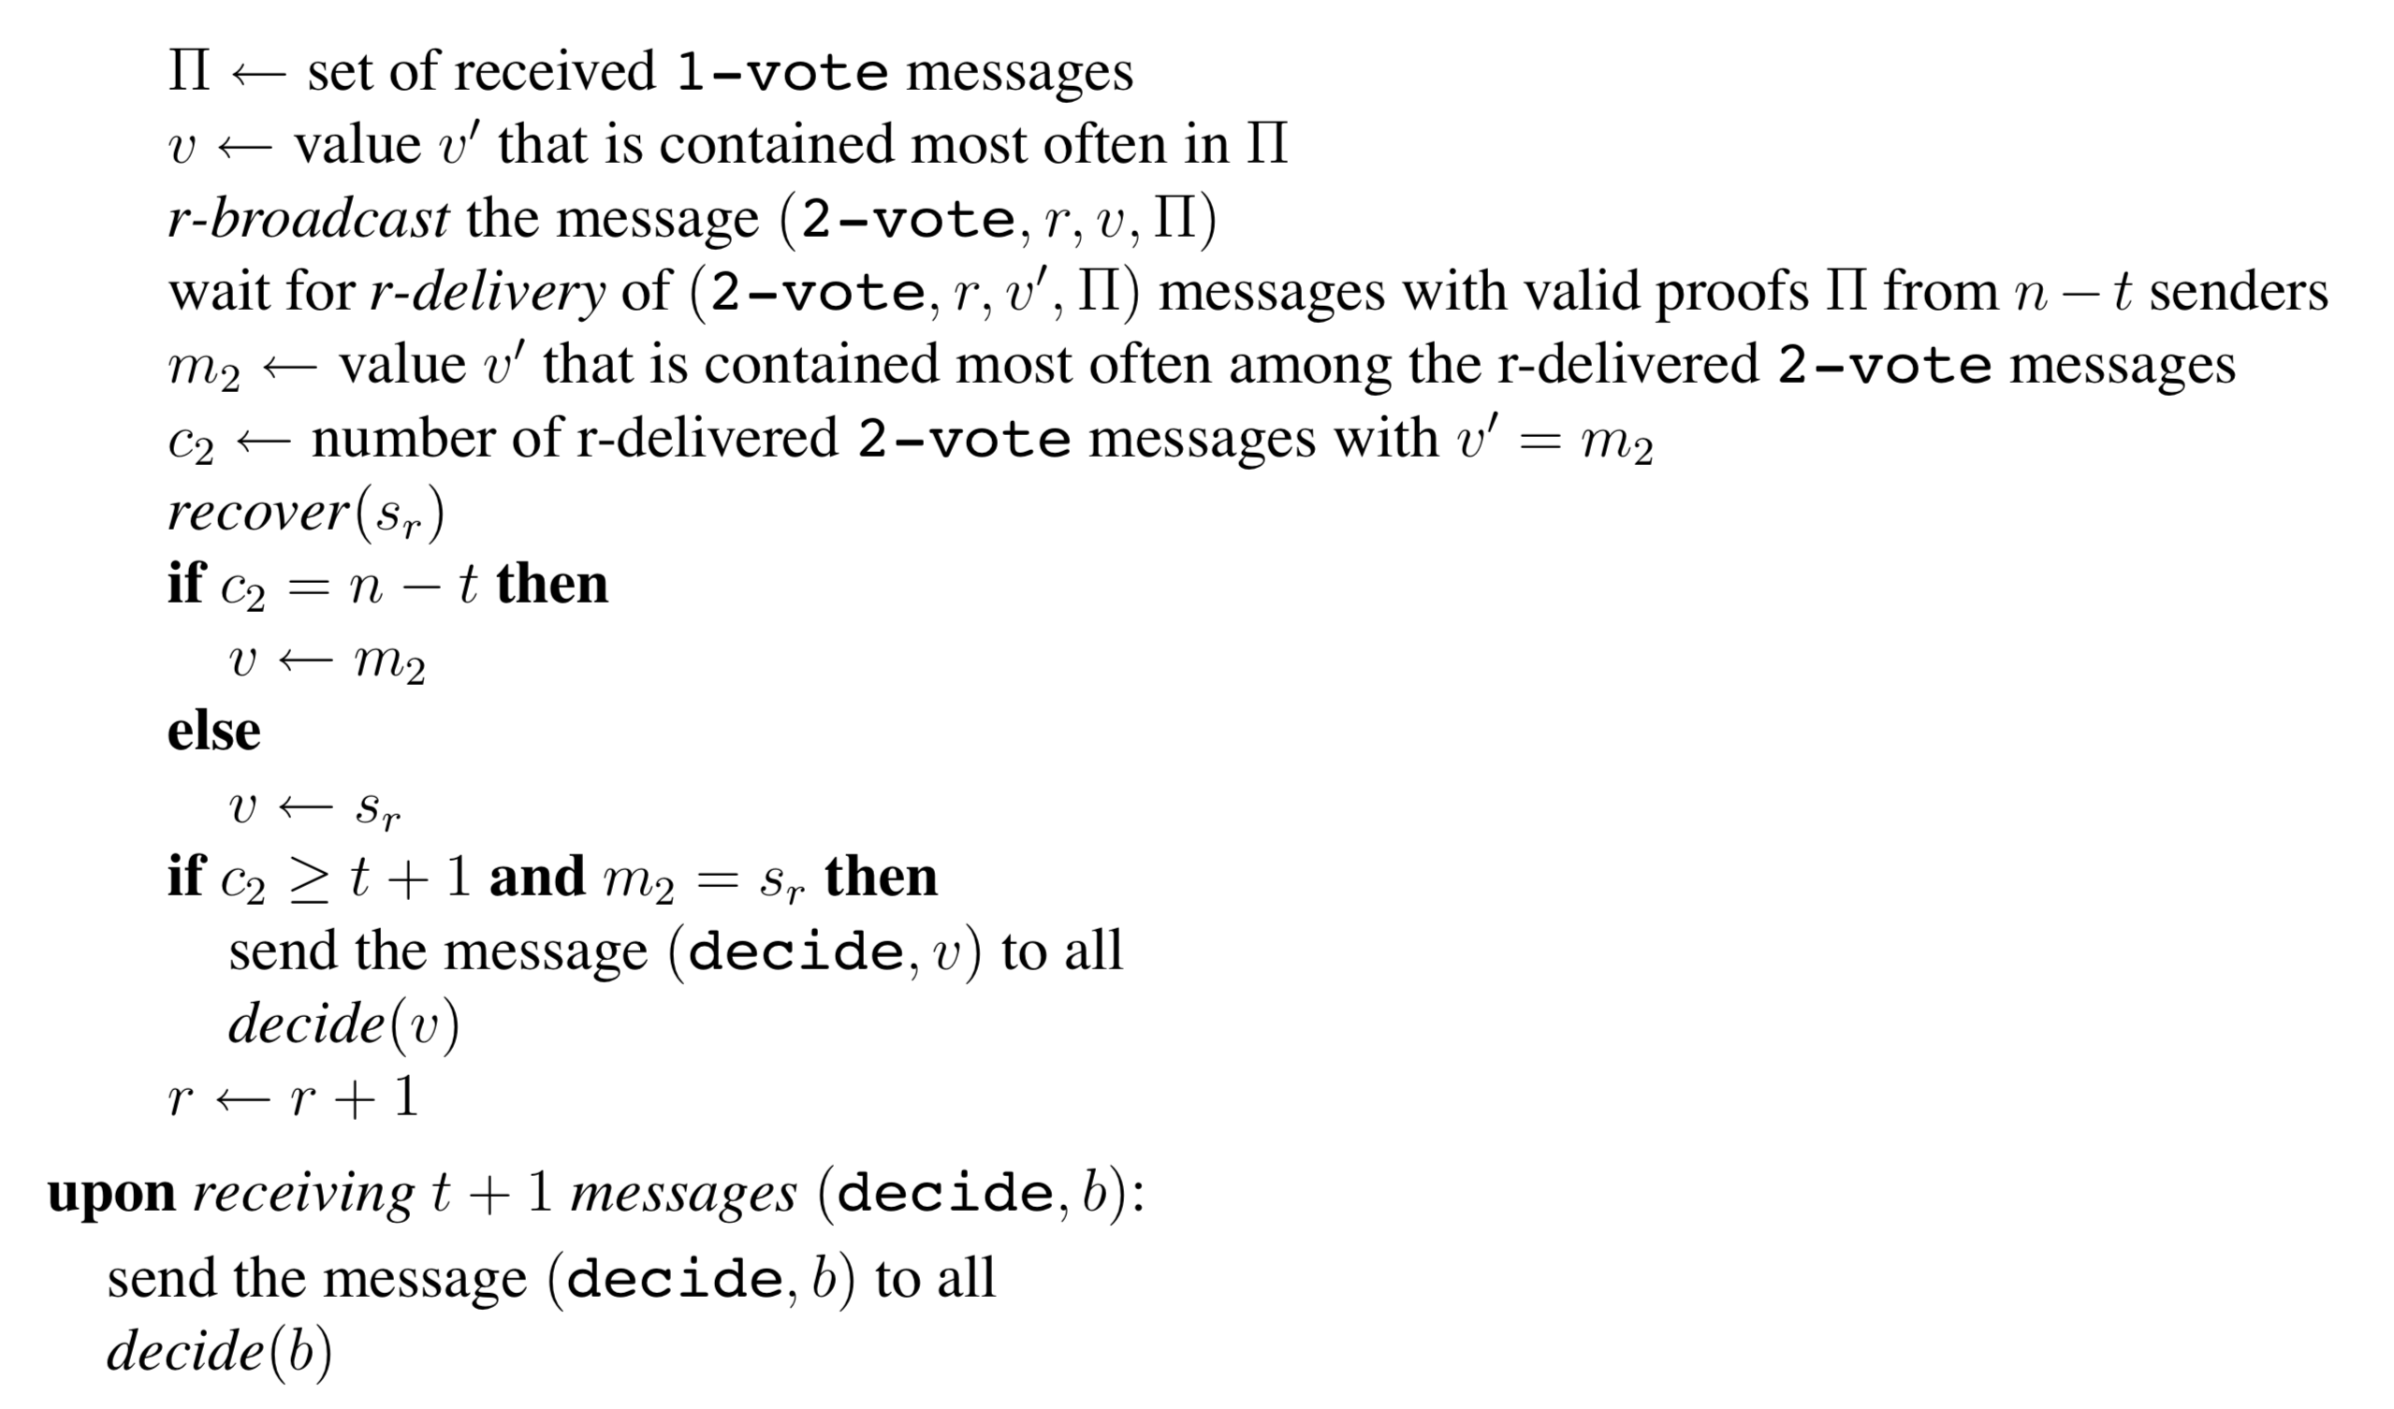
Asynchronous Binary Agreement
BFT Version
Random coin

Slide 28
Asynchronous Binary Agreement
Lemma 1: If all honest servers start some round r with vote v₀, then all honest servers will also terminate round r with vote v₀
Lemma 2: If two distinct honest servers start some round r with different votes, then with probability at least 1/2, all honest servers will terminate round r with the same vote.
Lemma 3: Binary agreement will terminate.
Simple reason: BA reaches agreement with probability at least 1/2 in every round, the expected number of rounds is 2, and the expected number of messages sent is O(n³)

Slide 29
BEAT Implementation
Implemented seven protocols
Five BEAT instances (BEAT0-4)
HoneyBadgerBFT (HB), HB + Bracha (for comparison)
Jerasure 2.0 for erasure coding
GF-complete for fingerprinted cross-checksum and GF operations
P-256 curve (128-bit security) for labeled threshold encryption and threshold PRF

Slide 30
Evaluation
Amazon EC2
Up to 92 nodes from ten different regions in different continents
Evaluate the protocols under different network sizes (number of replicas) and contention levels (batch sizes)
Vary the batch size where nodes propose 1 to 20,000 transactions at a time
“LAN tests”: nodes are selected from the same Amazon EC2 region
“WAN tests”: nodes are uniformly selected from different regions

Slide 31
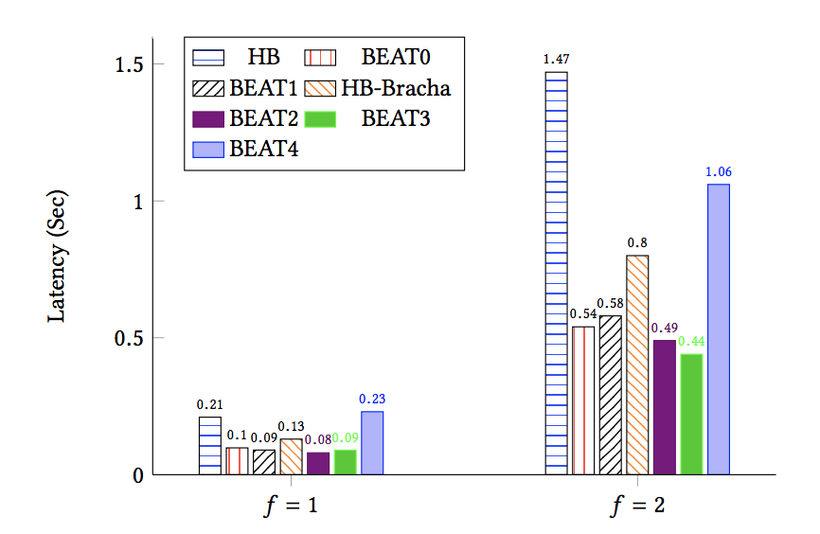
Latency in LAN Settings

Slide 32
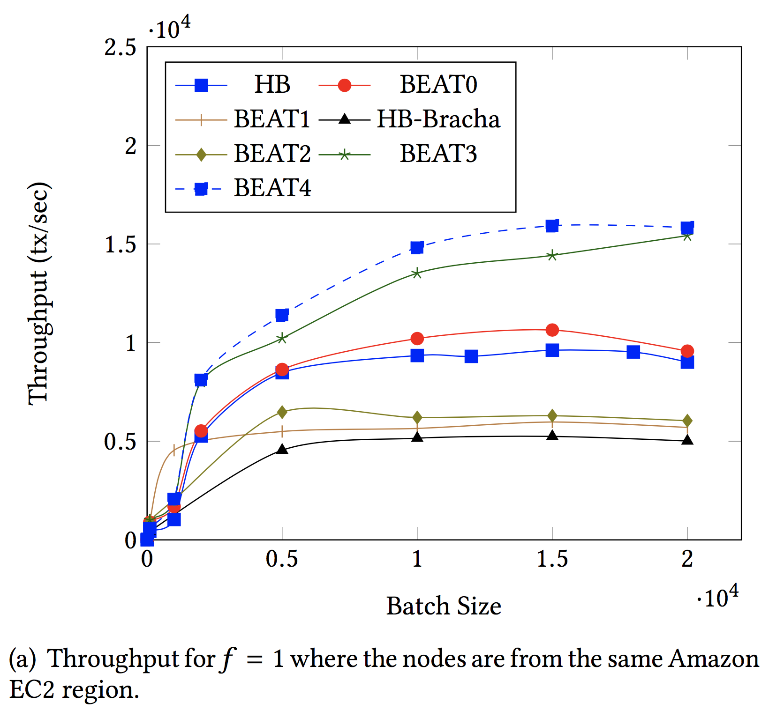
Throughput in LAN Setting (f = 1)

Slide 33
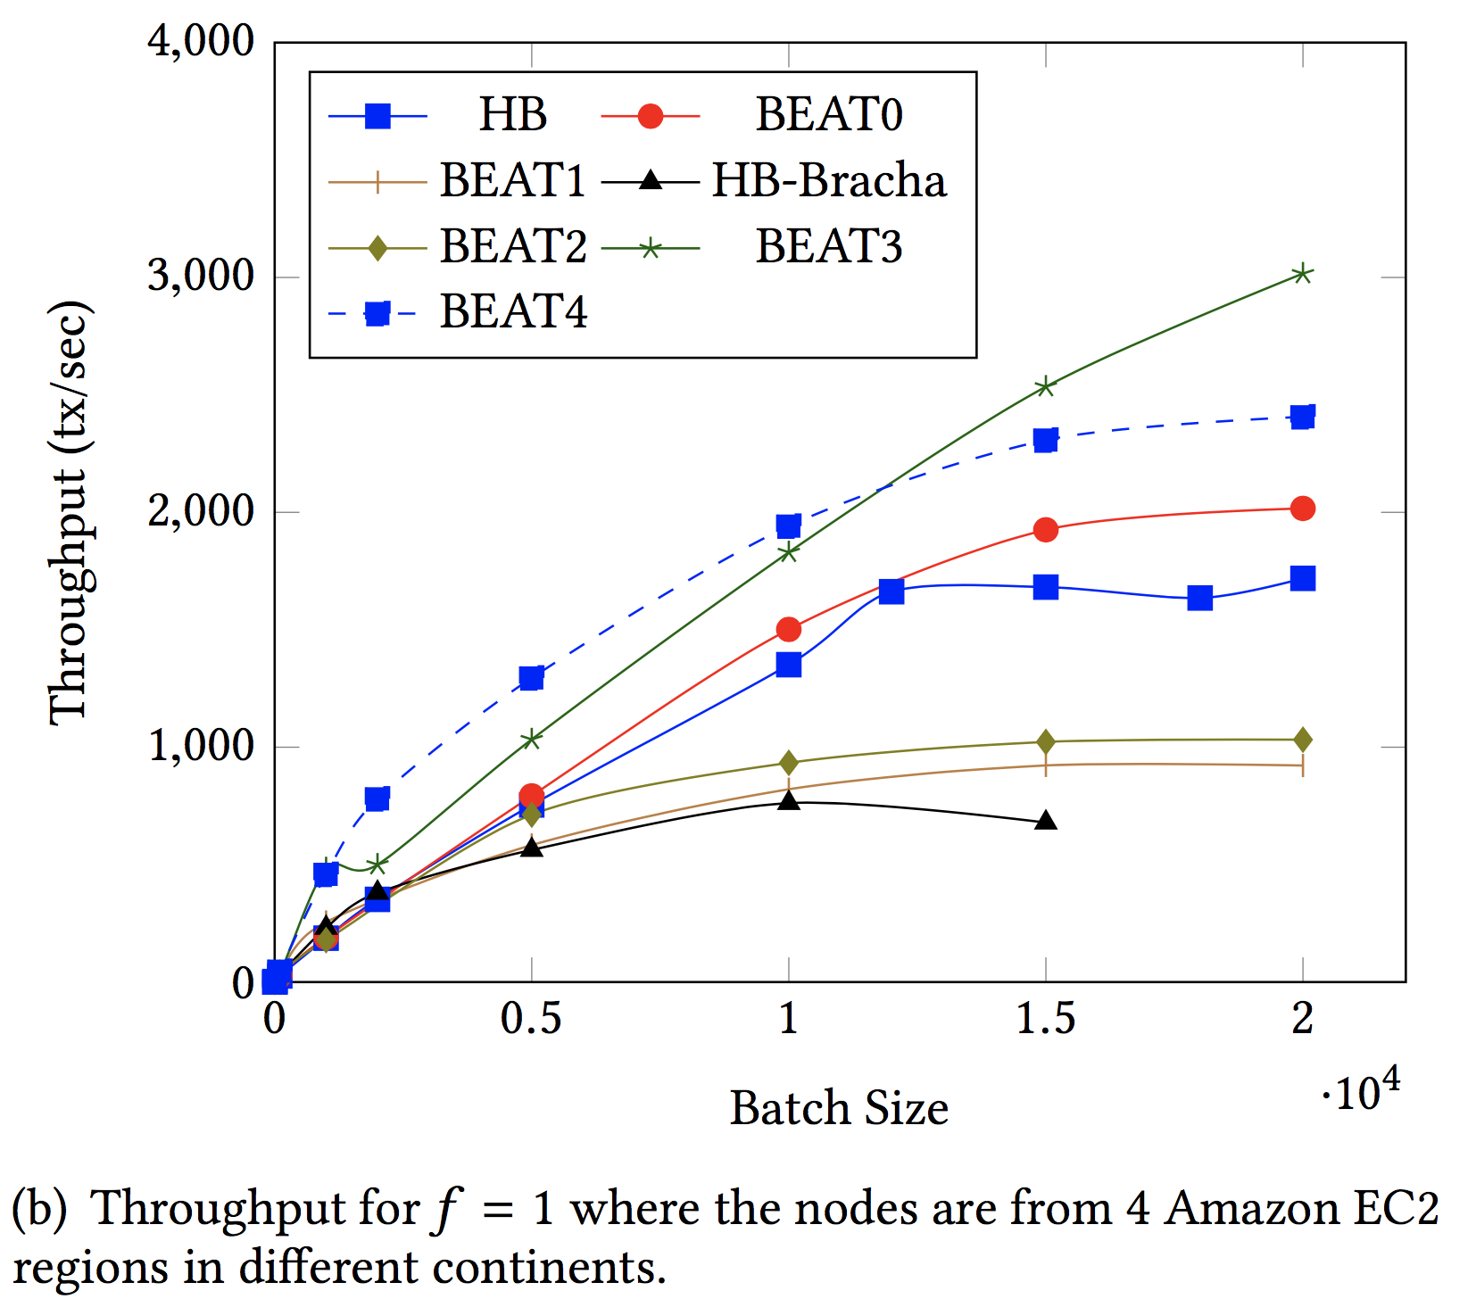
Throughput in WAN Setting (f = 1)

Slide 34
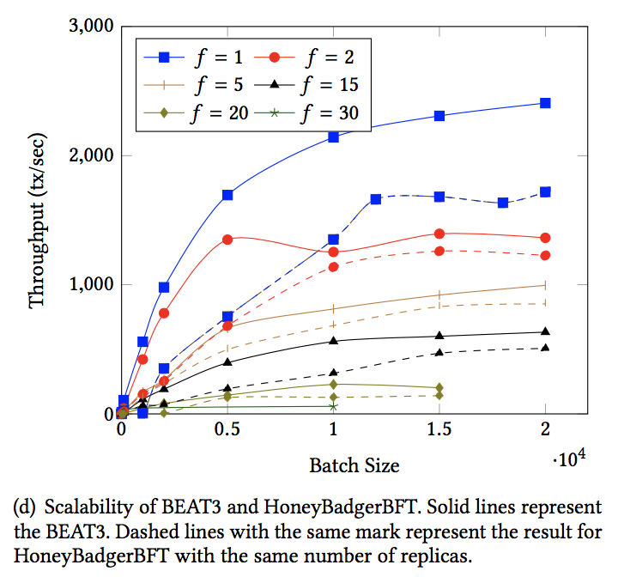
Scalability: BEAT3 vs. HoneyBadgerBFT
Solid lines: BEAT3
Dashed lines: HB

Slide 35
Lessons
BEAT explores various points in the design space of asynchronous total-ordering protocols
As in the partially synchronous case, there appears to be no one-size-fits-all protocol
Asynchronous protocols like HB and BEAT that avoid view-change subprotocols are arguably simpler than partially synchronous ones

Slide 36
References
G.Bracha, An asynchronous[(n−1)/3]-resilient consensus protocol,Proc. 3rdACM Symposium on Principles of Distributed Computing (PODC), 1984, pp. 154–162.
S. Toueg, Randomized Byzantine agreements, Proc. 3rd ACM Symposium on Princi- ples of Distributed Computing (PODC), 1984, pp. 163–178.
Lecture notes: https://disco.ethz.ch/courses/ss04/distcomp/lecture/chapter9.pdf
Miller, Andrew, et al. "The honey badger of BFT protocols." Proceedings of the 2016 ACM SIGSAC Conference on Computer and Communications Security. ACM, 2016.
Duan, Sisi, Michael K. Reiter, and Haibin Zhang. "BEAT: Asynchronous BFT made practical." Proceedings of the 2018 ACM SIGSAC Conference on Computer and Communications Security. ACM, 2018.

