Slide 1
IS 698/800-01:
Advanced Distributed Systems
Basics
Sisi Duan
Assistant Professor
Information Systems
sduan@umbc.edu

Slide 2
Announcement
Project Deliverable #1
  Due Feb 13
Please submit
  Names of team members (1-2 people per team)
  Project topic (tentative)
  Brief description of why you want to study the problem
  A rough plan

Slide 3
Announcement
Review for week 3
  Due Feb 13
  Van Renesse, Robbert, and Fred B. Schneider. "Chain Replication for Supporting High Throughput and Availability." OSDI. Vol. 4. No. 91–104. 2004.
  Less than 1 page
  Template (as a reference) can be found at the class website
Submission:
  Blackboard
  Email
  Hardcopy

Slide 4
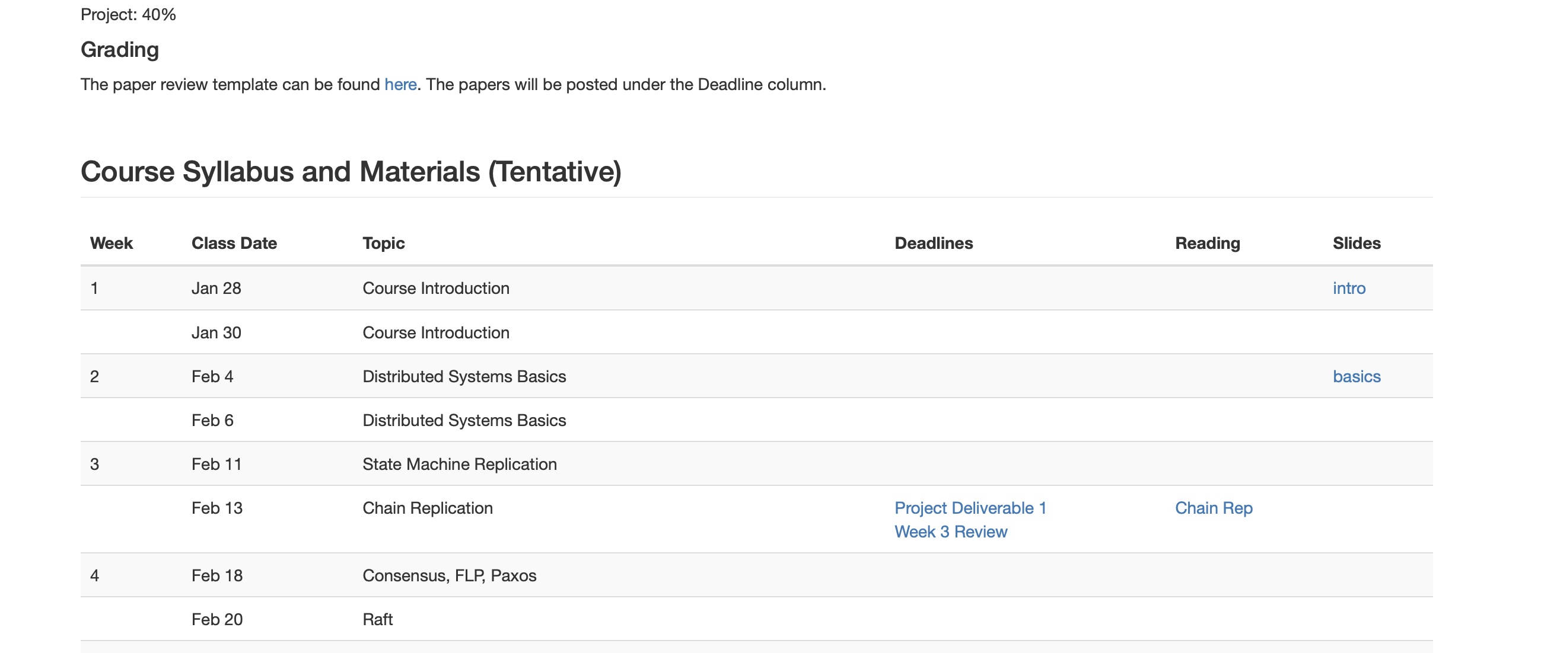
Announcement

Slide 5
Outline
Basic terms
Distributed systems challenges
Failure models
Timing models
Snapshots
Logical clocks

Slide 6
The Basics
A program is the code you write
A process is what you get when you run it
A message is used to communicate between processes
A packet is a fragment of a message that might travel on a write
A protocol is a formal description of message formats and the rules that two processes must follow in order to exchange those messages

Slide 7
The Basics (con’t)
A network is the infrastructure that links computer, workstations, terminals, servers, etc. It consists of routers which are connected by communication links.
A component can be a process or any piece of hardware required to run a process, support communications between processes, store data, etc.
A distributed system is an application that executes a collection of protocols to coordinate the actions of multiple processes on a network, such that all components cooperate together to perform a single or small set of related tasks.

Slide 8
Distributed Systems
From Wiki
  A distributed system is a model in which components located on networked computers communicate and coordinate their actions by passing messages.
A distributed system consists of multiple autonomous computers that communicate through a computer network. The computers interact with each other in order to achieve a common goal.
A distributed system is a collection of independent computers that appears to its users as a single coherent system.

Slide 9
Advantages of building distributed systems
The ability to connect remote users with remote resources in an open and scalable way
Open: each component is continually open to interaction with other components
Scalable: the system can easily be altered to accommodate changes in the number of users, resources and computing entities
Key: A distributed system must be reliable

Slide 10
Reliability of Distributed Systems
Fault-Tolerant: It can recover from component failures without performing incorrect actions.
Highly Available: It can restore operations, permitting it to resume providing services even when some components have failed.
Recoverable: Failed components can restart themselves and rejoin the system, after the cause of failure has been repaired.
Consistent: The system can coordinate actions by multiple components often in the presence of concurrency and failure. This underlies the ability of a distributed system to act like a non-distributed system.
Scalable: It can operate correctly even as some aspect of the system is scaled to a larger size. For example, we might increase the size of the network on which the system is running. This increases the frequency of network outages and could degrade a "non-scalable" system. Similarly, we might increase the number of users or servers, or overall load on the system. In a scalable system, this should not have a significant effect.
Predictable Performance: The ability to provide desired responsiveness in a timely manner.
Secure: The system authenticates access to data and services

Slide 11
Distributed Systems Challenges
Be able to continue operation even when some components fail
Software failures are common
  Reboot 20 machines a day manually!
2-3% have hardware failures
  Soft errors
  Hardware bit-flips
Most failures are software failures

Slide 12
Failures
Failure happens all the time
When you design, you design for failure
The classic partial failure problem
  If I send a message to you and then a network failure occurs, there are two possible outcomes. One is that the message got to you, and then the network broke, and I just didn't get the response. The other is the message never got to you because the network broke before it arrived.
The design for fault tolerance puts a multiplier on the value of simplicity
Failures: The more things I can do with you, the more things I have to think about recovering from. – Ken Arnold (Sun, designer of Jini and CORBA)

Slide 13
Failure Models
Halting failures: A component simply stops. There is no way to detect the failure except by timeout: it either stops sending "I'm alive" (heartbeat) messages or fails to respond to requests. Your computer freezing is a halting failure.
Fail-stop: A halting failure with some kind of notification to other components. A network file server telling its clients it is about to go down is a fail-stop.
Omission failures: Failure to send/receive messages primarily due to lack of buffering space, which causes a message to be discarded with no notification to either the sender or receiver. This can happen when routers become overloaded.
Network failures: A network link breaks.
Network partition failure: A network fragments into two or more disjoint sub-networks within which messages can be sent, but between which messages are lost. This can occur due to a network failure.
Timing failures: A temporal property of the system is violated. For example, clocks on different computers which are used to coordinate processes are not synchronized; when a message is delayed longer than a threshold period, etc.
Byzantine failures: This captures several types of faulty behaviors including data corruption or loss, failures caused by malicious programs, etc.

Slide 14
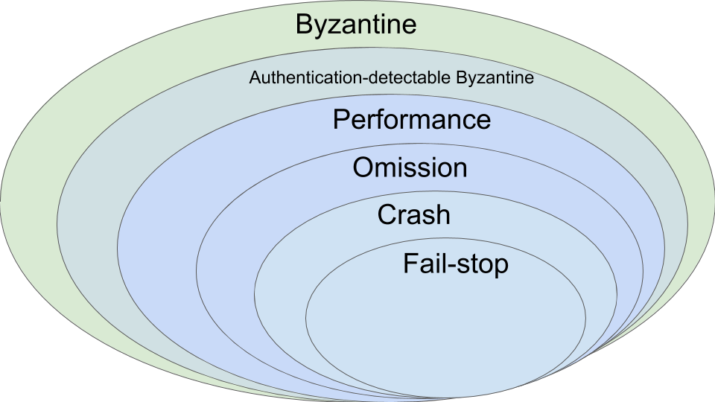
Failure Models

Slide 15
Failure Models
Crash
  Benign failures
  Failing to receive a request, or failing to send a response
Byzantine
  Arbitrary failures
  Processing a request incorrectly
  Corrupting local state
  Sending incorrect or inconsistent messages

Slide 16
8 Fallacies When Building a Distributed System
The network is reliable.
Latency is zero.
Bandwidth is infinite.
The network is secure.
Topology doesn't change.
There is one administrator.
Transport cost is zero.
The network is homogeneous.
Latency: the time between initiating a request for data and the beginning of the actual data transfer.
Bandwidth: A measure of the capacity of a communications channel. The higher a channel's bandwidth, the more information it can carry.
Topology: The different configurations that can be adopted in building networks, such as a ring, bus, star or meshed.
Homogeneous network: A network running a single network protocol.

Slide 17
8 Fallacies When Building a Distributed System
The network is reliable. -- Fault-tolerant protocol
Latency is zero. -- Timing assumption during the design
Bandwidth is infinite. -- Efficiency/Scalability of the protocol
The network is secure. -- Crypto, Safety of the protocol
Topology doesn't change. -- Membership protocol
There is one administrator.
Transport cost is zero. -- Efficiency of the protocol
The network is homogeneous.

Slide 18
How is it Done?

Slide 19
Client-Server Model
Cloud storage, outsourced database, network file systems, etc.
service is used to denote a set of servers of a particular type
Faulty server may render the service unavailable and unreliable!
Single point of failure!

Slide 20
Replication
Primary-Backup Replication/Master-Slave Replication
  The simplest replication
  f+1 replicas to tolerate f failures

Slide 21
Data Replication
Avoid single point of failure
Data replication: A service maintains multiple copies of data to permit local access at multiple locations, or to increase availability when a server process may have crashed
Caching
  A process has cached data if it maintains a copy of the data locally, for quick access if it is needed again
  A cache hit is when a request is satisfied from cached data, rather than from the primary service. For example, browsers use document caching to speed up access to frequently used documents.

Slide 22
Replication vs Cache
Caching is similar to replication, but cached data can become stale.
There may need to be a policy for validating a cached data item before using it.
If a cache is actively refreshed by the primary service, caching is identical to replication

Slide 23
Communication

Slide 24
Common Communication Pattern

Slide 25
Communication Mechanisms
Many protocols are available
  Sockets
  Remote Procedure Call (RPC)
  Distributed shared memory (later in the class)
  MPI
  …

Slide 26
Socket Communication
TCP (Transmission Control Protocol)
  Protocol built upon the IP networking protocol, which supports sequenced, reliable, two-way transmission over a connection (or session, stream) between two sockets
  More reliable
  More expensive
UDP (User Datagram Protocol)
  Also protocol built on top of IP. Supports best-effort, transmission of single datagrams
  It’s ok to lose, re-order, or duplicate messages
  Low latency

Slide 27
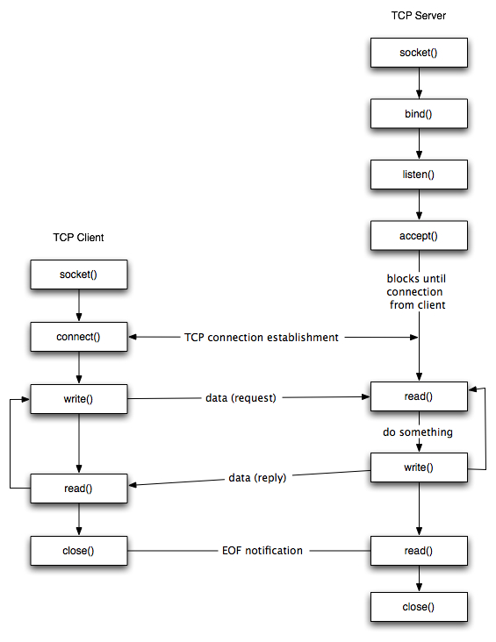
sock = socket.socket(socket.AF_INET, socket.SOCK_STREAM)
sock.bind((hostname, port))
sock.listen(1)
conn,addr = sock.accept()
server_addr=(hostname,portnum)
sock.connect(server_addr)
sock.sendall(msg)
buf = conn.recv(8092)
sock.close()

Slide 28
Other communication models
Broadcast
Multicast

Slide 29
RPC
Remote Procedure Call
A type of client/server communication
Ease of programming
Hide complexity
Standardize some low-level data packaging protocols

Slide 30
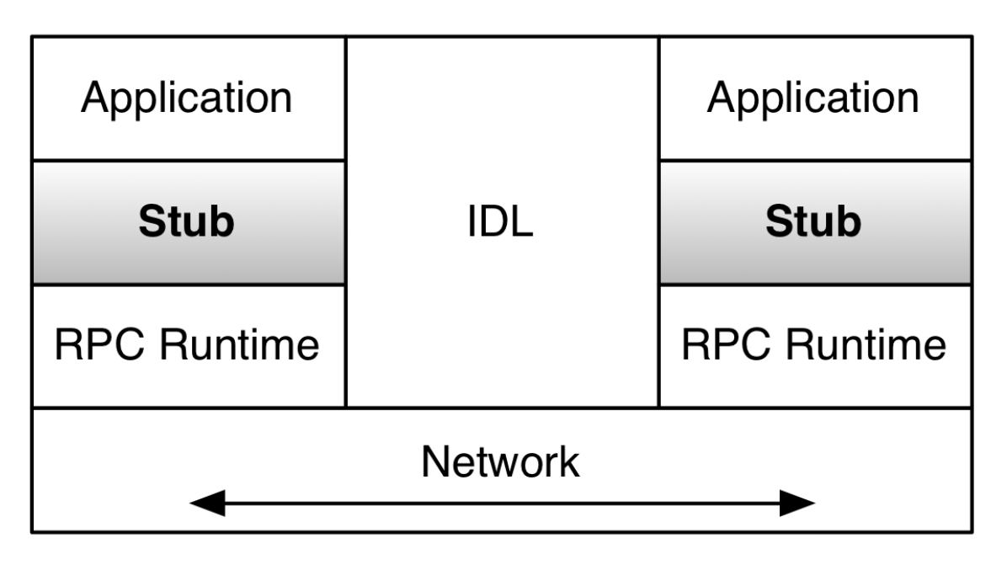
RPC
The application calls the remote procedure locally at the stub
The stub intercepts calls that are for remote servers
  Marshalling: pack the parameters into a message
  Make a system call to send the message
  Stubs are generated automatically by RPC frameworks (libraries), which also provide the RPC Runtime
  Programmers only write definitions for their data structures and protocols in an IDL

Slide 31
RPC
The RPC Runtime handles message sending
The interface definition language (IDL) handles message translation
RPC hides heterogeneity among the computers and handles the communication across network

Slide 32
RPC technologies
XML/RPC
  Over HTTP, huge XML parsing overheads
SOAP
  Designed for web services via HTTP, huge XML overhead
CORBA
  Relatively comprehensive, but quite complex and heavy
Protocol buffers
  Lightweight, developed by Google
Thrift
  Lightweight, supports services, developed by Facebook

Slide 33
Timing

Slide 34
Global Timing
Why?
  Airplane check-in, who got the last seat?
  Who submitted final auction bid before deadline?
  If two file servers get different update requests to the same file, what should be the order of those requests?
  Think about the collaborative writing example from last class
A globally consistent time standard would be ideal
But it’s impossible

Slide 35
Real-Clock Synchronization
Suppose I want to synchronize two machines M1 and M2
Straightforward solution
  M1 (sender) sends its own time T in message to M2
  M2 (receiver) sets its time according to the message
  But what time should M2 set?

Slide 36
Perfect Networks
Message always arrive, with propagation delay exactly d
Sender sends time T in a message
Receiver sets clock to T+d
  Synchronization is exact

Slide 37
Synchronous Networks
Messages always arrive, with propagation delay at most d
Sender sends time T in a message
Receiver sets clock to T+d/2
  Synchronization error is at most d/2

Slide 38
Timing Assumptions in Distributed Systems
Synchronous Systems
  Synchronous Computation
    There is a known upper bound on processing delays
    The time taken by any process to execute a step is always less than this bound
  Synchronous Communication
    There is a known upper bound on message transmission delays
    The time period between the instant at which a message is sent and the instant at which the message is delivered by the destination process is smaller than this bound

Slide 39
Timing Assumptions in Distributed Systems
Asynchronous systems
  Do not make any timing assumption about processes and links
Partial synchrony
  There is a bound on the processing delays and transmission delays, but the bound is unknown
Real networks are asynchronous
  Propagation delays are arbitrary
Real networks are unreliable
  Messages don’t always arrive
Discussion: How to “guess” the upper bound in the partial synchrony model?

Slide 40
The motivating example
Message passing, no failures
Timing assumption: synchronous, asynchronous
The server may ask other servers to
Compute the results and get back
To the client

Slide 41
The motivating example
Deadlock!

Slide 42
The motivating example
Design a protocol by which a processor can determine whether a global predicate (e.g., deadlock) holds

Slide 43
Events and Histories
Processes execute sequences of events
Events can be of 3 types: local, send, and receive
e_{p}^{i} is the i-th event of process p
The local history h_{p} of process p is the sequence of events executed by process p
  h_{p}^{k}: prefix that contains first k events
  h_{p}⁰: initial, empty sequence
The history H is the set h_{p0} U h_{p1} U … h_{pn-1}

Slide 44
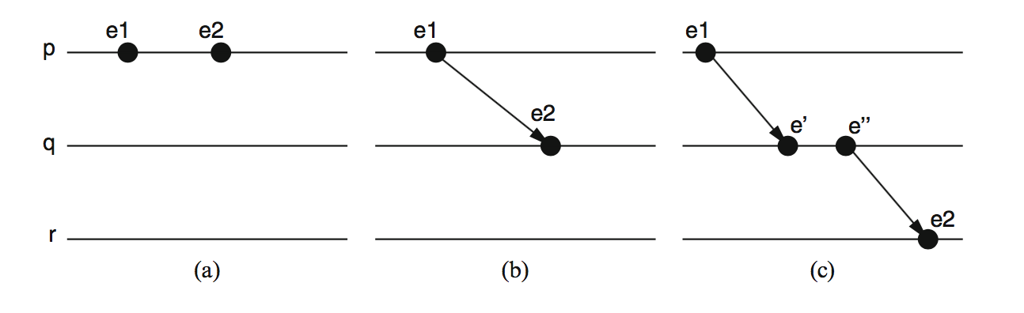
The Happened-Before Relation
e1 -> e2

Slide 45
Logical Time
Captures just the “happened-before” relationship between events
  Discard the infinitesimal granularity of time
  Corresponds roughly to causality
Definition (->): we say e1->e2 if e1 happens before e2

Slide 46
Global Logical Time
Definition (->): We define e->e’ if…
  Logical ordering: e->e’ if e->e’ for any process I
  Messages: send (m) -> receive (m) for any message m
  Transitivity: e->e’‘ if e->e’ and e’->e’’
We say e happens before e’ if e->e’

Slide 47
Concurrency
-> is only a partial order
some events are unrelated
Definition (concurrency): We say e is concurrent with e’ (written e||e’) if neither e->e’ nor e’->e

Slide 48
Space-Time Diagram

Slide 49
Space-Time Diagrams

Slide 50
Space-Time Diagrams

Slide 51
Space-Time Diagrams

Slide 52
Space-Time Diagrams

Slide 53
Space-Time Diagrams

Slide 54
Runs and Consistent Runs
A run is a total ordering of the events in H that is consistent with the local histories of the processors
A run is consistent if the total order imposed in the run is an extension of the partial order induced by ->
A single distributed computation may correspond to several consistent runs

Slide 55
Cuts
A cut C is a subset of the global history of H
C = h₁^{c1} U h₂^{c2} U h₃^{c3}

Slide 56
Cuts
A cut C is a subset of the global history of H
C = h₁^{c1} U h₂^{c2} U h₃^{c3}
The frontier of C is the set of events e₁^{c1}, e₂^{c2}, … e_{n}^{cn}

Slide 57

Global states and cuts
The global state of a distributed computation is an n-tuple of local states
$Σ=(σ1,…σn)$
To each cut (c1…cn) corresponds a global state ($σ1$^{c1}, ..., $σn$^{cn})

Slide 58

Consistent cuts and consistent global states
A cut is consistent if
  $∀ ei, ej:ej ε$ C $∧ei→$ $ej ⟹ei ∈C$
A consistent global state is one corresponding to a consistent cut

Slide 59
A consistent global state?

Slide 60
A consistent global state?
No. The cut contains the event corresponding to the receipt of the last message by p3 but not the corresponding send event

Slide 61
How to
Develop a protocol by which a processor can build a consistent global state
Informally, we want to be able to take a snapshot of the computation

Slide 62
The approach
Develop a simple synchronous protocol
Refine protocol and relax assumptions
Record
  Processor states
  Channel states
Assumptions
  FIFO channels
  Each m timestamped with T(send(m))

Slide 63
Snapshot
p0 selects t_{ss}
p0 sends “take a snapshot at t_{ss}” to all processes
when clock of pi reads t_{ss} then p
  records its local state σ_{i}
  sends an empty message along its outgoing channels
  starts recording messages received on each of incoming channels
  stops recording a channel when it receives first message with timestamp greater than or equal to t_{ss}
How to determine the timestamp scheme?

Slide 64
Lamport’s Algorithm
Each process i keeps a local clock, Li
Three rules:
  At process i, increment Li before each event
  To send a message m at process i, apply rule 1 and then include the current local time in the message: i.e., send(m,Li)
  To receive a message (m,t) at process j, set Lj = max(Lj,t) and then apply rule 1 before time-stamping the receive event
The global time L(e) of an event e is just its local time
– For an event e at process i, L(e) = Li(e)

Slide 65
Lamport’s Clock

Slide 66
Problem?
p0 selects t_{ss}
p0 sends “take a snapshot at t_{ss}” to all processes
when clock of pi reads t_{ss} then p
  records its local state σ_{i}
  sends an empty message along its outgoing channels
  starts recording messages received on each of incoming channels
  stops recording a channel when it receives first message with timestamp greater than or equal to t_{ss}

Slide 67
Snapshot II
processor p0 selects Ω
p0 sends “take a snapshot at Ω” to all processes; it waits for all of them to reply and then sets its logical clock to Ω
when clock of pi reads Ω then pi
  records its local state σi
  sends an empty message along its outgoing channels
  starts recording messages received on each incoming channel
  stops recording a channel when receives first message with timestamp greater than or equal to Ω

Slide 68
The synchrony problem

Slide 69
Snapshot III
processor p0 sends itself “take a snapshot “
when pi receives “take a snapshot” for the first time from pj :
  records its local state σi
  sends “take a snapshot” along its outgoing channels
  sets channel from pj to empty
  starts recording messages received over each of its other incoming channels
when pi receives “take a snapshot” beyond the first time from pk:
  stops recording channel from pk
when pi has received “take a snapshot” on all channels, it sends collected state to p0 and stops.

Slide 70
Snapshots: a perspective
The global state Σs saved by the snapshot protocol is a consistent global state
But did it ever occur during the computation?
  a distributed computation provides only a partial order of events
  many total orders (runs) are compatible with that partial order
  all we know is that Σs could have occurred
We are evaluating predicates on states that may have never occurred!

Slide 71
Execution Lattice

Slide 72
Execution Lattice

Slide 73
Execution Lattice

Slide 74
Execution Lattice

Slide 75
Execution Lattice

Slide 76
Execution Lattice

Slide 77
Execution Lattice

Slide 78
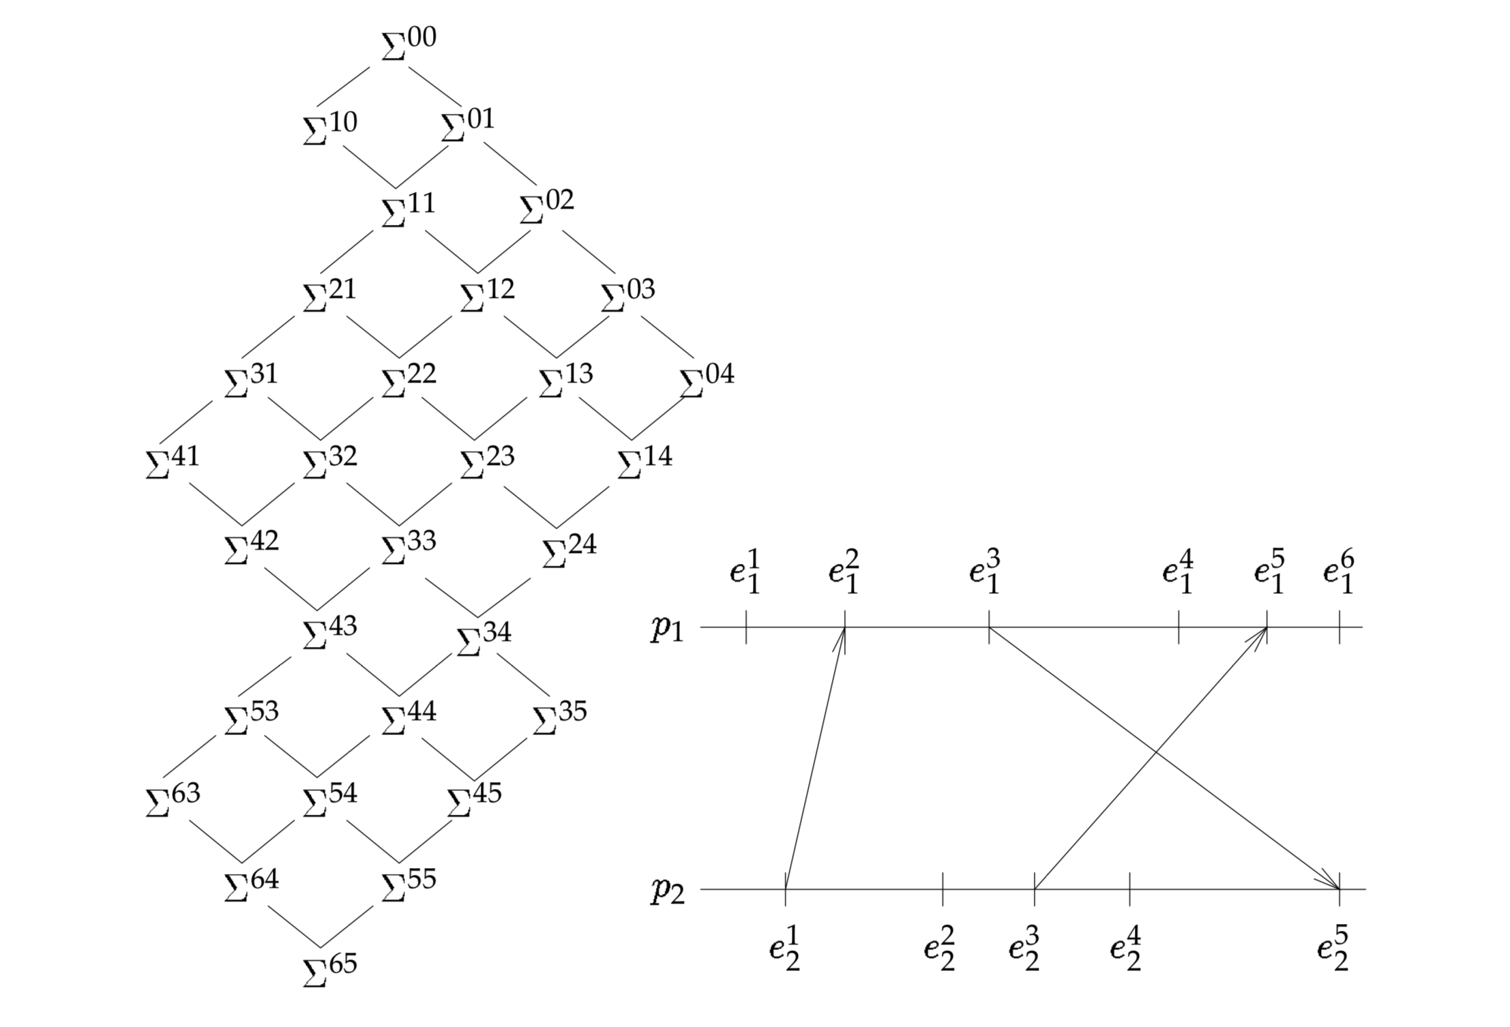
Execution Lattice

Slide 79
Reachability
Σ^{kl} is reachable from Σ^{ij} if there is a path from Σ^{kl} to Σ^{ij} in the lattice

Slide 80
Why we do care about this?
Deadlock is a stable property
If a run R of the snapshot protocol starts in Σ^{i} and terminates in Σ^{f}, then Σ^{i} ->R Σ^{f}
Deadlock in Σ^{i} implies deadlock in Σ^{f}

Slide 81
Observations
Monitor process does not query explicitly
Instead, it passively collects information and sues it to build an observation
An observation is an ordering of event of the distributed computation based on the order in which the receiver is notified of the events

Slide 82
Observations
An observation puts no constraint on the order in which the monitor receives notifications
To obtain a run, messages must be delivered to a monitor in FIFO order

Slide 83
Causal Delivery
FIFO delivery
  Send_{i}(m) -> send_{i}(m’) => deliver_{j}(m) -> deliver_{j}(m’)
Causal delivery generalizes FIFO
  Send_{k}(m) -> send_{k}(m’) => deliver_{j}(m) -> deliver_{j}(m’)

Slide 84
Causal Delivery
FIFO delivery
  Send_{i}(m) -> send_{i}(m’) => deliver_{j}(m) -> deliver_{j}(m’)
Causal delivery generalizes FIFO
  Send_{k}(m) -> send_{k}(m’) => deliver_{j}(m) -> deliver_{j}(m’)

Slide 85
Causal Delivery
FIFO delivery
  Send_{i}(m) -> send_{i}(m’) => deliver_{j}(m) -> deliver_{j}(m’)
Causal delivery generalizes FIFO
  Send_{k}(m) -> send_{k}(m’) => deliver_{j}(m) -> deliver_{j}(m’)

Slide 86
Causal Delivery
FIFO delivery
  Send_{i}(m) -> send_{i}(m’) => deliver_{j}(m) -> deliver_{j}(m’)
Causal delivery generalizes FIFO
  Send_{k}(m) -> send_{k}(m’) => deliver_{j}(m) -> deliver_{j}(m’)

Slide 87
Causal Delivery
FIFO delivery
  Send_{i}(m) -> send_{i}(m’) => deliver_{j}(m) -> deliver_{j}(m’)
Causal delivery generalizes FIFO
  Send_{k}(m) -> send_{k}(m’) => deliver_{j}(m) -> deliver_{j}(m’)

Slide 88
Causal Delivery
In synchronous system, easy
Asynchronous system?
  Logical clocks

