Slide 1
IS 698/800-01:
Advanced Distributed Systems
State Machine Replication
Sisi Duan
Assistant Professor
Information Systems
sduan@umbc.edu

Slide 2
Announcement
No review next week
Review for week 5
  Due Feb 25
  Ongaro, Diego, and John K. Ousterhout. "In search of an understandable consensus algorithm." USENIX Annual Technical Conference. 2014.
  Less than 1 page

Slide 3
Outline
Failure models
Replication
State Machine Replication
Primary Backup Approach
Chain Replication

Slide 4
A closer look at the failures
Mean time to failure/mean time to recover
Threshold: f out of n
  Makes condition for correct operation explicit
  Measures fault-tolerance of architecture, not single components

Slide 5
Failure Models
Halting failures: A component simply stops. There is no way to detect the failure except by timeout: it either stops sending "I'm alive" (heartbeat) messages or fails to respond to requests. Your computer freezing is a halting failure.
Fail-stop: A halting failure with some kind of notification to other components. A network file server telling its clients it is about to go down is a fail-stop.
Omission failures: Failure to send/receive messages primarily due to lack of buffering space, which causes a message to be discarded with no notification to either the sender or receiver. This can happen when routers become overloaded.
Network failures: A network link breaks.
Network partition failure: A network fragments into two or more disjoint sub-networks within which messages can be sent, but between which messages are lost. This can occur due to a network failure.
Timing failures: A temporal property of the system is violated. For example, clocks on different computers which are used to coordinate processes are not synchronized; when a message is delayed longer than a threshold period, etc.
Byzantine failures: This captures several types of faulty behaviors including data corruption or loss, failures caused by malicious programs, etc.

Slide 6
Hierarchy of failure models
Fail-stop: A halting failure with some kind of notification to other components. A network file server telling its clients it is about to go down is a fail-stop.

Slide 7
Hierarchy of failure models

Slide 8
Hierarchy of failure models
Omission failures: Failure to send/receive messages primarily due to lack of buffering space, which causes a message to be discarded with no notification to either the sender or receiver. This can happen when routers become overloaded.

Slide 9
Hierarchy of failure models

Slide 10
Hierarchy of failure models

Slide 11
Hierarchy of failure models

Slide 12
Fault Tolerance via Replication
Replication
To tolerate one failure, one must replicate data on >1 places
Particularly important at scale
  Suppose a typical server crashes every month
  How often some server crashes in a 10,000-server cluster?
  30*24*60/10000 = 4.3 minutes

Slide 13
Consistency: Correctness
How to replicate data “correctly”?
Replicas are indistinguishable from a single object
  Linearizability is ideal
  One-copy semantics: copies of the same data should (eventually) be the same
  Consistency
So the replicated system should ”behave” just like a un-replicated system

Slide 14
Consistency
Consistency
  Meaning of concurrent reads and writes on shared, possibly replicated, state
  Important in many designs

Slide 15
Replication
Replication in space
  Run parallel copies of a unite
  Vote on replica output
  Failures are masked
  High availability, but at high cost
Replication in time
  When a replica fails, restart it (or replace it)
  Failures are detected, not masked
  Lower maintenance, lower availability
  Tolerates only benign failures

Slide 16
Challenges
Concurrency
Machine failures
Network failures (network is unreliable)
Tricky
  Slow or fail?
Non-determinism

Slide 17
A Motivating Example
Replication on two servers
Multiple client requests (might be concurrent)

Slide 18
Failures under concurrency!
The two servers see different results

Slide 19
Non-determinism
An event is non-deterministic if the state that it produces is not uniquely determined by the state in which it is executed
Handling non-deterministic events at different replicas is challenging
  Replication in time requires to reproduce during recovery the original outcome of all non-deterministic events
  Replication in space requires each replica to handle non-deterministic events identically

Slide 20
The Solution
Make server deterministic (state machine)

Slide 21
The Solution
Make server deterministic (state machine)
Replicate server

Slide 22
The Solution
Make server deterministic (state machine)
Replicate server
Ensure correct replicas step through the same sequence of state transitions

Slide 23
The Solution
Make server deterministic (state machine)
Replicate server
Ensure correct replicas step through the same sequence of state transitions
Vote on replica outputs for fault tolerance

Slide 24
State Machines
Set of state variables + Sequence of commands
A command
  Reads its read set values
  Writes to its write set values
A deterministic command
  Produces deterministic wsvs and outputs on given rsv
A deterministic state machine
  Reads a fixed sequence of deterministic commands

Slide 25
Replica Coordination
All non-faulty state machines receive all commands in the same order
Agreement: Every non-faulty state machine receives every command
Order: Every non-faulty state machine processes the commands it receives in the same order

Slide 26
Primary Backup

Slide 27
The Idea
Clients communicate with a single replica (primary)
Primary:
  sequences clients’ requests
  updates as needed other replicas (backups) with sequence of client requests or state updates
  waits for acks from all non-faulty clients Backups use timeouts to detect failure of primary
On primary failure, a backup is elected as new primary

Slide 28
Passive Replication
Primary-Backup
We consider benign failures for now
Fail-Stop Model
  A replica follows its specification until it crashes (faulty)
  A faulty replica does not perform any action (does not recover)
  A crash is eventually detected by every correct processor
  No replica is suspected of having crashed until after it actually crashes

Slide 29
Primary-backup and non-determinism
Non-deterministic commands executed only at the primary
Backups receive either
  state updates (non-determinism?)
  command sequence (non-determinism?)

Slide 30
Where should replication be implemented?
In hardware
  Sensitive to architecture changes
At the OS level
  State transitions hard to track and coordinate
At the application level
  Requires sophisticated application programmers
Hypervisor-based fault tolerance
  Implement at a virtual machine running on the same instruction-set as underlying hardware

Slide 31
Case Study: Hypervisor
[Bressoud and Schneider]
Hypervisor: primary/backup replication
  If primary fails, backup takes over
  Caveat: assuming failure detection is perfect
Bressoud, Thomas C., and Fred B. Schneider. "Hypervisor-based fault tolerance." ACM Transactions on Computer Systems (TOCS) 14.1 (1996): 80-107.

Slide 32
Replication at VM level
Why replicating at VM-level?
  Hardware fault-tolerant machines are big in 80s
  Software solution is more economical
  Replicating at O/S level is messy (many interfaces)
  Replicating at app level requires programmer efforts
  Replicating at VM level has a cleaner interface (and no need to change O/S or app)
Primary and backup execute the same sequence of machine instructions

Slide 33

A strawman design
mem
mem
Two identical machines
Same initial memory/disk contents
Start execute on both machines
Will they perform the same computation?

Slide 34
Strawman flaws
To see the same effect, operations must be deterministic
What are deterministic ops?
  ADD, MUL etc.
  Read time-of-day register, cycle counter, privilege level?
  Read memory?
  Read disk?
  Interrupt timing?
  External input devices (network, keyboard)

Slide 35
Hypervisor’s architecture
Strawman replicates disks
at both machines
Problem: disks
might not behave identically
(e.g. fail at different sectors)
mem
mem
SCSI bus
primary
Hypervisor connects devices to
to both machines
Only primary reads/writes to devices
Primary sends read values to backup
Only primary handles interrupts from h/w
Primary sends interrupts to backup
ethernet
backup

Slide 36
Hypervisor executes in epochs
Challenge: must execute interrupts at the same point in instruction streams on both nodes
Strawman: execute one instruction at a time
  Backup waits from primary to send interrupt at end of each instruction
  Very slow….
Hypervisor executes in epochs
  CPU h/w interrupts every N instructions (so both nodes stop at the same point)
  Primary delays all interrupts till end of an epoch
  Primary sends all interrupts to backup

Slide 37
Hypervisor failover
If primary fails, backup must handle I/O
Suppose primary fails at epoch E+1
  In Epoch E, backup times out waiting for [end, E+1]
  Backup delivers all buffered interrupts at the end of E
  Backup starts epoch E+1
  Backup becomes primary at epoch E+2

Slide 38
Hypervisor failover
Backup does not know if primary executed I/O epoch E+1?
  Relies on O/S to re-try the I/O
Device needs to support repeated ops
  OK for disk writes/reads
  OK for network (TCP will figure it out)
  How about keyboard, printer, ATM cash machine?

Slide 39
Hypervisor implementation
Hypervisor needs to trap every non-deterministic instruction
  Time-of-day register
  HP TLB replacement
  HP branch-and-link instruction
  Memory-mapped I/O loads/stores
Performance penalty is reasonable
  A factor of two slow down
  How about its performance on modern hardware?
Notes:
A translation lookaside buffer (TLB) is a memory cache that stores recent translations of virtual memory to physical addresses for faster retrieval.
Branch with link (BL) copies the address of the next instruction (after the BL) into the link register. The branch instruction doesn't. BL would be used for a subroutine call, so when you want to return to where you were you can branch back to the link register.

Slide 40
Caveats in Hypervisor
Hypervisor assumes failure detection is perfect
What if the network between primary/backup fails?
  Primary is still running
  Backup becomes a new primary
  Two primaries at the same time!
Can timeouts detect failures correctly?
  Pings from backup to primary are lost
  Pings from backup to primary are delayed

Slide 41
The History of Failure Handling
For a long time, people do it manually (with no guaranteed correctness)
  One primary, one backup. Primary ignores temporary replication failure of a backup.
  If primary crashes, human operator re-configures the system to use the former backup as new primary
  some ops done by primary might be “lost” at new primary
Still true in a lot of the systems
  A consistency checker is run at the end of every day and fix them (according to some rules).

Slide 42
Handling Primary Failures
Select another one!
But it is not easy

Slide 43
Normal Case Operations

Slide 44
When the primary fails
Backups monitor the correctness of the primary
  In the crash failure model, backups can use failure detector (won’t cover it in this class)
  Other methods are available…
If the primary fails, other replicas can start view change to change the primary
  Msg type: VIEW-CHANGE

Slide 45
View Change

Slide 46
What to include for the new view before normal operations?
General rule
  Everything that has been committed in previous views should be included
Brief procedures
  Select the largest sequence number from the logs of other replicas
  If the majority of nodes have included a request m with sequence number s, include m with s in the new log
  Broadcast the newLog to all the replicas
  Replicas adopt the order directly

Slide 47
Chain Replication

Slide 48
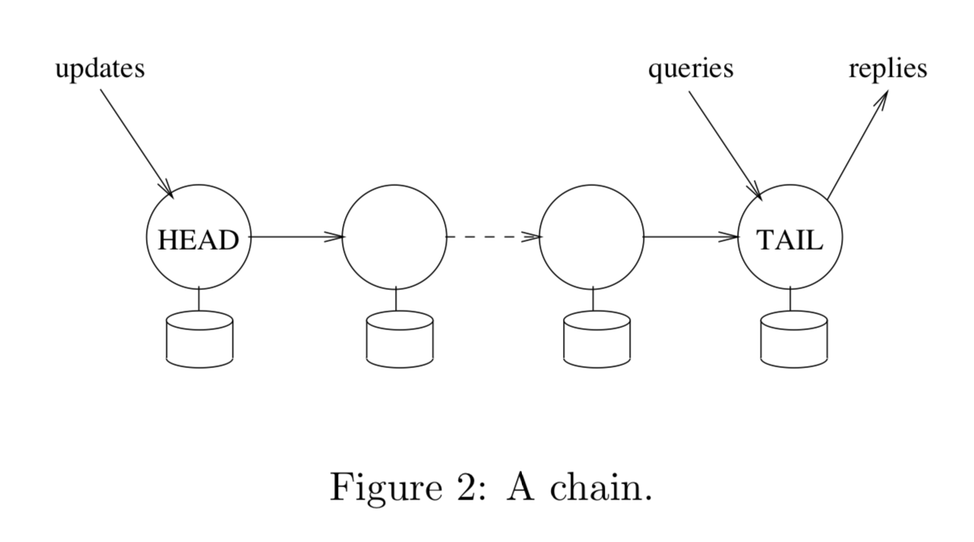
Chain Replication
Renesse, Schneider, OSDI 04

Slide 49
Chain Replication
Renesse, Schneider, OSDI 04
Storage services
  Store objects
  Support query operations to return a value derived from a single object
  Support update operations to atomically change the state of a single object according to some pre-programmed, possibly non-deterministic, computation involving the prior state of that object
Strong consistency guarantees
Fail-stop failures
FIFO links

Slide 50
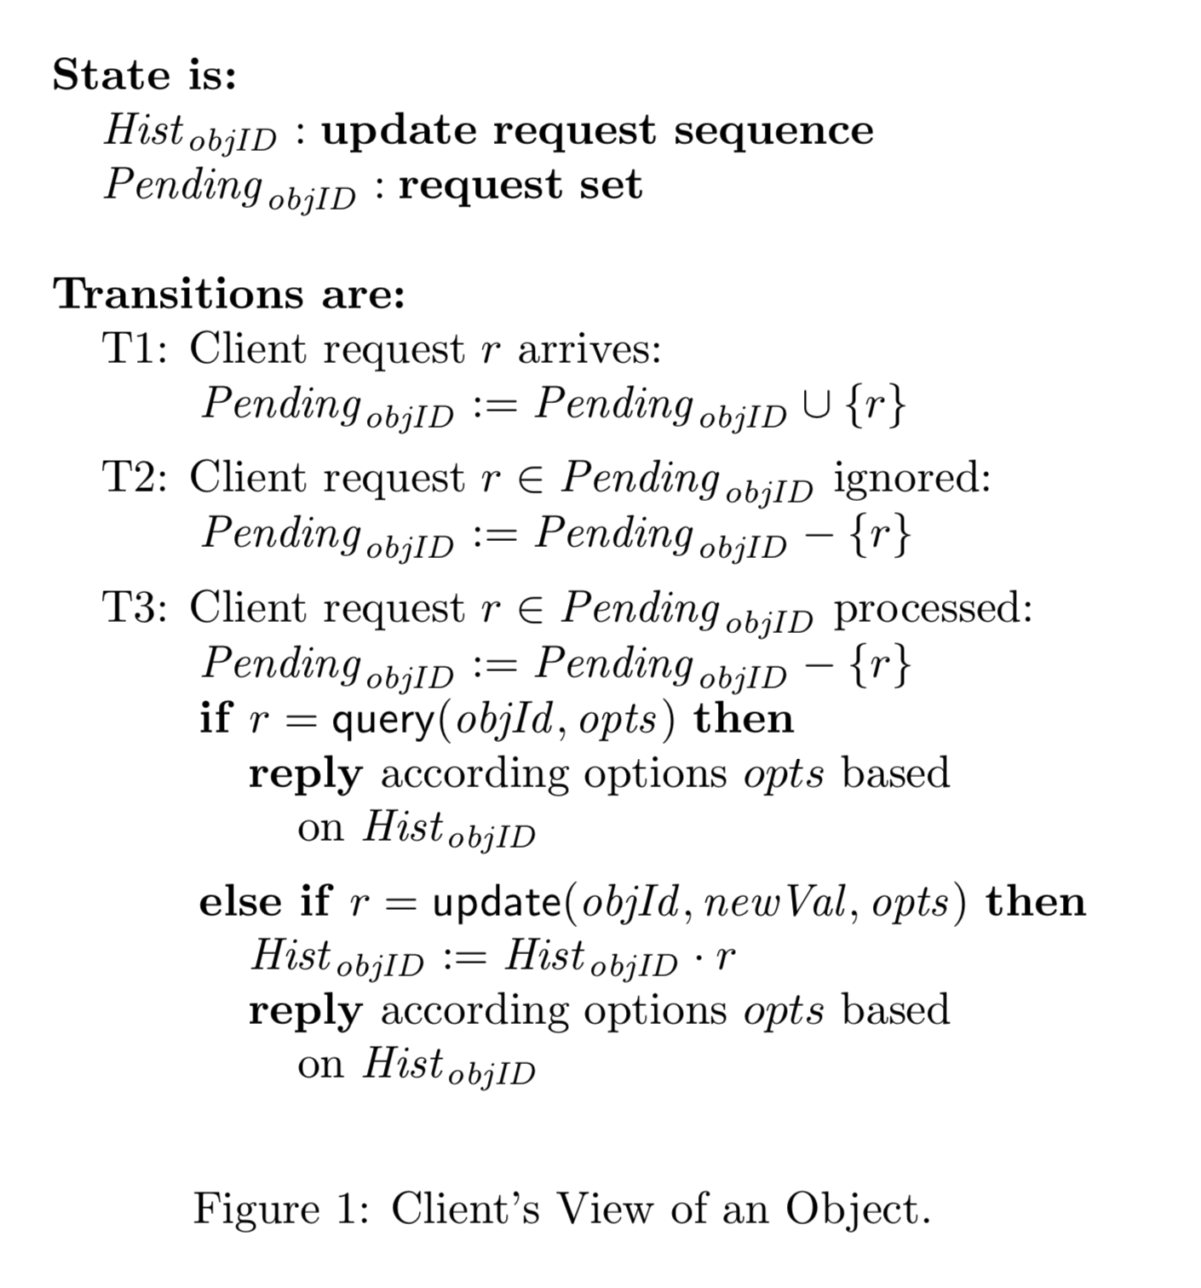
Chain Replication
objID: object ID
HistobjID : sequence of updates
Pending_{objID} : unprocessed requests

Slide 51
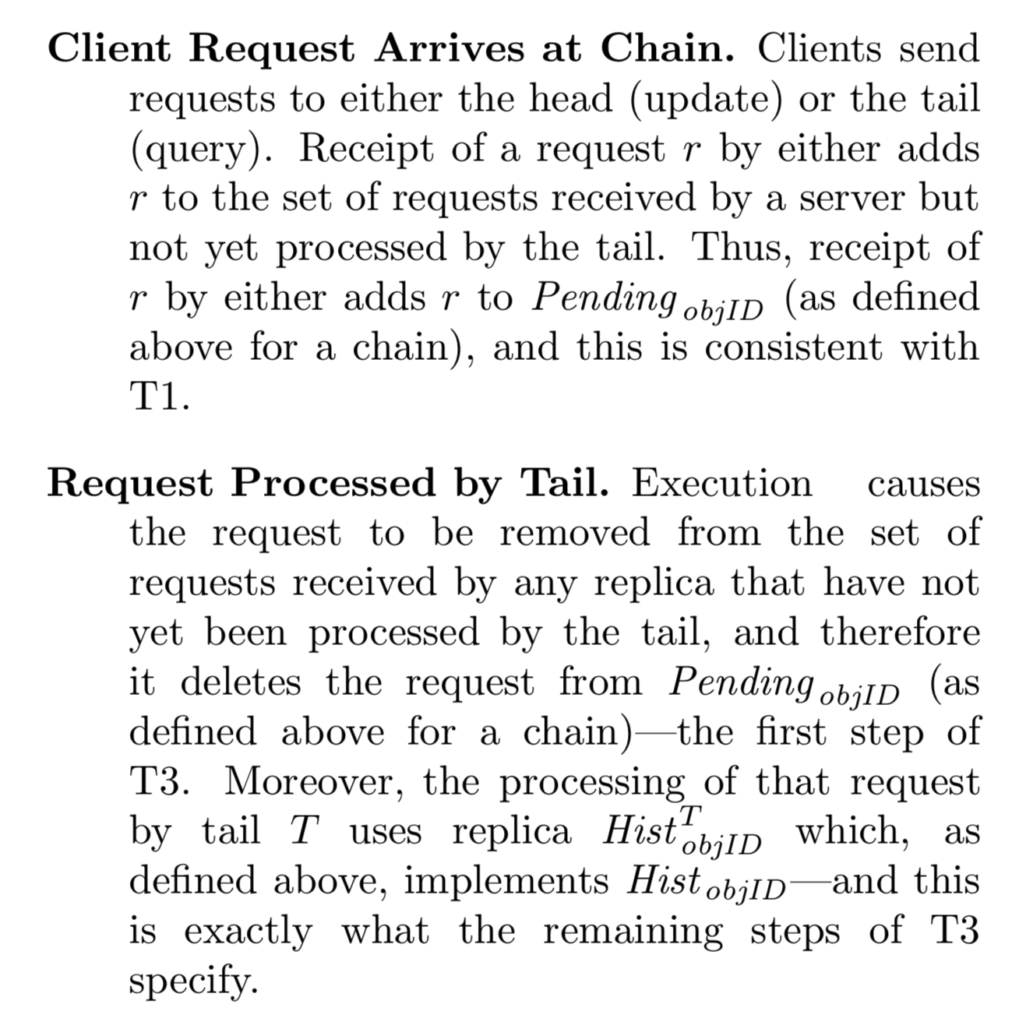
Chain Replication

Slide 52
Coping with Failures
A master service
  Detects failures of servers
  Informs each server in the chain of its new predecessor or new successor in the new chain obtained by deleting the failed server
  Informs clients which server is the head and which is the tail of the chain

Slide 53
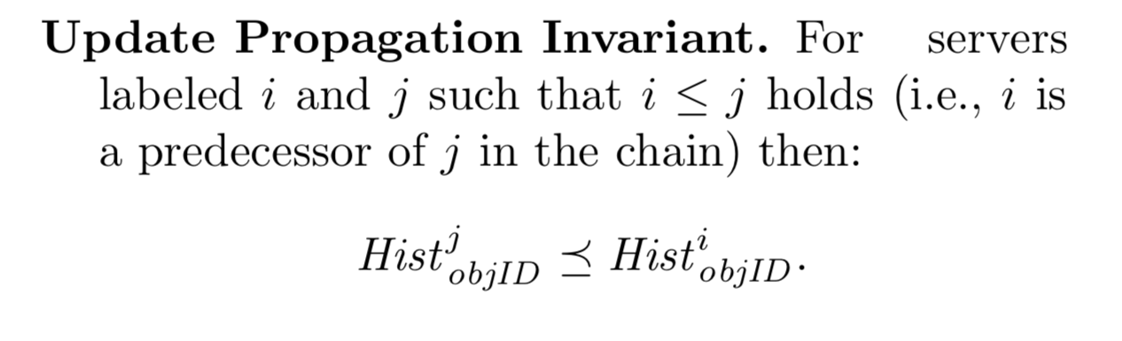
Coping with Failures
A master service distinguishes three cases
  failure of the head
  failure of the tail
  failure of some other server in the chain.

Slide 54
Failure of the head
Remove H from the chain and make the successor to H the new head of the chain

Slide 55
Failure of the head
Remove H from the chain and make the successor to H the new head of the chain
Pending_{objID}

Slide 56
Failure of the Tail
Remove tail T from the chain and make predecessor T’ of T the new tail of the chain.
Pending_{objID}
Hist_{objID}

Slide 57
Failure of other servers
Inform S’s successor S+ of the new chain configuration and then informs S’s predecessor S-

Slide 58
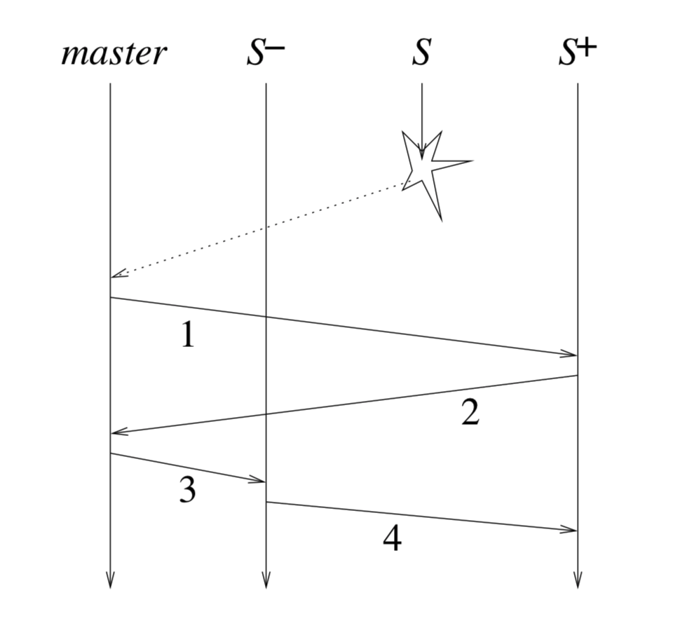
Failure of other servers
Inform S’s successor S+ of the new chain configuration and then informs S’s predecessor S-

Slide 59
Failure of other servers
Inform S’s successor S+ of the new chain configuration and then informs S’s predecessor S-

Slide 60
Failure of other servers
S- connects with S+
Stops processing any messages
Send
  Hist^{S}_{objID} that might not have reached S+
  S- starts to process message after S+ acknowledges
Each server maintains a list of Sent_{i}
  Requests that are forwarded but not processed

Slide 61
After faulty nodes are removed…
The chain becomes shorter and shorter…
Add new servers to the chain
Where shall we add the new server?

Slide 62
Evaluation Criteria
Performance without failures
  Latency
  Throughput
  Bandwidth
Performance under failures
  Performance degradation
  Cost for recovery

Slide 63
Chain Replication
Primary/backup approach
Also state machine replication
Performance without failures?
Higher latency
But parallel dissemination can be used to compensate

Slide 64
Chain Replication
Performance under failure?
Head failure
Tail failure
Middle server failure

Slide 65
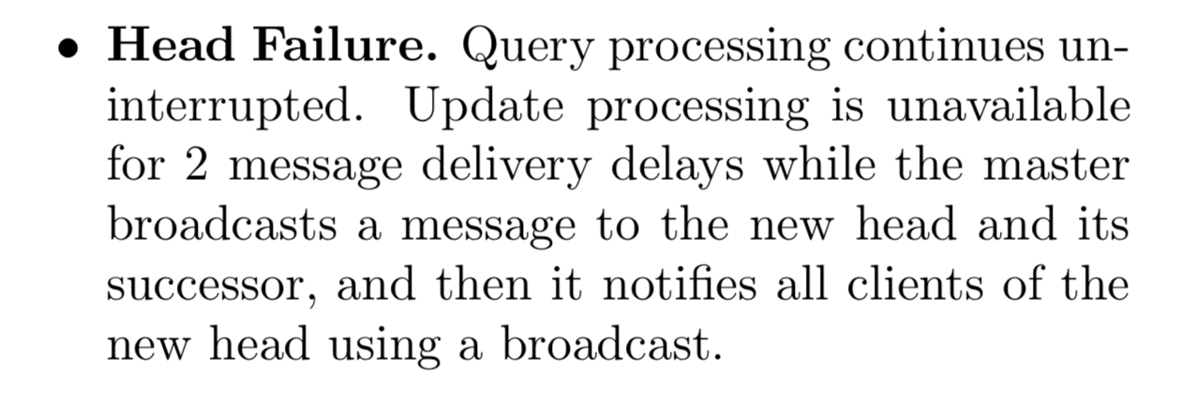
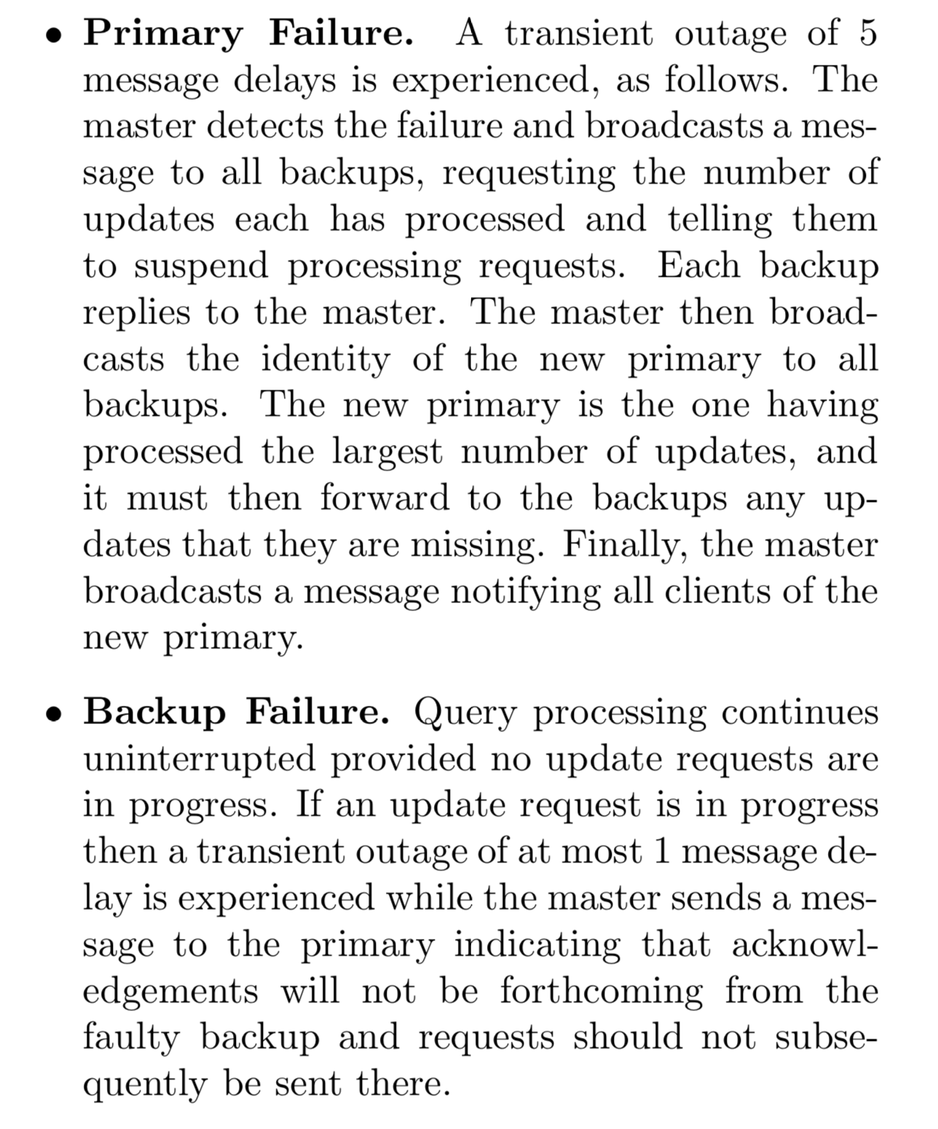
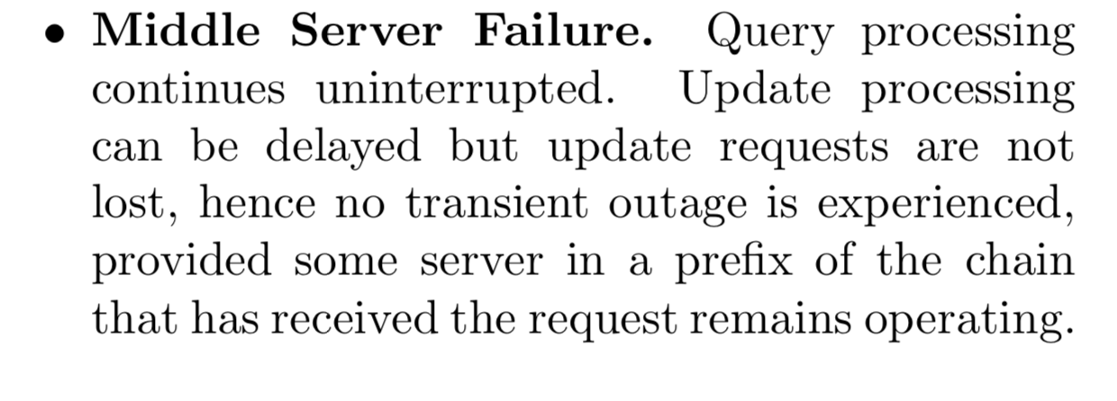
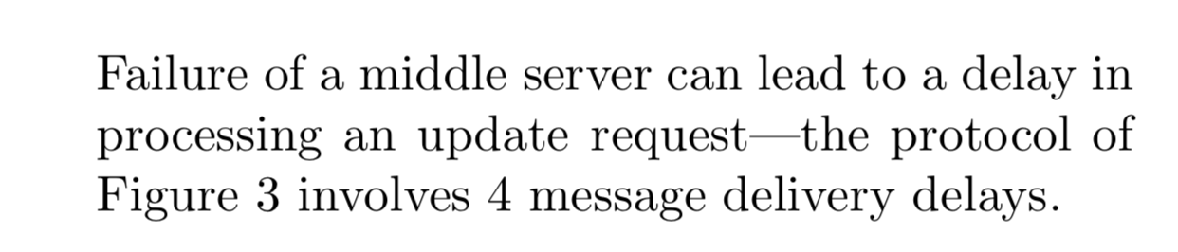
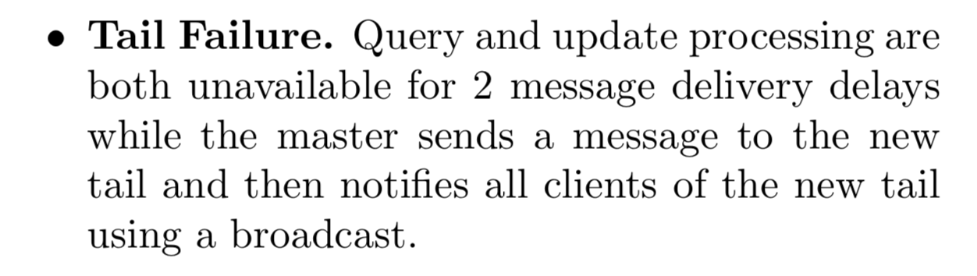
Chain Replication

Slide 66
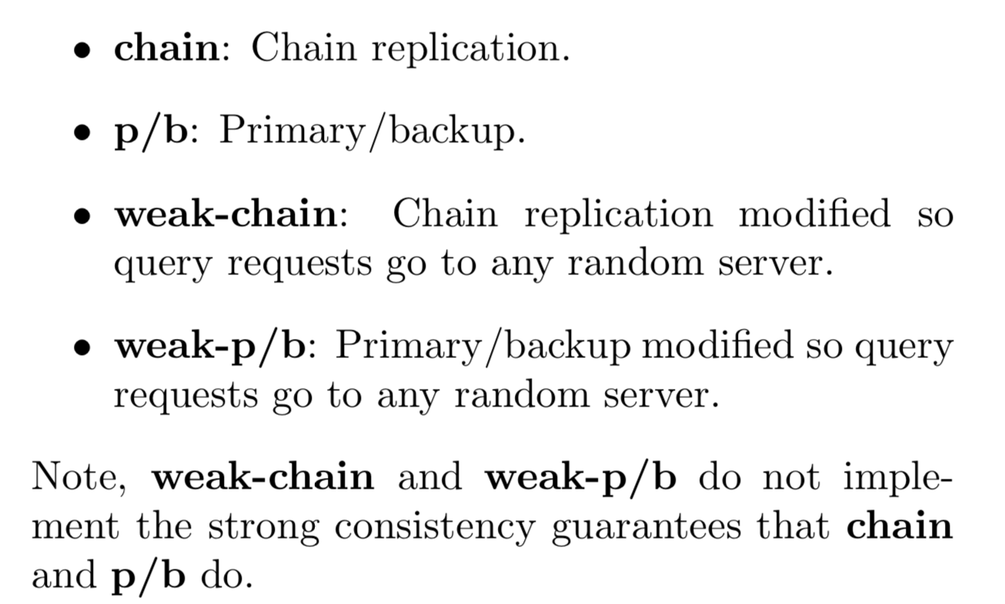
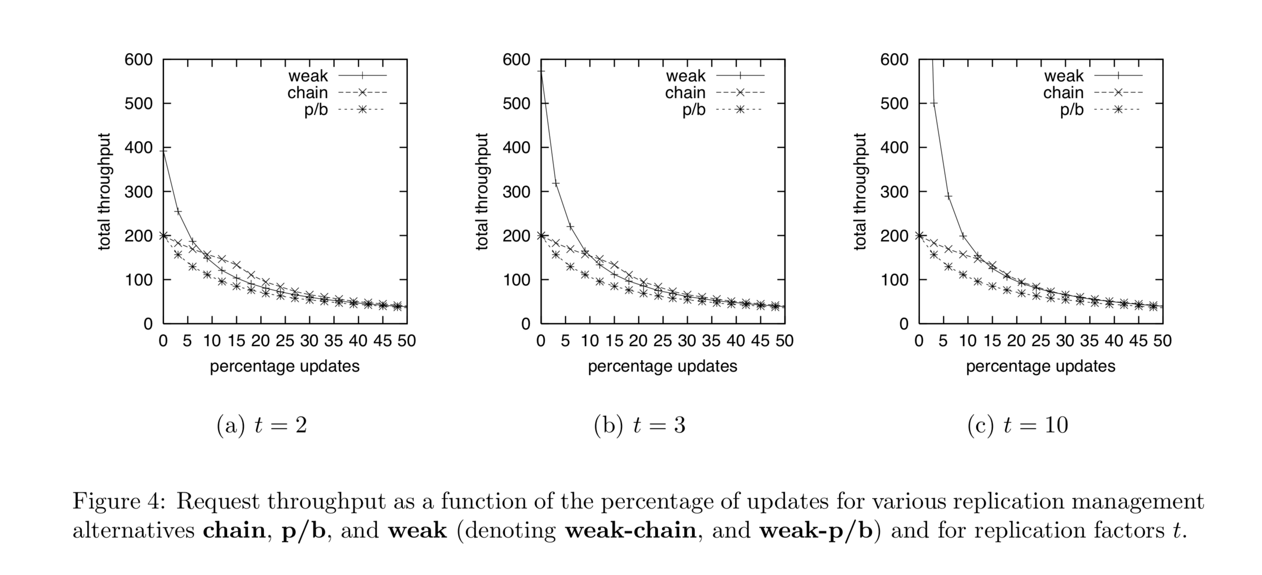
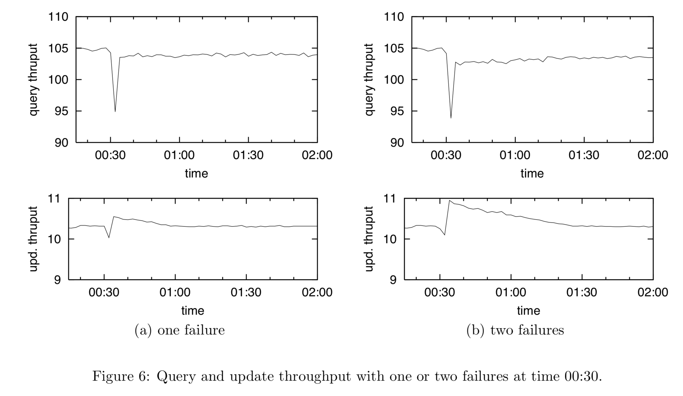
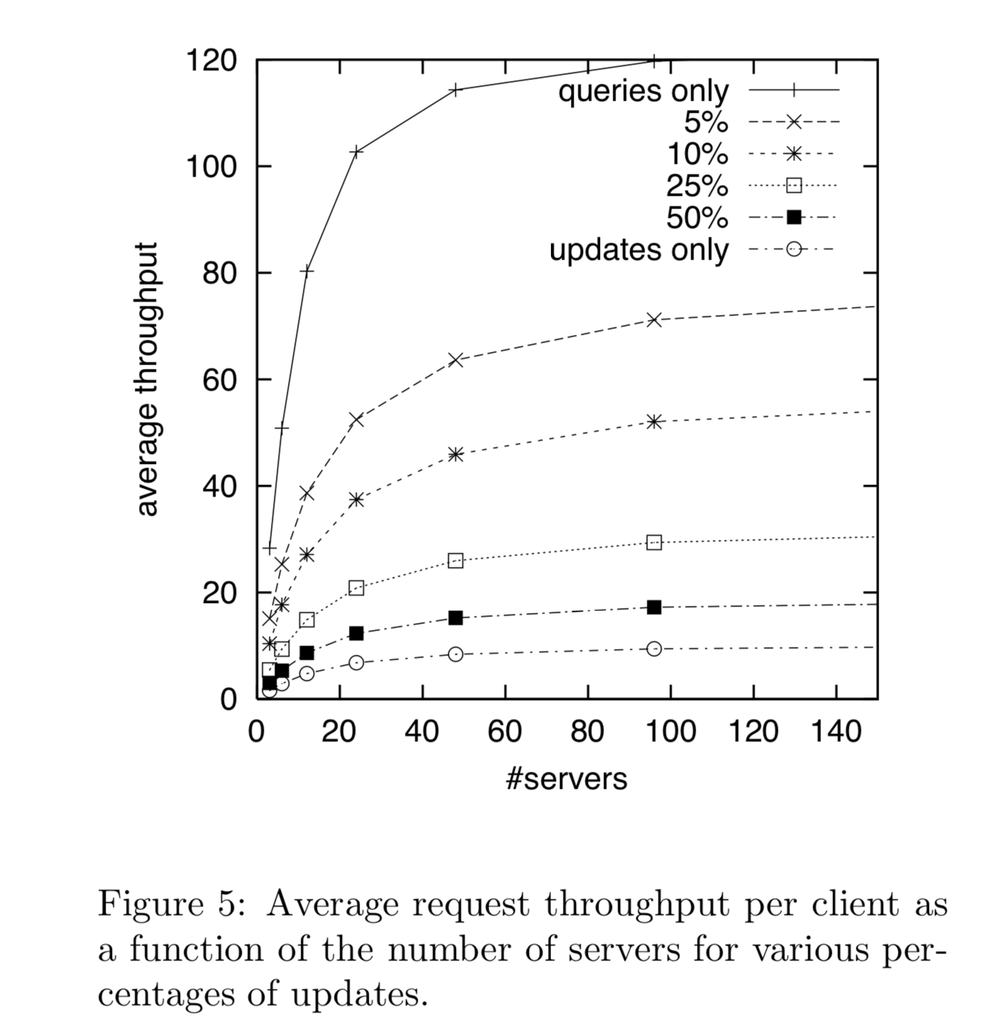

Slide 67
Chain Replication Discussion

Slide 68
Primary Backup Replication
Hot Backups process information from the primary as soon as they receive it
Cold Backups log information received from primary, and process it only if primary fails
Rollback Recovery implements cold backups cheaply:
  the primary logs directly to stable storage the information needed by backups
  if the primary crashes, a newly initialized process is given content of logs—backups are generated “on demand”

