Slide 1
IS 698/800-01:
Advanced Distributed Systems
Crash Fault Tolerance
Sisi Duan
Assistant Professor
Information Systems
sduan@umbc.edu

Slide 2
Outline
A brief history of consensus
Paxos
Raft

Slide 3
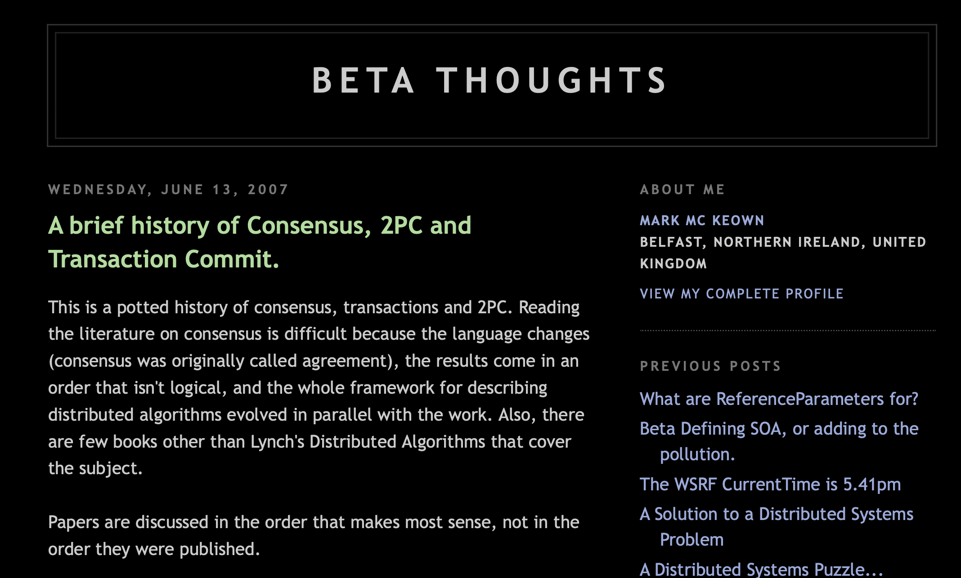
A brief history of consensus
http://betathoughts.blogspot.com/2007/06/brief-history-of-consensus-2pc-and.html

Slide 4
The Timeline
1978 “Time, Clocks and the Ordering of Events in a Distributed System”, Lamport
  The ‘happen before’ relationship cannot be easily determined in distributed systems
  Distributed state machine
1979, 2PC. “Notes on Database Operating Systems”, Gray
1981, 3PC. “NonBlocking Commit Protocols”, Skeen
1982, BFT. “The Byzantine Generals Problem”, Lamport, Shostak, Pease
1985, FLP. “Impossibility of distributed consensus with one faulty process” Fischer, Lynch and Paterson.
1987. “A Comparison of the Byzantine Agreement Problem and the Transaction Commit Problem.”, Gray
Submitted in 1990, published in 1998, Paxos. “The Part-Time Parliament”, Lamport
1988, “Consensus in the presence of partial synchrony”, Dwork, Lynch, Stockmeyer.

Slide 5
2PC
X = read(A)
Y = Read(B)
Write (A, x-100)
Write (B, y+100)
commit
Client sends a request to the coordinator

Slide 6
2PC
X = read(A)
Y = Read(B)
Write (A, x-100)
Write (B, y+100)
commit
Client sends a request to the coordinator
Coordinator sends a PREPARE message

Slide 7
2PC
X = read(A)
Y = Read(B)
Write (A, x-100)
Write (B, y+100)
commit
Client sends a request to the coordinator
Coordinator sends a PREPARE message
A, B replies YES or NO
  If A does not have enough balance, reply no

Slide 8
2PC
X = read(A)
Y = Read(B)
Write (A, x-100)
Write (B, y+100)
commit
Client sends a request to the coordinator
Coordinator sends a PREPARE message
A, B replies YES or NO
Coordinator sends a COMMIT or ABORT message
  COMMIT if both say yes
  ABORT if either says no

Slide 9
2PC
X = read(A)
Y = Read(B)
Write (A, x-100)
Write (B, y+100)
commit
Client sends a request to the coordinator
Coordinator sends a PREPARE message
A, B replies YES or NO
Coordinator sends a COMMIT or ABORT message
  COMMIT if both say yes
  ABORT if either says no
Coordinator replies to the client
A,B commit on the receipt of commit message

Slide 10
2PC

Slide 11
3PC

Slide 12
3PC with Network Partitions
Coordinator crashes after it sends PRE-COMMIT to A
A is partitioned later (or crashes and recover later)
None of B,C,D have got PRE-COMMIT, they will abort
A comes back and decides to commit…

Slide 13
The Timeline
1978 “Time, Clocks and the Ordering of Events in a Distributed System”, Lamport
  The ‘happen before’ relationship cannot be easily determined in distributed systems
  Distributed state machine
1979, 2PC. “Notes on Database Operating Systems”, Gray
1981, 3PC. “NonBlocking Commit Protocols”, Skeen
1982, BFT. “The Byzantine Generals Problem”, Lamport, Shostak, Pease
1985, FLP. “Impossibility of distributed consensus with one faulty process” Fischer, Lynch and Paterson.
1987. “A Comparison of the Byzantine Agreement Problem and the Transaction Commit Problem.”, Gray
Submitted in 1990, published in 1998, Paxos. “The Part-Time Parliament”, Lamport
1988, “Consensus in the presence of partial synchrony”, Dwork, Lynch, Stockmeyer.

Slide 14
Reliable Broadcast
Validity
  If the sender is correct and broadcasts a message m, then all correct processes eventually deliver m
Agreement
  If a correct process delivers a message m, then all correct processes eventually deliver m
Integrity
  Every correct process delivers at most one message, and if it delivers m, then some process must have broadcast m

Slide 15
Terminating Reliable Broadcast
Validity
  If the sender is correct and broadcasts a message m, then all correct processes eventually deliver m
Agreement
  If a correct process delivers a message m, then all correct processes eventually deliver m
Integrity
  Every correct process delivers at most one message, and if it delivers m ≠ SF, then some process must have broadcast m
Termination
  Every correct process eventually delivers some message

Slide 16
Consensus
Validity
  If all processes that propose a value propose v , then all correct processes eventually decide v
Agreement
  If a correct process decides v, then all correct processes eventually decide v
Integrity
  Every correct process decides at most one value, and if it decides v, then some process must have proposed v
Termination
  Every correct process eventually decides some value

Slide 17
The FLP Result
Consensus: getting a number of processors to agree a value
In asynchronous system
  A faulty node cannot be distinguished from a slow node
Correctness of a distributed system
  Safety
    No two correct nodes will agree on inconsistent values
  Liveness
    Correct nodes eventually agree

Slide 18
The FLP Idea
Configuration: System state
Configuration is v-valent if decision to pick v has become inevitable: all runs lead to v
  If not 0-valent or 1-valent, configuration is bivalent
Initial configuration
  At least one 0-valent {0,0….0}
  At least one 1-valent {1,1,….1}
  At least one bivalent {0,0…1,1}

Slide 19
Configuration
0-valent
configurations
bi-valent
configurations
1-valent
configurations

Slide 20
Transitions between configurations
Configuration is a set of processes and messages
Applying a message to a process changes its state, hence it moves us to a new configuration
Because the system is asynchronous, can’t predict which of a set of concurrent messages will be delivered “next”
But because processes only communicate by messages, this is unimportant

Slide 21
Lemma1
Suppose that from some configuration C, the schedules σ₁, σ₂ lead to configurations C₁ and C₂, respectively.
If the sets of processes taking actions in σ₁ and σ₂, respectively, are disjoint than σ₂ can be applied to C₁ and σ₁ to C₂, and both lead to the same configuration C₃

Slide 22
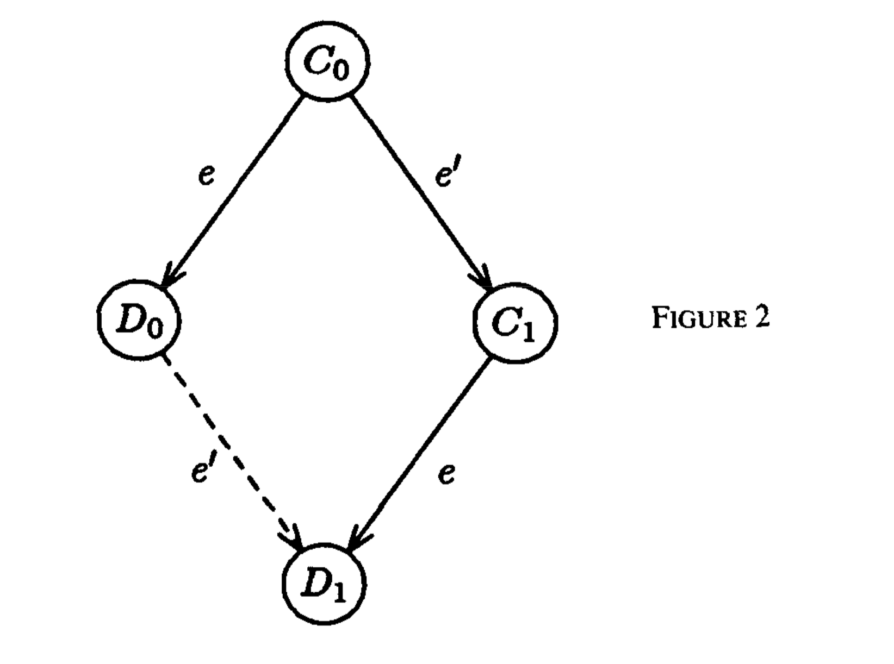
Lemma1

Slide 23
The Main Theorem
Suppose we are in a bivalent configuration now and later will enter a univalent configuration
We can draw a form of frontier, such that a single message to a single process triggers the transition from bivalent to univalent

Slide 24
The Main Theorem
C
e
e’
bivalent
D₀
C₁
univalent
e’
e
D₁

Slide 25
Single step decides
They prove that any run that goes from a bivalent state to a univalent state has a single decision step, e
They show that it is always possible to schedule events so as to block such steps
Eventually, e can be scheduled but in a state where it no longer triggers a decision

Slide 26
The Main Theorem
They show that we can delay this “magic message” and cause the system to take at least one step, remaining in a new bivalent configuration
Uses the diamond-relation seen earlier
But this implies that in a bivalent state there are runs of indefinite length that remain bivalent
Proves the impossibility of fault-tolerant consensus

Slide 27
Notes on FLP
No failures actually occur in this run, just delayed messages
Result is purely abstract. What does it “mean”?
Says nothing about how probable this adversarial run might be, only that at least one such run exists

Slide 28
FLP intuition
Suppose that we start a system up with n processes
Run for a while… close to picking value associated with process “p”
Someone will do this for the first time, presumably on receiving some message from q
If we delay that message, and yet our protocol is “fault-tolerant”, it will somehow reconfigure
Now allow the delayed message to get through but delay some other message

Slide 29
Key insight
FLP is about forcing a system to attempt a form of reconfiguration
This takes time
Each “unfortunate” suspected failure causes such a reconfiguration

Slide 30
FLP in the real world
Real systems are subject to this impossibility result
But in fact often are subject to even more severe limitations, such as inability to tolerate network partition failures
Also, asynchronous consensus may be too slow for our taste
And FLP attack is not probable in a real system
  Requires a very smart adversary!

Slide 31
Chandra/Toueg
Showed that FLP applies to many problems, not just consensus
  In particular, they show that FLP applies to group membership, reliable multicast
  So these practical problems are impossible in asynchronous systems, in formal sense
But they also look at the weakest condition under which consensus can be solved

Slide 32
Chandra/Toueg Idea
Separate problem into
  The consensus algorithm itself
  A “failure detector:” a form of oracle that announces suspected failure
  But it can change its mind
Question: what is the weakest oracle for which consensus is always solvable?

Slide 33
Sample properties
Completeness: detection of every crash
  Strong completeness: Eventually, every process that crashes is permanently suspected by every correct process
  Weak completeness: Eventually, every process that crashes is permanently suspected by some correct process

Slide 34
Sample properties
Accuracy: does it make mistakes?
  Strong accuracy: No process is suspected before it crashes.
  Weak accuracy: Some correct process is never suspected
  Eventual strong accuracy: there is a time after which correct processes are not suspected by any correct process
  Eventual weak accuracy: there is a time after which some correct process is not suspected by any correct process

Slide 35
A sampling of failure detectors
Completeness | Accuracy
 | Strong | Weak | Eventually Strong | Eventually Weak
Strong | Perfect P | Strong S | Eventually Perfect ◊P | Eventually Strong ◊ S
Weak | D | Weak W | ◊ D | Eventually Weak ◊ W

Slide 36
Perfect Detector?
Named Perfect, written P
Strong completeness and strong accuracy
Immediately detects all failures
Never makes mistakes

Slide 37
Example of a failure detector
The detector they call W: “eventually weak”
More commonly: ◊W: “diamond-W”
Defined by two properties:
  There is a time after which every process that crashes is suspected by some correct process
  There is a time after which some correct process is never suspected by any correct process
Think: “we can eventually agree upon a leader.” If it crashes, “we eventually, accurately detect the crash”

Slide 38
◊W: Weakest failure detector
They show that ◊W is the weakest failure detector for which consensus is guaranteed to be achieved
Algorithm is pretty simple
  Rotate a token around a ring of processes
  Decision can occur once token makes it around once without a change in failure-suspicion status for any process
  Subsequently, as token is passed, each recipient learns the decision outcome

Slide 39
Paxos

Slide 40

Paxos
Leslie Lamport
2013 Turing Award
The Part-Time Parliament 1998
The only known completely-safe and largely-live agreement protocol
Tolerates crash failures
Let all nodes agree on the same value despite node failures, network failures, and delays
  Only blocks in exceptional circumstances that are very rare in practice
Extremely useful
  Nodes agree that client X gets a lock
  Nodes agree that Y is the primary
  Nodes agree that Z should be the next operation to be executed

Slide 41
Paxos Examples
Widely used in both industry and academia
Examples
  Google Chubby (Paxos-based distributed lock service, we will cover it later)
  Yahoo Zookeeper (Paxos-based distributed lock service, the protocol is called ZaB)
  Digital Equipment Corporation - Frangipani (Paxos-based distributed lock service)
  Scatter (Paxos-based consistent DHT)
Notes:
Frangipani – distributed file system
Scatter - key-value storage – university of Washington developed it

Slide 42
Paxos Properties
Safety (something bad will never happen)
  If a correct node p1 agrees on some value v, all other correct nodes will agree on v
  The value agreed upon was proposed by some node
Liveness (something good will eventually happen)
  Correct nodes eventually reach an agreement
Basic idea seems natural in retrospect, but why it works (proof) in any detail is incredibly complex

Slide 43
High-level overview of Paxos
Paxos is similar to 2PC, but with some twists
Three roles
  Proposer (just like the coordinator, or the primary in primary/backup approach)
    Proposes a value and solicits acceptance from others
  Acceptors (just like the machines in 2PC, or the backups…)
    Vote if they would like to accept the value
  Learners
    Learn the results. Do not actively participate in the protocol
The roles can be mixed
  A proposer can also be learner, an acceptor can also be learner, proposer can change…
  We consider Paxos where proposers and acceptors are also learners (it is slightly different from the original protocol)

Slide 44
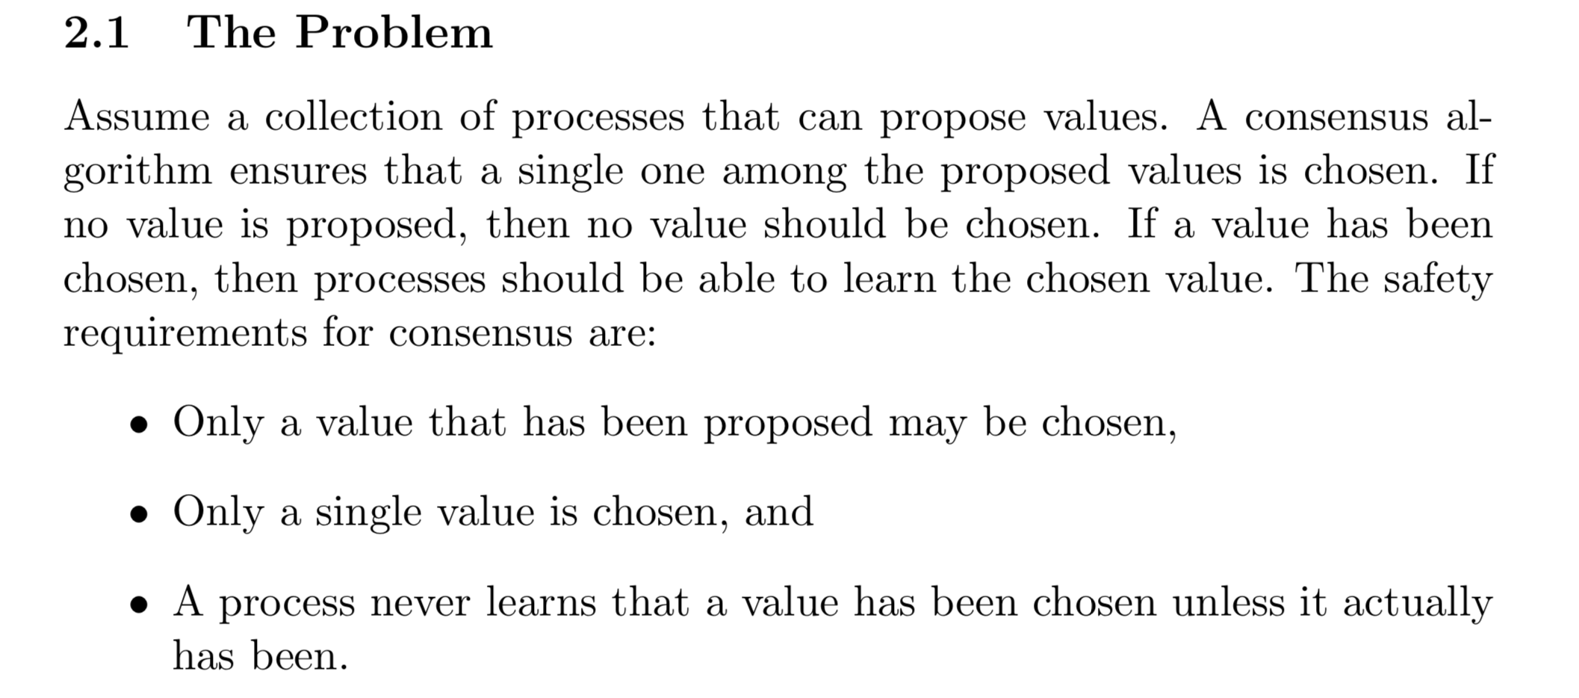
Paxos

Slide 45
High-level overview of Paxos
Values to agree on
  Depend on the application
  Whether to commit/abort a transaction
  Which client should get the next lock
  Which write we perform next
  What time to meet…
For simplicity, we just consider
they agree on a value

Slide 46
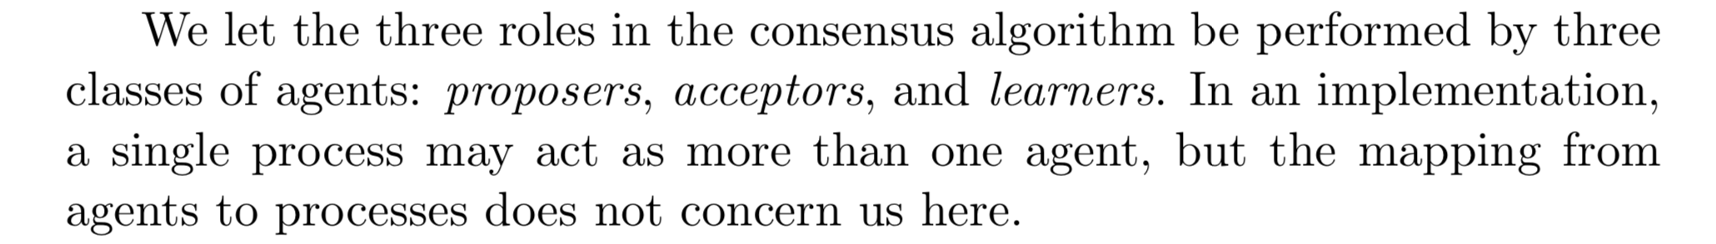
High-level overview of Paxos
The roles
  Proposer
  Acceptors
  Learners
In any round, there is only one proposer
But any one could be the proposer
Everyone actively participate in the protocol and have the right to ”vote” for decision. No one has special powers
(The proposer is just like a coordinator)

Slide 47
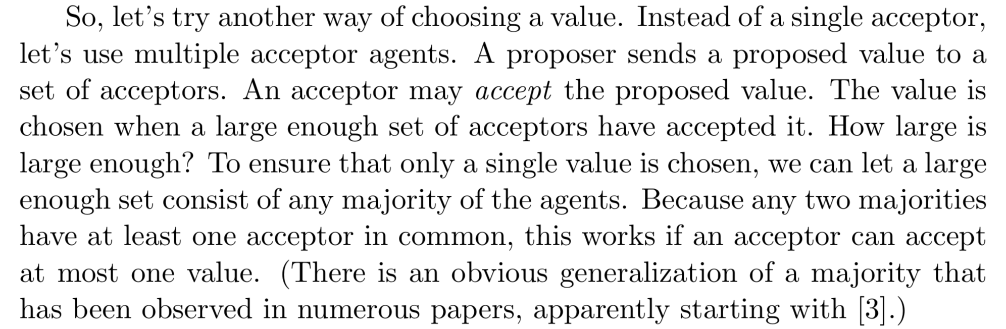
Core Mechanisms
Proposer ordering
  Proposer proposes an order
  Nodes decide which proposals to accept or reject
Majority voting (just like the idea of quorum!)
  2PC requires all the nodes to vote for YES to commit..
  Paxos requires only a majority of votes to accept a proposal
    If we have n nodes, we can tolerate floor((n-1)/2) faulty nodes
    If we want to tolerate f crash failures, we need 2f+1 nodes
    Quorum size = majority nodes = (n+1)/2 (f+1 if we assume there are 2f+1 nodes)

Slide 48
Majority voting
  If we have n nodes, we can tolerate floor((n-1)/2) faulty nodes
  If we want to tolerate f crash failures, we need 2f+1 nodes
  Quorum size = majority nodes = ceil((n+1)/2) (f+1 if we assume there are 2f+1 nodes)

Slide 49
Majority voting
We say that Paxos can tolerate/mask nearly half the node failures so make sure that the protocol continues to work correctly.
No two majorities (quorums) can exist simultaneously, network partitions do not cause problems (remember 3PC suffers from such a problem)

Slide 50
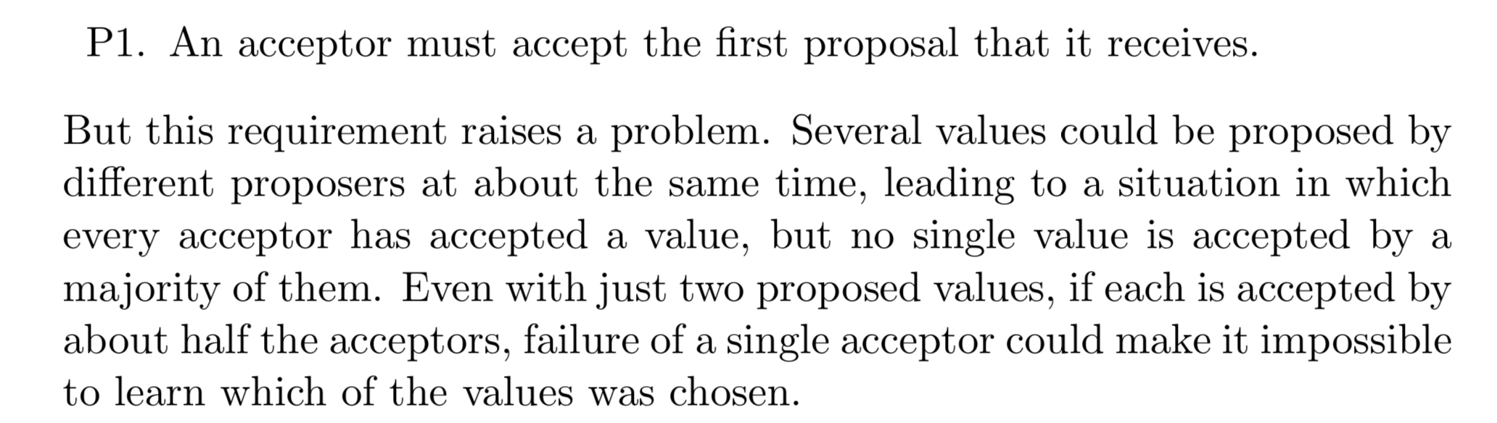
Paxos

Slide 51
Paxos
P2. If a proposal with value v is chosen, then every higher-numbered proposal that is chosen has value v.
P2a. If a proposal with value v is chosen, then every higher-numbered proposal accepted by any acceptor has value v.
P2b. If a proposal with value v is chosen, then every higher-numbered proposal issued by any proposer has value v.
P2c. For any v and n, if a proposal with value v and number n is issued, then there is a set S consisting of a majority of acceptors such that either (a) no acceptor in S has accepted any proposal numbered less than n, or (b) v is the value of the highest-numbered proposal among all proposals numbered less than n accepted by the acceptors in S.

Slide 52
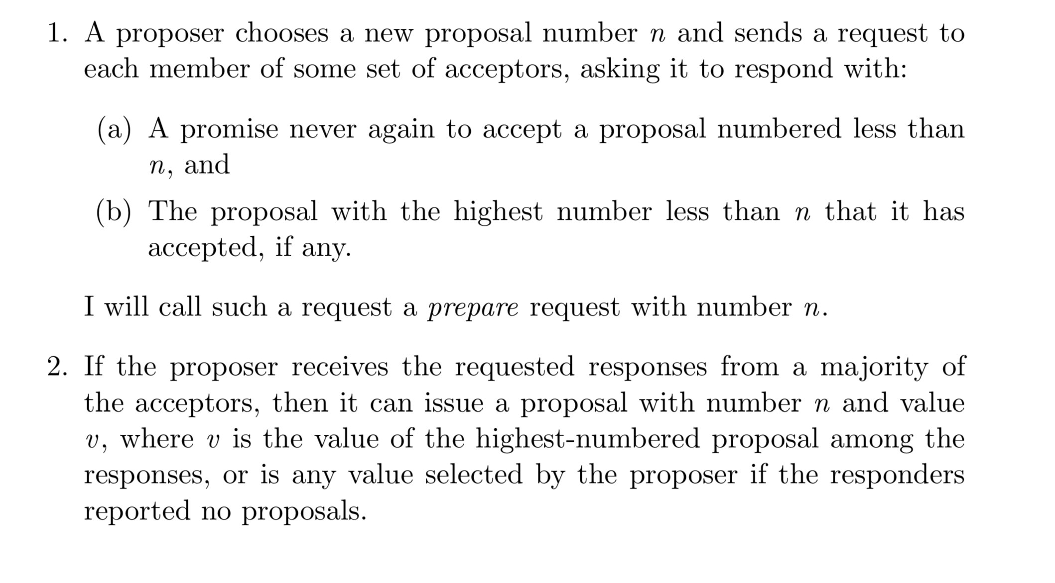
Paxos

Slide 53
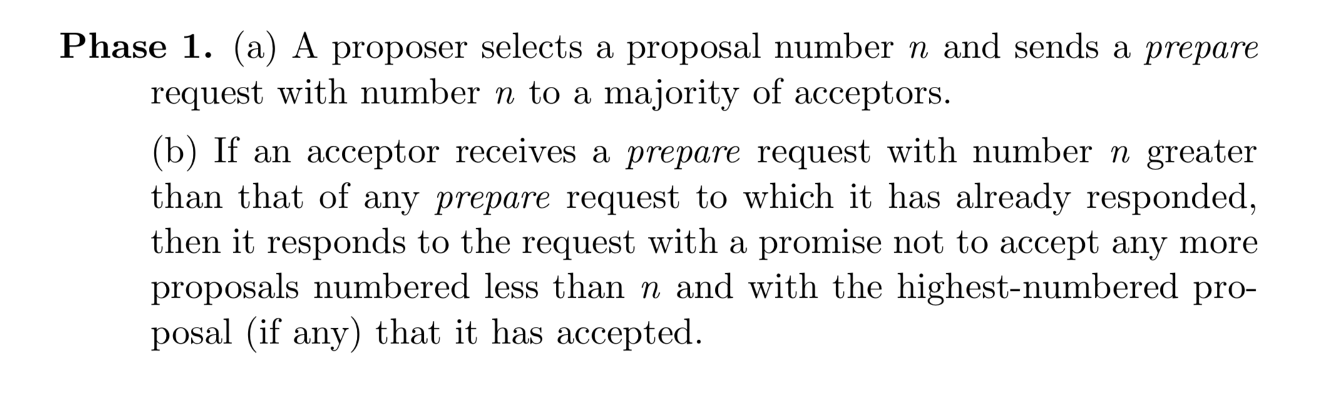
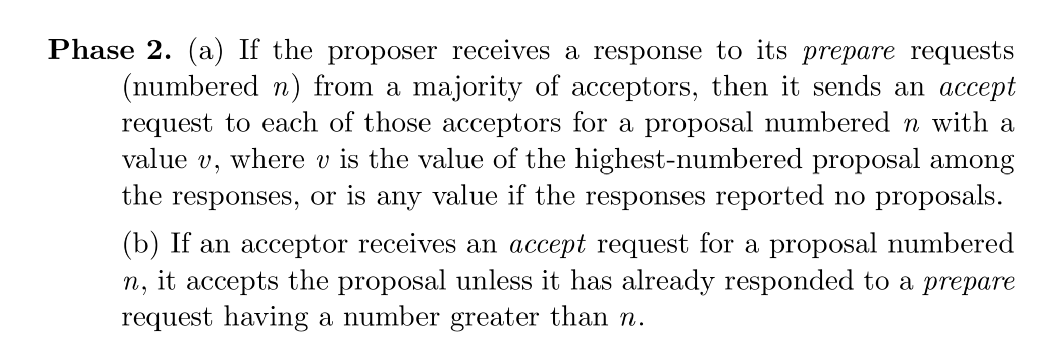
Paxos

Slide 54
Learners
The obvious algorithm is to have each acceptor, whenever it accepts a proposal, respond to all learners, sending them the proposal.
Only one distinguished learner learn the result, other learners follow it.
Use a larger set of distinguished learners. Other learners learn from them.

Slide 55
Paxos
Phase 1: Prepare (propose)
  Leader chooses one request m and assigns a sequence number s
  Leader sends a PREPARE message to all the replicas
  Upon receiving a PREPARE message, if s>s’, replies PROMISE (yes)
  Also send the message to other replicas (in original Paxos, they broadcast to learners…)

Slide 56
Paxos
What if multiple nodes become proposers simultaneously?
What if the new proposer proposes different values than an already decided value?
What if there is a network partition?
What if a proposer crashes in the middle of solicitation?
What if a proposer crashes after deciding but before announcing the results?
…
Phase 2: Accept (propose)
  If the leader gets PROMISE from a majority
    m is agreed
    Send ACCEPT to all the replicas and reply to the client
  Otherwise, restart Paxos
  (Replica) Upon receiving a ACCEPT message, if s=cs, it knows m is agreed

Slide 57
Paxos
A diagram closer to the original Paxos algorithm

Slide 58
Paxos without considering learners

Slide 59
Paxos
Doesn’t look too different from 3PC
Main differences
  We collect votes from majority instead of from everyone
  We use sequence numbers (order) so that multiple proposals can be processed
  We can elect a new proposer if the current one fails

Slide 60
Paxos
Discussion
  Assume there are 2f+1 replicas and f of them are faulty
  If all the f failures are acceptors, what will happen?
  If the proposer fails, what will happen?

Slide 61
Paxos

Slide 62
Chubby
Google’s distributed lock service
What is it?
  Lock service in a loosely-coupled distributed system
  Client interface similar to
    While-file advisory locks
    Notification of various events
  Primary goals: reliability, availability, easy-to-understand semantics

Slide 63
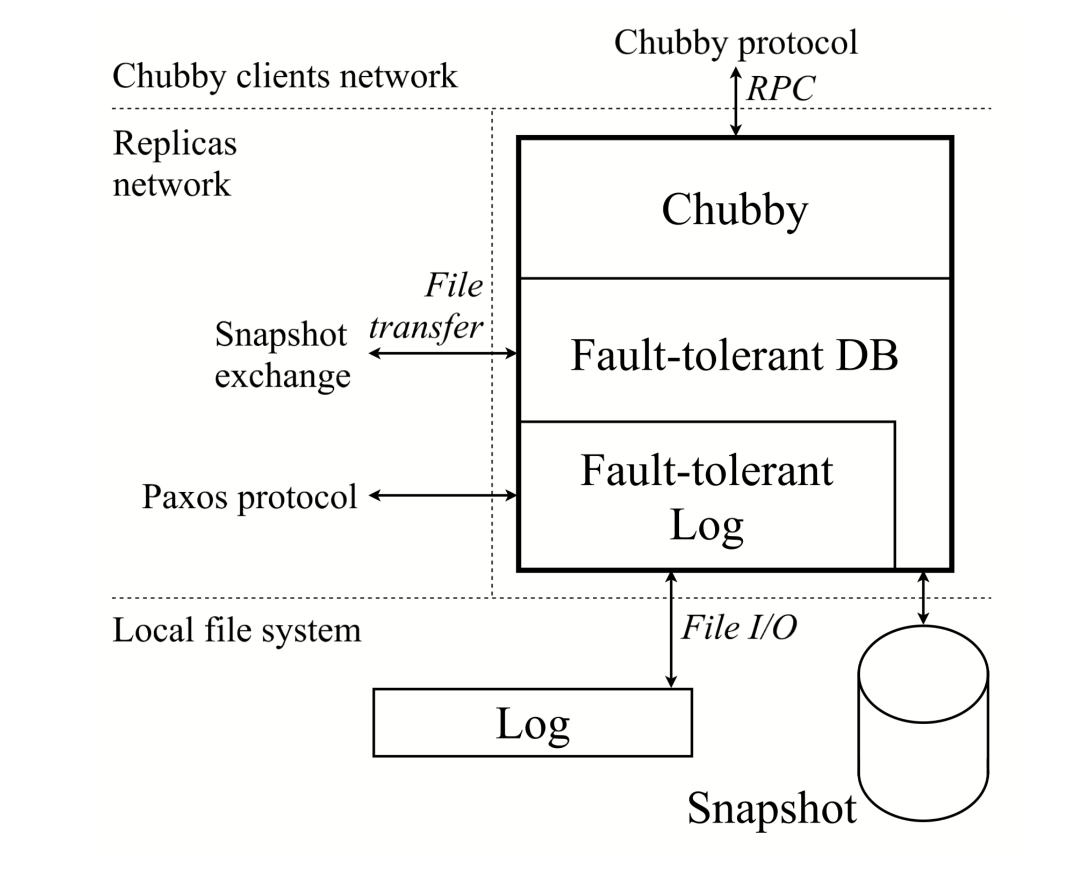
Paxos in Chubby

Slide 64
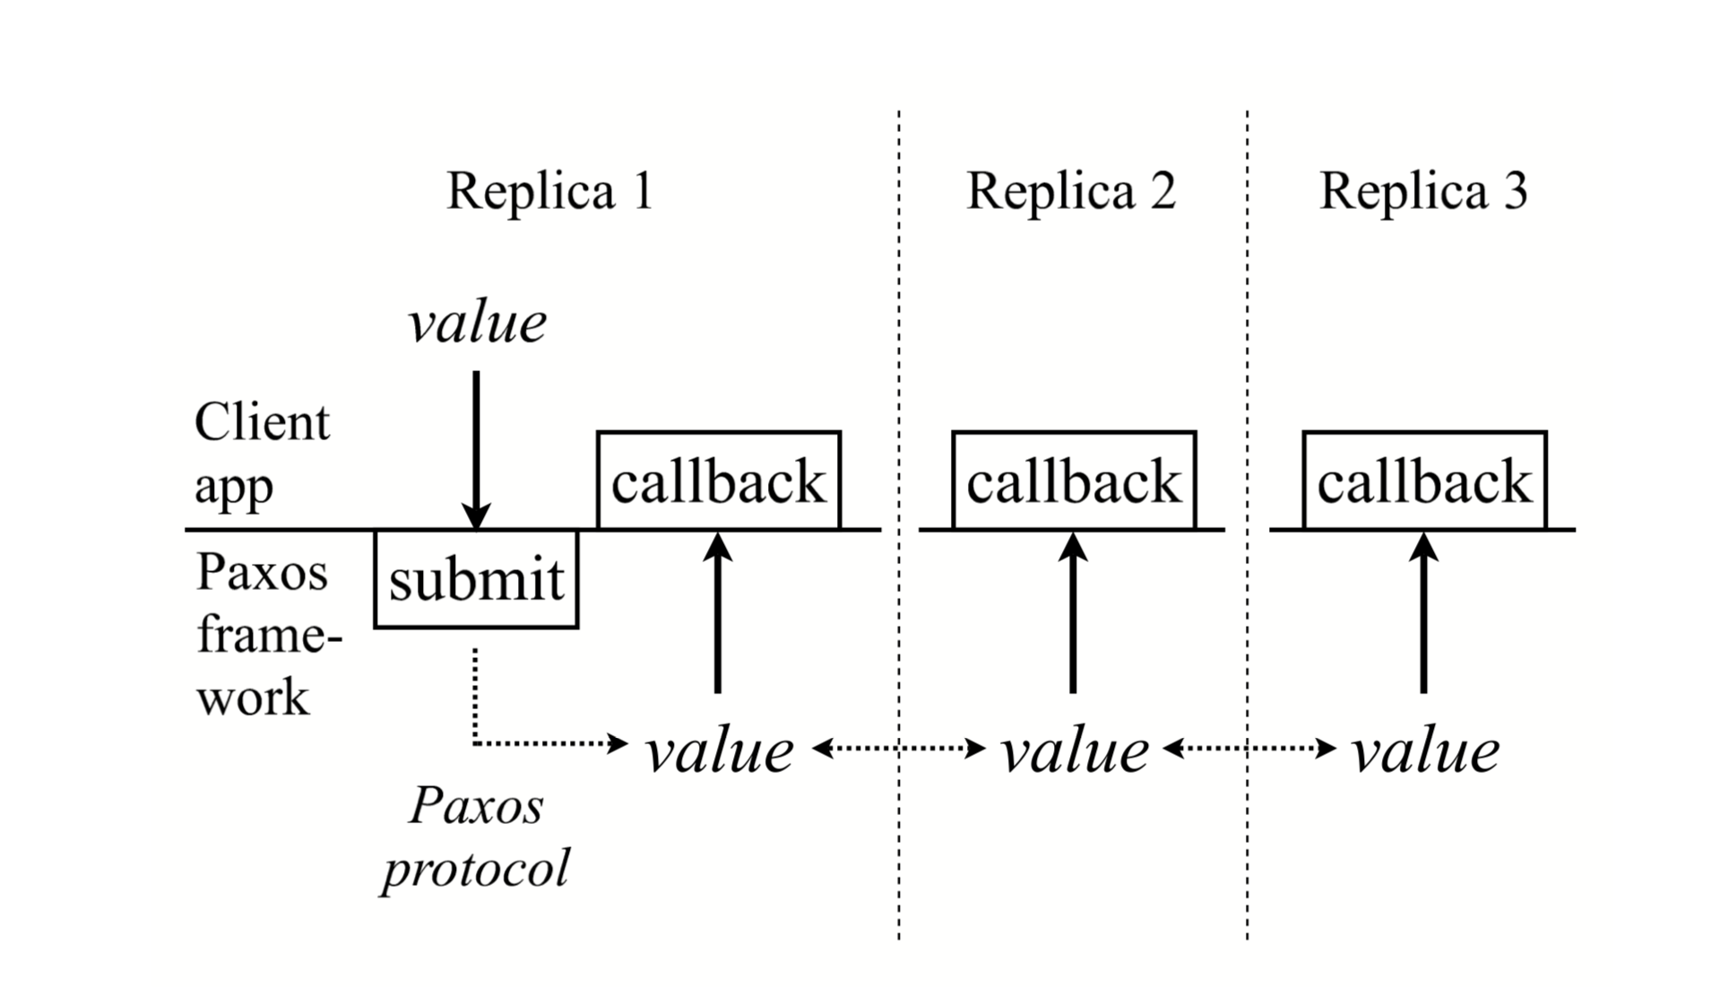
Paxos in Chubby

Slide 65
Paxos Challenges in Chubby
Disk corruption
file(s) contents may change
  the checksum of the contents of each file is stored in the file
file(s) may become inaccessible
  indistinguishable from a new replica with an empty disk
  Have a new replica leave a marker in GFS after start-up
  If this replica ever starts again with an empty disk, it will discover the GFS marker and indicate that it has a corrupted disk

Slide 66
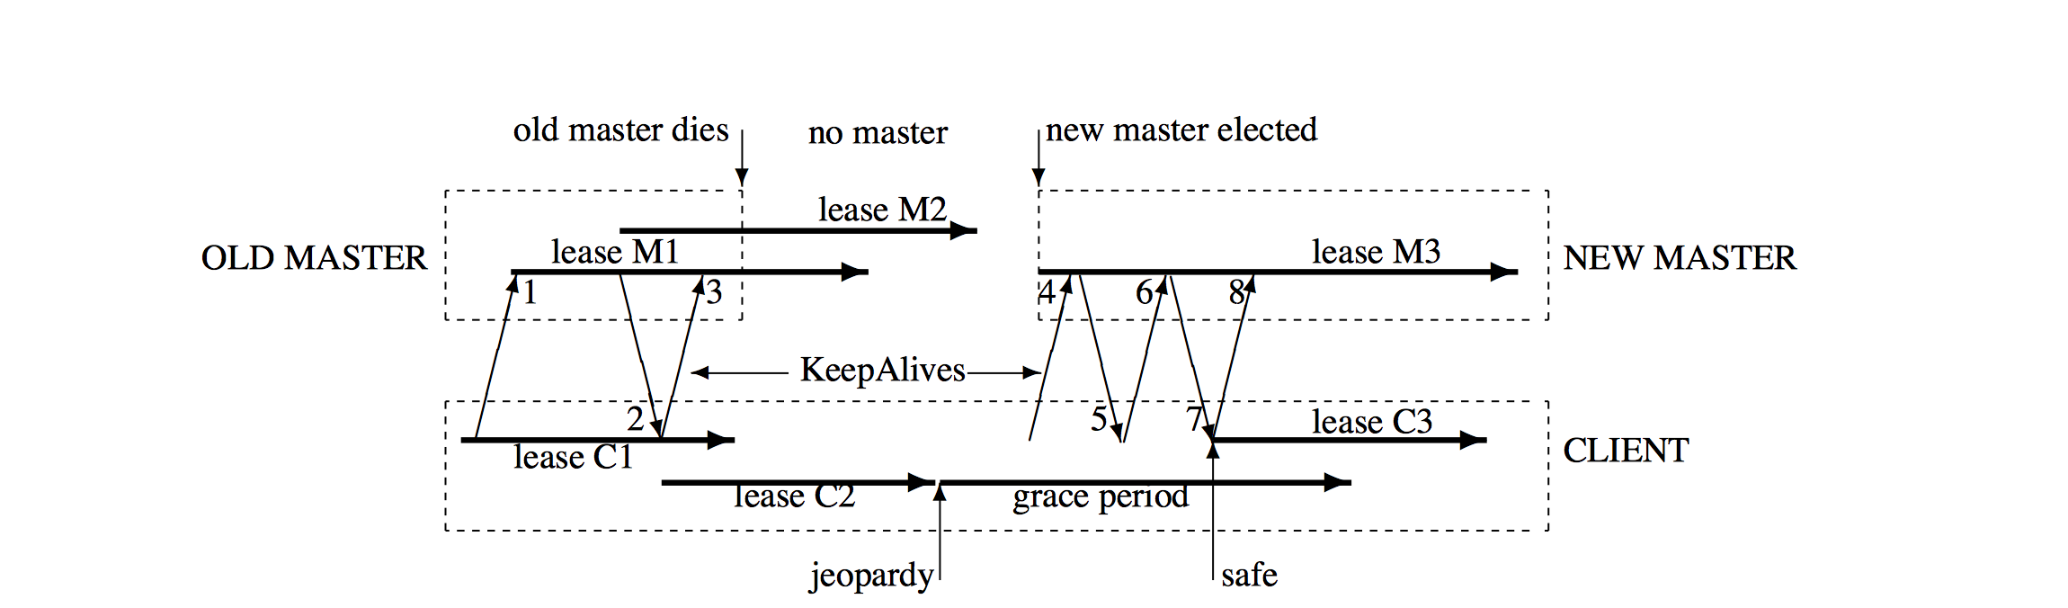
Paxos Challenges in Chubby
Leader change

Slide 67
Paxos Challenges in Chubby
Snapshots (Checkpoints)
  The snapshot and log need to be mutually consistent. Each snapshot needs to have information about its contents relative to the fault-tolerant log.
  Taking a snapshot takes time and in some situations we cannot afford to freeze a replica’s log while it is taking a snapshot.
  Taking a snapshot may fail.
  While in catch-up, a replica will attempt to obtain missing log records.

Slide 68
Snapshot
When the client application decides to take a snapshot, it requests a snapshot handle.
The client application takes its snapshot.
  It may block the system while taking the snapshot, or – more likely – spawn a thread that takes a snapshot while the replica continues to participate in Paxos. The snapshot must correspond to the client state at the log position when the handle was obtained. Thus if the replica continues to participate in Paxos while taking a snapshot, special precautions may have to be taken to snapshot the client’s data structure while it is actively updated.
When the snapshot has been taken, the client application informs the framework about the snapshot and passes the corresponding snapshot handle. The framework then truncates the log appropriately.

Slide 69
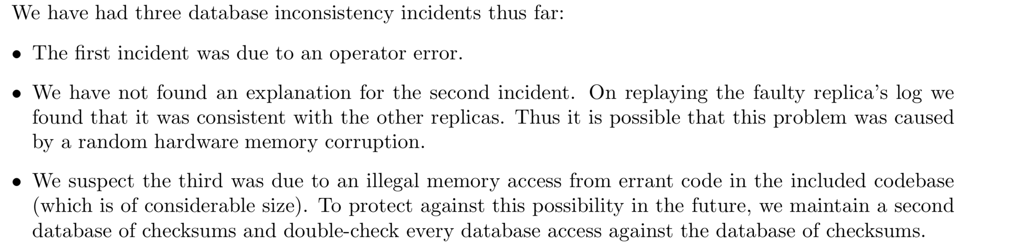
Paxos Challenges
The chance for inconsistencies increases with the size of the code base, the duration of a project, and the number of people working simultaneously on the same code.
Database consistency checker

Slide 70
Unexpected failures
Our first release shipped with ten times the number of worker threads as the original Chubby system. We hoped this change would enable us to handle more requests. Unfortunately, under load, the worker threads ended up starving some other key threads and caused our system to time out frequently. This resulted in rapid master failover, followed by en-masse migrations of large numbers of clients to the new master which caused the new master to be overwhelmed, followed by additional master failovers, and so on.
When we tried to upgrade this Chubby cell again a few months later, our upgrade script failed because we had omitted to delete files generated by the failed upgrade from the past. The cell ended up running with a months-old snapshot for a few minutes before we discovered the problem. This caused us to lose about 30 minutes of data.
A few months after our initial release, we realized that the semantics provided by our database were different from what Chubby expected.
We have encountered failures due to bugs in the underlying operating system.
As mentioned before, on three occasions we discovered that one of the database replicas was different from the others in that Chubby cell.

