Slide 1


Slide 2
Outline
BFT
PBFT
Zyzzyva

Slide 3
Announcement
Review for week 7
  Due Mar 11
  Gilad, Yossi, et al. "Algorand: Scaling byzantine agreements for cryptocurrencies." Proceedings of the 26th Symposium on Operating Systems Principles. ACM, 2017.
Mar 13 in class
  Project progress presentation
  Each team has 9-10 minutes
  Describe 1) your topic, 2) why you study it (motivation), 3) your progress, 4) where do you see your project could end up with.
  Sign up google sheet for your schedule
Submit your project progress report by Mar 27

Slide 4
Byzantine Generals Problem
Concerned with (binary) atomic broadcast
  All correct nodes receive the same value
  If broadcaster is correct, correct nodes receive broadcasted value
Can be used to build consensus/agreement protocol
  BFT Paxos

Slide 5

Why 2f+1 cannot tolerate Byzantine failures?
indistinguishable

Slide 6
PBFT
Practical Byzantine Fault Tolerance. M. Castro and B. Liskov. OSDI 1999.
Replicate services across many nodes
  Assumption: only a small fraction of nodes are Byzantine
  Rely on a super-majority of votes to decide on correct computation
Use at least 3f+1 replicas to tolerate f failures
Byzantine Paxos!

Slide 7
The Setup
System model
  Partial synchrony
  Unreliable channels
Service
  Byzantine clients
  Up to f Byzantine replicas
System goals
  Safety: always (even under asynchrony)
  Liveness: during periods of synchrony

Slide 8
BFT Quorums
Quorum size: 2f+1 out of 3f+1 ((n+f+1)/2)
Why?
  Any two quorums intersect at least f+1 nodes.
  One quorum = 2f+1, two quorums = 4f+2, there are 3f+1 nodes in the system
  There are at most f faulty replicas
  So in the intersection, there is at least one correct replica!
  Discussion and reminder: why the correct replica is important?

Slide 9
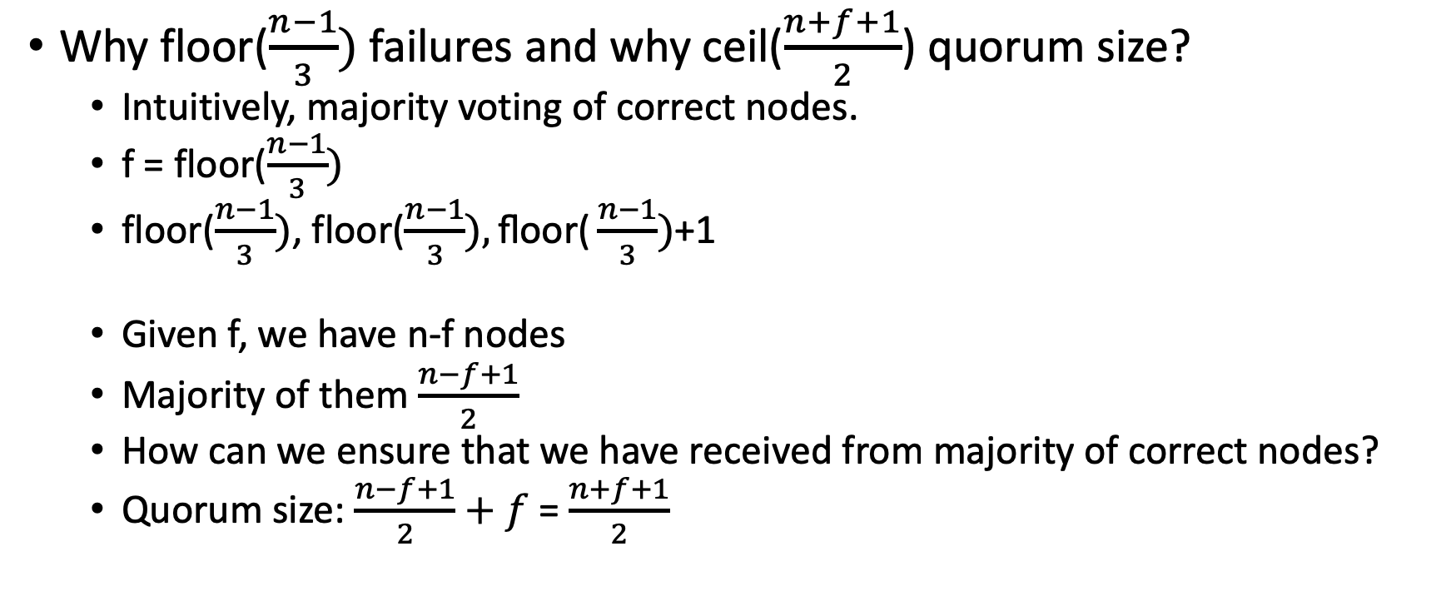
Byzantine Quorums
Why floor($\frac{n−1}{3})$failures and why ceil($\frac{n+f+1}{2}$) quorum size?
  Intuitively, majority voting of correct nodes.
  f = floor($\frac{n−1}{3})$
  floor($\frac{n−1}{3})$, floor($\frac{n−1}{3}),\text{floor}\text{(}\frac{n−1}{3})$+1
  Given f, we have n-f nodes
  Majority of them $\frac{n−f+1}{2}$
  How can we ensure that we have received from majority of correct nodes?
  Quorum size: $\frac{n−f+1}{2}+f$= $\frac{n+f+1}{2}$

Slide 10
Byzantine Quorum
10 nodes, tolerating 3 failures
Quorum size?

Slide 11
Byzantine Quorum
11 nodes, tolerating 3 failures
Quorum size?

Slide 12
Byzantine Quorum
12 nodes, tolerating 3 failures
Quorum size?

Slide 13
Byzantine Quorum
10 nodes, 3 failures, quorum = 7
11 nodes, 3 failures, quorum = 8
12 nodes, 3 failures, quorum = 8
13 nodes, 4 failures, quorum = 9
…

Slide 14
PBFT Overview
Primary runs the protocol in the normal case
Replicas can vote to elect a new primary through a view change protocol (if they have enough evident that the primary fails)
Replicas agree on the order of client requests (use sequence number)
All the messages are authenticated using MACs or digital signatures

Slide 15
Primary Backup + Quorum System
executions are sequences of views
clients send signed commands to primary of current view
primary assigns sequence number to client’s command
primary writes sequence number to the register implemented by the quorum system defined by all the servers (primary included)
In every phase, a replica collects matching votes from a quorum of nodes. The votes: certificate.

Slide 16
The Faulty Behaviors
Faulty primary
  Could ignore commands; assign same sequence number of different requests; skip sequence numbers
Faulty backup
  Could incorrectly store commands forwarded by a correct primary
Faulty replicas could incorrectly respond to the client

Slide 17
PBFT
Normal operation
  The common case
View changes
  Elect a new primary
Garbage collection
  Reclaim the storage used to keep certificates
Recovery
  How to make a faulty replica behave correctly again

Slide 18
Replica’s state
Replica id i (0 through n-1 assuming there are n=3f+1 replicas)
  0,1,2,…
A view number v, initially 0
Primary has id i=v%n
Last accepted request sequence number s’
Status of each sequence number (PRE-PREPARE, PREPARED, COMMITTED)

Slide 19
The PBFT Protocol
Client sends a request m to the primary

Slide 20
The PBFT Protocol
Phase 1: PRE-PREPARE
Primary selects a client request m, assigns a sequence number s, and send < PRE-PREPARE> to all the replicas

Slide 21
The PBFT Protocol
Phase 2: PREPARE
On receiving a <PRE-PREPARE> message
  If the current view = v, s>=s’, it has not accepted another pre-prepare message with the same sequence number, s is between two watermarks, accept the order, update its s’ to s, and sends a <PREPARE> message to all other replicas

Slide 22
The PBFT Protocol
Phase 2: PREPARE
On receiving 2f matching <PREPARE> messages (including its own message), a replica
  Sets its status as prepared
  Sends a COMMIT message to other replicas

Slide 23
The PBFT Protocol
Phase 2: PREPARE
The P-certificate: ensures total order already
  The request m
  A Pre-prepare for m in view v with s
  2f Prepare from different backups that match the pre-prepare

Slide 24
The PBFT Protocol
Phase 2: PREPARE
The P-certificate: ensures total order already
  Why a third phase?

Slide 25
The PBFT Protocol
Phase 2: PREPARE
The P-certificate: ensures total order already
  Why a third phase?
  During the view change, a new leader could modify it

Slide 26
The PBFT Protocol
Phase 3: COMMIT
On receiving 2f+1 matching <COMMIT> messages (including its own message), a replica
  Sets its status as committed
  Sends a reply message to the client

Slide 27
The PBFT Protocol
Phase 3: COMMIT
C-Certificate
  A P-certificate (m,v,s)
  2f+1 matching COMMIT messages

Slide 28
The PBFT Protocol
Reply

Slide 29
Garbage Collection
Multicast <CHECKPOINT,n,d,i>
n – sequence number of last committed request
d – digest of the state
When receiving 2f+1 CHECKPOINT messages
  Save the stable checkpoint certificate
  Delete the logs

Slide 30
How to handle faulty primary?
How does Viewstamped replication or Paxos detect faulty primary?
Will it work in Byzantine model?
How should we handle this in BFT?

Slide 31
What will happen if the primary is Byzantine
Every replica will set up a timer upon receiving a client request
If the client request hasn’t been processed before the timer expires
Send a <VIEW-CHANGE,v+1> message to all other replicas
When receiving f+1 VIEW-CHANGE message (if the replica hasn’t voted for view change yet), sends a VIEW-CHANGE message to all replicas
When receiving 2f+1 VIEW-CHANGE message, we know all the correct replicas must know we are going to have view change! (Why?)
Start view change!

Slide 32
New View
The new primary re-orders all the client requests that have not been agreed and start normal operations again
Way much trickier than the benign failure model (Think about Viewstamped Replication)
What do we need?

Slide 33
View Change
When a node sends a VIEW-CHANGE message
  It stops accepting any messages beside VIEW-CHANGE and NEW-VIEW
  Multicast <VIEW-CHANGE,v+1,P,Q>
  P contains all P-certificates and Q (pre-prepared messages)
2f+1 VIEW-CHANGE messages form a certificate to move to a new view

Slide 34
New View
The new primary selects l and h
  l is the largest sequence number of the last stable checkpoint
  h is the largest sequence number in the P-certificate

Slide 35
New View
The new primary selects l and h
  l is the largest sequence number of the last stable checkpoint
  h is the largest sequence number in the P-certificate
For every sequence number s between l and h
  If there is a P-certificate for s (2f+1 view-change messages)
  And f+1 Q (pre-prepared at f+1 nodes)
  Otherwise, select NULL

Slide 36
New View
The new primary sends
  Sends <NEW-VIEW,v+1,V,X>
  V: 2f+1 view change messages
  X: last stable checkpoint, and the selected requests

Slide 37
New View
When a backup receives NEW-VIEW messages, it checks
  It is signed properly
  It contains valid V
  Verify locally X is correct
Add all entries to its log
Multicast a PREPARE for each message
Enter the new view

Slide 38
Why 3 phases?
Are 2 phases good enough?
View change, collect 2f+1 VIEW-CHANGE messages
  Multicast <VIEW-CHANGE,v+1,P,Q>
  P contains all P-certificates and Q (pre-prepared messages)
  New leader selects a m if there is at least one p-certificate and f+1 in Q

Slide 39
Why 3 phases?
If a request is prepared at one correct node, not other request will be prepared in the same view
New leader selects a m if there is at least one p-certificate and f+1 in Q
The p-certificate, some node mentions this has been committed,
F+1 pre-prepared, this request has been received by at least one correct node

Slide 40
Why 3 phases?
The new leader (e.g., p2)
Receives messages from p0 and p3
P0, m, pre-prepared
P3, nothing…
P2 selects NULL
If only wo phases, the client needs to collect 2f+1 matching replies

Slide 41
Why 3 phases?
What do we know if there are 3 phases?
If a request is committed at a correct node…
  It receives 2f+1 commit messages
  At least f+1 of them are correct
  These f+1 nodes will definitely include m in both P and Q
  A view change will be triggered by 2f+1 VIEW-CHANGE messages
  At least f+1 of them are correct
  The f+1 and f+1 must have at least one correct node in common (majority voting of correct nodes!)
  It will include m in P! (using digital signature, this is good enough!)

Slide 42
Optimization
Digest replies
Tentative execution
Request batching
Read optimization

Slide 43
Evaluation Criteria
Cryptographic operations
Network bandwidth
  Message lengths
  Number of messages
Protocol cost
  Number of phases
Trade-offs among all the parameters (frequency of failures, frequency of checkpoints, etc.)

Slide 44
Zyzzyva

Slide 45
Zyzzyva (I)
Uses speculation to reduce the cost of BFT replication
  Primary replica proposes the order of client requests to all secondary replicas (standard)
  Secondary replicas speculatively execute the request without going through an agreement protocol to validate that order (new idea)

Slide 46
Zyzzyva (II)
As a result
  States of correct replicas may diverge
  Replicas may send diverging replies to client
Zyzzyva’s solution
  Clients detect inconsistencies
  Help convergence of correct replicas to a single total ordering of requests
  Reject inconsistent replies

Slide 47
How?
Clients observe a replicated state machine
Replies contain enough information to let clients ascertain if the replies and the history are stable and guaranteed to be eventually committed
Replicas have checkpoints

Slide 48
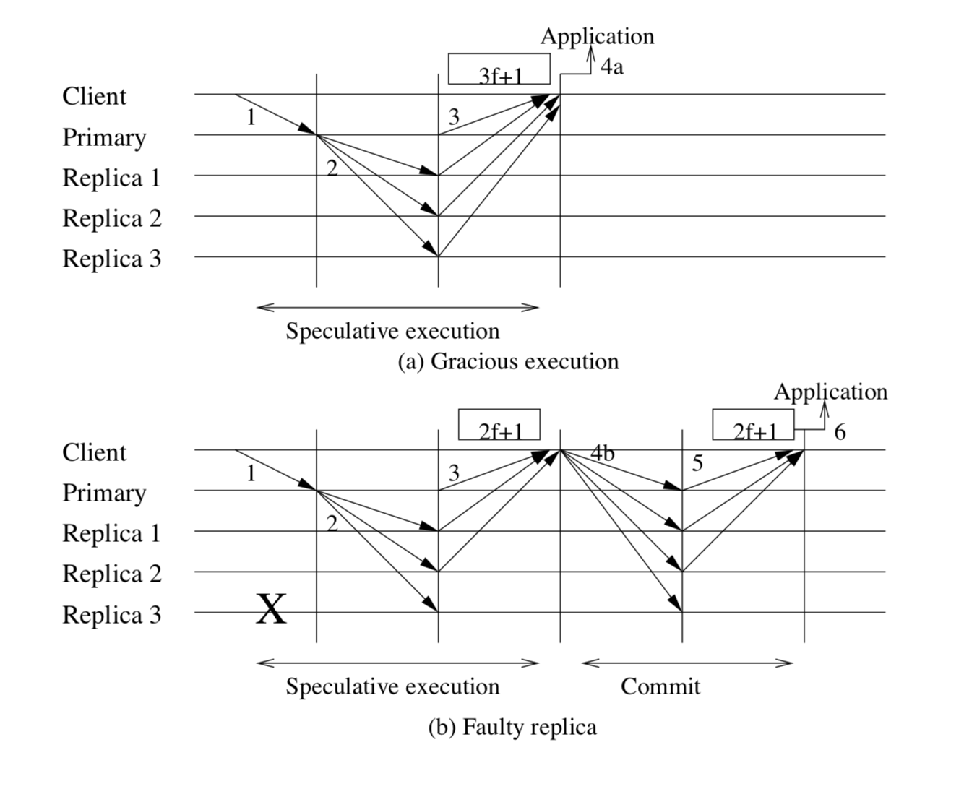
Zyzzyva

Slide 49
Explanations
Secondary replicas assume that
  Primary replica gave the right ordering
  All secondary replicas will participate in transaction
Initiate speculative execution
Client receives 3f + 1 mutually consistent responses

Slide 50
Explanations (I)
Client receives 3f mutually consistent responses
Gathers at least 2f + 1 mutually consistent responses
Distributes a commit certificate to the replicas
Once at least 2f + 1 replicas acknowledge receiving a commit certificate, the client considers the request completed

Slide 51
Explanations (II)
If enough secondary replicas suspect that the primary replica is faulty, a view change is initiated and a new primary elected
During view change, still collect 2f+1 view-change messages
If f+1 of them include a request m, include that in the new view

Slide 52
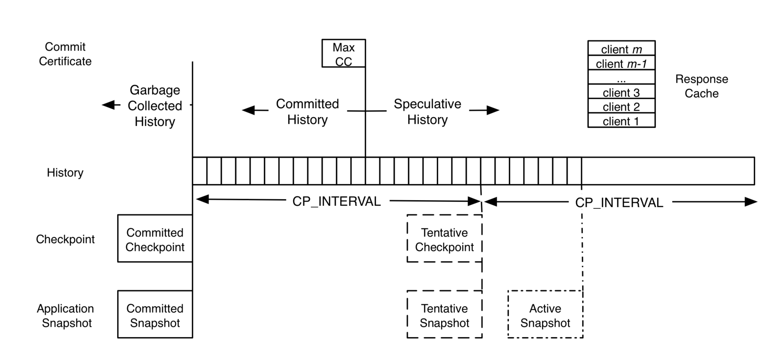
Zyzzyva State

Slide 53
Explanations (I)
Each replica maintains
  A history of the requests it has executed
  A copy of the max commit certificate it has received
    Let it distinguish between committed history and speculative history

Slide 54
Explanations (II)
Each replica constructs a checkpoint every CP_INTERVAL requests
It maintains one stable checkpoint with a corresponding stable application state snapshot
It might also have up to one speculative checkpoint with its corresponding speculative application state snapshot

Slide 55
Explanations (III)
Checkpoints and application state become committed through a process similar to that of earlier BFT agreement protocols
  Replicas send signed checkpoint messages to all replicas when they generate a tentative checkpoint
  Commit checkpoint after they collect f + 1 signed matching checkpoint messages

Slide 56
Breaking safety
Abraham, Ittai, et al. "Revisiting fast practical byzantine fault tolerance." arXiv preprint arXiv:1712.01367 (2017).

