Slide 1
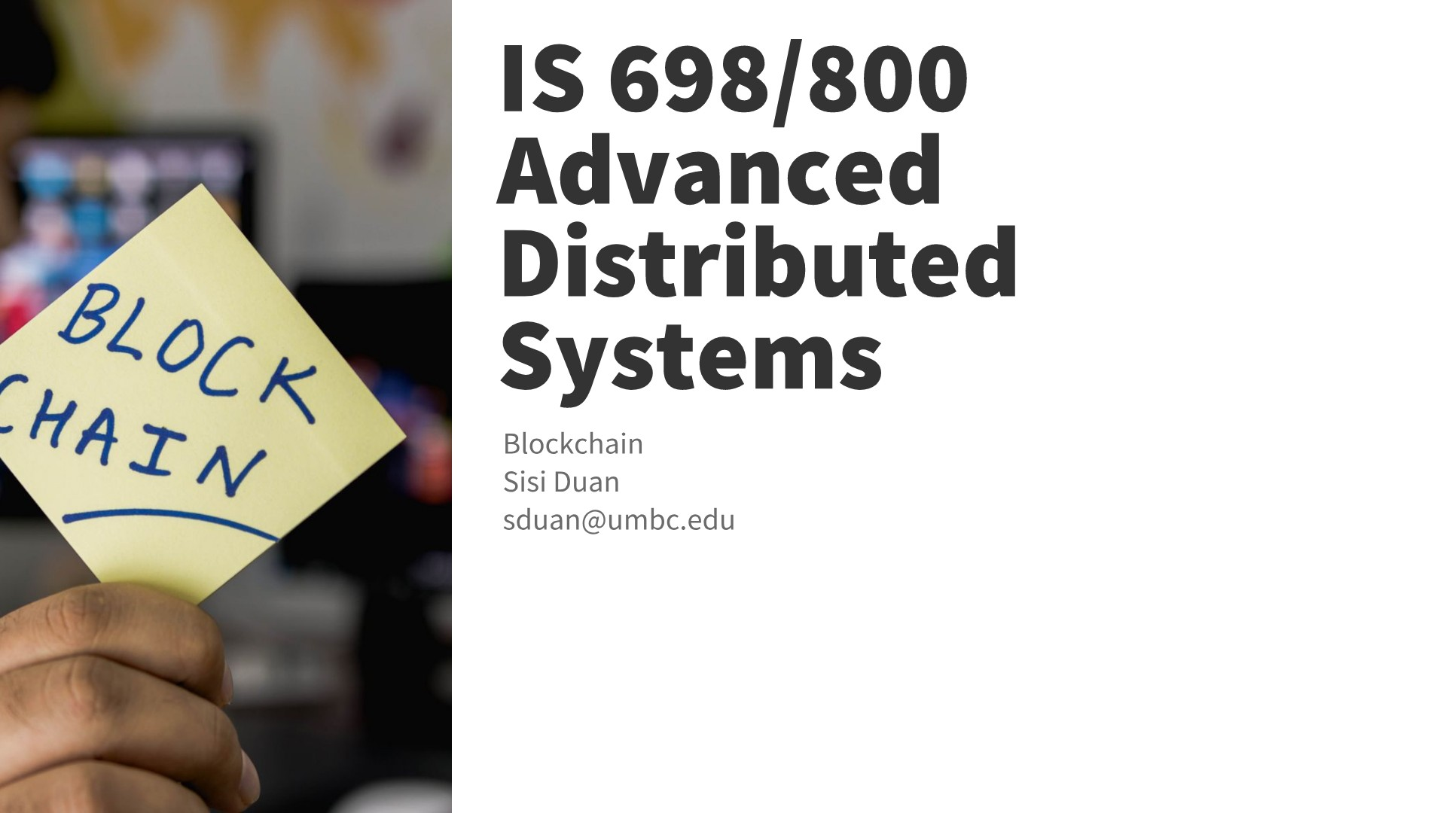

Slide 2
Outline
What is blockchain
Permissionless blockchain – Bitcoin
Formalizing blockchain

Slide 3

What is Blockchain?
A growing list of
digital records
Consensus
cryptography
Decentralized
network
Distributed
database

Slide 4
History of cryptocurrency
Hayek. Denationalization of money, free banking and inflation targeting. 1977.
Satoshi Nakamoto. Bitcoin: A Peer-to-Peer Electronic Cash System. 2008.

Slide 5
Bitcoin
Bitcoin | The protocol / technology
bitcoins | The currency / coin / unit of account
Transaction | Transfer of a coin from one owner to the next, signed cryptographically
Public/Private key | The receiver’s public key is his Bitcoin address The sender’s private key is used to digitally sign the transaction
Block | Validated collection of transactions over 10 minutes, created through mining
Mining | Generates a block and validates transactions through proof-of-work, creating new bitcoins in the process
Blockchain | Timestamped sequence of linked blocks The public ledger

Slide 6
Bitcoin Overview
Every participant maintains a ledger of all the transactions
Work together to verify transactions
Key components: proof-of-work, blocks, hash chain

Slide 7
How Bitcoin Works
Ledger
Every one maintains the the history of all the transactions in the network
User | bitcoins
Alice | 3
Bob | 4.2
Carol | 10.3

Slide 8
Sending money
Alice->Bob: 1BTC

Slide 9
Sending money
Alice->Bob: 1BTC

Slide 10
Sending money
Alice->Bob: 1BTC
Every one applies to its local copy of the ledger

Slide 11
Questions
How to make sure the sender actually sends the transaction?
How to make sure the sender does have enough money?
How to ensure the order of the transactions?
How to ensure which transaction should be processed first?

Slide 12
Questions
How to make sure the sender actually sends the transaction?
  Digital signatures
  Two types: asymmetric key based (used in bitcoin) and symmetric key based
  As long as the sender does not lose its private key, then the message with the digital signature is generated by the sender

Slide 13

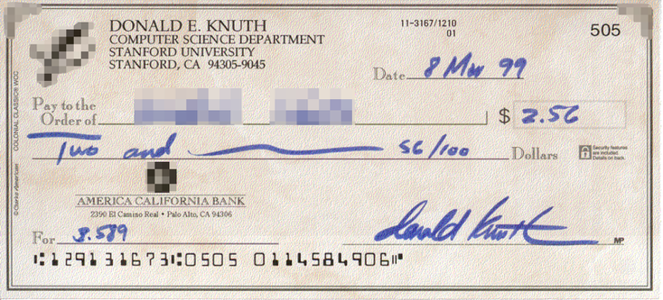
Bitcoin Transactions
Public key 0xc7b2f68...
Public key 0xa8fc93875a972ea
Signature 0xa87g14632d452cd

Slide 14
Questions
How to make sure the sender does have enough money?

Slide 15
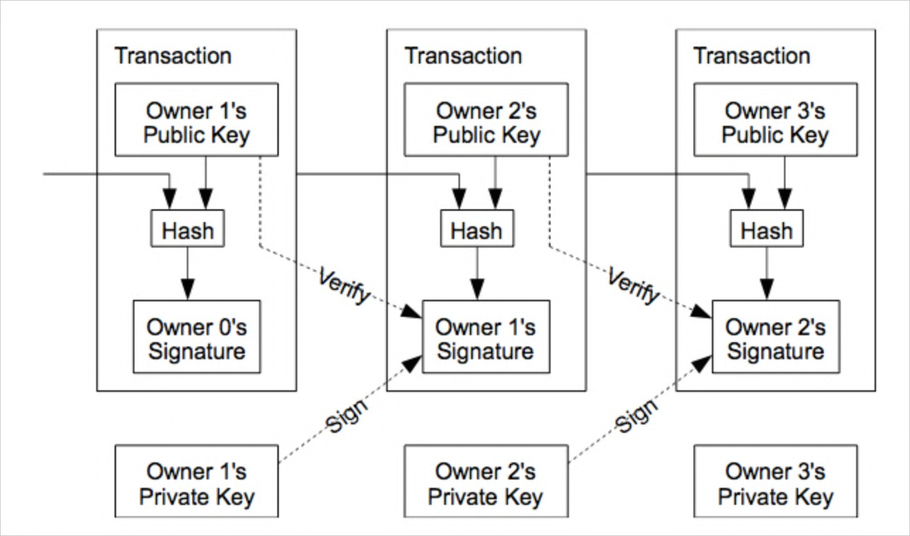
Bitcoin: How to ensure the order of the transactions? Hash chain

Slide 16
Questions
How to ensure the which transaction should be processed next?
  Every time, one node (leader) proposes the next transaction (or a batch of transactions)
  Proof of work
  Current leader throws a puzzle and everyone tries to solve it
  The one who solves it first will be the next leader

Slide 17
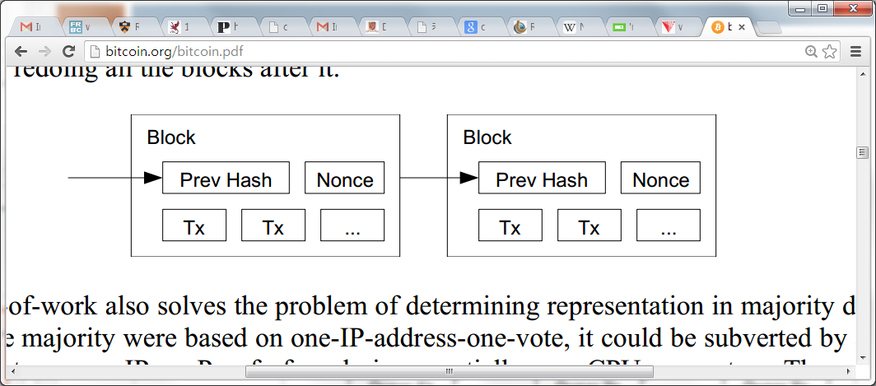
Use of Cryptographic Hashes
  Proof-of-work
    Block contains transactions to be validated and previous hash value.
    Pick a nouce such that H(prev hash, nounce, Tx) < E. E is a variable that the system specifies. Basically, this amounts to finding a hash value who’s leading bits are zero. The work required is exponential in the number of zero bits required.
    Verification is easy. But proof-of-work is hard.

Slide 18
Tie breaking
Two nodes may find a correct block simultaneously.
  Keep both and work on the first one
  If one grows longer than the other, take the longer one
Two different block chains (or blocks) may satisfy the required proof-of-work.

Slide 19
Reverting is Hard
Reverting gets exponentially hard as the chain grows.
2. Recompute nonce
3. Recompute the next nonce
1. Modify the transaction (revert or change the payer)

Slide 20
Practical Limitation
At least 10 mins to verify a transaction.
  Agree to pay
  Wait for one block (10 mins) for the transaction to go through.
  But, for a large transaction ($$$) wait longer. Because if you wait longer it becomes more secure. For large $$$, you wait for six blocks (1 hour).

Slide 21
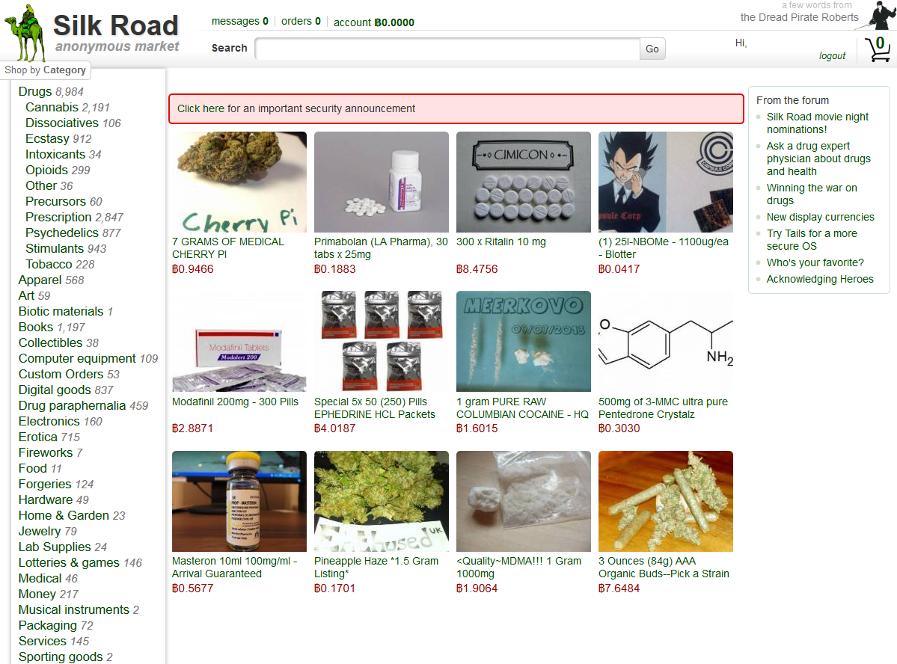
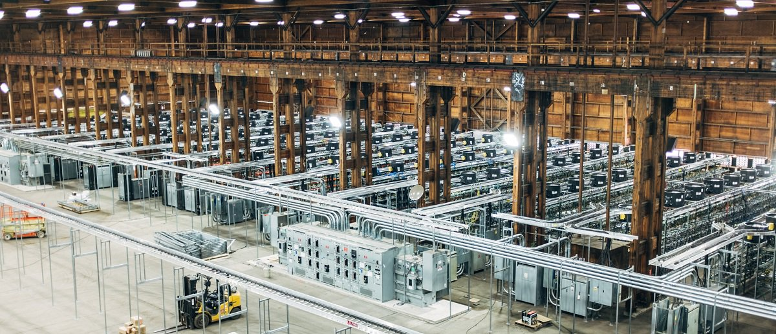
Other Challenges
Scalability
Not really decentralized, about 20 mining pools in total
25% computing power is not that hard to obtain by a single party
Legal issues

Slide 22
Blockchains: Other topics
Cryptocurrencies
Permisisonless blockchains
Smart contract
Permissioned blockchains
Proof-of-stake

Slide 23
Smart Contract
A computer program executed in a secure environment that directly controls digital assets
EVM (Ethereum), Chaincode (Hyperledger Fabric)
Examples of secure environment
  single trusted party (bank)
  decentralized network(blockchain)
  Trusted hardware (Intel SGX)

Slide 24
Ethereum Smart Contract
Two types of accounts
  Normal account like Bitcoin
  Smart contract account
    1)code, 2) private key-value storage
    Code can
      Send ETH to other accounts
      Read/write storage
      Call the contracts

Slide 25
Ethereum Transactions
Normal transactions
Transactions to contracts
  Function calls
  Specify which object you are talking to, which function, and what data
  Transactions to create contracts

Slide 26
How to create a contract?
Send a transaction
  To: empty
  Value: value sent to the new contract
  Data: code of the contract
  gasprice (ether per unit gas)
  Startgas (maximum gas consumable)
  Digital signature (ECDSA)
If tx is successful
  Returns the address of the new contract

Slide 27
How to interact with a contract?
Send a transaction
  To: contract address
  Value: value sent to the new contract
  Data: data supposed to be read by the contract
  gasprice (ether per unit gas)
  Startgas (maximum gas consumable)
  Digital signature (ECDSA)
If tx is successful
  Returns the output from the contract

Slide 28
What’s the relationships between PoW and BFT?
They solve the same problem, why?
Same
  Linearizability
Different
  Fixed leader vs different leaders

Slide 29
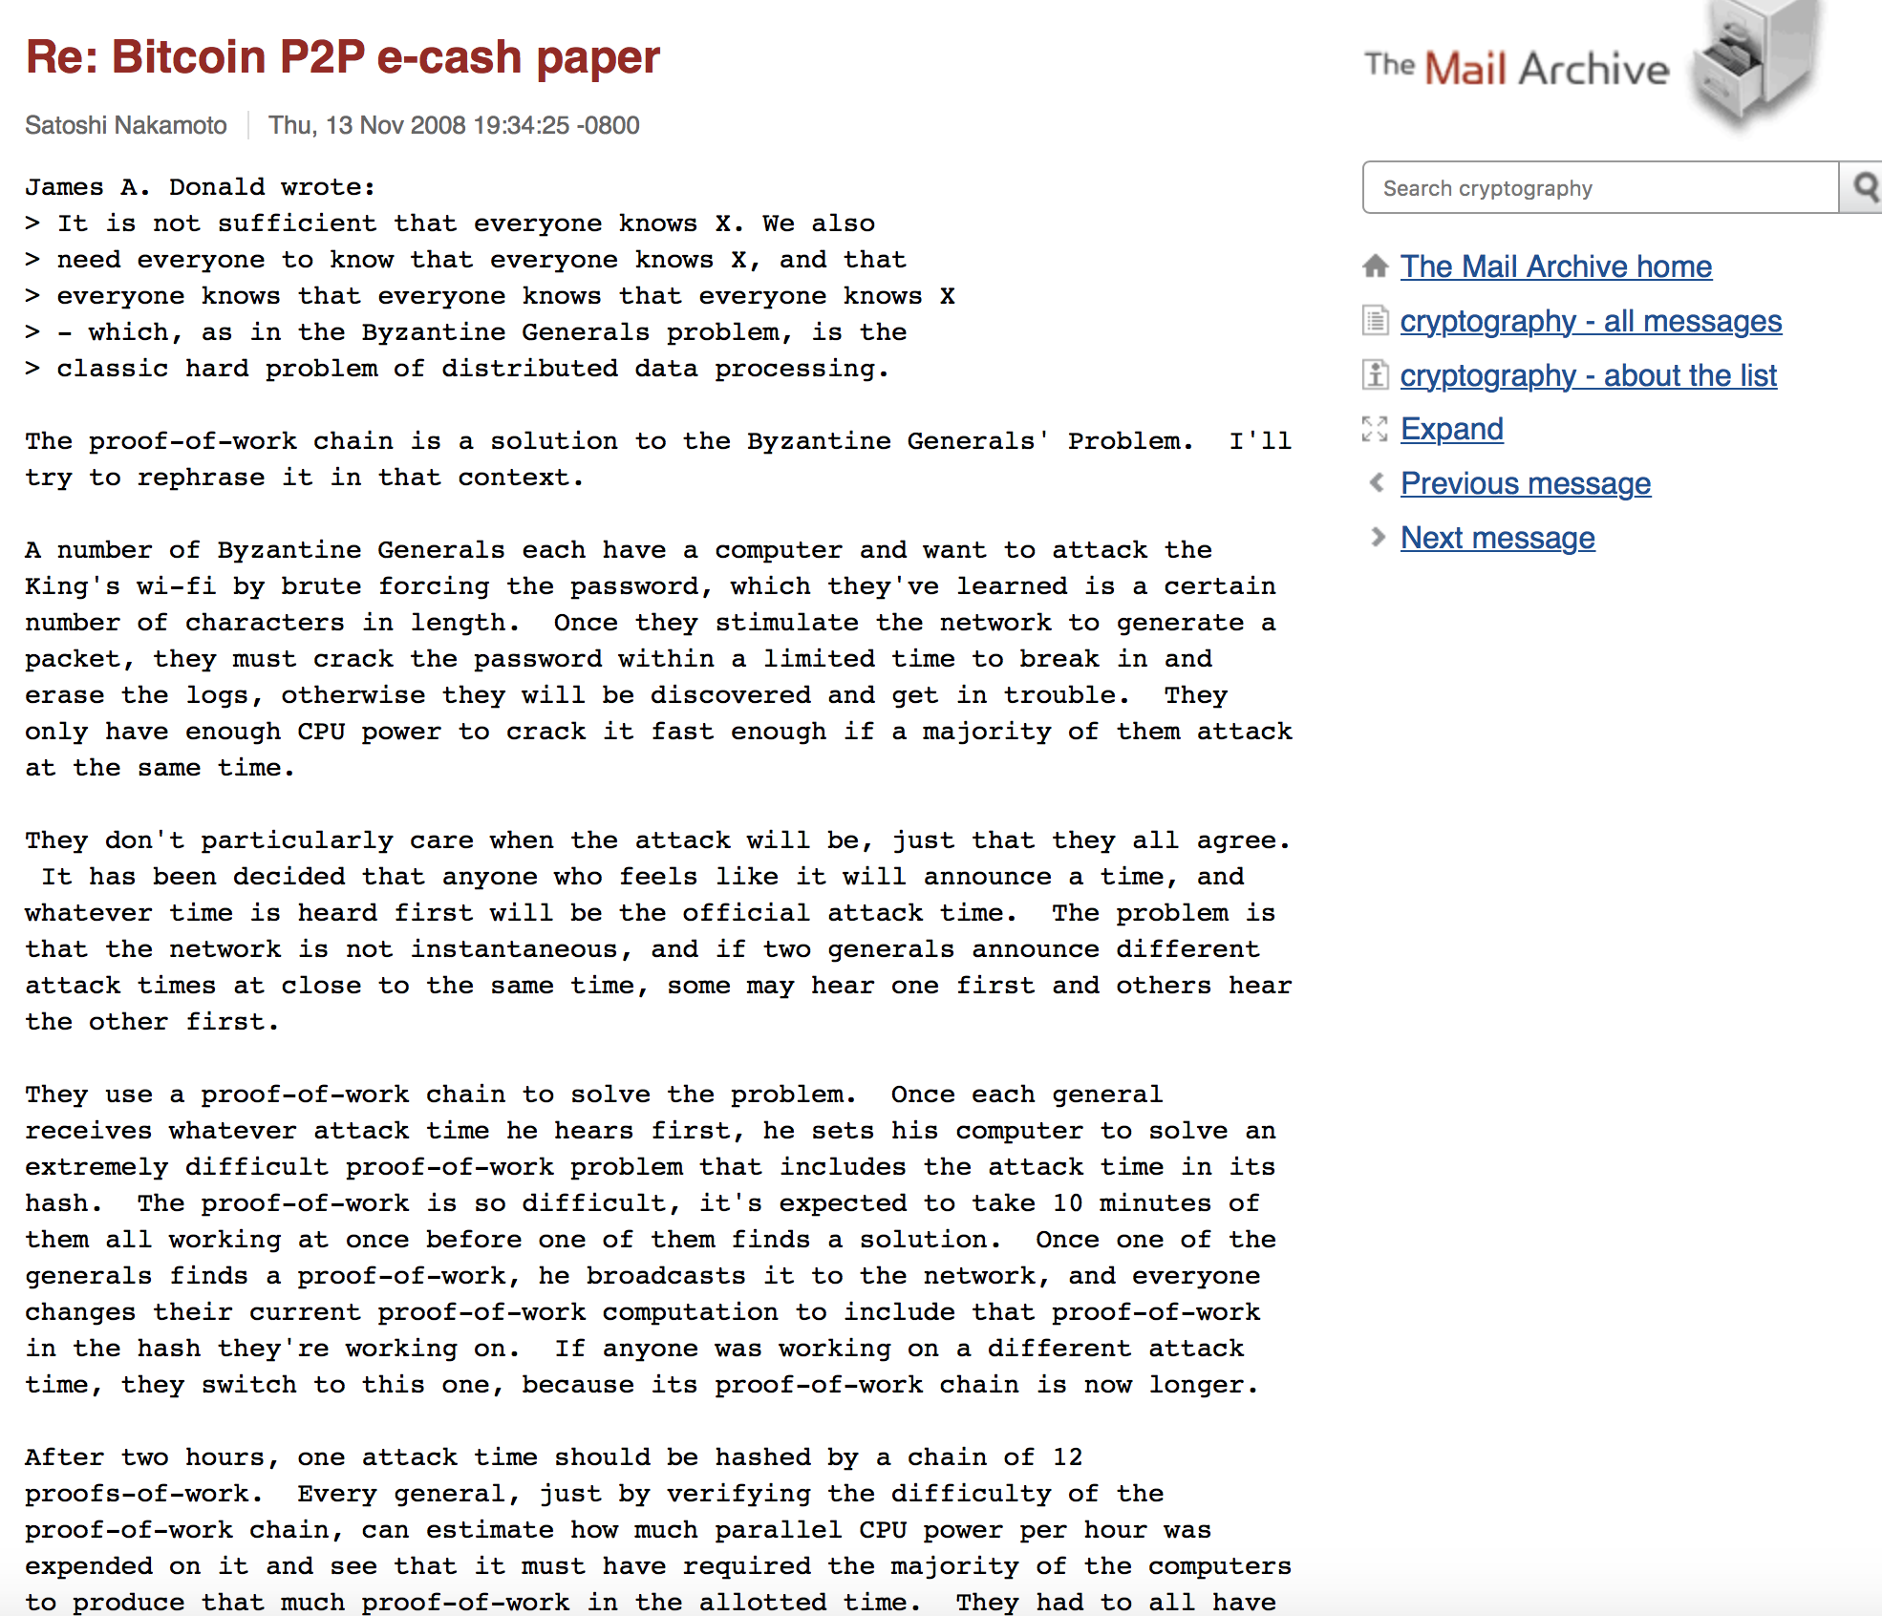
https://www.mail-archive.com/cryptography@metzdowd.com/msg09997.html

Slide 30
Permissioned Blockchains
Run BFT protocols to reach a consensus

Slide 31
Blockchain: A Layered View
Layer 1: State machine replication (SMR)
Layer 2: Smart contracts
  Allow to programmatically facilitate, verify, or enforce the negotiation or performance of a business transactions
Layer 3: Services
  Applications

Slide 32
The System Model
Timing assumption
  Synchrony
  Asynchrony
  Partially synchrony
Adversary model
Correctness goals
  Safety
  Liveness

Slide 33
Adversary Model
Threshold Adversary Model
  The total number of parties, n
  The total number of parties that can fail, f
  Typical threshold
    N>2f or n>3f

Slide 34
Adversary Model
Computational Threshold Adversary (CTA) Model
  The total amount of computational power, Nc
  The total amount of computational power the adversary can control, Fc
  Typically
    Nc>2Fc
  In bitcoin, the computational power means the difficulty of inverting SHA1/SHA256

Slide 35
Adversary Model
Stake Threshold Adversary (STA) Model
  Finite abstract resource R
  The total amount of resources R, N_{R}
  The total amount of resource R that the adversary can control, F_{R}
  Example
    Ethereum Proof-of-stake, N_{R} > 3 F_{R}
  Combination of the previous two models

Slide 36
Nakamoto Consensus / PoW Consensus
Timing assumption
  Synchrony/asynchrony/partial synchrony?
  Why?
  If network delay can be unbounded then the adversary can boost its computational power just by making the no-faulty parties incur much higher delay…

Slide 37
Nakamoto Consensus / PoW Consensus
Uses PoW to implement a leader election “oracle”
FPCNELE (Fair, Pre-commit, non-equivocation, leader election) oracle
(Independence)
  Each party is elected independently
  Multiple parties may be elected in the same round
(Fairness)
  The probability of electing each party is proportional to its relative computational power
(Pre-Commit non-Equivocation Leadership announcement)
  In each round, each party commits to an action and the oracle probabilistically elects parties and announces them and their action

Slide 38
PoW implements the FPCNELE oracle
Cryptographic puzzles
(Pre-commit)
  Solving the puzzle requires to commit to a specific block
(Public verifiability)
  The solver of the puzzle can generate a solution certificate of his correct solution and his committed block. This certificate can be efficiently publicly verified
(Fairness)
  The probability of solving the puzzle (generating a solution certificate) at any given round is proportional to the computational power of the party
A simple version
  SHA1(P||i||o||nounce) <H
  P- base of the puzzle, H – hardness parameter
  i – public key, o - action

Slide 39
Longest Fork Wins
(New Block via FPCNELE Oracle)
  The oracles allows each elected leader to announce a single pre-committed new block
(Longest Fork Wins)
  Non-faulty leaders will connect their pre-committed block to the leaf block which forms the longest path from the genesis block

Slide 40
Blockchain logs/transactions
Dynamically growing directed path or directed acyclic graph (DAG)
Correctness Properties
(Uniqueness)
  There is a unique deterministic function L(G) to extract a single path P = g, a1, a2…ak from G.
(Liveness)
  The path L(G) is constantly growing. A transaction is appended to L(G) eventually
(Safety)
  If P = g, a1, a2…ak = L(G) is a path of length k for G and G grows to become G’ then for any ai the probability that ai is not in L(G’) is exponentially decreasing proportional to k-i
(Fairness)
  The proportion of nodes in P that belong to non-faulty parties is at least proportional to their relative computational power

Slide 41
Translation of NC notions in the BFT language
View
  Length of the longest chain
  Starting from 0 and grow upon every proposed transaction
  A correct node rejects any other message from views lower than v
Propose
  Successfully solving the puzzle at the end of L(G) implicitly and statistically represents acceptance of L(G) by a large fraction of parties
Commit
  A node in view v decides on the block at a position v-e in L(G), the longest chain in G. With probability proportional to e, this block will not be overturned by any future insertions to G.

Slide 42
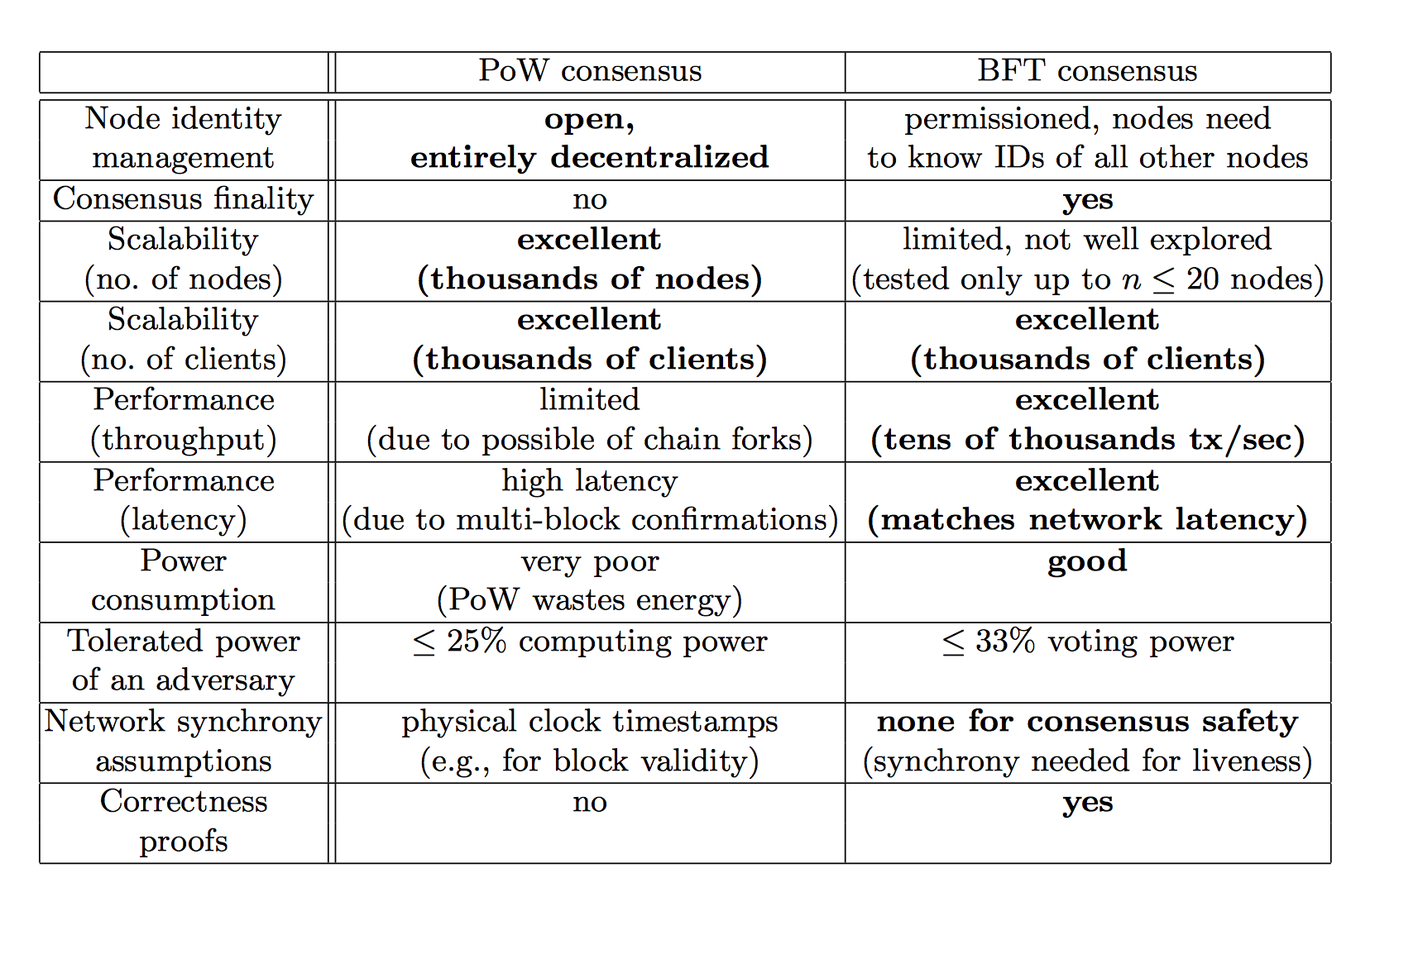
Permissionless v.s. Permissioned Blockchains
M. Vukolic 2015

Slide 43

Hyperledger
Lead by IBM, supported by > 300 organizations
Five major projects
  Fabric – PBFT
  Burrow
  Sawtooth
  Indy
  Iroha - BChain

Slide 44
Look into the consensus protocols
Hyperledger Fabric -- Zab/Paxos -> PBFT
Hyperledger Iroha – Sumeragi (BChain)
Tendermint – variant of PBFT
Symbiont -- BFT-SMaRt (implements variant of PBFT)
Corda – Raft and BFT-SMaRt
Quorum by JPMorgan Chase – QuorumChain and Raft-based Chain
Proprietary protocols - Kadena

Slide 45
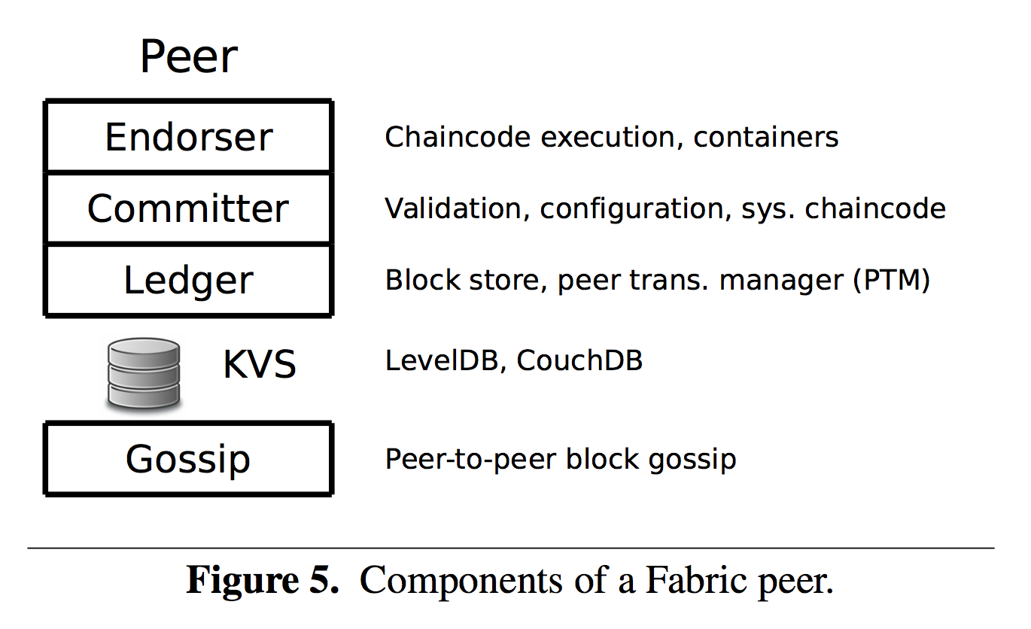
Hyperledger Fabric

Slide 46
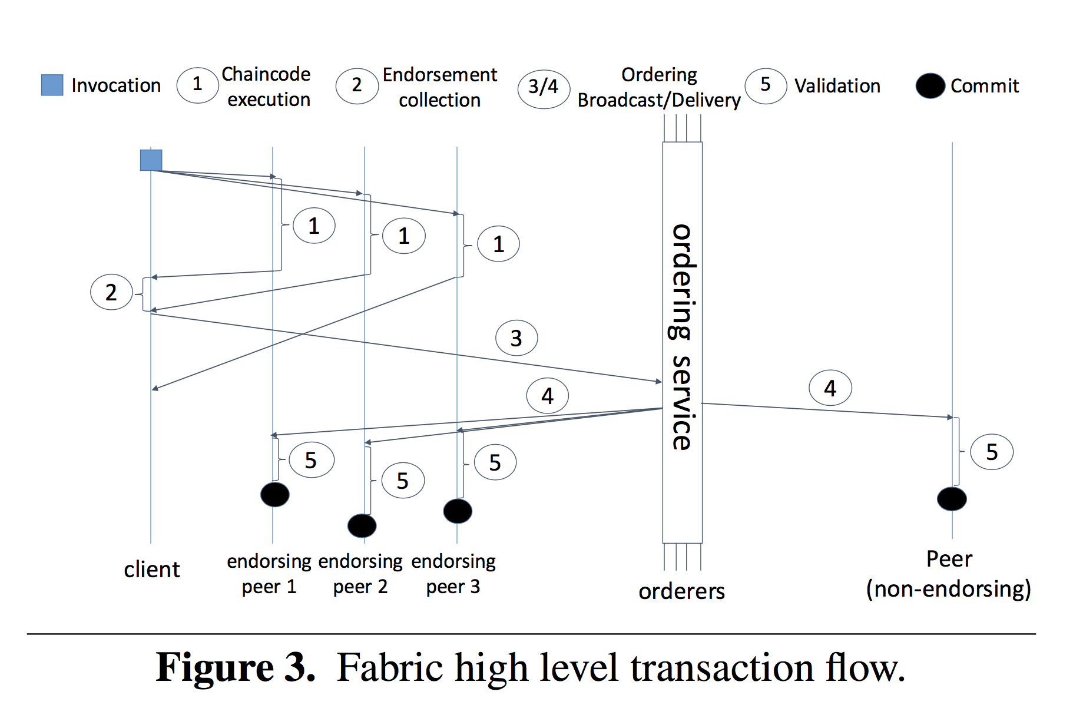
Hyperledger Fabric

Slide 47
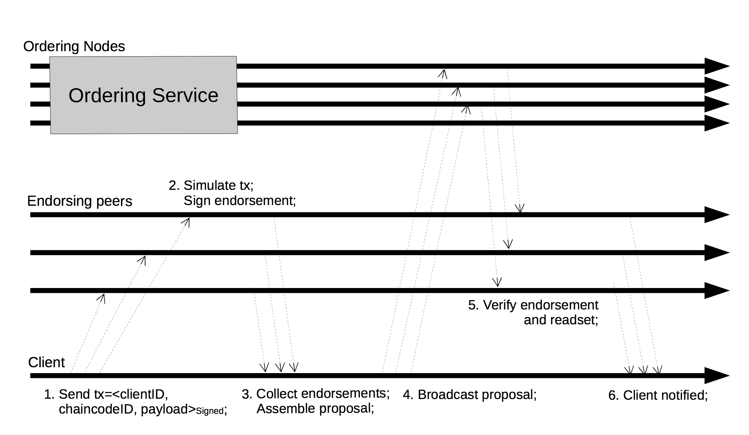
Hyperledger Fabric

Slide 48
Discussion
Scalability
Performance
What are the challenges of BFT consensus in the blockchains?

Slide 49
Permissioned Blockchain – Open Problems
Engineering cryptographic systems
Major components/problems
  Formal protocol proof and reviews, technical comparisons, etc.
  Application-driven implementation
  Evaluation and Resilience under actual attacks and network incidents
… blockchain developers should look towards the established experience in
cryptography, security, and the theory of distributed systems for building
trustworthy systems. Otherwise, it might be dangerous to entrust financial
value to new protocols. Open discussion, expert reviews, broad validation,
and standards recommendations should be employed.
Christian Cachin and Marko Vukolic – IBM Research Zurich
Blockchain consensus protocols in the wild.

Slide 50
Blockchain Challenges
Scalability
Cost
Killer app

