Slide 1
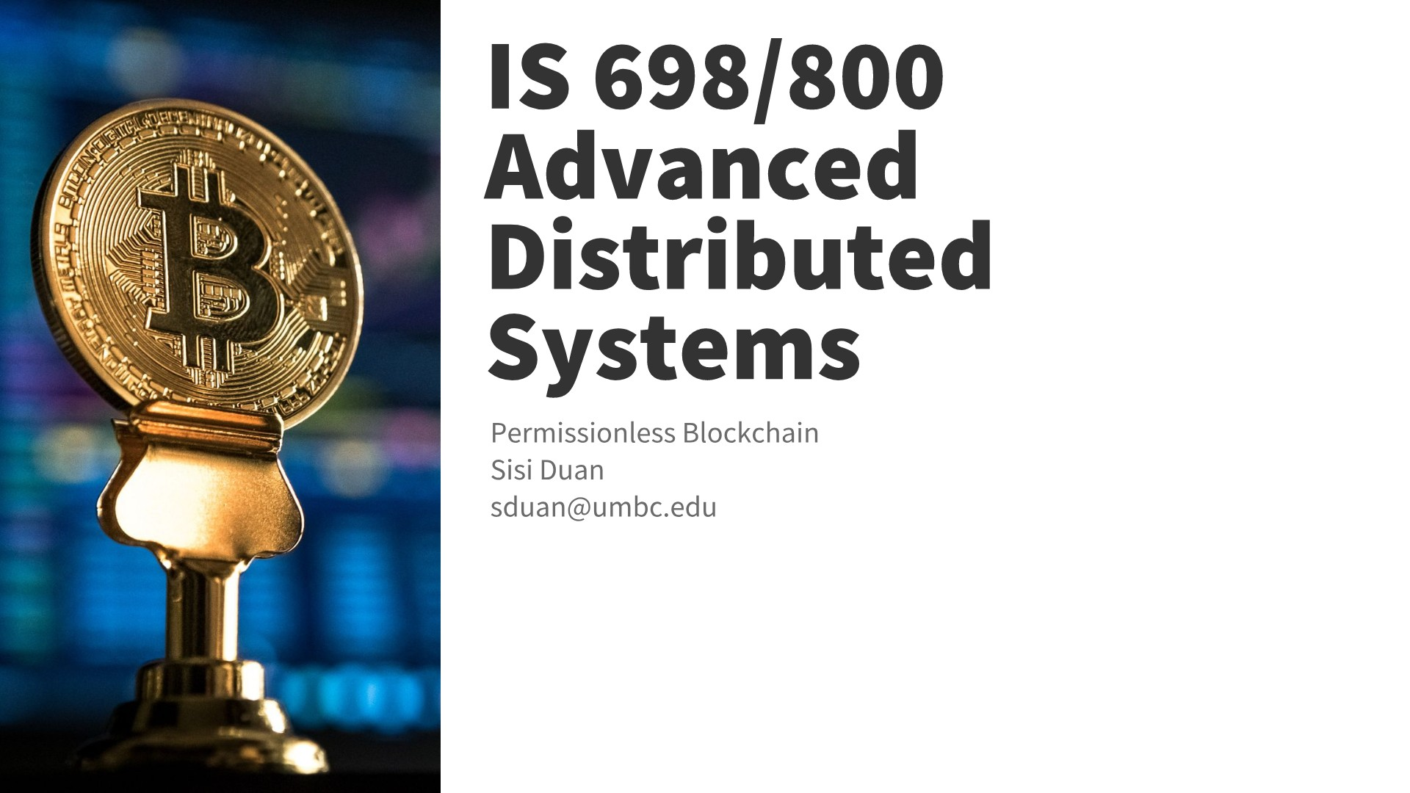

Slide 2
Announcement
Sign up google sheet for in class lectures
Overview of the topics
  Membership management
  Hybrid Consensus
  Scaling consensus
  Randomized BFT (2)
  Hybrid blocks (3)

Slide 3

Algorand
Gilad, Yossi, et al. "Algorand: Scaling byzantine agreements for cryptocurrencies." Proceedings of the 26th Symposium on Operating Systems Principles. ACM, 2017.

Slide 4
Algorand Overview
Cryptocurrency
Communication
  Gossip
Main assumption
  Honest majority of money
Main idea
  Byzantine agreement (BA)
Goals
  Trivial computation
  True decentralization
  Finality of payment – using BA
  Scalability

Slide 5
Byzantine Agreement Overview
BFT/Permissioned Blockchains Challenges
  Not scalable
  Players are fixed and known in advance
BA*

Slide 6
Key Ideas
Weighted users
  Users are weighted by the money in their account
Instead of having all the nodes run BA, let a subset of nodes represent the whole group and run BA*.
  Called a committee
  Rotating committee per block

Slide 7
Weighted Users vs Proof of Stake (PoS)
PoS flaw in a nutshell
  Malicious leader (who assembles new block) can create a fork in the network
  Can be caught (e.g., since two versions of the new block are signed with his key) -> the leader loses his money
Algorand
  Weights ensure that the attacker cannot amplify his power by using pseudonyms
    As long as the attacker controls less than 1/3 of the monetary value of the system
  Guarantee that the probability for forks is negligible

Slide 8
Algorand Committee
BA is not scalable
BA* uses consensus by committee
  Randomly selects a small set of representatives from the total set of users
  Committee members will publicly broadcast messages slowing others to learn agreed-upon block
Concerns
  How to randomly choose committee members?
  How to ensure adversary cannot fake being a committee member?
  How to ensure committee members are not targeted?

Slide 9
Algorand Committee
Problem
  How to randomly choose committee members
  Ensure adversary cannot fake being a committee member
Solution: cryptographic solutions
  Users can independently and privately determine if they are chosen
  Sortition will choose users randomly based on their weights
    Randomness comes from publicly known seed
  Verfiable Random Runctions (VRF)

Slide 10
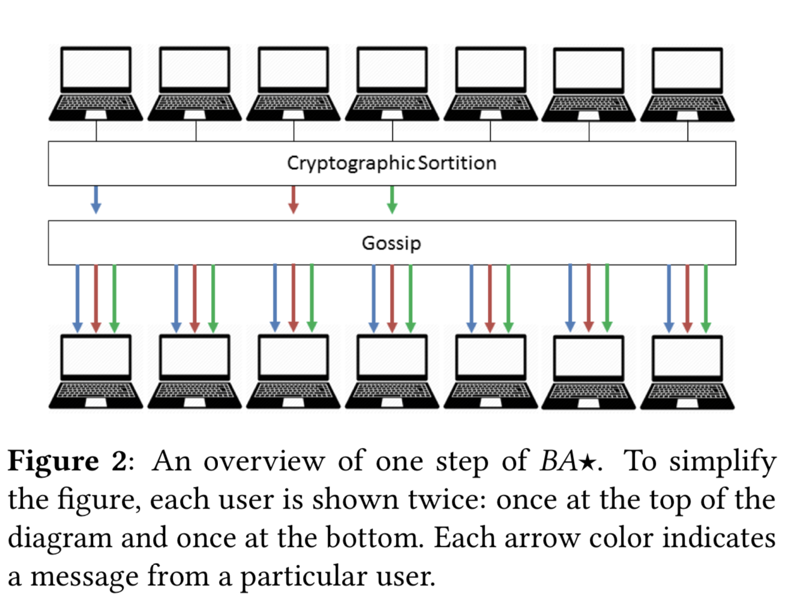
Algorand Committee

Slide 11
Algorand Features
Problem
  How to randomly choose committee members
  Ensure adversary cannot fake being a committee member
Solution: cryptographic solutions
  Users have (pk, sk)
  Every user will execute Fsk
  Fsk(Seed) => (hash h, proof pi)
  Algorand will set criteria (based on weight)
    If user’s h fulfills criteria -> user in committee
  Committee members attach h, pi, pk to messages
  Verify(Seed,h,pi,pk)

Slide 12
Algorand Features
Problem
  How to randomly choose committee members
  Ensure adversary cannot fake being a committee member
Solution: cryptographic solutions
  Users have (pk, sk)
  Every user will execute Fsk
  Fsk(Seed) => (hash h, proof pi)
  Algorand will set criteria (based on weight)
    If user’s h fulfills criteria -> user in committee
  Committee members attach h, pi, pk to messages
  Verify(Seed,h,pi,pk)

Slide 13
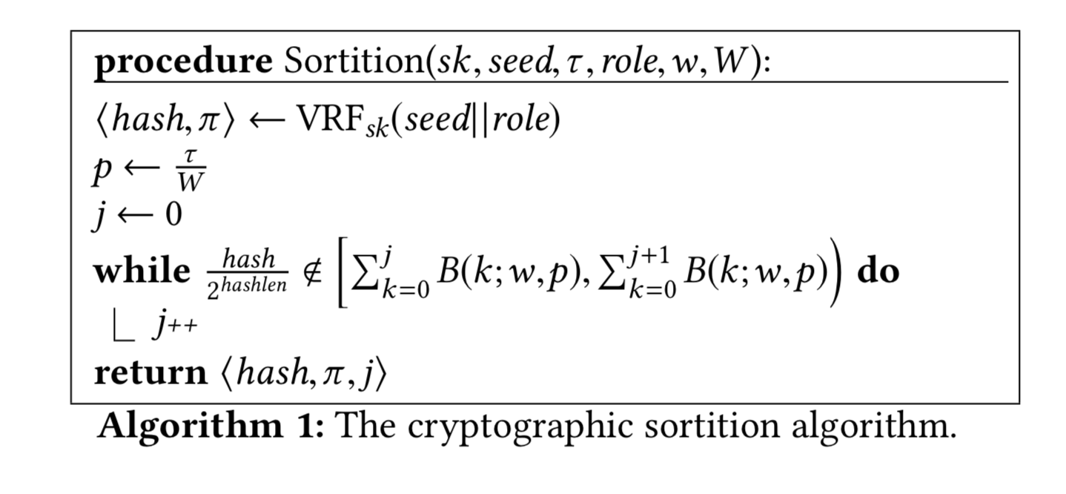
Select committee according to the weights
In other words, according to the amount of money in each user’s account
Prevent Sybil attack (?!)

Slide 14

Algorand Features
Problem: Adversary may target a committee member once that member sends a message
Solution: Participant replacement
  Committee members only speak once
  Immediately becomes irrelevant to BA*
    BA* avoids any private state
  New committee is elected every step of BA*
  All users can become committee members
  The seed is refreshed every R rounds

Slide 15
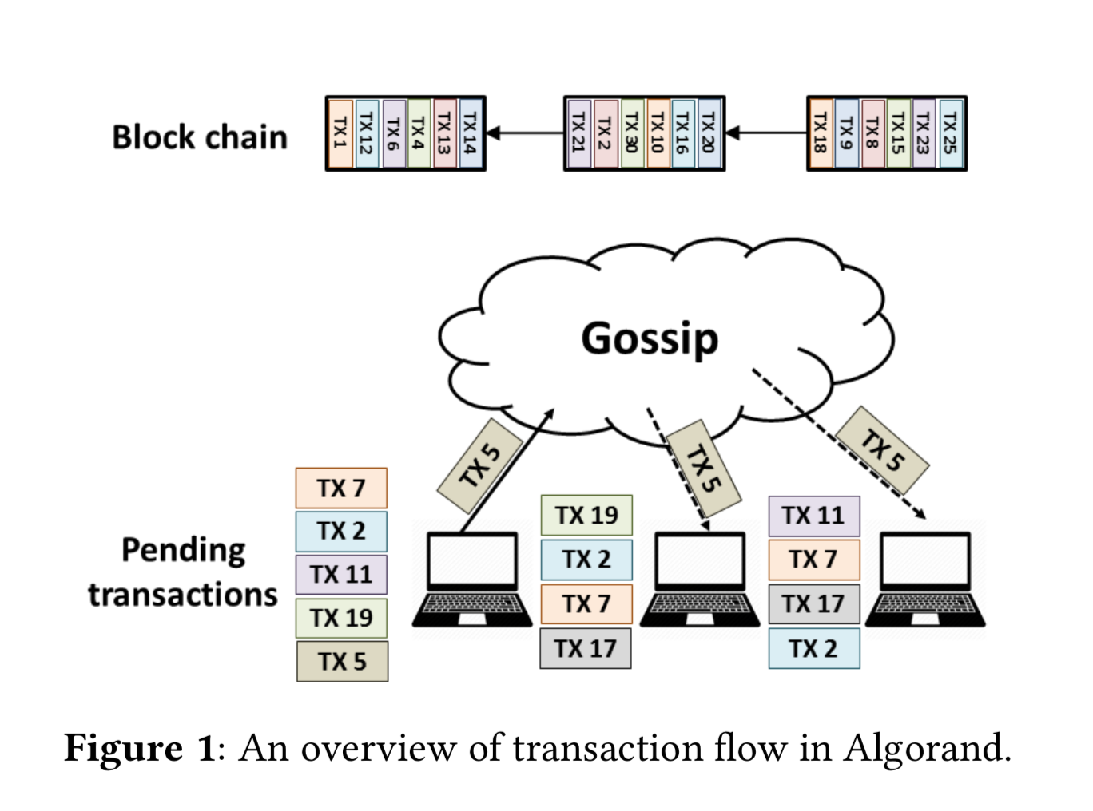
Communication
Communicate via gossip
  Each user collects a block of transactions they hear about
Algorand will initiate a round starting w/block proposal
  Create committee using Sortition
  All committee members will propose their block
Users will wait for a time period to receive blocks
  Only keep highest priority block
All users who received some block will initiate BA* to reach majority consensus and commit a block

Slide 16
BA*
Phase 1: Reduction()
  Reach consensus on one of two values, a proposed block or an empty block
Phase 2: BinaryBA()
  Reach consensus on either the block from reduction or an empty block
  Relies on Reduction() to ensure that at most one non-empty block is passed to BinaryBA() by all honest users

Slide 17
Another overview…
Each phase runs in steps
  Phase 1: 2 steps
  Phase 2: 2-11 steps
Each step calls sortition to create a committee
Each committee member will broadcast their votes for their block
Users that receive more than t votes for a block will hold onto that block
All users can see messages

Slide 18
BA* - Reduction()
Context: Users have received a block from block proposal
Reduce agreement of block into agreeing on hash of the block or an empty block
Step 1: Each committee member votes for their block
  All users will see these votes and tally them up and adopt the majority or the empty block
Step 2: Each committee member votes for their block
Pass on phase 2

Slide 19
BA* - BinaryBA()
Receive a single block from Reduction()
  In examples, assume nonempty block
We will now choose either the empty block or the block from reduction
In synchronous system
  Simple case:
  Step 1: Most committee members send the same block
  Nodes notice they are passing a large threshold, they will invoke a special final vote
  Step Final: Large threshold of users vote for the same block and commit to blockchain

Slide 20
BA* - BinaryBA()
Synchronous system
Adversary case:
  Step 1: Adversary tells User_A its vote, and remaining users nothing
    Other users timeout
      If chosen for committee, does not adopt empty block, instead times out
    User_A reaches consensus
      Guaranteed to remain in next three steps
  Step 2: Anyone who time’d out will adopt User_A’s block
  Step N: Continue until special FINAL round

Slide 21
BA* - BinaryBA()
Asynchronous system
Step 1: committee share their votes
  User_A hears all the votes and reaches consensus on block B
  All other users time out
Step 2: User_A votes for B, but eveyrone times out a 2nd time
Time’d out users will adopt empty block E and gossip to their network

Slide 22
BinaryBA() – Getting Unstuck
Committee members will agree on binary value (coin) from their hash
  Choose the least significant bit of the lowest hash amongst committee
Attach coin to messages, as means of reaching consensus
  As long as enough users observe the same bit, BinaryBA() will reach consensus in the next iteration of the loop with probability ½
  Adversary consistently having lowest hash is extremely unlikely

Slide 23
Evaluation
1000 VMs on Amazon’s EC2
8 cores and up to 1 Gbps network throughput
50 users per VM
1MB block
Cap bandwidth is 20 Mbps
Equal amount of money per user

Slide 24
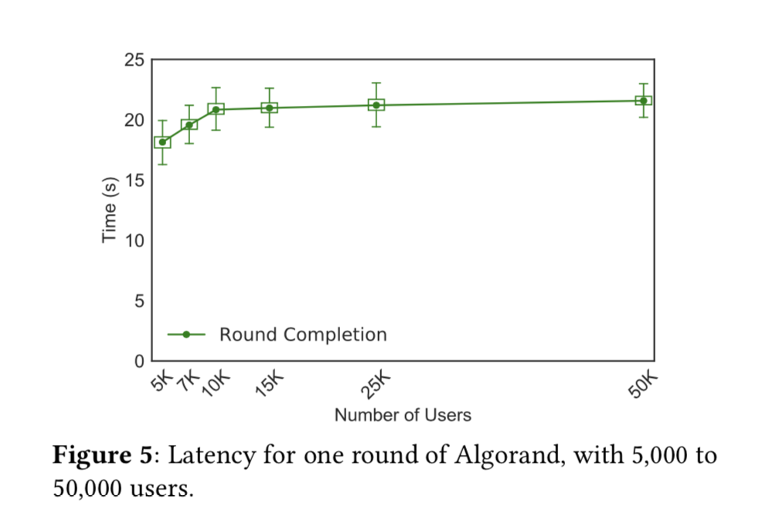
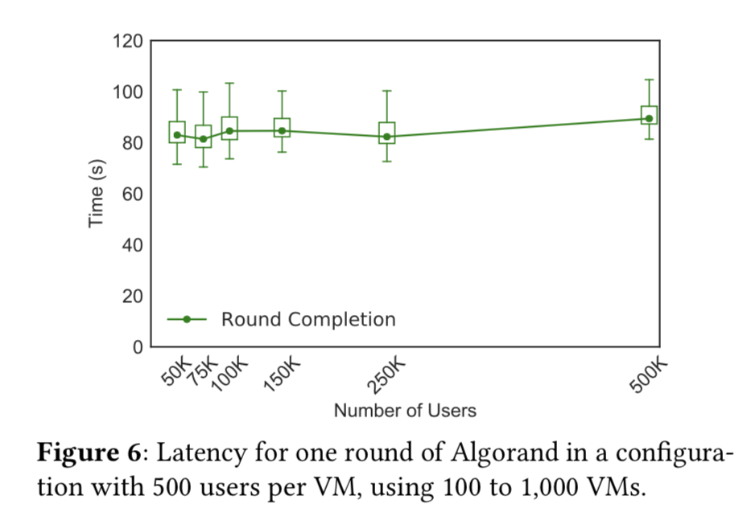
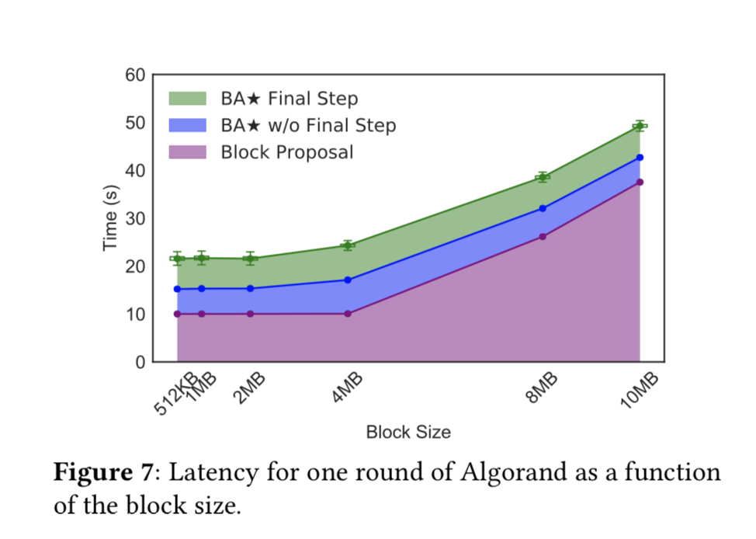
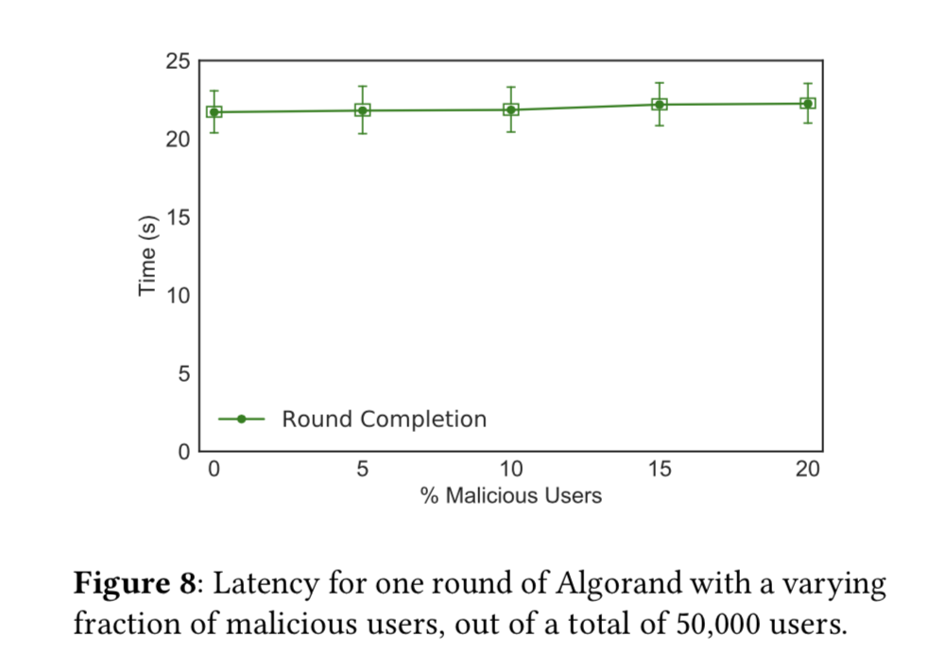
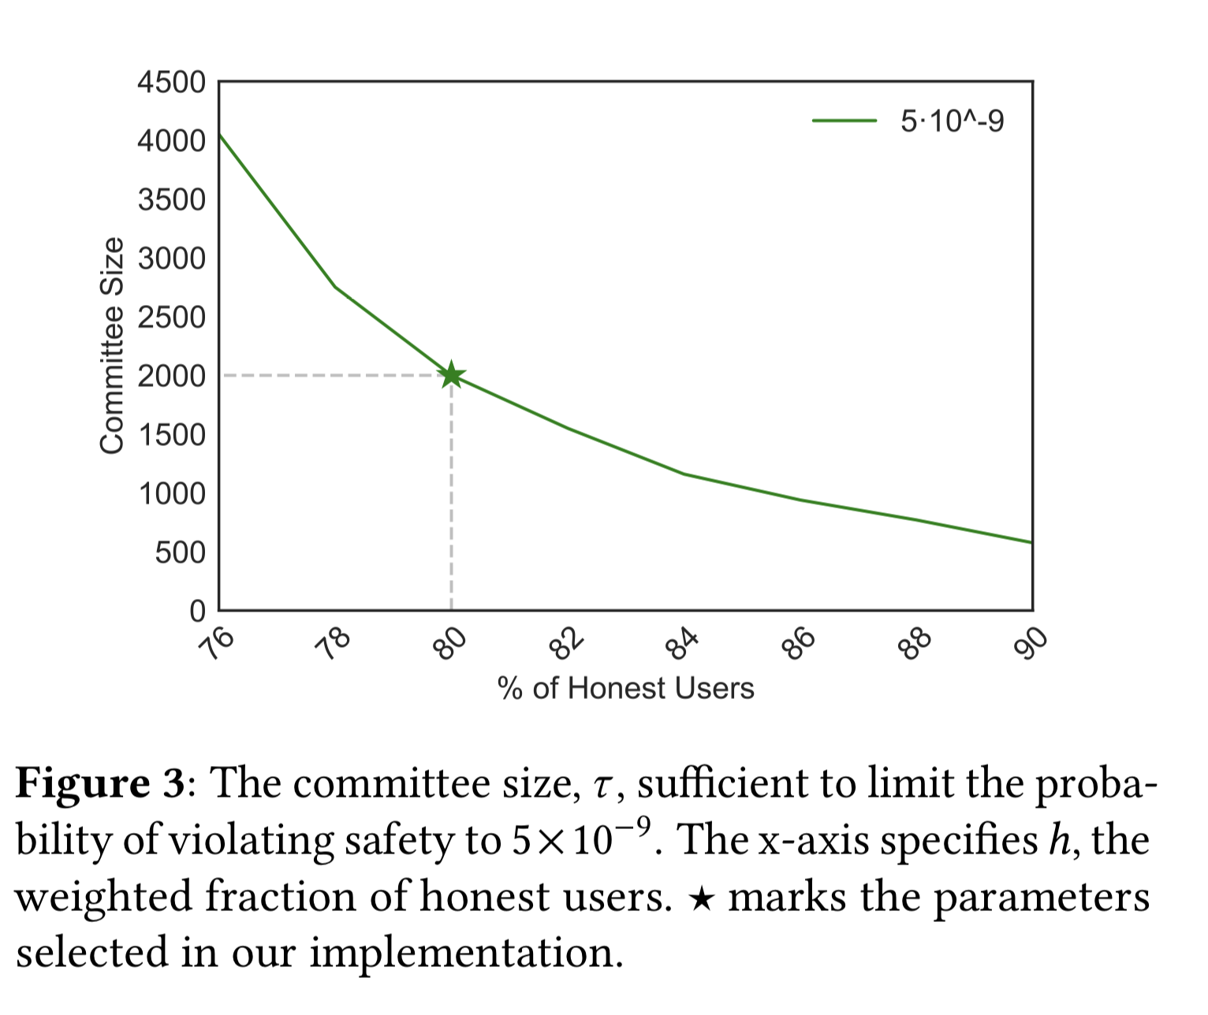
Evaluation

Slide 25
Discussion
Strength
Weakness

Slide 26
Discussion
Scalable due to the idea of random committee
Experimentation is great
Gossip…?
Limited to cryptocurrency
Tradeoffs between public blockchain and private/consortium blockchain

