Slide 1
IS 698/800-01: Advanced Distributed Systems Membership Management
Sisi Duan
Assistant Professor
Information Systems
sduan@umbc.edu

Slide 2
Outline
Membership Protocols
(Logically) Centralized Solution
Zookeeper
Decentralized Solution
Gossip-based membership

Slide 3
Membership Protocols
Maintain a list of other alive (non-faulty) processes at each process in the system
Flavors
Strongly consistent: all membership lists identical at all times (hard, may not scale)
Weakly consistent: membership lists not identical at all times
Eventually consistent: membership lists always moving towards becoming identical eventually (scales well)

Slide 4
Membership Management
(Logically) Centralized solution
Auxiliary service
Zookeeper, Hadoop
Decentralized solution
Usually gossip-based
Cassandra, redis, uber…

Slide 5
Centralized Solution
Store the membership management list in an auxiliary service
Zookeeper
Etcd
Chubby
The auxiliary service is replicated for fault tolerance

Slide 6
Apache Zookeeper
Service for coordinating processes of distributed applications
Java-based
Coordination
Group membership
Configuration
Leader election
Queuing
Status monitoring

Slide 7
Apache Zookeeper
Avoid the “locking-service” (which can degrade the performance)
Wait-free data objects
Goals
High performance
General
Reliable

Slide 8
Apache Zookeeper
Replicated servers
Read/write
TCP connection
Reads are local
Writes go through consensus (Zab) and logged to persistent storage for reliability

Slide 9
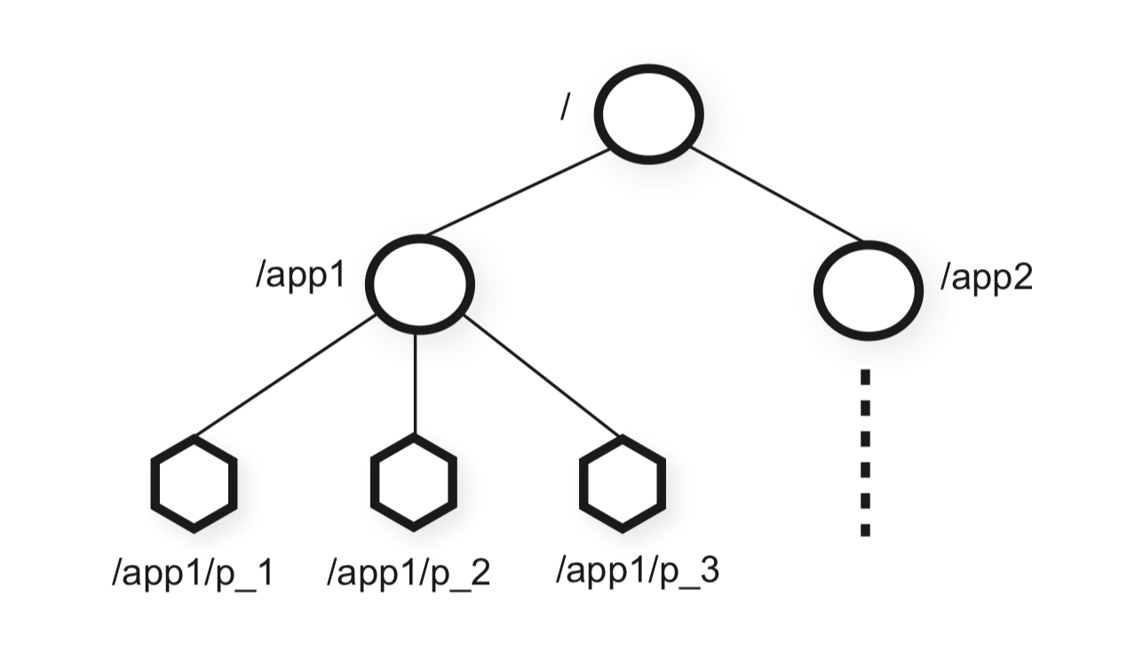
Zookeeper membership management
Znodes
A set of data nodes
Organized according to a hierarchical name space
Similar concept with file systems
Map to client application
Clients can manipulate znodes

Slide 10
Zookeeper membership
Membership for each app
Client has a view of all the client processes in the app
Two types of nodes
Regular
Ephemeral
Created by clients
Both types can be deleted by
the clients or the system

Slide 11
Zookeeper membership
A znode z_{g}
Represents the group
When a process member p starts
Create an ephemeral child znode z_{p} under z_{g}
Each has a unique id
If the process p fails
z_{p} is removed automatically

Slide 12
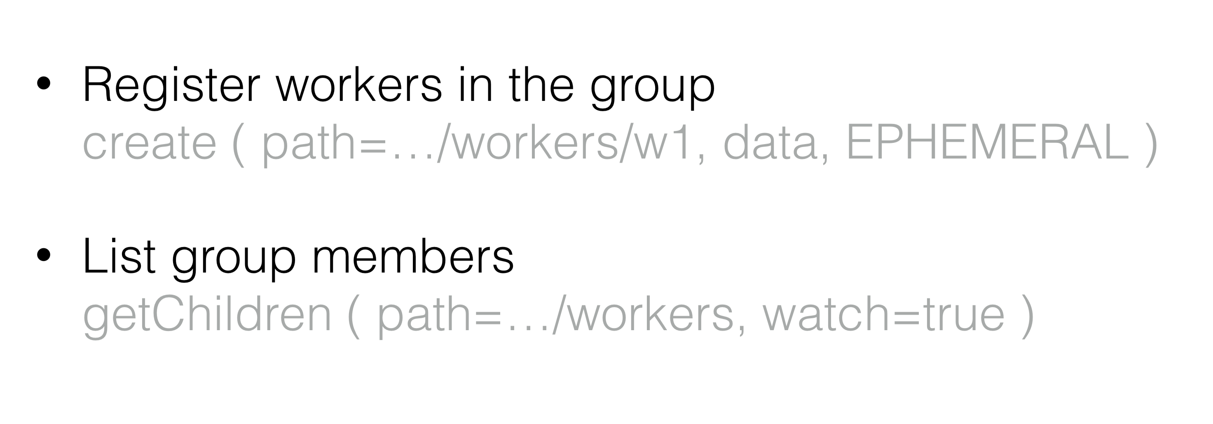
Zookeeper Membership
Processes can obtain group information by sampling listing the children of z_{g}

Slide 13
How do you know a process fails?
Failure detectors
Time
Synchronous
Asynchronous
Failures
Crash stop
Crash recovery
…
Which one is the easiest to detect?

Slide 14
Failure detector
needs to know about pj’s failure
Crash-stop failure
pi
pj
X

Slide 15
Ping-Ack
If pj fails, within T time units, pi will send
it a ping message, and will time out within
another T time units. Detection time = 2T
needs to know about pj’s failure
pi
ping
pj
ack
- pi queries pj once every T time units
- if pj does not respond within T time units,
pi marks pj as failed
- pj replies

Slide 16
Heart-beating
In reality, detection time
is T time units (why?)
needs to know about pj’s failure
pi
heartbeat
pj
- pj maintains a sequence number
- pj sends pi a heartbeat with incremented
seq. number after every T’(=T) time units
if pi has not received a new heartbeat for the
past T time units, pi declares pj as failed
If pj has sent x heartbeats until the time it fails, then pi will
timeout within (x+1)*T time units in the worst case, and will detect pj as failed.

Slide 17
Failure Detector Properties
Completeness = every process failure is eventually detected (no misses)
Accuracy = every detected failure corresponds to a crashed process (no mistakes)
Given a failure detector that satisfies both Completeness and Accuracy
One can show that Consensus is achievable
FLP => one cannot design a failure detector (for an asynchronous system) that guarantees both above properties

Slide 18
Completeness or Accuracy
Most failure detector implementations are willing to tolerate some inaccuracy, but require 100% completeness
Plenty of distributed apps designed assuming 100% completeness, e.g., p2p systems
“Err on the side of caution”.
Other processes need to make repairs whenever a failure happens
Heart-beating – satisfies completeness but not accuracy (why?)
Ping-Ack – satisfies completeness but not accuracy (why?)

Slide 19
Completeness or Accuracy?
Both Heart-beating and Ping-Ack provide
Probabilistic accuracy (for a process detected as failed, with some probability close to 1.0, it is true that it has actually crashed).
That was for asynchronous systems
Heart-beating and Ping-ack can satisfy both completeness and accuracy in synchronous systems (why?)

Slide 20
From Failure Detection to Distributed System Membership Management
Difference from original failure detection is
we want not one process (pi), but all processes in system to know about failure
➔ May need to combine failure detection with a dissemination protocol
What’s an example of a dissemination protocol?

Slide 21
Zookeeper
A small cluster monitors the failures and notifies the clients
Pros
Simple
Cons
Connectivity issue
Failures of the cluster members

Slide 22
Decentralized Solutions
Usually gossip-based
Van Renesse, Robbert, Yaron Minsky, and Mark Hayden. "A gossip-style failure detection service." Proceedings of the IFIP International Conference on Distributed Systems Platforms and Open Distributed Processing. Springer-Verlag, 2009.

Slide 23
Gossip-style Membership
Each node detects failures of other nodes locally
Eventually all the nodes have a common view of the membership

Slide 24
Gossip-Style Membership
Each member has
Address of known member
The largest heartbeat counter of known member
Heartbeat counter and the time last time it was updated
Incremented periodically
Procedures
When the counter increases, select a random member and send heartbeat
Upon receiving reply for heartbeat, the local list is updated with the corresponding heartbeat counter from that member

Slide 25
1 | 10118 | 64
2 | 10110 | 64
3 | 10090 | 58
4 | 10111 | 65
1 | 10120 | 66
2 | 10103 | 62
3 | 10098 | 63
4 | 10111 | 65
2
1
Address
Time (local)
1 | 10120 | 70
2 | 10110 | 64
3 | 10098 | 70
4 | 10111 | 65
Heartbeat Counter
Protocol
Each process maintains a membership list
Each process periodically increments its own heartbeat counter
Each process periodically gossips its membership list
On receipt, the heartbeats are merged, and local times are updated
4
3
Current time : 70 at node 2
(asynchronous clocks)

Slide 26
Gossip-Style Membership
The list is broadcast to other nodes occasionally
To be discovered
Recover from network partition
In a group of N processes, it takes O(log(N)) time for a heartbeat update to propagate to everyone with high probability
Very robust against failures – even if a large number of processes crash, most/all of the remaining processes still receive all heartbeats
Failure detection: If the heartbeat has not increased for more than T_{fail} seconds, the member is considered failed
T_{fail} usually set to O(log(N)).

Slide 27
Gossip-Style Failure Detection
What if an entry pointing to a failed node is deleted right after T_{fail} (=24) seconds?
Fix: remember for another T_{fail}
1 | 10120 | 66
2 | 10110 | 64
3 | 10098 | 75
4 | 10111 | 65
1 | 10120 | 66
2 | 10110 | 64
3 | 10098 | 50
4 | 10111 | 65
1 | 10120 | 66
2 | 10110 | 64
4 | 10111 | 65
1 | 10120 | 66
2 | 10103 | 62
3 | 10098 | 55
4 | 10111 | 65
2
1
Current time : 75 at node 2
4
3

Slide 28
Gossip-based membership
Pros
Resiliency
Performance
Scalable (?)
Cons
Stability
Inconsistent views

Slide 29
Uber’s Ringpop
https://eng.uber.com/intro-to-ringpop/

Slide 30
Uber’s Ringpop Overview
An open-source library that maintains a consistent hash ring atop a membership protocol. It can be used by applications to arbitrarily shard data in a scalable and fault-tolerant manner.
Node.js
Three parts
A membership protocol (SWIM variant)
Consistent hashing
Forwarding capabilities

Slide 31
Uber membership protocol
A SWIM variant
Gossip over TCP
Computes membership and ring checksum

Slide 32
SWIM
Scalable
Weakly consistent
Infection-style
Membership protocol

Slide 33
SWIM Failure Detection
Similar with the classic gossip-based membership protocols
Failure detection
gossip-based random peer detection
Indirect ping: ask another K set of random peers to ping the target node (help improve the accuracy)
(Network load compared with the previous approach?)

Slide 34
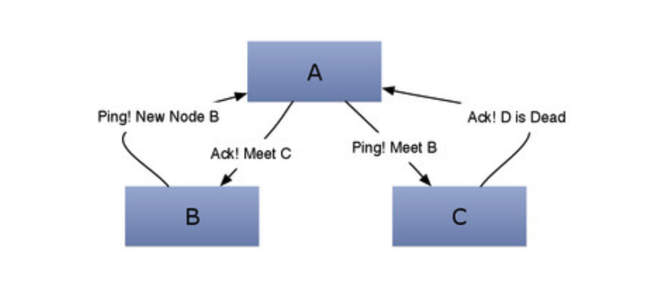
SWIM Information Dissemination
Infection style dissemination
State update is piggybacked with the ping-ack messages

Slide 35
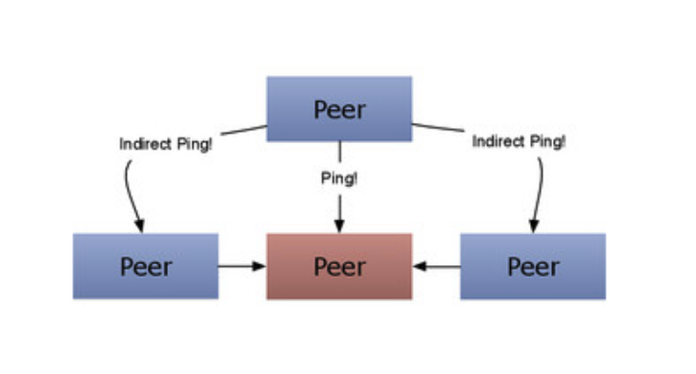
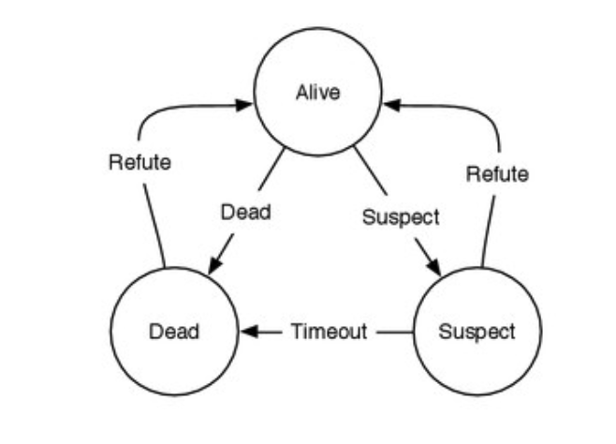
SWIM Information Dissemination

Slide 36
Ringpop

Slide 37
Ringpop

Slide 38
Failure Detection and Membership Topics
Other failure types?
Efficiency and accuracy

Slide 39
Other related readings
Chockler, Gregory V., Idit Keidar, and Roman Vitenberg. "Group communication specifications: a comprehensive study." ACM Computing Surveys (CSUR) 33.4 (2001): 427-469.
Leitao, Joao, José Pereira, and Luis Rodrigues. "HyParView: A membership protocol for reliable gossip-based broadcast." Dependable Systems and Networks, 2007. DSN'07. 37th Annual IEEE/IFIP International Conference on. IEEE, 2007.
Das, Abhinandan, Indranil Gupta, and Ashish Motivala. "Swim: Scalable weakly-consistent infection-style process group membership protocol." Dependable Systems and Networks, 2002. DSN 2002. Proceedings. International Conference on. IEEE, 2002.
Cowling, James, et al. "Census: Location-aware membership management for large-scale distributed systems." (2009).

