Slide 1
IS 698/800-01:
Advanced Distributed Systems
Separating Agreement from Execution
Sisi Duan
Assistant Professor
Information Systems
sduan@umbc.edu

Slide 2
Overview
Separating execution from agreement
Why and how?
Another look at Paxos and Fabric
Separating execution from agreement
Shuttle: Byzantine chain replication

Slide 3
SMR and Blockchains
What we have talked about so far…
  SMR as a service
  Availability and integrity (total order of requests, consistency…)
  Storage (read and write…)
The challenges in real applications
  Execution time
  Storage space

Slide 4
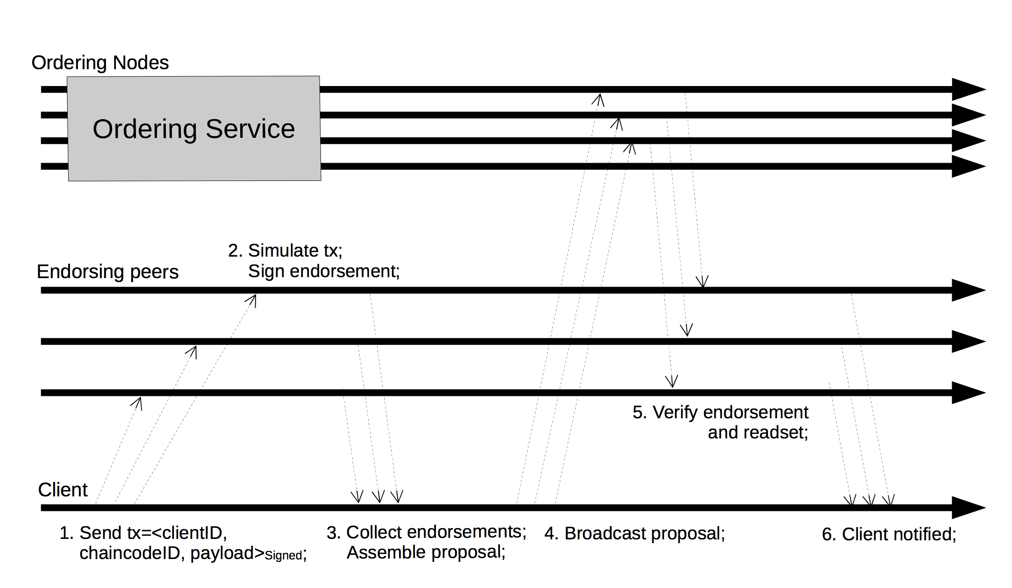
Another look at hyperledger Fabric

Slide 5
Another look at Paxos
A diagram closer to the original Paxos algorithm

Slide 6
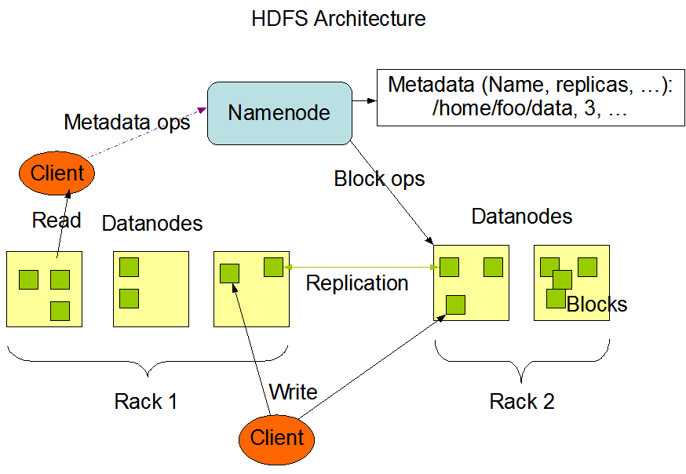
HDFS

Slide 7
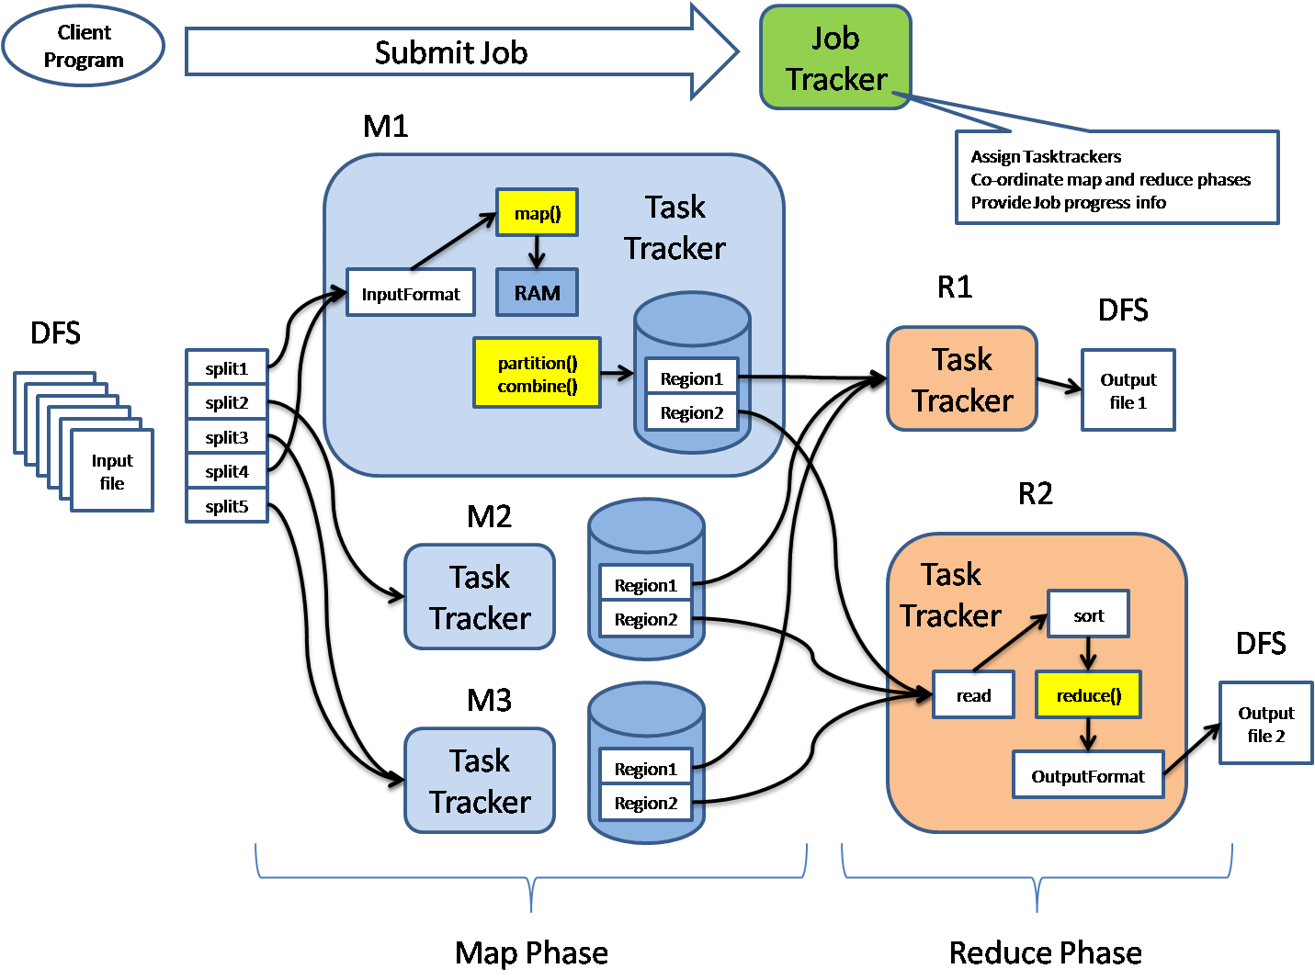
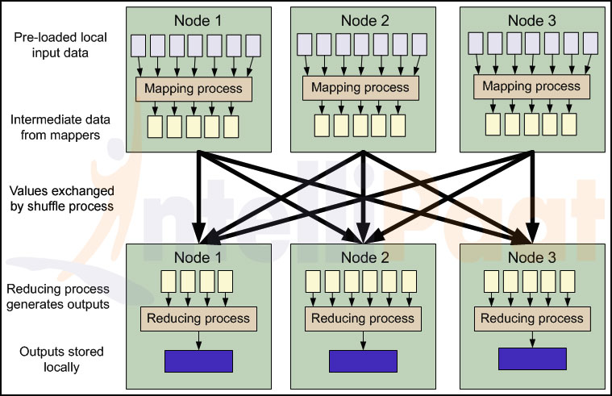
MapReduce

Slide 8
Separating execution from agreement
Wang, Yang, Lorenzo Alvisi, and Mike Dahlin. "Gnothi: Separating data and metadata for efficient and available storage replication." ATC 2012.
Androulaki, Elli, et al. "Erasure-coded Byzantine storage with separate metadata." PODC. Springer, Cham, 2014.
Cachin, Christian, Dan Dobre, and Marko Vukolić. "Separating data and control: Asynchronous BFT storage with 2t+ 1 data replicas." Symposium on Self-Stabilizing Systems. Springer, Cham, 2014.
Yin, Jian, et al. "Separating agreement from execution for byzantine fault tolerant services." ACM SIGOPS Operating Systems Review 37.5 (2003): 253-267.
Duan, Sisi, and Haibin Zhang. "Practical state machine replication with confidentiality." SRDS. IEEE, 2016.
Van Renesse, Robbert, Chi Ho, and Nicolas Schiper. "Byzantine chain replication." International Conference On Principles Of Distributed Systems. Springer, Berlin, Heidelberg, 2012.

Slide 9
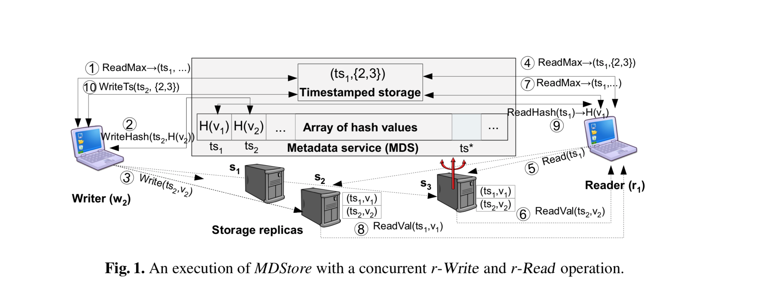
An example of separation
Cachin, Christian, Dan Dobre, and Marko Vukolić. "Separating data and control: Asynchronous BFT storage with 2t+ 1 data replicas." Symposium on Self-Stabilizing Systems. Springer, Cham, 2014.

Slide 10
Separating Execution from Agreement
Yin, Jian, et al. "Separating agreement from execution for byzantine fault tolerant services." ACM SIGOPS Operating Systems Review 37.5 (2003): 253-267.
Agreement cluster generates an order for a request
The ordered request is sent to the execution cluster
  What should be the proof?
Execution cluster executes the requests and returns the result to A and then the client
What should be the failure model?
  Agreement cluster?
  Execution cluster?

Slide 11
Separating Execution from Agreement
Client sends request to Agreement cluster (AC)
A server orders the request using BFT such as PBFT
AC generates a commit certificate (2f+1 signatures with commit messages) and sends to EC
EC
  Waits until all previous requests have been executed
  executes the requests and generates a reply
  Reply certificate: t+1 signatures and a reply

Slide 12
Separating Execution from Agreement
Benefits?
  Execution extensive operations do not become the bottleneck
  Storage space is not an issue
  Agreement cluster does not need to know what’s inside the request
  Simple majority from execution cluster

Slide 13
Separating Execution from Agreement
Confidentiality?
  Faulty results are sent to the clients as well

Slide 14
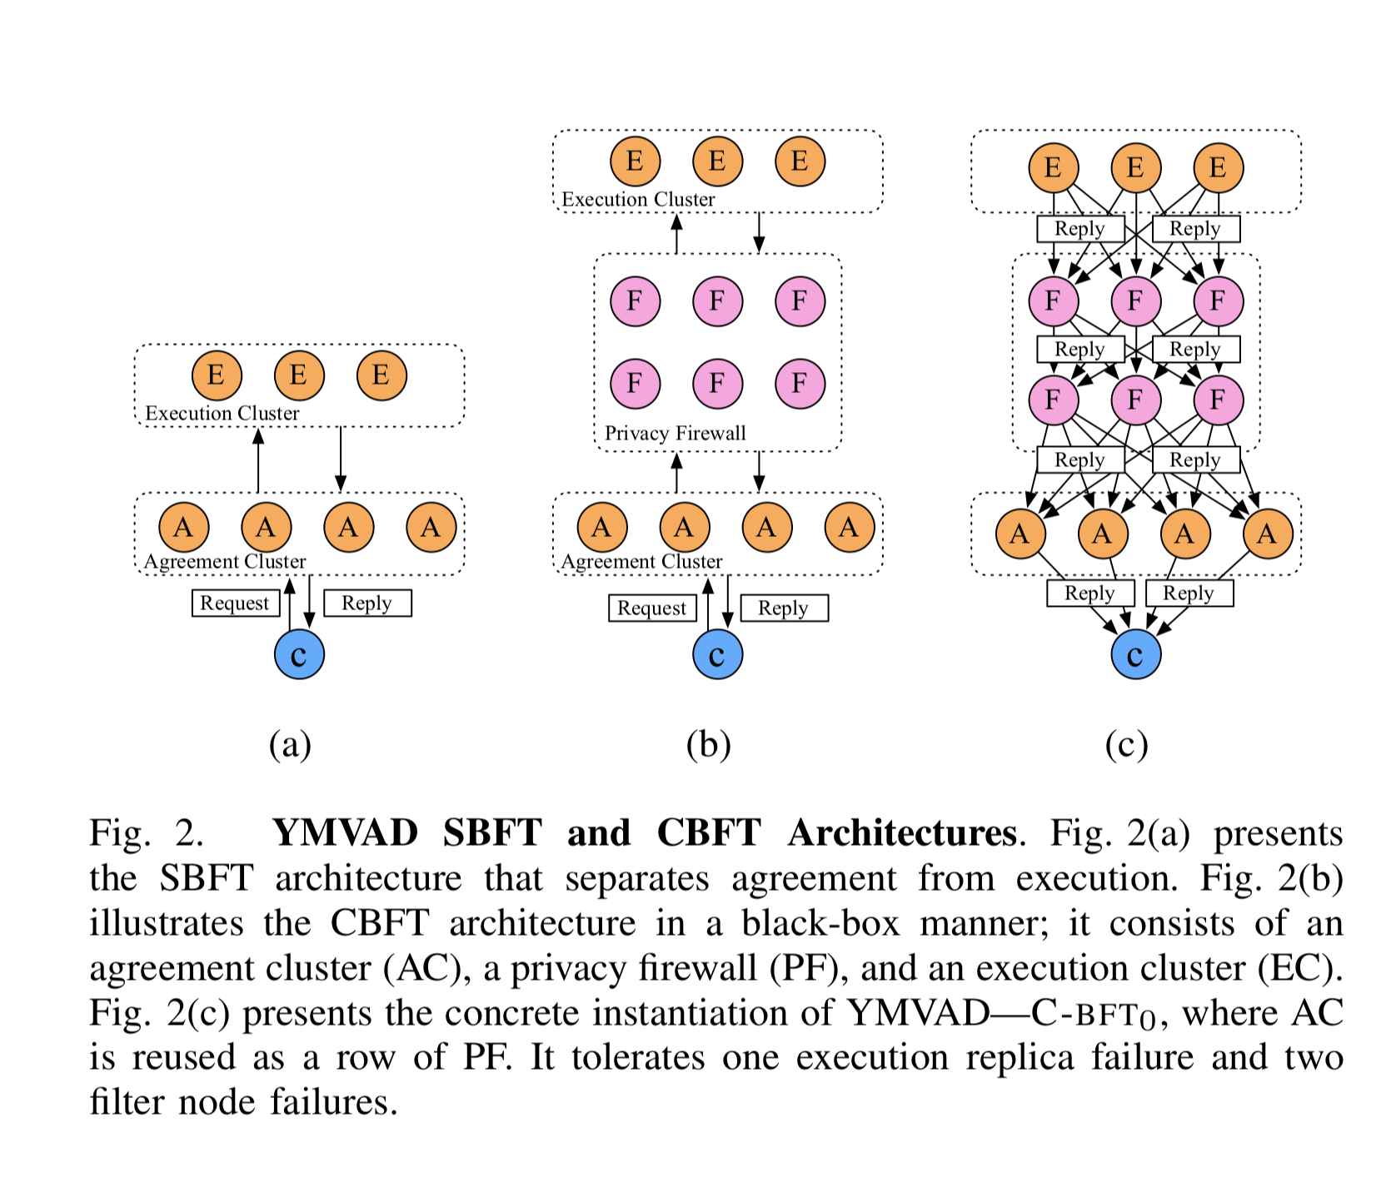
Confidentiality
Adding privacy firewall
Instead of letting clients collect and combine the results, do them for the clients using the F.

Slide 15
Confidentiality
Adding privacy firewall
Filter the results
How many F do we need in each row?
How many rows do we need?
Assumption: h failures in the firewalls

Slide 16
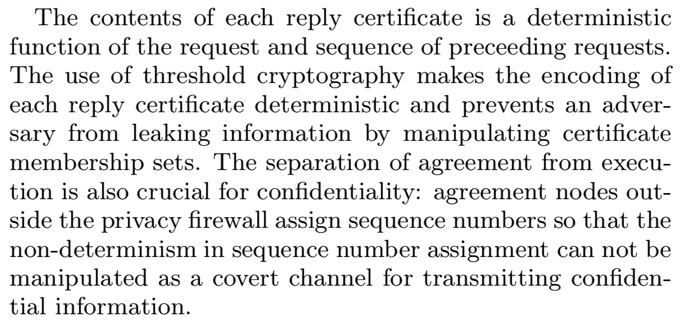
Confidentiality
The request and reply body are encrypted
Using threshold signatures
Why?

Slide 17
The privacy firewall
There exists at least one correct path between AC and EC which only consists of correct filters
There exists one row which only consists of correct filter nodes and the rows below do not have any information from nay replicas in EC

Slide 18
Another look at confidentiality and safety
Duan, Sisi, and Haibin Zhang. "Practical state machine replication with confidentiality." SRDS. IEEE, 2016
The requests and replies are encrypted?
What’s the issue?
Encryption: deterministic or randomized?
  Deterministic… not good…
  Randomization: violate the need for threshold signature and the PF cannot filter…

Slide 19
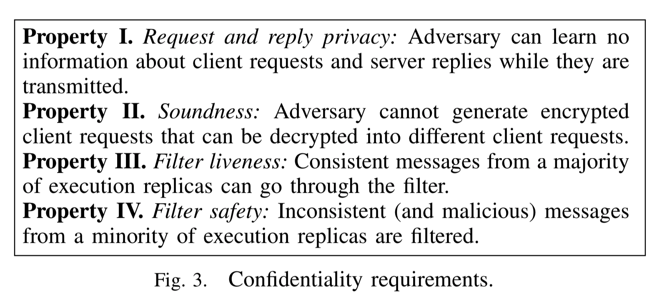
Enabling confidentiality

Slide 20
Enabling Confidentiality
AEAD (soundness)
  Authenticated encryption scheme with associated data
Efficiency
  Symmetric key based authentication and encryption
Randomized BFT (request and reply privacy)
  Random coins
  Request-specific random coin

Slide 21
Byzantine Chain Replication: Shuttle
Van Renesse, Robbert, Chi Ho, and Nicolas Schiper. "Byzantine chain replication." International Conference On Principles Of Distributed Systems. Springer, Berlin, Heidelberg, 2012.
Another concept of separating roles
Configurable chain replication

Slide 22
Replica states and transitions
States
  PENDING
  ACTIVE
  IMMUTABLE
Transitions
  orderCommand(p,C,s,o)
  BecomeImmutable(p)
  switchConfig(C,C’,H)
  becomeActive(p,C,hist)

Slide 23
Olympus: The centralized oracle
Configuration service
Generates configurations
Issuing inithist statements
Generate a new configuration upon receiving a reconfiguration-request statement

Slide 24
Shuttle: The failure-free case
Client obtains a configuration from Olympus
Send o to the head of the chain
Each replica
  Validates the requests
  Applies o and obtain a result r
  Adds the request to the order proof
  Adds the result to the result proof
  Forwards the message to the next replica
Tail: forwards the result proof to the client
The result proof is return backwards to the chain

Slide 25
Shuttle: under failures
Client cannot receive response on time and retransmit
If the server has the result, return to the client
If the server is immutable, return error
Head
  If it has the result, sent to the client
  If it has ordered requests and still is waiting for the result to come back: starts a timer
  It does not recognize the operation: order it again

Slide 26
Shuttle: under failures
If the timer expires at any replica
  Send a reconfiguration-request statement to Olympus
Olympus
  Send signed wedge requests to all the replicas
    Correct replicas respond with wedged statements (becomeImmutable)
  Await responses from a quorum of replicas, and construct a history h by selecting the longest order proof for each slot
  Allocate a new configuration C of replicas and seed those with h and a configuration statement for C. The replica then become active(becomeActive)

Slide 27
A comparison
Different primitives and purposes
Simple separation: performance, no confidentiality

Slide 28
Conclusion
The concept is everywhere
  Chubby
  Zookeeper
  Storage sys
Simple
Separate the design of agreement and storage
Performance
Latency is obviously longer

Slide 29
Conclusion
Also a common concept
  Google file system master service
Pros
  Simple
  Efficient
Cons
  Single point of failures?
  How about frequent failures?

